Slide 1
How to Strengthen Farmer Seed System Resilience
Tom Remington
Catholic Relief Services
TOPS Workshop Washington DC
November 14, 2012

Slide 2
Making Resilience Relevant
The resilience debate has been dominated by an abstract discussion about how aid agencies should describe their work. In order to give more meaningful support to people whose livelihoods are precarious, far more understanding is needed about what kind of support is most effective and how this can best be delivered.
HPG Policy Brief 49 September 2012

Slide 3
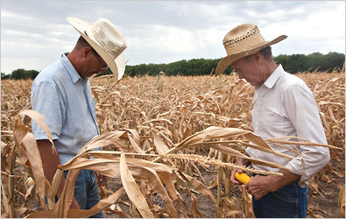
Shocks and Stresses Impact Farmer Seed Systems
Drought
Flood
Conflict
Pests & Diseases

Slide 4
Presentation Questions
What are ‘seed systems’?
What is ‘seed security’?
What is ‘resilience’?
How can seed systems be made more resilient?

Slide 5
What is a Seed System?
Both botanical and vegetatively propagated
Interconnected rather than linear
Seed intimately integrated with production
Widely variable – within and between cropping systems
Women play a critical role

Slide 6
Seed Security Conceptual Framework
Parameter | Description
Availability | Sufficient quantity of seed of appropriate crops available in proximity in time for planting
Access | People have adequate income or other resources to purchase or barter for seed
Varietal Quality | Seed is acceptable purity of adapted and preferred varieties
Seed Quality | Seed is of acceptable cleanliness and viability
Resilience | There are diverse seed sources to meet farmers’ needs after shocks or stresses

Slide 7
The Six Parameters of Resilience
Productivity
Stability
Autonomy
Equity
Sustainability
Diversity
Resilience

Slide 8
Resilience & Vulnerability
The ability to adapt when confronting shocks and stresses
The susceptibility to and inability to cope with shocks and stresses

Slide 9
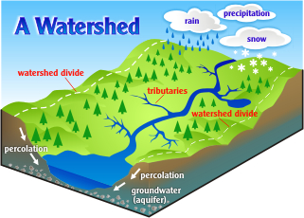
Scale and Scope
Macroregion
Watershed
Village
Farm
Crop System
Field

Slide 10
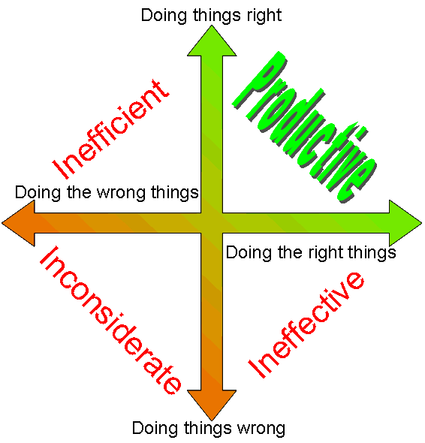
Productivity

Slide 11
Sustainability
Trends

Slide 12
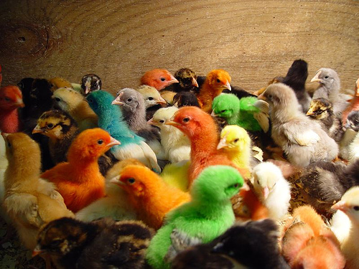
Diversity

Slide 13
Stability
Shocks

Slide 14
Equity
Intra-Household
Inter-Household
Gender

Slide 15
Autonomy
Independence
Self Sufficiency
Freedom
Choice

Slide 16
Understanding Seed Systems

Slide 17
Seed System Security Description & Diagnosis
Assess
Analyze
Recommend
Interpret

Slide 18
Productivity & Sustainability
More than Varieties & Seed
Fertilizer Use
Integrated Nutrient Management
Irrigation & Drainage
Pest & Disease Control
Storage
Marketing

Slide 19
Diversity & Stability
Farming System
Integrated crops and animals
Cropping System
Multi- & inter-cropping
Variety
Addition & substitution
Seed
Ensuring multiple sources

Slide 20
Equity & Autonomy
Farmers at the center as seed managers
Farmer customer segmentation
Critical role of women
Access & choice:
Own saved seed
Social network
Market
Commercial

Slide 21
Supporting and Empowering Farmer Seed Managers
Once farmers have the variety, the economic gains from using certified seed of the self pollinated crops usually does not justify the investment. Moreover, certified seed is not always better quality than the seed reproduced by a farmer
(Almekinders & Louwaars, 1999)

Slide 22
Conclusions
Resilience is the right approach
There is a need to go beyond defining to applying resilience in practice
Strengthening seed systems can increase resilience
Resilience needs to be applied to other agricultural subsectors

