Slide 1
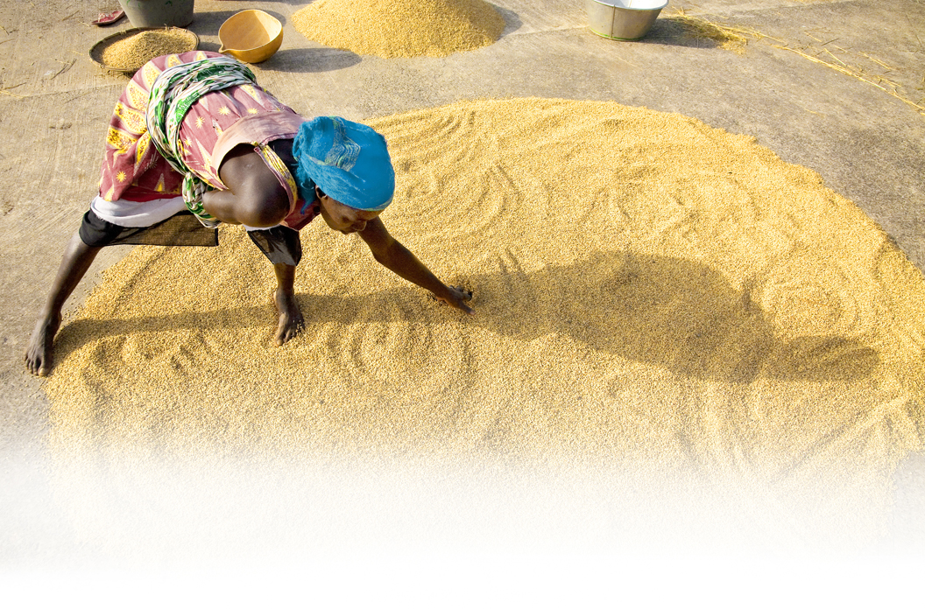
Strategies and Tools for Gender Integration

Slide 2
Session Objective
To continue the discussion on useful tools for integrating gender in program design and implementation.

Slide 3
Online Discussion: Identification of Tools for Gender Integration in Food Security Programming.
A summary of the online discussion can be found here:
http://www.fsnnetwork.org/identification-tools-gender-integration-food-security-programming-discussion-summary
We asked two questions to start the online discussion:
What are the tools or guidance you turn to for conducting a gender analysis to inform food security program activities?
What other helpful tools for integrating gender into food security programs have you used in your work?
The results included audits, analyses, checklists, and manuals as well as other types of media such as video to demonstrate capacity building exercises.

Slide 4
Identification of Tools for Gender Integration in Food Security Programming
Program Design
The Gender Marker for OCHA proposals addressing humanitarian response: http://oneresponse.info/CROSSCUTTING/GENDER/Pages/The%20IASC%20Gender%20Marker.aspx
SBC framework: http://www.coregroup.org/our-technical-work/working-groups/social-and-behavior-change/111
SC tool (upon request)
Gates guidance (p21 of this doc): http://www.gatesfoundation.org/learning/Documents/gender-responsive-orientation-document.pdf

Slide 5
Identification of Tools for Gender Integration in Food Security Programming
Value Chains
Promoting Gender Equitable Opportunities in Agricultural Value Chains (USAID-funded GATE project): http://transition.usaid.gov/our_work/cross-cutting_programs/wid/pubs/GATE_Gender_Ag_Value_Chain_Handbook_summary_11-09.pdf
FIELD Report 11: Behavior Change Perspectives on Gender and Value Chain Development: Tools for Research and Assessment: http://microlinks.kdid.org/library/field-report-11-behavior-change-perspectives-gender-and-value-chain-development-tools-resear
Cha cha cha book: Challenging Chains to Change: http://www.kitpublishers.nl/net/KIT_Publicaties_output/ShowFile2.aspx?e=2008
Land O’Lakes training in Rwanda and Zambia

Slide 6
QUESTION: Who is piloting the WEAI?
Please send your comments on its feasibility for use in programming to Emily Hogue: ehogue@usaid.gov

Slide 7
Identification of Tools for Gender Integration in Food Security Programming
Staff and Partner Training
LWR recently had a training in Uganda for staff of partner organizations: http://blog.lwr.org/2012/09/gender-integration-in-uganda/
Audits
InterAction: http://www.interaction.org/document/gender-audit-overview
Ethiopia example: http://www.fsnnetwork.org/document/gender-%E2%80%9Clens%E2%80%9D-examples-introspective-steps-improving-gender-programming-organizations)
Internal organizational policies, strategies, guidelines
LWR, ACDI/VOCA, SC, CRS
Land O’Lakes presentation: https://www.fuzemeeting.com/replay_meeting/16bfac72/2371129

Slide 8
This presentation was made possible by the generous support of the American people through the United States Agency for International Development (USAID). The contents are the responsibility of Save the Children and do not necessarily reflect the views of USAID or the United States Government.

