Slide 1

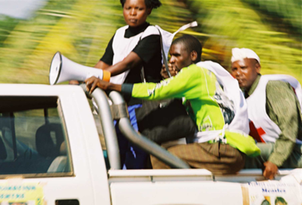
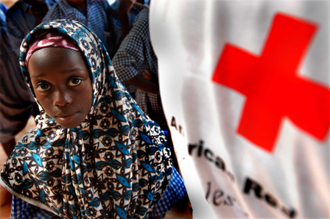
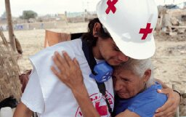
RESILIENCE

Slide 2
Visualising resilience
social capital
natural capital
physical capital
financial capital
human capital
political capital
resilience level
critical resilience level
relief
recovery
early recovery
Long term resilience programming
time
stresses
disaster or crisis
resilience level
intervention

Slide 3

Intervntion
strategies
Possible Intervention Strategies
ANTICIPATE
RESPOND
ADAPT
TRANSFORM
RESPOND

Slide 4
1. No intervention
social capital
natural capital
physical capital
financial capital
human capital
political capital
resilience level
critical resilience level
time
resilience level
stresses
disaster or crisis
Notes:
As there is no external support impact of crisis goes deeper and bouncing back takes longer and does not go above critical resilience level.

Slide 5
building
blocks
2. Response
social capital
natural capital
physical capital
financial capital
human capital
political capital
resilience level
critical resilience level
relief
recovery
early recovery
time
resilience level
stresses
disaster or crisis
intervention
Notes:
Relief interventions help to reduce the impact (as a result of search and rescue, better medical care(first aid), prepositioning of relief goods, contingency planning..). Also recovery interventions allows communities/households to bounce back better/further.

Slide 6
2. Response
Response
Search and rescue
Food
Water
Shelter
Medical care
Psycho-social care
Early recovery
Restoring critical infrastructure
and services such as water, health services
electricity, (transitional) shelter
social capital
natural capital
physical capital
financial capital
human capital
political capital
resilience level
critical resilience level
relief
recovery
early recovery
time
resilience level
stresses
disaster or crisis
intervention

Slide 7
building
blocks
3. Anticipate
social capital
natural capital
physical capital
financial capital
human capital
political capital
resilience level
critical resilience level
relief
recovery
early recovery
time
resilience level
stresses
disaster or crisis
intervention

Slide 8
building
blocks
3. Anticipate
social capital
natural capital
physical capital
financial capital
human capital
political capital
resilience level
critical resilience level
relief
recovery
early recovery
Long term resilience programming
time
resilience level
stresses
disaster or crisis
intervention

Slide 9
3. Anticipate
Anticipate
Preparedness for response
Early warning early action
(Non-) structural mitigation
Awareness raising and public education
Vaccination campaigns
social capital
natural capital
physical capital
financial capital
human capital
political capital
resilience level
critical resilience level
relief
recovery
early recovery
Long term resilience programming
time
resilience level
stresses
disaster or crisis
intervention

Slide 10
building
blocks
4. Adapt
social capital
natural capital
physical capital
financial capital
human capital
political capital
resilience level
critical resilience level
relief
recovery
early recovery
Long term resilience programming
time
resilience level
stresses
disaster or crisis
intervention

Slide 11
building
blocs
4. Adapt
?
social capital
natural capital
physical capital
financial capital
human capital
political capital
?
?
resilience level
?
critical resilience level
relief
recovery
early recovery
Long term resilience programming
time
resilience level
stresses
disaster or crisis
intervention

Slide 12
building
blocks
4. Adapt
Adapt
Climate-smart DRR, health and watsan
(water harvesting, mangroves/coral restoration,
relocation)
Early warning early action
?
social capital
natural capital
physical capital
financial capital
human capital
political capital
?
?
resilience level
?
critical resilience level
relief
recovery
early recovery
Long term resilience programming
time
resilience level
stresses
disaster or crisis
intervention

Slide 13
building
blocks
5. Transform
social capital
natural capital
physical capital
financial capital
human capital
political capital
resilience level
critical resilience level
relief
recovery
early recovery
Long term resilience programming
time
resilience level
stresses
disaster or crisis
intervention

Slide 14
building
blocks
5. Transform
Transform
Humanitarian diplomacy
Transforming vulnerabilities in capacities (VCA)
Hygiene behaviour change
social capital
natural capital
physical capital
financial capital
human capital
political capital
resilience level
critical resilience level
relief
recovery
early recovery
Long term resilience programming
time
resilience level
stresses
disaster or crisis
intervention

Slide 15

building
blocks
Building long-term resilience
resilience level
critical resilience level
time

Slide 16
A safe and resilient community… The characteristics of a safe and resilient community
 | …is knowledgeable and healthy. It has the ability to assess, manage and monitor its risks. It can learn new skills and build on past experiences
 | …is organised. It has the capacity to identify problems, establish priorities and act. …has infrastructure and services. It has strong housing, transport, power, water and sanitation systems. It has the ability to maintain, repair and renovate them. …has economic opportunities. It has a diverse range of employment opportunities, income and financial services. It is flexible, resourceful and has the capacity to accept uncertainty and respond (proactively) to change. …can manage its natural assets. It recognises their value and has the ability to protect, enhance and maintain them …is connected. It has relationships with external actors who provide a wider supportive environment, and supply goods and services when needed.
... and is therefore better able prepare, prevent, respond to and recover from shocks and stresses.

Slide 17
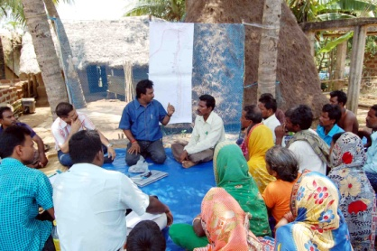
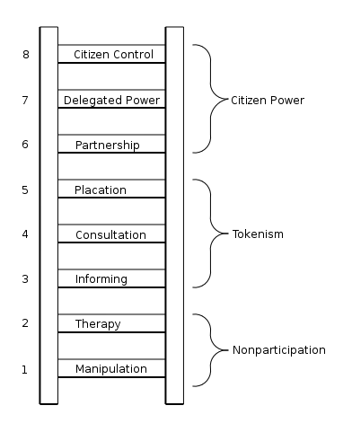
1. Promoting community self-management
“ Community empowerment and local ownership are essential for communities to be in the driving seat of developmental processes.”
The ladder of participation

Slide 18
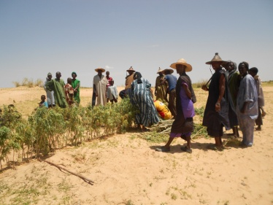
2. Cross-sectoral approaches
“ Resilience work requires building bridges across established thematical divides: therefore comprehensive assessments, planning and implementation across various sectors are called for .”
RESILIENCE
PHAST/VCA
DRR
HEALTH
WASH
CBHFA
CROSS-SECTORAL
= connectors

Slide 19
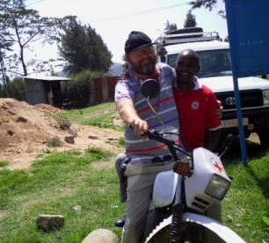
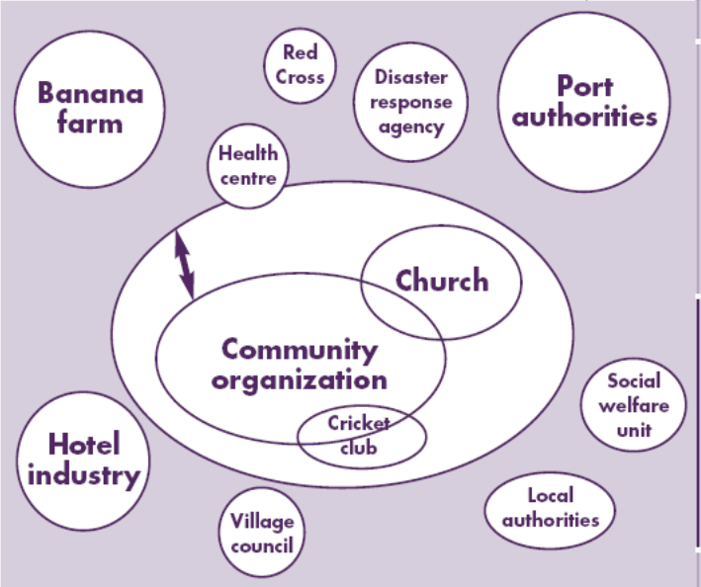
3. Partnership approach
“Partnerships based on mutual complementarity are essential in order to strengthen community resilience. National Societies should seek collaboration with local government, NGOs, businesses and knowledge centers in areas which are not their specific expertise or mandate”.

Slide 20
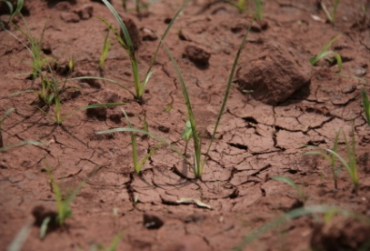
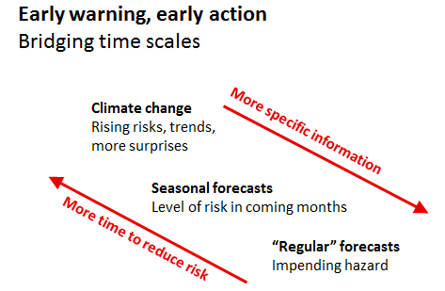
4. Working accross all timescales
“ Making full use of climate information available for the short-, medium-, and long-term to routinely take action in anticipation of a future disaster risk.”

Slide 21

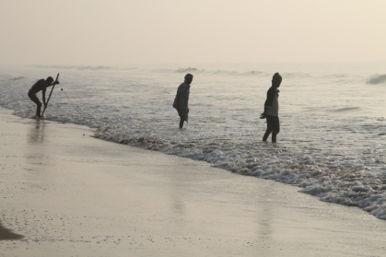
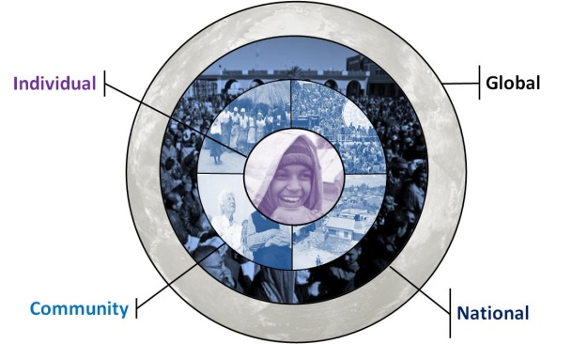
5. Working across spatial scales
“A resilience approach requires understanding the interconnectedness of levels : from individual to household and community to national and global level. “

Slide 22
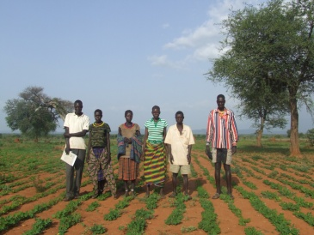
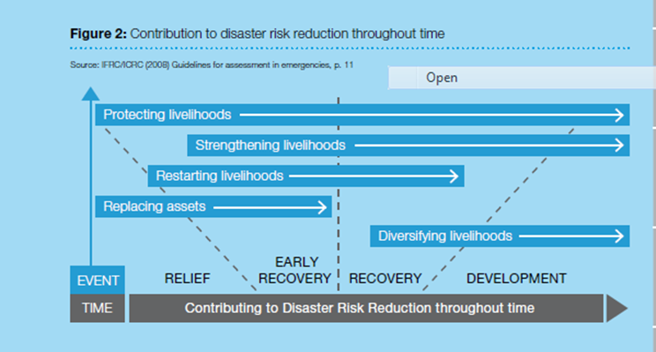
6. Livelihood-centred approach
“Resilience work in essence focuses on strengthening livelihood capitals in their human, social, physical, financial, natural and political dimensions through a variety of interventions”.

Slide 23
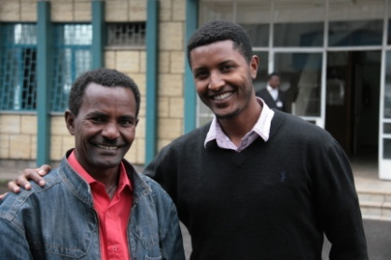
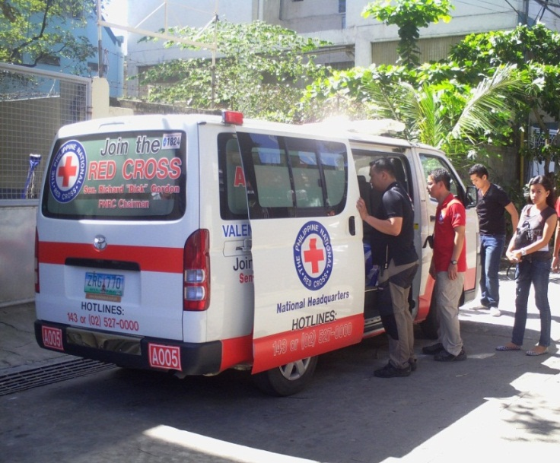
7. Strengthening institutional resilience
“Resilient institutions reinforce community resilience, meaning that programs will better embedded into the local context and focused on long-term, sustainable impact”.

Slide 24
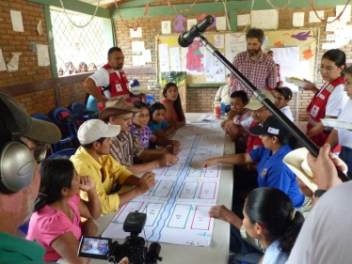
8. Promoting a learning culture
“A strong learning culture is key to enhancing community resilience: sharing lessons learned and good/bad practices within and between communities, between CSOs and communities as well as with external actors, such as knowledge centers and local authorities”.
1. Internal to internal - “Learning from each other”
2. External to internal - “Incorporating external knowledge.”
3. Internal to external - “Documenting and communicating to others”

Slide 25
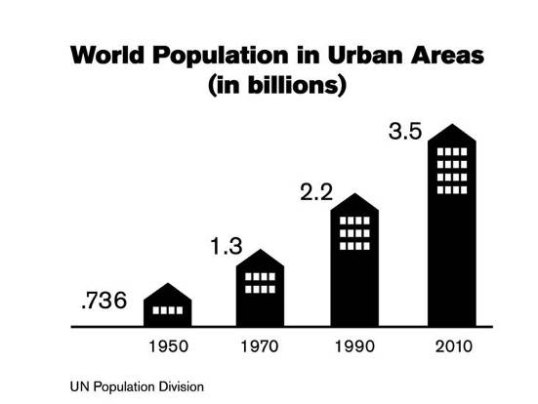
Resilience Lends Toward:
Integration (Breaking Down Silos)
Focus on Capacity and Ability
Conflate
Humanitarian and Development
global
Multiple
communities,
i.e. city or region
community
household
resilience

Slide 26
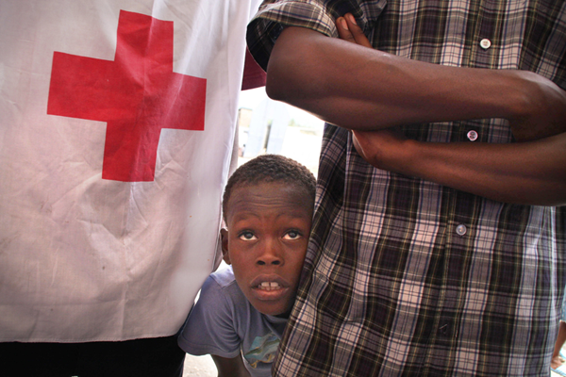
Matt Marek/American Red Cross
THANK YOU
Notes:
Story behind the background photograph: A young boy in Jacmel, Haiti looks on while HRC volunteers and community leaders discuss the needs of 700 people at a shelter displaced by the four hurricanes and tropical storms that ravaged the country.

