Slide 1
Overview of Community-Based Management of Acute Malnutrition (CMAM) TOP capacity building workshop Maputo, September 21, 2011 adapted from FANTA-2 training on CMAM
Notes:
Adapted from presentation of FANTA-2 Project

Slide 2
Today we will…
Discuss acute malnutrition
Describe recent innovations and evidence making CMAM possible.
Identify the components of CMAM and how they work together.
Explore how CMAM can be implemented in different contexts.

Slide 3
Chronic Undernutrition
Prolonged undernutrition
First two years critical
Affects body and brain
Not entirely reversible
Has an inter-generational effect
Measured by stunting, or being short for one’s age compared to reference population
2 yrs 2 months 4 yrs 4 months
Notes:
Mention
-Children throughout the world can attain growth potential if nurtured in healthy environments and caregivers follow recommended health, nutrition and child care practices
-Average height of children from birth to five years was nearly identical across 6 populations (Brazil, Ghana, India, Norway, Oman and the US)
-Stunting: (short stature for age) reflects shortness-for-age; an indicator of chronic malnutrition and calculated by comparing the height-for-age of a child with a reference population. Stunting is considered a dynamic process which reflects persistent, cumulative effects of undernutrition in early life.
-Stunting is a physical manifestation of all the other processes going on. Stunting indicates that other, less obvious processes (immune system and brain development) have been compromised. It’s not that being short is bad in and of itself.
-All children grow similarly during the first five years

Slide 4
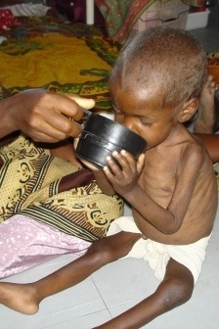
Acute Undernutrition
Acute weight loss
Recent and severe process
Strongly associated with mortality
Usually associated with severe deprivation of food intake and/or disease
Measured by
wasting, or being low weight for one’s height
Edema
Notes:
Wasting: (too thin for height) reflects a recent and severe process that has led to substantial weight loss, usually associated with starvation and/or disease. Calculated by comparing weight-for-height of a child with a reference population. Often used to assess the severity of emergencies because it is strongly related to mortality (acute malnutrition).

Slide 5
Severe acute malnutrition=SAM
Moderate acute malnutrition = MAM
Notes:
Wasting: (too thin for height) reflects a recent and severe process that has led to substantial weight loss, usually associated with starvation and/or disease. Calculated by comparing weight-for-height of a child with a reference population. Often used to assess the severity of emergencies because it is strongly related to mortality (acute malnutrition).

Slide 6
Underweight
Too thin (underweight) for one’s age
Composite indicator – could be because of low weight or height or both
Underweight and stunting behave similarly (e.g. similar associations, growth curves)
Notes:
Underweight: (low weight for age) measured by comparing the weight-for-age of a child with a reference population. It is a composite indicator and does not tell us if the child’s weight is low because they are stunted, wasted, or both.
MDG1 is based on underweight.
Underweight and stunting behave similarly in terms of their associated determinants, patterns on growth curves, etc.

Slide 7
Today we will…
Discuss acute malnutrition
Describe recent innovations and evidence making CMAM possible.
Identify the components of CMAM and how they work together.
Explore how CMAM can be implemented in different contexts.

Slide 8
Traditionally, children with SAM were treated as inpatients
Low coverage leading to late presentation
Overcrowding
Heavy staff work loads
Cross infection
High default rates due to need for long stay
Potential for mothers to engage in high risk behaviours to cover meals
8
Notes:
8

Slide 9
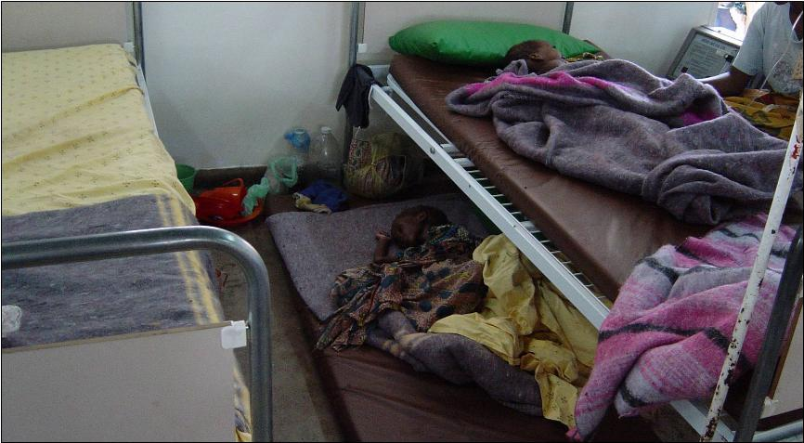

Slide 10
New Innovations Making CMAM Possible
RUTF
New classification of acute malnutrition
Mid-upper arm circumference (MUAC) accepted as independent criteria for the classification of SAM

Slide 11
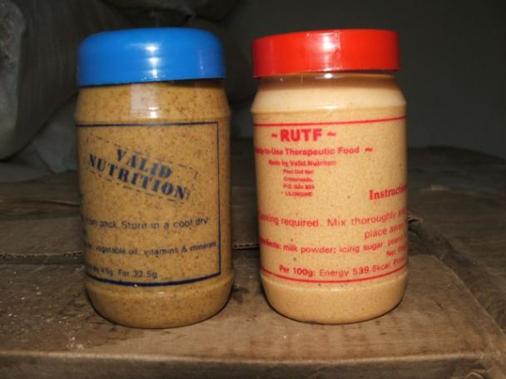
Ready to
Use
Therapeutic
Food
Most well-known brand name = Plumpy’nut
http://www.guardian.co.uk/society/video/2009/oct/11/plumpynut-ethiopia-food-hunger

Slide 12
Ready-to-Use Therapeutic Food (RUTF)
No microbial growth even when opened
Safe and easy for home use
Energy and nutrient dense: 500 kcal/92g
Same formulation as therapeutic milk (F100) except it contains iron

Slide 13
Ready-to-Use Therapeutic Food (RUTF)
Ingredients
Peanuts (ground into a paste)
Vegetable oil
Powdered sugar
Powdered milk
Vitamin and mineral mix (special formula)
Additional formulations of RUTF are being researched, e.g. with chickpeas and sesame
Other formulations of ready-to-use foods for different uses are being tested, e.g. supplementation, prevention of malnutrition

Slide 14
Ready-to-Use Therapeutic Food (RUTF)
Is ingested after breast milk
Safe drinking water should be provided
Usually is well liked by children, some adults find it too sweet
Can be produced locally
Is not given to infants under 6 months

Slide 15
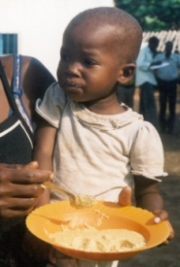
Previous Classification for Treatment of Acute Malnutrition
Acute Malnutrition
Severe acute malnutrition
Inpatient Care
Moderate acute malnutrition
Supplementary
Feeding
Notes:
Complications: anorexia or no appetite, intractable vomiting, convulsions, lethargy or not alert, unconsciousness, lower respiratory tract infection (LRTI), high fever, severe dehydration, severe anaemia, hypoglycaemia, or hypothermia
**Children with MAM with medical complications are admitted to supplementary feeding but are referred for treatment of the medical complication as appropriate

Slide 16
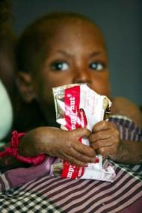
New classifications for the Community-Based Treatment of Acute Malnutrition
Acute Malnutrition
Severe acute malnutrition
with medical complications*
Inpatient Care
Severe acute malnutrition
without medical complications
Outpatient Care
Moderate acute malnutrition
Supplementary
Feeding
Notes:
Complications: anorexia or no appetite, intractable vomiting, convulsions, lethargy or not alert, unconsciousness, lower respiratory tract infection (LRTI), high fever, severe dehydration, severe anaemia, hypoglycaemia, or hypothermia
**Children with MAM with medical complications are admitted to supplementary feeding but are referred for treatment of the medical complication as appropriate

Slide 17
N Darfur 2001
Karnoi &
Malha
Tina
Um Barow
Kutum
Mellit
Fata Barno
El Sayah
Koma
Serif
Korma
Kebkabiya
El Fasher
Um Keddada
100 kms
Tawila & Dar el Saalam
Hospital with inpatient care
Outpatient care site
Taweisha
Inpatient care site
El Laeit

Slide 18
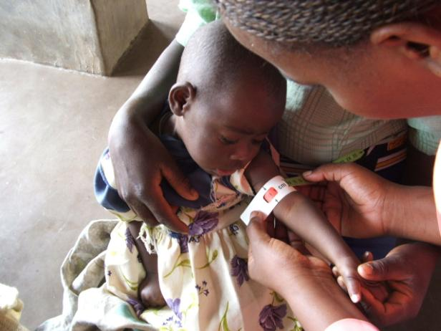
Measuring MUAC

Slide 19
Screening and Admission Using MUAC
Initially, CMAM used 2 stage screening process:
MUAC for screening in the community
Weight-for-height (WFH) for admission at a health facility
= Time consuming, resource intense, some negative feedback, risk of refusal at admission
MUAC for admission to CMAM (WFH is optional)
= Easier, more transparent, child identified with SAM in the community will be admitted, thus fewer children are turned away

Slide 20
Today we will…
Discuss acute malnutrition
Describe recent innovations and evidence making CMAM possible.
Identify the components of CMAM and how they work together.
Explore how CMAM can be implemented in different contexts.

Slide 21
Core Components of CMAM
1
4
3
5
2

Slide 22
1. Community Outreach
Key individuals and groups in the community:
Promote good nutrition practices and CMAM services
Make CMAM and the treatment of SAM understandable
Dialogue on barriers to uptake
Find malnourished individuals in the community
Referral them for treatment
Conduct follow-up home visits

Slide 23
at the health center…

Slide 24
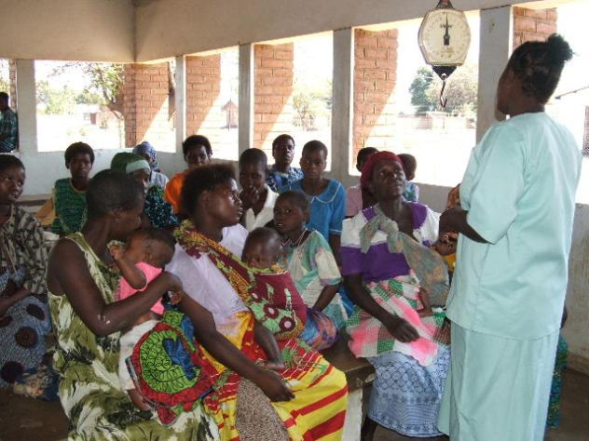
Group nutrition counseling

Slide 25
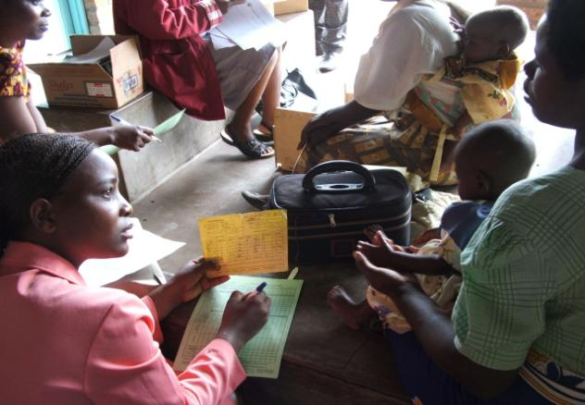
Intake

Slide 26
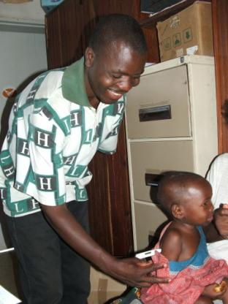
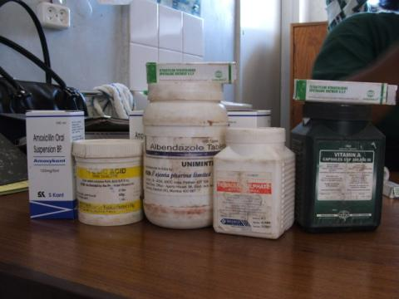
Medical examination & treatment for any illnesses
Amoxycillin
Anti-Malarials
Vitamin A
Anti-helminths
Measles vaccination

Slide 27
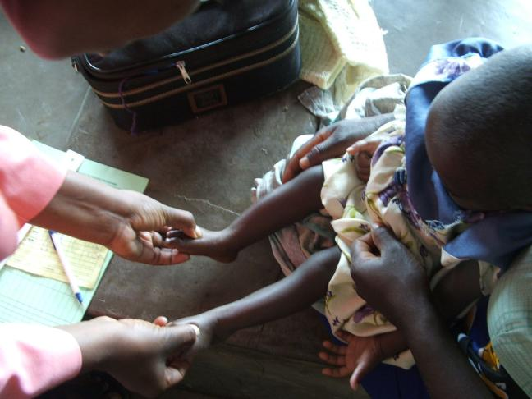
Testing for oedema

Slide 28
Measuring weight

Slide 29
Measuring height or length

Slide 30
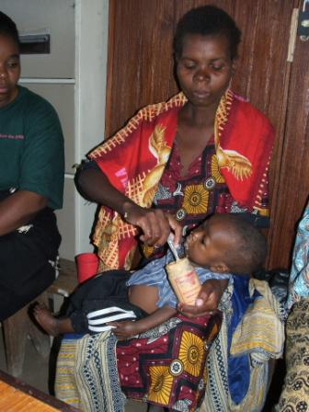
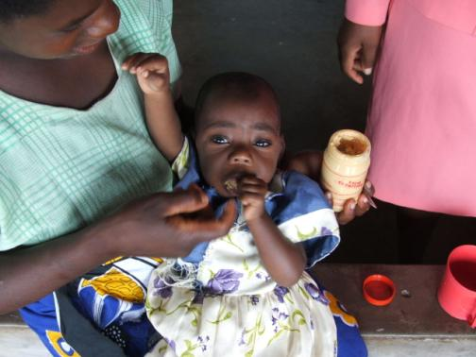
Appetite test

Slide 31
Classification of nutritional status

Slide 32
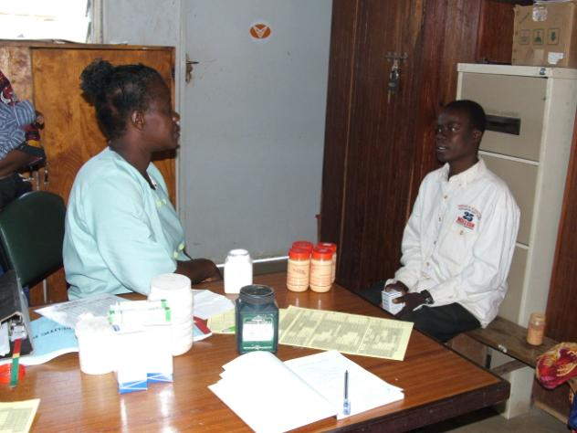
Individual counseling

Slide 33
2. Outpatient Care for SAM
Target group: people with SAM + WITHOUT medical complications + with good appetite
Activities:
Follow-on visits at the health facility
Medical assessment and monitoring
Basic medical treatment for illnesses
Continued nutrition treatment

Slide 34
3. Inpatient Care for SAM
Medical treatment according to WHO and/or national protocols
Go to outpatient care after complications are resolved, edema is reduced, and has an appetite
All infants under 6 months with SAM receive specialized treatment until full recovery

Slide 35
4. Services or Programs for MAM
Treatment for illnesses or complications + routine medications
Still debating which is best formulation for “treatment”
Traditionally has been supplementation with fortified blended food, e.g. CSB
Now seeing new products like “Plumpy’sup” and CSB Plus to better address MAM

Slide 36
5. Prevention of undernutrition
Counseling on infant and young child feeding, health and hygiene should be part of every component of CMAM – from community to inpatient to outpatient
This is where community-based programs such as MYAPs can add even more value

Slide 37
Today we will…
Discuss acute malnutrition
Describe recent innovations and evidence making CMAM possible.
Identify the components of CMAM and how they work together.
Explore how CMAM can be implemented in different contexts.

Slide 38
Group work
In groups, discuss the ‘way forward’
15 minutes

Slide 39
Results for 21 Inpatient and Outpatient Programs (2001 to 2006)

Slide 40
CMAM in Different Contexts
Extensive emergency experience
Some transition into longer term programming, as in the cases of Malawi and Ethiopia
Movement toward updating national guidelines to include these new protocols
e.g., Ghana, Zambia, Rwanda, Haiti, Nepal, Mozambique
Growing experience in high HIV prevalent areas
Links to voluntary counselling and testing (VCT) and antiretroviral therapy (ART)

Slide 41
Calculating weight-for-height or BMI (if needed for intake)
BMI = body-mass index
(=kg/m² or =lb/in²*703)
Exercise:
Child who is

