Slide 1
FSN Network MEETING
November 2012

Slide 2
Objectives
Present and solicit feedback on Livelihoods and Food Security Technical Assistance (LIFT’s) approach
Collect input from Food Security and Nutrition service providers
Notes:
AGENDA: Welcome, review agenda, review objectives (Jacky)

Slide 3
Promotion
Asset, income and
consumption growth
PULL
Protection
Asset protection
Income and consumption
stabilization
LOW
HIGH
HOUSEHOLD VULNERABILITY
HOUSEHOLD LIVELIHOOD & FOOD SECURITY
Provision
Asset recovery
Consumption support
HIGH
PUSH
LOW
Notes:
There are significant overlaps between provision, protection and promotion. With the greatest emphasis being on protection strategies, to ensure that households are resilient to shocks.

Slide 4
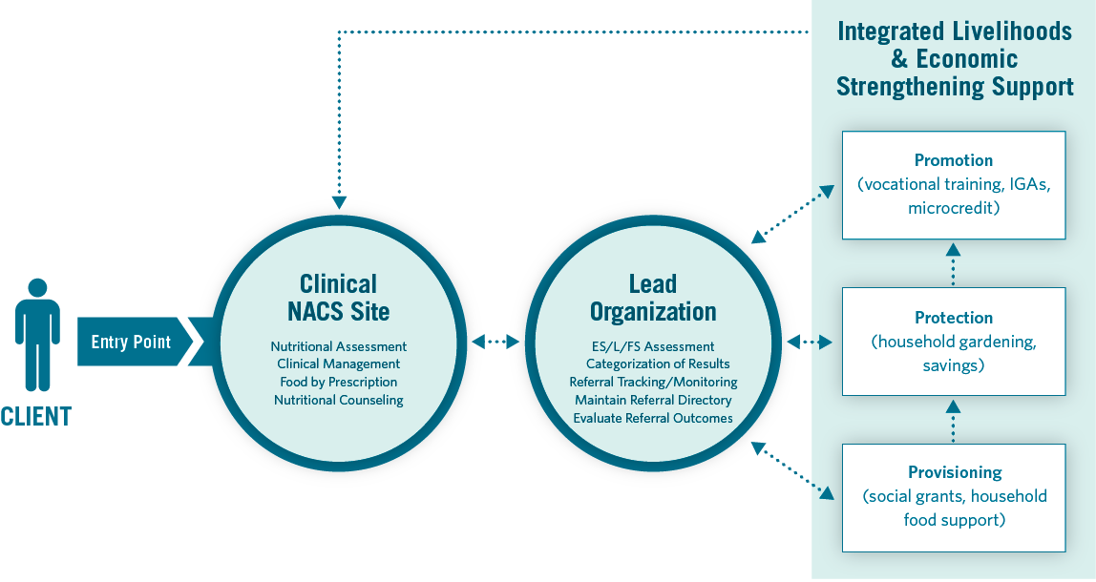
Lift Working model for linking ES /l/FS Services to a Continuum of support
Notes:
The presentation will provide an overview of LIFTs work in both the first half of this model (facilitating linkages) as well as the second half (provision of quality ES/L/FS services).
Will be referring back to this later.

Slide 5
segment & match Clients with ES/L/FS Services
1. Diagnostic Tool
Purpose:
Simplify client intake process
Identify the most appropriate and feasible ES/L/FS interventions for clients
Encourage vulnerable populations toward social welfare programs and less vulnerable towards more market based solutions
Notes:
LIFT will develop a diagnostic tool to guide NACS staff to assess the levels of poverty and vulnerability of potential clients and match those to the most appropriate and feasible ES/L/FS interventions to achieve greater social impact through LIFT programs. The diagnostic tool will incorporate a range of contextual situational factors into the decision making process to put in place a process that will enable the program to segment its client populations into the three levels of support in the LIFT framework: provision, protection, promotion and scale efforts rapidly, without compromising the accuracy of the placement outcome. LIFT’s goal through the development of a diagnostic tool is to carefully place subsidies linking vulnerable populations to safety nets and social welfare programs while encouraging less vulnerable towards more market based solutions maximizing the use of available resources. The diagnostic tool will ensure
a simple intake process that would take 5 to 10 minutes to complete per client and could be easily deployed through multiple delivery channels integrating and harmonizing nutrition and ES/L/FS interventions. Additionally, the use of the diagnostic tool will emphasize the localization and multi-directionality of the LIFT framework increasing the level of outreach of the program through an efficient, easily replicable, and cost-effective process.
Use diagnostic to carefully place subsidies linking vulnerable populations to safety nets and social welfare programs while encouraging less vulnerable towards more market based solutions maximizing the use of available resources.

Slide 6
2. Organizational Network Analysis
MAP & understand ES/l/fs Service providers
Purpose:
Identify ES/L/FS service providers and intermediaries, including catchment areas, eligibility criteria, capacity to absorb clients, etc.
Build relationships
Baseline frequency of referrals
Notes:
ONA is an innovative and accessible approach to understanding relationships among actors. The approach can provide information about the extent to which organizations share information and resources or refer clients. Results can help actors make better use of available resources to benefit clients.

Slide 7
Link NACS Clients to ES/l/FS Services
3. Referrals
Purpose:
Explore the basic function of LIFT
Diagnose NACS clients
Refer them to appropriate ES/L/FS services
Track clients to see if they act on referral
Notes:
AGENDA: Key Action Research Questions (Clinton)

Slide 8
Technical Support to strengthen Service quality
4. Upgrading ES/L/FS Services
Purpose:
Improve the quality and diversity of ES/L/FS services
Ensure sustainability of services
Notes:
AGENDA: Key Action Research Questions (Clinton)

Slide 10
LIFT Contacts
For more information about LIFT, please contact:
Jacky Bass Project Director jbass@fhi360.org
Tim Quick LIFT AOTR tquick@usaid.gov

