Slide 1
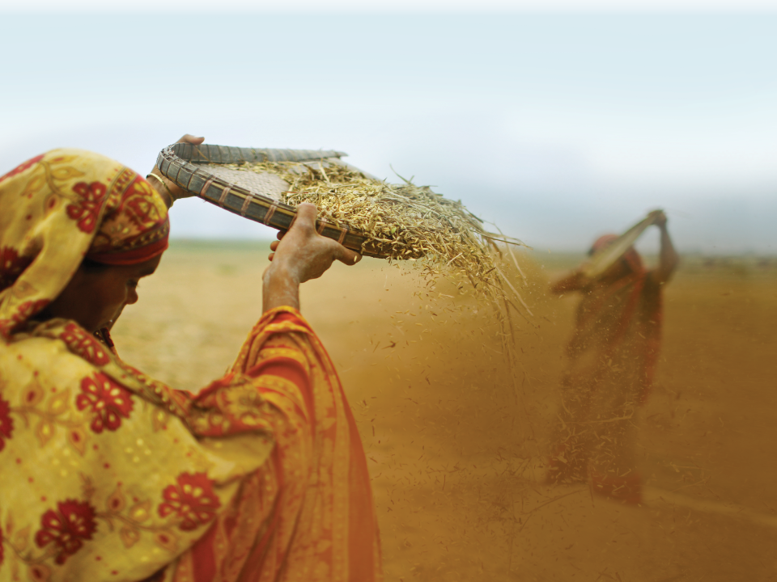
Increasing African Homestead Farming System Production and Productivity

Slide 2
What is a Farming System?
Where a household (HH) lives, grows HH crops and raise their HH animals.
Homestead management
Access to input supply systems
Gardening and tree cropping
Field cropping systems
Animal production systems
Post harvest problems and potential solutions

Slide 3
The Homestead Household
Household compound management
Early morning sweeping
Use of kitchen water/wastes
Use of animal manure
Tree planting
Gardening
Fencing

Slide 4
Agricultural Input Supply and Utilization
Seed and planting materials
Tree nurseries (Moringa, fruit trees, etc.)
Fertilizers – organic, inorganic
Tools & animal traction/transport
Animals for stocking & restocking
Fencing materials
Crop storage technologies
Other???

Slide 5
Gardening and Tree Cropping
Why have a garden in the HH compound?
Provides nutritious food
High value crops to market
Why plant trees in the HH compound?
Trees grow as children grow
Multi-purpose uses

Slide 6
What are the best practices to intensify homestead agricultural productivity?
Intensify management of traditional farming systems
Increasing plant density per unit land area
Make best use of HH kitchen residues
Better management of animals and manure
Soil & water conservation practices
Soil fertility enhancement practices
Crop rotations with nitrogen fixing cover crops like Macuna

Slide 7
Diversify traditional homestead farming systems
Intercropping cereals & grain legumes
Root & tubers
Garden crops
Tree crops
Small ruminants
Poultry

Slide 8
This presentation was made possible by the generous support of the American people through the United States Agency for International Development (USAID). The contents are the responsibility of Save the Children and do not necessarily reflect the views of USAID or the United States Government.

