Slide 1
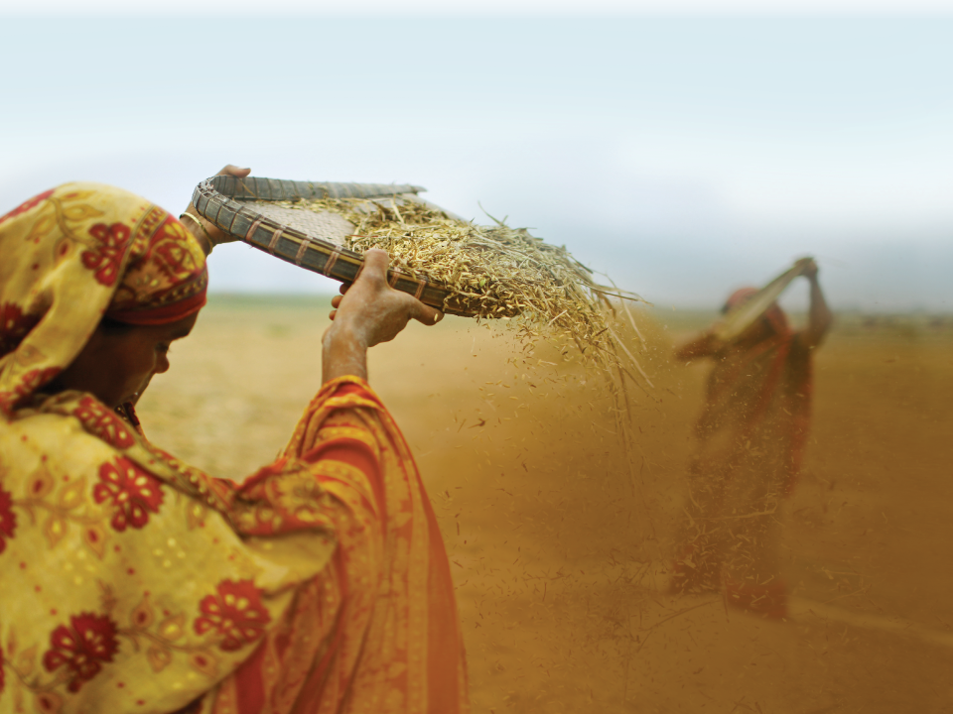
TOPS Gender Task Force
M&E Capacity Strengthening Workshop, Addis Ababa
4 to 8 June 2012
Kristi Tabaj, TOPS/Save the Children

Slide 2
TOPS Gender Task Force
Vision: The Food Security and Nutrition Network Gender Task Force is a community of technical specialists and practitioners working to improve the integration of gender equality and women's and girls' empowerment into food security and nutrition programming.
Slide # 1

Slide 3
TOPS Gender Task Force
Objectives for 2012 - 2015:
To aggregate key resources integral to advancing gender equality and empowerment in food security programming.
To produce resources aiding in addressing knowledge gaps and analysis.
To develop mechanisms to provide knowledge resources.
To deliver resources to program implementers.
Slide # 2

Slide 4
TOPS Gender Task Force
Key Deliverables
Finalized core competencies
Mapping of key gender contacts (Title II implementers and resource organizations)
Identify key/preferred tools for gender audit/analysis/evaluation
FSN Network
http://www.fsnnetwork.org//task-force/gender-integration
Slide # 3

Slide 5
Gender and Age Disaggregated Data
Collecting information on both gender and age can provide insight into program gaps and opportunities.
Nutrition needs for adolescent mothers.
Knowledge gaps in certain age groups (ex: those impacted by war).
Other examples?
Slide # 4

Slide 6
Gender Awareness Training
Gender versus sex
Gender equality versus gender equity
What is promoted in programming may not be practiced in the home. A gender bias may be present.
What are the stereotypes?
What are the consequences to breaking those stereotypes?
How far could/should the limits be pushed?
Slide # 5

Slide 7
Group Work (30 minutes)
Select 5-6 questions from this survey that could be used or adapted in your project to monitor the following:
change in empowerment of women (select 2-3 questions)
how food insecurity/nutrition is improved by integrating gender considerations (select 2-3 questions)
Slide # 6

Slide 8
This presentation was made possible by the generous support of the American people through the United States Agency for International Development (USAID). The contents are the responsibility of Save the Children and do not necessarily reflect the views of USAID or the United States Government.

