Slide 1
Collaborating, Learning and Adapting for More Effective Development Programs 4th FSN Network Regional Knowledge Sharing Meeting Washington DC November 14, 2012
Stacey Young, PhD Senior Learning Advisor Bureau for Policy, Planning & Learning

Slide 2
What goes wrong in development?

Slide 3
What goes wrong in development?
Lack of coordination and lost synergy
Duplication of efforts
Weak evidence base
Outdated practice
Poor fit with context
Static plans & implementation
Fixation on targets
Implementation modes assume passive “beneficiaries”

Slide 4
What is USAID doing about it?
Evaluation policy
Program Cycle reforms to restore analytic rigor and to recast approach as inherently adaptive
Collaborating, Learning & Adapting (CLA) emphasis among growing number of missions

Slide 5
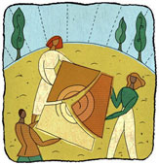
CLA in Strategic Planning
Fill gaps in evidence base
Ground strategy in context
game-changers
Advisory partners
Build on experience
candid conversations
positive deviance
Resources, staff and incentives for collaborating, learning and adapting

Slide 6
CLA in Project Design
Design project within broader context
Program influence as well as dollars
Choose flexible mechanisms
Define deliverables to promote collaborating, learning and adapting
New project construct requires IP coordination and collaborative learning
Ways to support it (embedded, standalone)
Catalyze learning for local development actors

Slide 7
CLA During implementation
Plan periodic research/synthesis/review to strengthen and update analytics
Build learning focus into partners’ meetings
and portfolio reviews
Capture learning from departing staff
Institute informal, cross-sectoral
discussion forums on game changers
Fund IPs to capture and share learning (their own and others’)
Notes:
We can upgrade our technical knowledge and strengthen the evidence base for our program through continuous learning and periodic review of new knowledge. This can include building learning and knowledge sharing into partners’ scopes, budgets and deliverables; sharing what’s learned with other stakeholders as appropriate; and using monitoring processes that involve frequent feedback to enable timely course correction – generally, and particularly with respect to game changers.
People’s experience is a critical resource – we can institute processes such as informal discussions, awards for sharing knowledge, and exit interviews to help people share their knowledge and experience so others can learn and apply it to program decisions. Our IPs represent the biggest pool of knowledge and experience – we need to include them in these processes.

Slide 8
Implications for Partners
We need you to show us how
What are you already doing?
To coordinate and collaborate
To learn continuously and catalyze learning for others
To adapt quickly for greater effectiveness
What are your biggest challenges in this area? How can USAID lead, facilitate, or get out of the way?

Slide 9
Relevance to Resilience Agenda
Integrate and innovate (vs. aggregate) previously separate approaches to develop new kinds of interventions
Shift from short-term to longer-term approach
Learn to measure processes, intangibles
Work across a broad range of stakeholders
Catalyze local learning: shift communities from HA to resilience and growth

Slide 10
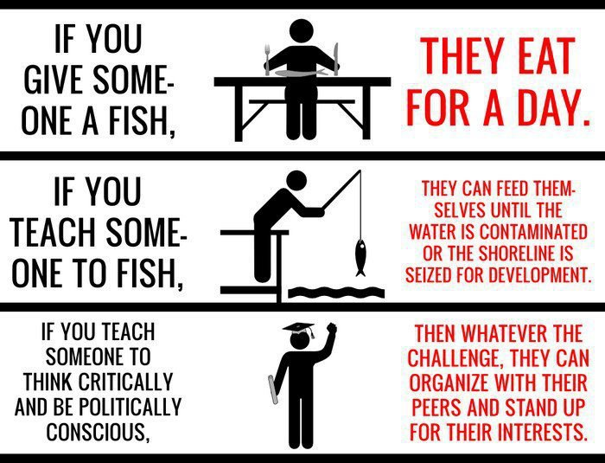
The opportunity: to do development differently
Notes:
Just an analogy, but a good one

Slide 11
Resources
USAID Evaluation Policy
http://transition.usaid.gov/evaluation/USAIDEvaluationPolicy.pdf
Program Cycle Learning Guide (draft)
Practical models, methods, examples
http://kdid.org/kdid-lab/library/usaid-program-cycle-learning-guide
Learning Lab web site
Resources/forums on collaborating, learning and adapting
http://kdid.org/kdid-lab/library
KM Impact Challenge
M&E methods for learning in international development
http://kdid.org/kmic
Notes:
And here’s where you can find more help.

