Slide 1
Armed Conflict: A Typology
For Discussion Only
Office of Conflict Management and Mitigation
Bureau of Democracy, Conflict and Humanitarian Assistance

Slide 2
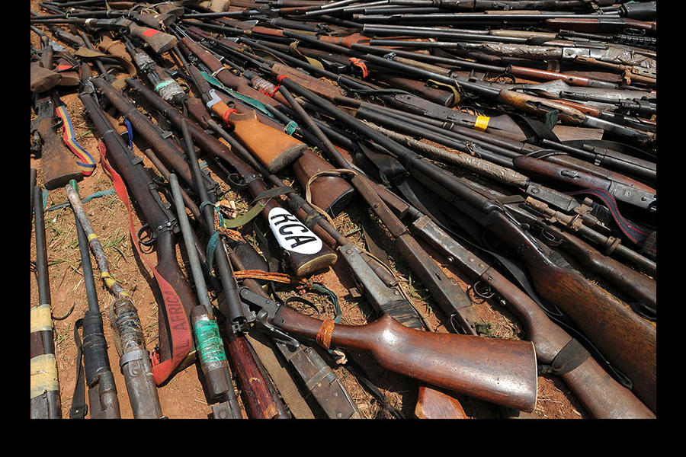
24
countries with active armed conflict
26
countries with recently terminated conflict
50
conflict-affected countries
Notes:
Arms confiscated from ex-Seleka rebels and ‘anti-balaka’ militia by the French military Operation Sangaris are presented at a French military base in Bangui Frebruary 28, 2014. Presiden Hollande flew to CAR to tell its leaders and French forces stationed there that France will work to stop the country splitting in tow. (CREDIT: Sia Kambou/Reuters).

Slide 3
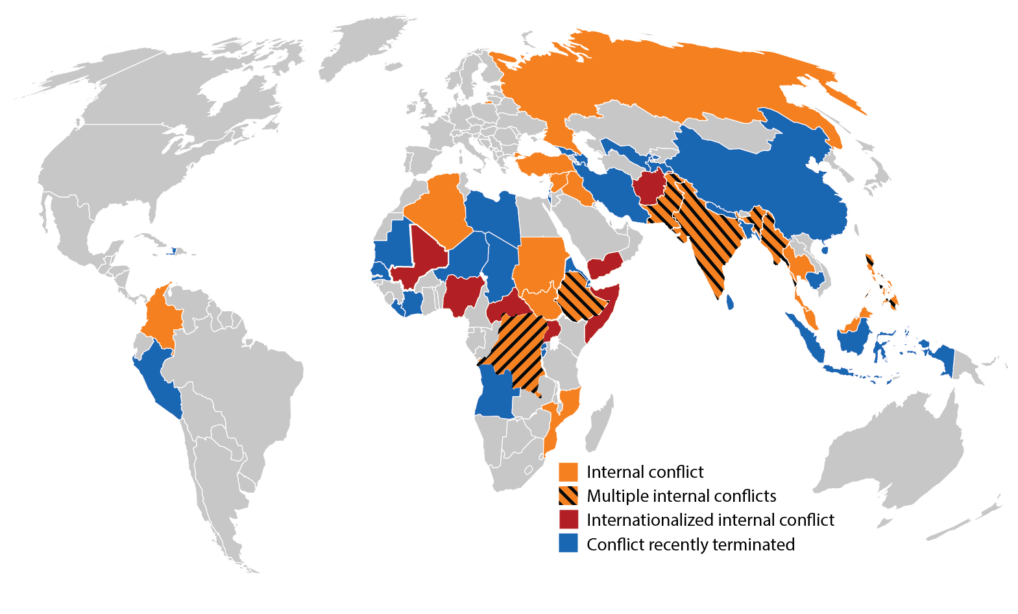
Armed conflict, 2013

Slide 4
Armed Conflict Typology
Active Conflict
Post-Conflict
Conflict Vulnerable

Slide 5
Armed Conflict Typology
Active Conflict - A contested incompatibility that concerns government and/or territory where the use of armed force between two parties, of which at least one is the government of a state results in at least 25 battle-related fatalities in one calendar year. (Definition used by the Uppsala Conflict Data Program)
Post-Conflict
Conflict Vulnerable

Slide 6
Armed conflict, 2013

Slide 7
Armed Conflict Typology
Active Conflict
Post-Conflict – Any country in which an active armed conflict subsides (i.e. does not produce more than 25 battle-related fatalities) within the past 10 years.
Conflict Vulnerable

Slide 8
Armed conflict, 2013

Slide 9
Armed Conflict Typology
Active Conflict
Post-Conflict
Conflict Vulnerable –
Any country that exhibits fragility or risk of instability (in a range from very modest levels to the most acute) AND
is not presently involved in active conflict or in a post-conflict stage.

Slide 10
Conflict Vulnerable
AFRICA | Namibia | North Korea | E&E
Benin | Sierra Leone | Papua New Guinea | Armenia
Burkina Faso | Swaziland | Solomon Islands | Belarus
Cameroon | Tanzania | Timor-Leste | Ukraine
Congo, Rep. | Togo | Turkmenistan
Equatorial Guinea | Zambia | Uzbekistan | LATIN AMERICA
Gabon | Zimbabwe | Vietnam | Bolivia
Gambia |  |  | Venezuela
Ghana | ASIA | MENA
Guinea | Comoros | Egypt
Guinea-Bissau | Fiji | Lebanon
Kenya | Kazakhstan | Saudi Arabia
Madagascar | Kyrgyz Republic
Malawi | Laos

