Slide 1
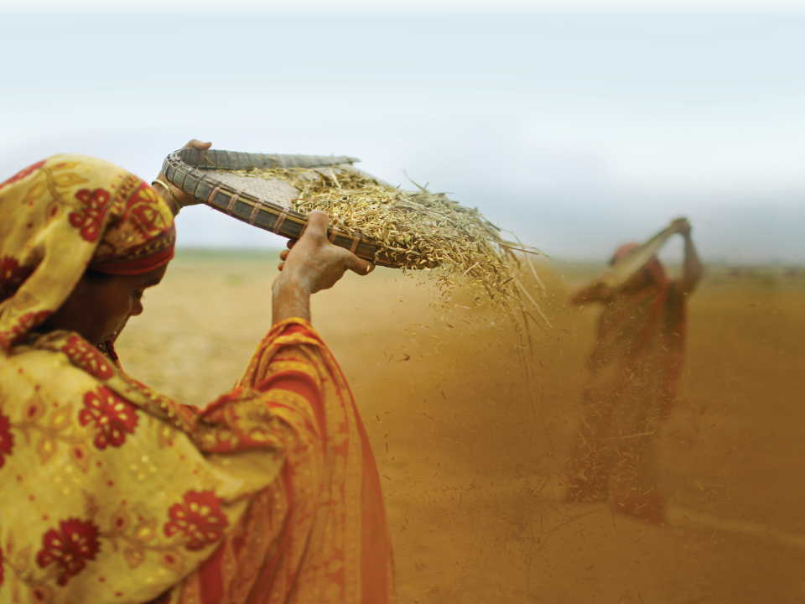


Integrating Agriculture and Nutrition in Food Aid Projects: What does each specialty need from the other?

Slide 2

Target: The household…with children under age two?
UNDERLYING: RESILIENCY….EARLY WARNING…..SUSTAINABILITY
FOOD SECURITY
Indicators:
HH income
HH production
Child stunting
AVAILABILITY
ACCESSABILITY
UTILIZATION

Slide 3
FOOD SECURITY PROJECTS
Targets:
1) The nutritional health of the HH income producers
Why worry about the well-being of HH income producers?
2) The nutritional health of vulnerable members (women and children) of the household
Why are some members of the HH “vulnerable”??
Why worry about the well-being of vulnerable members of the household?

Slide 4
CORE COMPETENCIES FOR AGRICULTURE SPECIALISTS
Understand the structure and function of a household (HH) farm “system”
  Crop production
  Related environmental issues (soil, water, etc.)
  Level of risk (drought, disease, pests, etc.)
  Storage and consumption of crop production
  Sale of crop production
Identify crop gaps throughout the year
Understand the local “food system”
Identify opportunities to enter the market – the “value chain”

Slide 5
AGRICULTURE INTERVENTION DESIGN
GOAL: Identify solutions for gaps in crops and market opportunities:
  using the HH resource base
  within the HH human resource potential
Strategy A: Increase crop production (“yield”)
Strategy B: Diversify crop production
Strategy C: Intensify the farming system
All while looking at the environmental protection of the resource base (soil, water).

Slide 6
AGRICULTURE INTERVENTIONS
Common activities:
Seek food security with new or different staple crops (seasonal food security)
Diversify production
  Diversify production with crops that have a market -- entering the value chain to increase income
  Diversify production with crops the household will like to consume, for diversified household consumption
  Diversify production with crops that are new and good for the environment, the soil, sustainability, etc.
Improve post-harvest storage
Any of these activities may also be
designed to “intensify the farming system”.

Slide 7
Target: The household…with children under age two?
UNDERLYING: RESILIENCY….EARLY WARNING…..SUSTAINABILITY
FOOD SECURITY
Indicators:
HH income
HH production
Child stunting
AVAILABILITY
ACCESSABILITY
UTILIZATION

Slide 8
What project agriculture staff may not know:
The “pillars” of food security and the role of the agriculture interventions in each pillar (especially “utilization”)
What the other components of a food aid project are doing or why
Why health & nutrition focus on “vulnerable” women and children under age two (“targets”)
What is the definition of food “value “ by a nutrition staff, as compared to an agriculture definition of food value (“potassium”).
The basic food groups concept (i.e. balanced meal)
Essential Nutrition Actions
How the agriculture interventions can contribute to improving the nutritional status of women and children

Slide 9
KEY NUTRITION CONCEPTS
TO SHARE WITH AGRICULTURE SPECIALISTS
KNOW YOUR BASIC FOOD GROUPS FOR A BALANCED AND VARIED DIET
ENERGY = Staple Food
PROTECTION: Fruits and Vegetables
GROWTH: Protein
ENERGY?:
Fats Sugars
One nutrition advisor’s perspective ☺

Slide 10
THE NEEDS OF PREGNANT AND LACTATING WOMEN……..AND WHY
……insert photo of pregnant and lactating women…………

Slide 11
For Children ages 6 to 24 months:
F.A.D.U.A.
or
F.A.T.V.A.H.

Slide 12
For Children age 6-24 m: F.A.D.U.A.
Small children have small stomachs
Much improvement can occur with use of staple food for complementary feeding
  Frequency of feeding
  Amount fed
  Density of the porridge (water, oil)
  Utilization (variety = protein, vitamin A & iron)
  Actively feeding child (encouraging, etc.)

Slide 13
AGRICULTURE SUPPORT FOR NUTRITION
√ Food security with staple crops; seasonal security
√ Diversified production
  √ Entering the value chain
    Teach household income management: budget to include % for animal protein foods
    Include agreements to reserve a portion of commercial crops for community availability
  √ Diversify crops for household consumption
    Include protein crops = legumes
    Include a few vegetable crops HIGH in Vitamin A and iron
    Promote consumption of “new” crops
√ Post-harvest storage
Home gardens ?? Fruit trees?? Small animals??

Slide 14
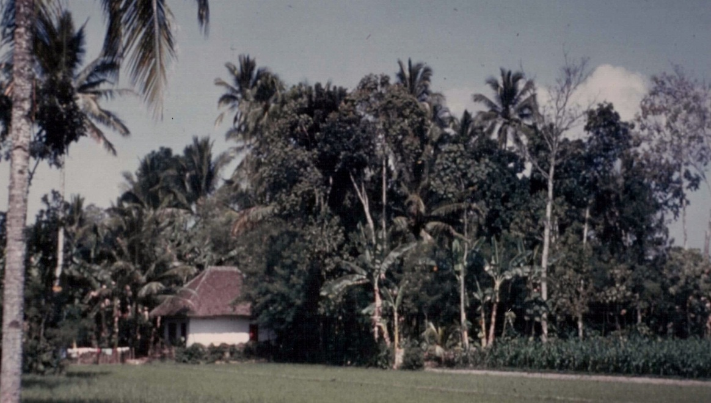
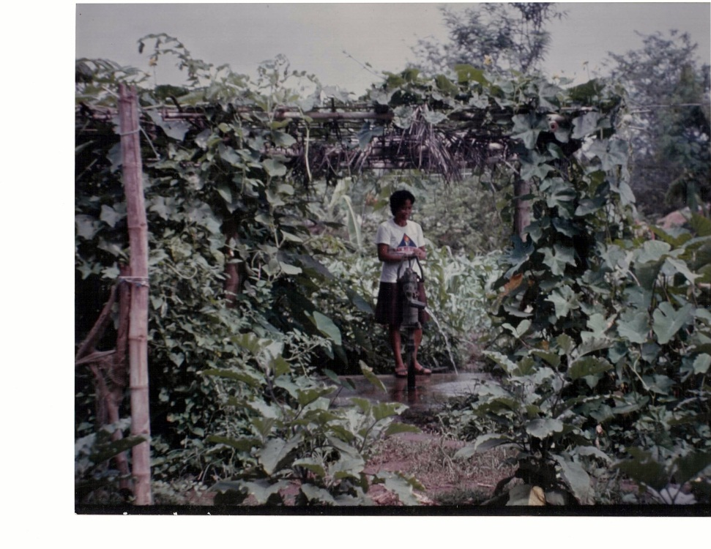
HOME GARDENS
Link between agriculture – nutrition – gender
Daily source of some first foods for baby
FRUIT TREES = sustainable source of Vitamin A but not usually available in the project’s first years
SMALL ANIMALS: Sustainability? Who cares for? What do they consume?

Slide 15
SMALL GROUP ACTIVITY: POINTS OF INTEGRATION
Instructions:
Discuss some specific points of integration between agriculture activities and nutrition activities in your project, or potential points of integration.
What is the role of agriculture staff and of nutrition staff in the integration?
How could this integration be improved?

Slide 16
Activity: Backyard gardens
Role of agriculture staff: providing seeds and training on how to plant/grow
Role of nutrition staff: Selecting beneficiaries
How could this integration be improved:
  Add nutrition education with a social and behavioral change focus so that households feed the vegetables to children
  Do cooking demonstrations
  Focus on preservation techniques (and preservation of nutrients)
  Use during recovery and transition.
  Need to find additional options for those families who were not selected because they did not have land or access to water, or other extremely vulnerable households
Additional comments on potential improvement:
  Nutrition staff could help select choice of seeds
  At the project design stage, nutrition and agriculture staff could discuss and decide upon their role in relation to the above-mentioned improvements

Slide 17
Activity: Selecting seeds for livelihoods activities
Role of agriculture staff: Selecting locally acceptable and soil appropriate varieties.
Role of nutrition staff: Selecting most nutrient dense varieties and crops that will diversify the diet.
How could this integration be improved:
Discussion to reach a common understanding and appreciation of each other’s agendas; i.e. agriculture staff wanted potatoes but nutrition staffs were resistant; nutrition staff wanted to prioritize poultry but agriculture staff prioritized small ruminants.

Slide 18
Other potential points of integration
Among existing activities:
Food distribution: maximize an additional opportunity with mass education by nutrition staff AND agriculture staff
Choose crops that do a “double duty” (have market value and nutrition value for vulnerable members of household) in the value chain
Conduct cross-training among key actors and stakeholders
Support advocacy to host government and donors of the benefits of and opportunities for integration
Potential constraints / opportunities:
Trade-offs, but these should be known and embraced (investment in agriculture output vs. nutrition)
Time horizon and ease of measurement of impact (agriculture production vs. generational behavior change)
Targeting! (Household vs. children under age two)
Role of donors (constrained funding streams and mandates)
Take a deliberate approach to de/stove-piping (expanded dialogue, joint capacity building)

Slide 19
AG SPECIALIST INPUT
NUTRITION SPECIALIST INPUT
FOOD SECURITY & MATERNAL CHILD NUTRITION
OTHER SPECIALIST INPUT
POTENTIAL POINTS OF INTEGRATION
DURING THE LIFE OF A PROJECT
Seasonal food security of staple crops
Adding crops with protein (legumes)
Selecting vegetables HIGH in Vitamin A & iron
Promoting consumption of new foods
Teaching household budget management for nutrition improvement
Agreements to reserve portion of crop for community consumption
Involving PERSONS OF INFLUENCE

Slide 20
AG SPECIALIST INPUT
NUTRITION SPECIALIST INPUT
FOOD SECURITY & MATERNAL CHILD NUTRITION
OTHER SPECIALIST INPUT
POTENTIAL POINTS OF INTEGRATION DURING PROJECT DESIGN STAGE
Seasonal food security of staple crops
Adding crops with protein (legumes)
Selecting vegetables HIGH in Vitamin A & iron

Slide 21
Carrots or Pumpkins?
Pumpkin
Big seed, save seed.
Eat seed, flowers, leaves, fruit.
Weed management
Multipurpose
Traditional food
Carrot
Small seed, new seed.
Eat root only
High management
Sensitive to harvest/post harvest
Not traditional food
Is a PUMPKIN a PUMPKIN ??

Slide 22
AG SPECIALIST INPUT
NUTRITION SPECIALIST INPUT
FOOD SECURITY & MATERNAL CHILD NUTRITION
OTHER SPECIALIST INPUT
POTENTIAL POINTS OF INTEGRATION
DURING PROJECT IMPLEMENTATION
HARMONIZED MESSAGES ☺
Promoting consumption of new foods
Teaching household budget management for nutrition improvement
Agreements to reserve portion of crop for community consumption
Involving PERSONS OF INFLUENCE

Slide 23
Target: Children under age two
UNDERLYING: RESILIENCY…EARLY WARNING….SUSTAINABILITY
FOOD SECURITY
Indicators:
HH income
HH production
Child stunting
AVAILABILITY
ACCESSABILITY
UTILIZATION

