Slide 1
Building Effective Collaboration and Integrated Programming
Moderator:
Janine Schooley, Senior VP Programs, PCI
Panelists:
Pascale Wagner, Country Director, PCI/Guatemala
Bal Maria Gutierrez, Regional Director, PCI/Guatemala
Rosy Cano-Hays, PCI Consultant
@FSNNetwork
#TOPSProgram

Slide 2
Resource Guide for Building Effective Collaboration and Integrated Programming
Washington, DC
May 7, 2015
This resource guide was made possible by a grant from the USAID Technical and Operational Performance Support (TOPS) program. The TOPS Micro Grants Program is made possible by the generous support and contribution of the American people through the United States Agency for International Development (USAID). The contents of the materials produced through the TOPS Micro Grants Program do not necessarily reflect the views of TOPS, USAID or the United States Government As per Bianca’s new guidance. This must be located on the first page or in the back cover. We can decide where to put it. but I believe we don’t have a back cover.

Slide 3
Agenda
Background on Guatemala and the Coordinating Committee Experience
Resource Guide Development
Key Components of the Resource Guide
Group Discussion: From Concepts to Practice
www.pciglobal.org
Notes:
3

Slide 4
Background
Since 2013
Four departmental and one central committee have been created
Huehuetenango – San Marcos - Quiche – Quetzaltenango –Totonicapán
Working on development issues in the same geographical area
Committees’ responsibilities: identify challenges and local solutions by integrating and operationalizing a participatory approach
Maintain communication with other stakeholders, including the central committee
www.pciglobal.org
Notes:
4

Slide 5
Committee Structure
Petit Committee
(Central)
Quetzaltenango
Committee
Quiche
Committee
Huhuetenango
Committee
San Marcos
Committee
The Petite Committee is composed of one representative from each of the six technical sectors and its role is to:
Facilitate departmental committee coordination
Formulate specific solutions, and relevant context for integration challenges arising in any of the five departments
Ensure WHIP strategic coordination
Develop and implement creative strategies to build collaborative local solutions and ensure solid horizontal and vertical communication
www.pciglobal.org
Notes:
5

Slide 6
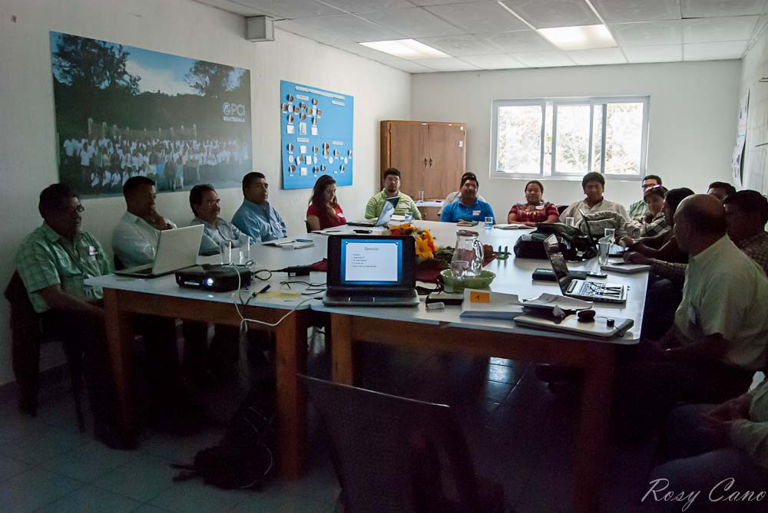
Huhuetenango’s Committee
Started with five organizations implementing projects funded by USAID.
Gradually, other partners funded by USDA joined this committee.
Today, 13 member organizations have developing projects in 24 municipalities in Huehuetenango's Department.
These projects address health and nutrition issues, economic production, natural resources, environmental concerns, resilience, education and technical assistance.
USAID requested that PCI serve as the secretariat/coordinator of this committee.
www.pciglobal.org
Notes:
6

Slide 7
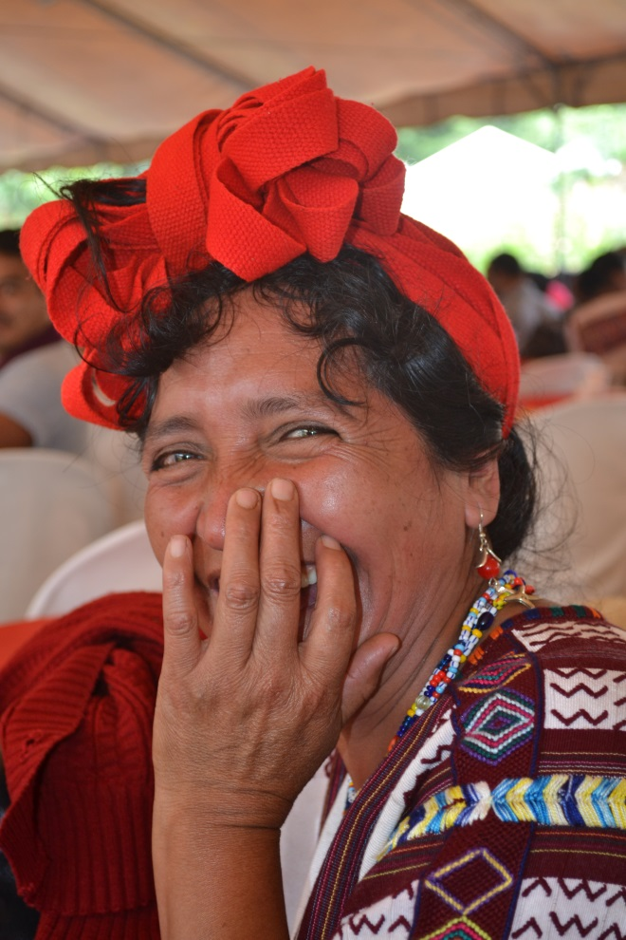
Resource Guide Development
PCI was funded by the Technical and Operational Performance Support (TOPS) small grants program during the period of June 2014 to May 2015, for the development of guidelines for “Effective Coordination and Intentional Integration”, based upon this rich experience gained in our current programs in Guatemala.
www.pciglobal.org
Notes:
7

Slide 8
Guide Development Process
Assessed current status of the key USG program implementers to improve the coordination and integration of services in Guatemala.
Facilitated conversation between committee members in Huehuetenango.
Learned from current practical experience gained, lessons learned, best practices and effective coordination among implementing partners.
Provided guidance and recommendations.
Drew from the group’s experience and develop practical guidelines for effective coordination and collaboration.
www.pciglobal.org
Notes:
8

Slide 9
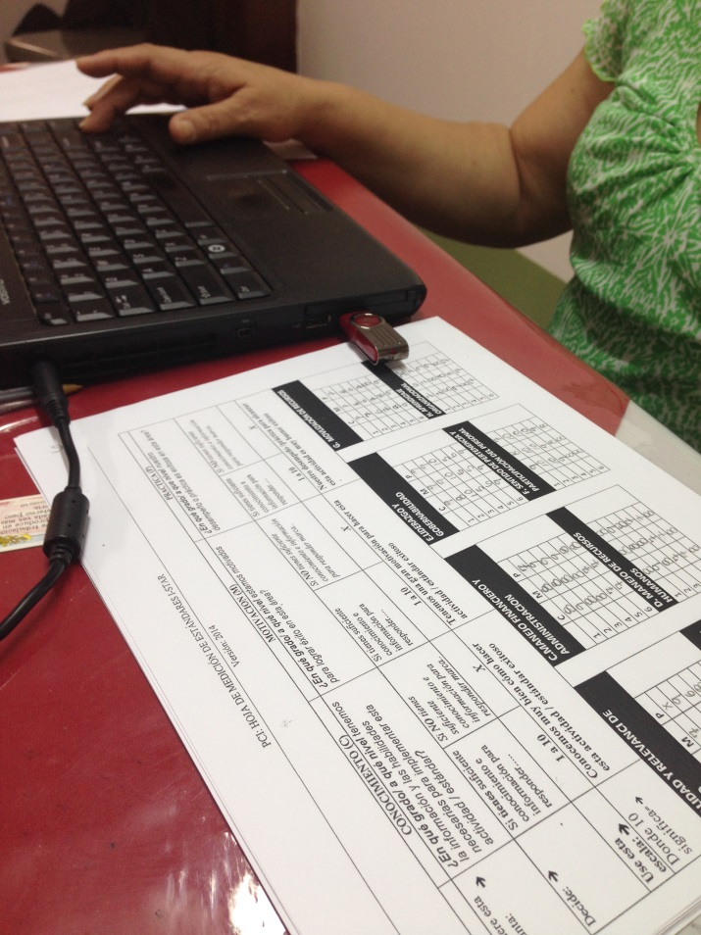
Getting the Best From Collaborative Implementers
Methodologies Used for Guide Development
PCI facilitated conversations between and among committee members in Huehuetenango using several tools and methodologies to gather committee experiences and significant findings:
I-STAR (Integrated System for Transformational Assessment and Results) -- PCI and EDC
Appreciative Inquiry Approach
www.pciglobal.org
Notes:
9

Slide 10
Methodologies
I-STAR is a comprehensive, standards-based (action oriented) approach to building effective and sustainable organizations and networks that are able to contribute to improve the health and development of the communities they serve.
I-STAR is based in the strategy of “begin winning”, because during the analysis and reflection sessions, organizations are invited to identify their competence areas that can be the basis of the organizational strengthening activities that require more effort going forward.
The starting point for improvement is to recognize the need.
- Masaaki Imai
www.pciglobal.org
Notes:
10

Slide 11
Methodologies
Appreciative Inquiry Approach
Is an approach to organizational and community development that has been used successful worldwide to cultivate hope, build capacity, unleash collective appreciation and imagination, and bring about positive change.
Positive questions around affirmative topics were created to inspire constructive dialogue between participants, during this session members were able to share experiences, best practices and develop new possibilities to bring the desired future into being.
www.pciglobal.org
Notes:
11

Slide 12
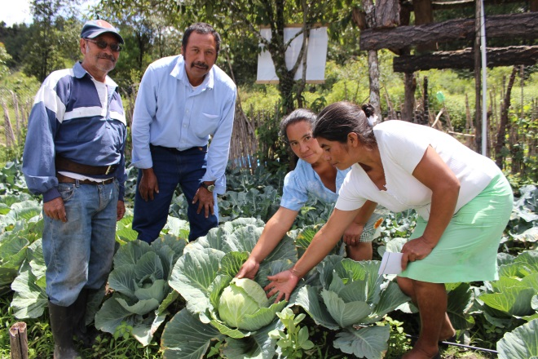
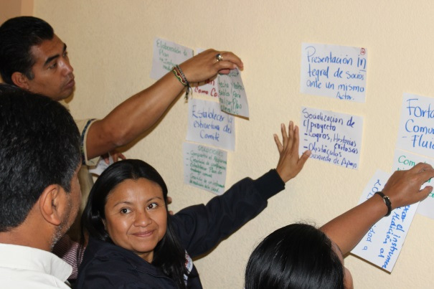
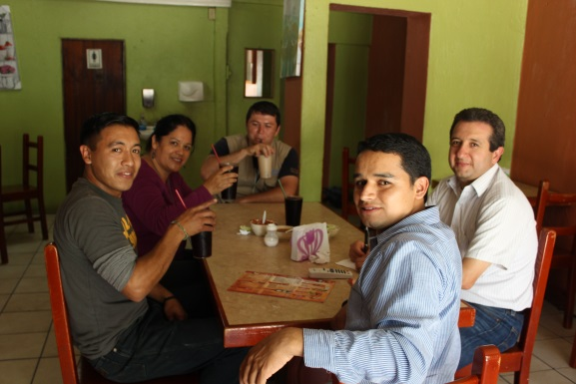
Assessment Opportunities
The exercise provided an opportunity to :
Learn real and illustrative examples of promising practices
Document challenges and barriers
Identify from committee experience the key elements for a successful collaboration
www.pciglobal.org
Notes:
12

Slide 13
Process Results
I-STAR and Appreciative Inquiry methodologies helped the committee to have a friendly attitude and allowed them to recognize their achievements such as:
Increased awareness about projects supported by USAID and USDA in the region
Creating working groups by thematic area
Informal coordination with other members of the Collaborative
Developed mapping coverage
Coordination committee procedures
Quarterly newsletter to share best practices and achievements
Signing agreements with participating organizations and other sectors
Identified community benefits from coordination between committee members
More defined structure
www.pciglobal.org
Notes:
13

Slide 14
Significant Findings
Committee members were also able to identify areas where their performance was satisfactory as well areas of opportunity to improve collaboration efforts.
www.pciglobal.org
Notes:
14

Slide 15
Huhuetenagos’s Committee
Committee Goals Looking Forward:
• Complementarity in their interventions • Strengthening committee’s structure • Identify participating organizations’ strengths • Establish a joint working plan • Develop a tool to measure their impact • Create a communication system • Have a space to share community needs and priorities • Create collective learning programs including specialized technical assistance • Reduce individualism and competition • Achieve better communication and coordination with the central committee
www.pciglobal.org
Notes:
15

Slide 16
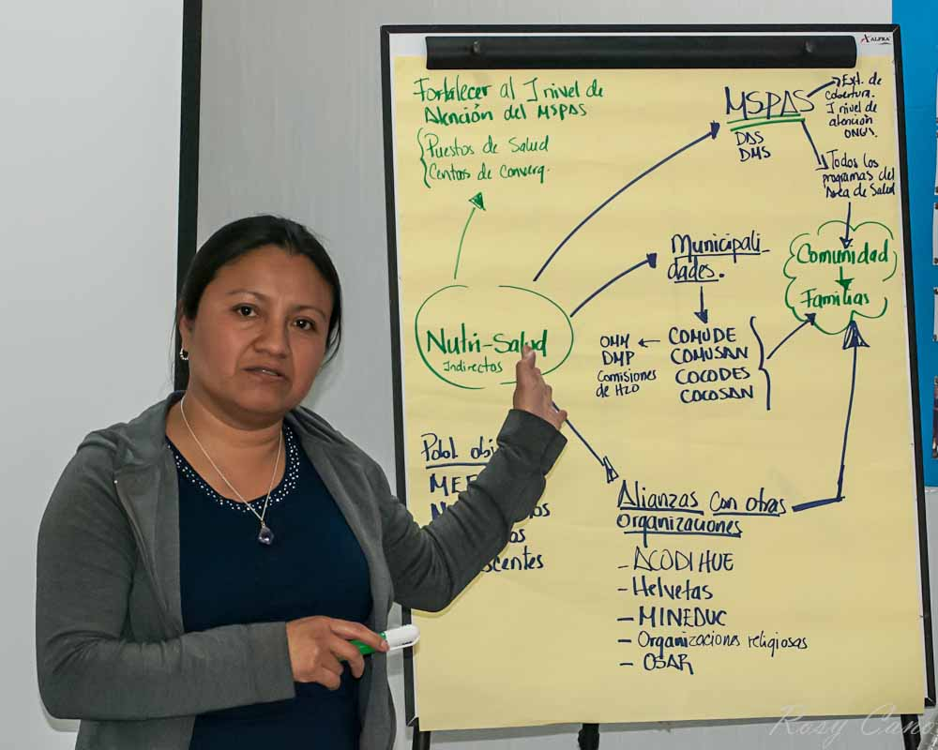
Collaboration Benefits
Throughout the committee, we have had the opportunity to complement our services and benefit the community in a more comprehensive way.
Committee Member
Collaboration Mapping Process
www.pciglobal.org
Notes:
16

Slide 17
Key Components of the Guide
www.pciglobal.org
Notes:
17

Slide 18
Guide’s Purpose
The Guide’s main purpose is to provide recommendations, examples and lessons learned, local and worldwide, to improve and promote effective coordination and collaboration between USG-funded organizations currently working in the Western Highlands Integrated Programs ---- to achieve greater impact.
www.pciglobal.org
Notes:
18

Slide 19
Key Components of Guide
Collaboration concepts
Practical recommendations for promoting effective cooperation mechanisms
Effective mechanisms for collaboration
Opportunities for success in collaborative efforts
Importance of monitoring and evaluation tools and processes
Case Study - Experience in Huehuetenango
Recommendations for donors
www.pciglobal.org
Notes:
19

Slide 20
What Do You Want the Partnership To Be About?
There are three different levels:
Collaboration – a mutually beneficial and well-defined relationship entered into by two or more organizations to achieve common goals
Coordination – more formal relationships, an understanding of compatible missions, some planning and division of roles is required (aka “task force”)
Cooperation – informal relationships without any commonly define mission, structure, or planning effort (also known as a “coalition” or “network”
Levels of participation intensity
www.pciglobal.org
Notes:
20

Slide 21
How Do They Compare?
Cooperation | Coordination | Collaboration
Lower Intensity Higher Intensity
Shorter-term, informal relationships Share information only Separate goals, resources and structure | Longer-term effort around a project or task Some planning and division of roles Some shared resources, rewards and risks | More durable and pervasive relationships New structure with commitment to common goals All partners contribute resources and share rewards and leadership
From, Collaboration Handbook: Creating, Sustaining, and Enjoying the Journey by Michael Winner and Karen Ray. Retrieved from: http://www.lcrclandtrustexchange.org/InformationDocuments/collaborationhandbook091609.pdf
www.pciglobal.org
Notes:
21

Slide 22
Community Collaborations Work When…
They have:
A supportive community environment
Member characteristics are favorable to collaboration
Clear organization process and structure
Effective communication
Focused and empowering purpose
Adequate resources
www.pciglobal.org
Notes:
22

Slide 23
Practical recommendations for effective collaborative mechanisms
Identify collaboration as a need
Evaluate collaboration readiness
Nature of participation
Benefits from participation
Identify key partners
www.pciglobal.org
Notes:
23

Slide 24
Effective mechanisms for collaboration
Use Memorandums of Understanding to clearly define partners roles, expectations, decision making, accountability and contributions
Define level of organizational commitment
Appropriate Structure
Clear roles definition
Decision making protocols
Well define communication process
www.pciglobal.org
Notes:
24

Slide 25
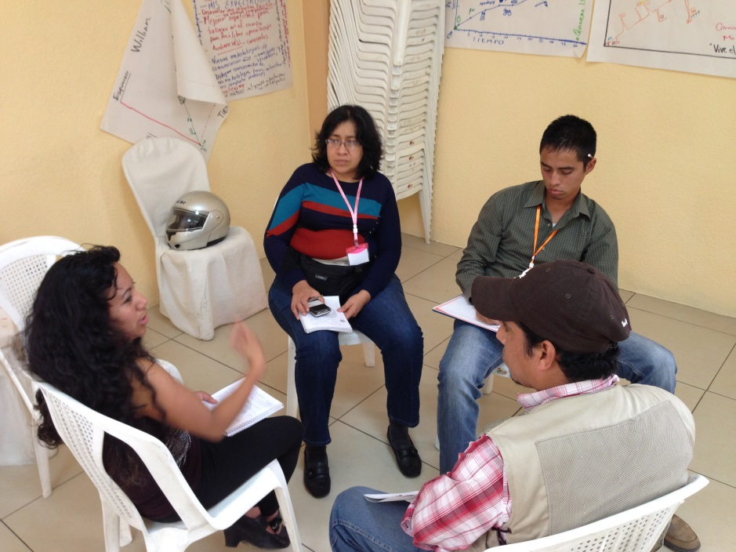
Opportunities For Success
Conditions for collective success
Shared vision
Develop tools to measure impact
Organizational participants offer value to the collaboration
Defined structure and processes
Have an effective communication strategy
www.pciglobal.org
Notes:
25

Slide 26
Common Challenges and Potential Barriers
Challenges
Barriers
Losing autonomy
Losing control
Losing visibility
Jeopardize reputation
Lack of trust
Not getting results
Lack of institutional support
Roles and expectations unclear
There is no progress
Power out of balance
www.pciglobal.org
Notes:
26

Slide 27
Monitoring and Evaluation
Value the evaluation process
View evaluation as a process of reflection
Integrate evaluation to work
Evaluate collaboration through different phases
Use different methods
Evaluate process and results
Document
www.pciglobal.org
Notes:
27

Slide 28
Monitoring and Evaluation
Formulate well defined collaboration indicators such as:
Participation meeting rate
Active participation of members
Proper use of resources
Meeting objectives
Contributions to public polices changes
www.pciglobal.org
Notes:
28

Slide 29
Group Discussion
From Concepts to Practice
At your tables, please discuss the following and be prepared to present back to the full group:
From your own experience, what most contributes to effective collaboration?
How can collaboration contribute to integrated programming?
www.pciglobal.org
Notes:
29

Slide 30
THANK YOU!!!
This resource guide was made possible by a grant from the USAID Technical and Operational Performance Support (TOPS) program. The TOPS Micro Grants Program is made possible by the generous support and contribution of the American people through the United States Agency for International Development (USAID). The contents of the materials produced through the TOPS Micro Grants Program do not necessarily reflect the views of TOPS, USAID or the United States Government As per Bianca’s new guidance. This must be located on the first page or in the back cover. We can decide where to put it. but I believe we don’t have a back cover.
http://www.pciglobal.org/collaborationresourceguide/
www.pciglobal.org
Notes:
30

Slide 31
Thank you for attending!
The presentation, photos, and tweets from today’s session will be available soon at fsnnetwork.org.

