Slide 1
Conflict Sensitivity and Engaging with Conflict
For Discussion Only
FACTRS*
Office of Conflict Management and Mitigation
Bureau of Democracy, Conflict and Humanitarian Assistance
* Fragility and Conflict Technical Research Services

Slide 2
Aid in Conflict Contexts
Notes:
Aid in Conflict Contexts
Aid is not neutral in contexts of conflict.
When resources are brought into a context, those resources and their means of transfer will effect relationships among people in that context.

Slide 3
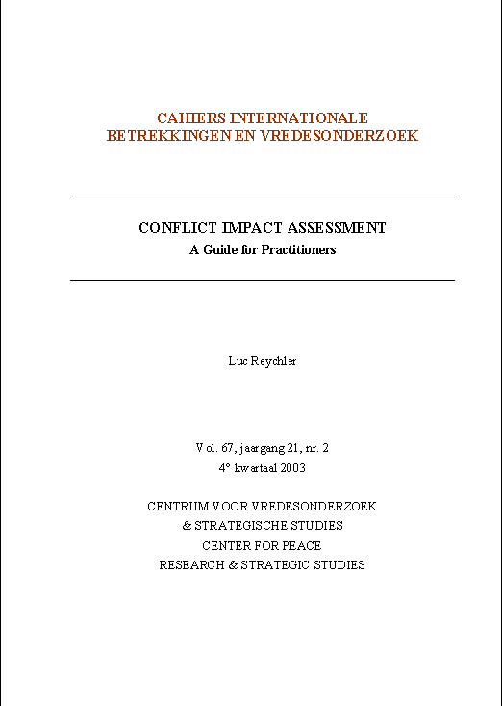
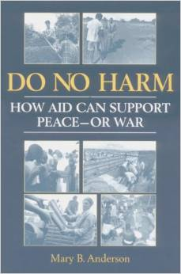
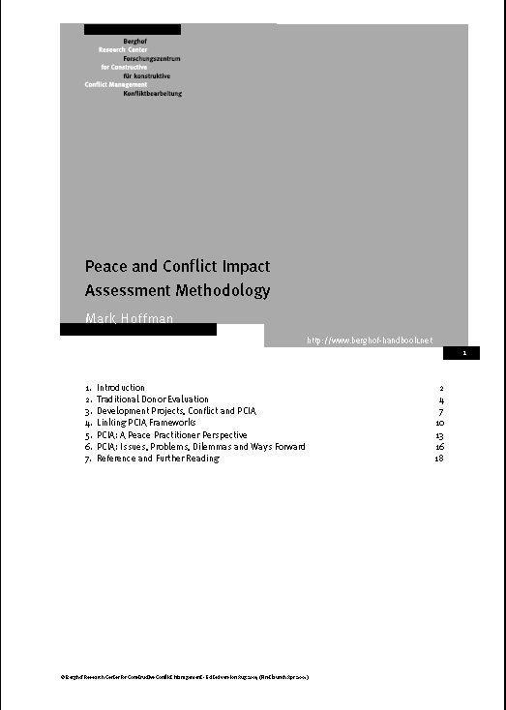
Notes:
Beginning in the late 1990s, several methodologies, frameworks and tools emerged to assist aid practitioners in designing and implementing interventions to take into account their effects on conflict.

Slide 4
Conflict sensitivity frameworks help organizations:
Understand the context of conflict in which they operate
Understand the interaction between their programs and the context
Act upon this understanding in order to avoid negative impacts and maximize positive impacts on the conflict.
Notes:
Conflict sensitivity frameworks help organizations:
Understand the context of conflict in which they operate
Understand the interaction between their programs and the context
Act upon this understanding in order to avoid negative impacts and maximize positive impacts on the conflict.

Slide 5
The Intent of Conflict Sensitivity
Options | Dividers/ Sources of Tension/ Capacities for War | Assistance in Development | Connectors/ Local Capacities for Peace | Options
 | Systems & Institutions Attitudes & Actions Different Values & Interests Different Experiences Symbols & Occasions ? | Mandate Fundraising/ Funding HQ Organization & Donor Relations Why? Where? When? What? With Whom? By Whom? How? Resource transfers and implicit ethical messages Redesign/adjust activity | Systems & Institutions Attitudes & Actions Shared Values & Interests Common Experiences Symbols & Occasions ?
Local Capacities for Peace Project (LCPP), 2001, based on Anderson, Mary B., 1999.
Notes:
The intent of conflict sensitivity
Conflict Sensitivity is a set of techniques for designing and implementing programs that have positive impacts on the relationships among groups in a context.
A thorough application of conflict sensitivity frameworks can do more than reduce the negative; it can also help to build on existing positive dynamics in intergroup relations in the context.
Conflict sensitivity can be applied to any type of aid program.
(Some discussion about the LCPP framework)

Slide 6
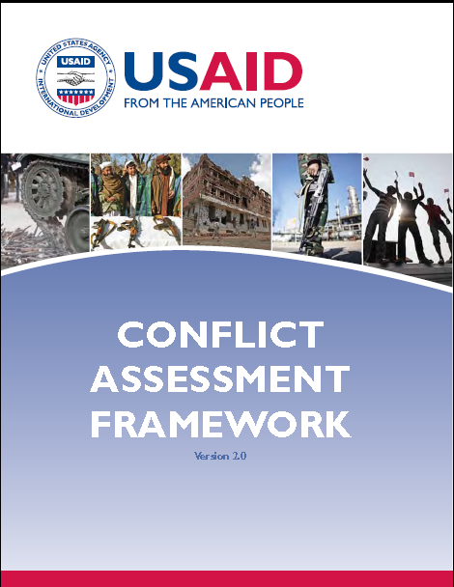
Notes:
Since conflict sensitivity began to get more attention among international assistance providers, many more tools have been created to help us better understand and respond to conflict. One such tool is USAID’s Conflict Assessment Framework, which was first produced in 2002 and was then updated as Version 2.0 in 2012. We won’t get into the details of it today, but thought it worth highlighting as a resource.

Slide 7
The Conflict Intervention Spectrum
Notes:
The conflict intervention spectrum
Avoid negative effects
Implement basic conflict sensitivity with the aim of reducing the negative impacts of programming.
Build on positive effects
Reinforce positive factors in society, reduce divisions, seek to enhance positive impacts of the program on the overall situation.
Contribute to peace
Address or engage key drivers of conflict/peace at local or macro levels.
Where do your programs or portfolios intervene on the conflict intervention spectrum?

