Slide 1
Data Sharing for HDP Coherence: Practical Case Studies
Wednesday, April 3, 2024 | 8 – 9:30 AM ET, 16:00 – 17:30 EAT

Slide 2
Interpretation
Everyone must select a language!
Click “interpretation” at the bottom of your Zoom window
Select the language you would like to hear
Chacun doit choisir une langue !
Cliquez sur << interpretation >> au bas de votre écran Zoom
Sélectionnez la langue de votre choix

Slide 3
What is IDEAL?
Implementer-Led Design, Evidence, Analysis & Learning
IDEAL addresses knowledge and capacity gaps expressed by the food and nutrition security implementing community, supporting them in the design and implementation of effective emergency and non-emergency food security activities.
www.fsnnetwork.org/IDEAL
Funder: USAID’s Bureau for Humanitarian Assistance (BHA)
Duration: 6 years (2019-2024)
Consortium: Save the Children, Mercy Corps, TANGO International, The Kaizen Company (until 2022); supported by technical partner, Acute Incite

Slide 4
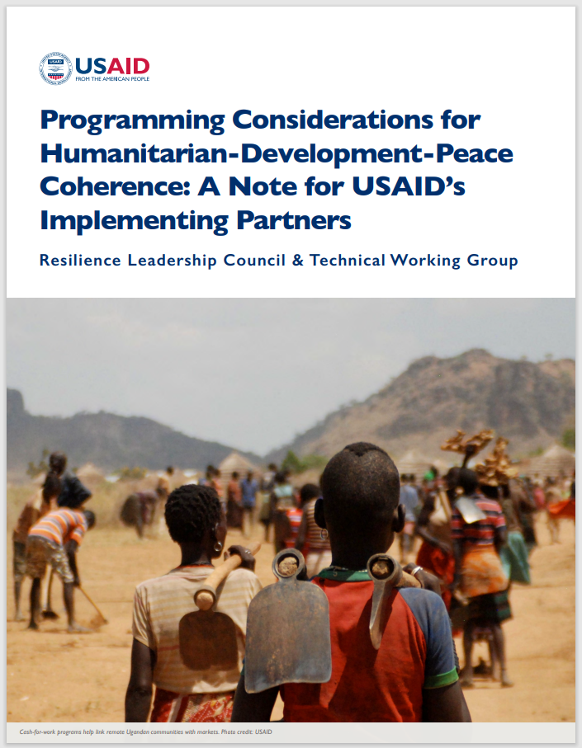
What is HDP Coherence?
“HDP coherence aims to promote complementary collaboration across humanitarian, development, and peace actors in pursuit of a common agenda. Its goal is to maximize impact and sustainability of programs across different kinds of assistance and to reduce the need for humanitarian assistance (HA) over time.”
- USAID’s Programming Considerations for Humanitarian-Development-Peace (HDP) Coherence: A Note for Implementing Partners

Slide 5
Available now on the FSN Network!

Slide 6
Quick Poll!
Photo Credit: Sedera Ramanitra / CRS Madagascar

Slide 7
Panel
CRS - Madagascar
Mercy Corps - DRC
Ethiopia
Cara Raboanarielina
Karolina Sklebena
Ashenafi Alemu
Strategic Learning Lead, Maharo RFSA
Crisis Analysis Team Director
Program Manager, JEOP, CRS
Gerard Rabesoa
Ottavia Magenes
Retta Gudisa
MEAL Lead, Maharo RFSA
New Initiatives and Partnerships Manager
MEL Lead, SPIR II RFSA, World Vision International

Slide 8
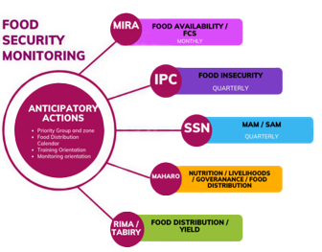
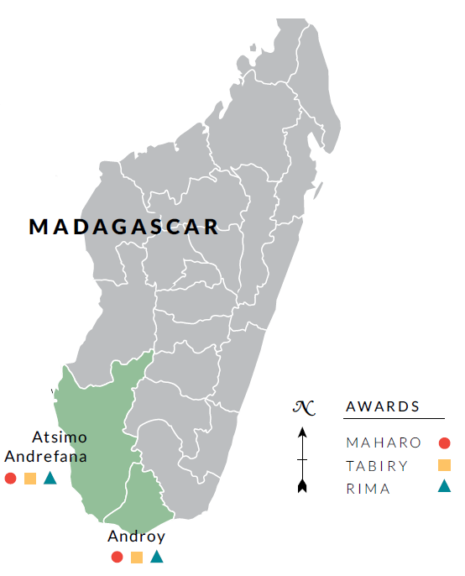
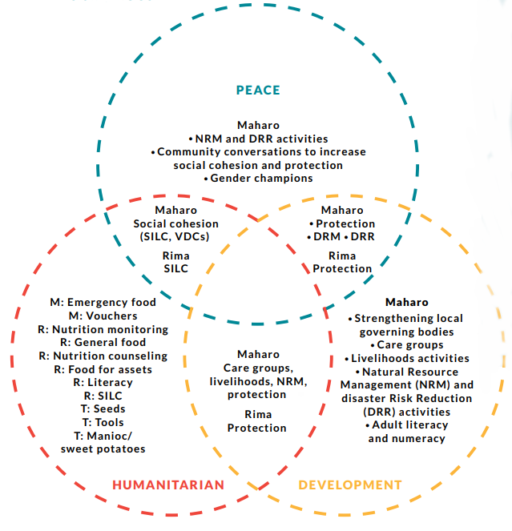
HDP Coherence in Southern Madagascar

Slide 9
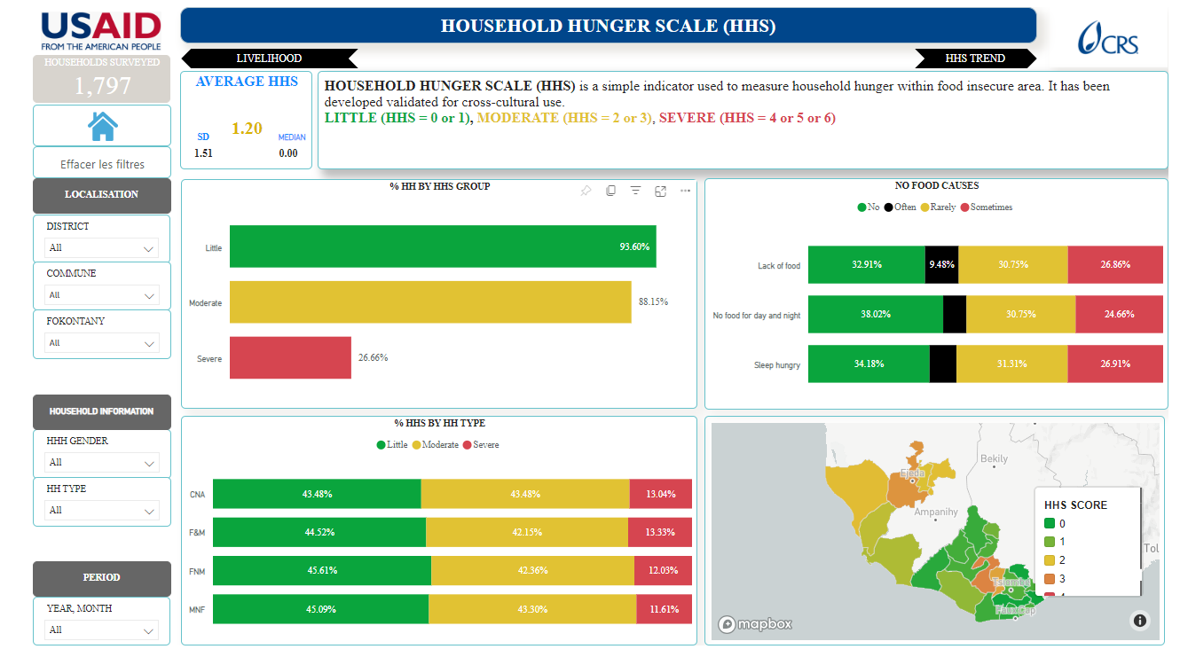
Monthly Interval Resilience Analysis (MIRA) Madagascar
Monthly Interval Resilience Analysis (MIRA), developed by CRS in partnership with Cornell University, is a structured protocol that seeks to identify families in vulnerable situations with a focus on the characterization of risks due to the various dimensions of care.

Slide 10
What are the information needs in crisis setting?
“CAT DRC mission is to support data-driven decision-making, adaptive management and anticipatory action in highly volatile contexts of various crises in DRC.”
Emergency
When is the right moment?
CRISIS
ANALYSIS
Conception
phase
Implementation
phase
Development
Peacebuilding
Evaluation
Closure
Revision
Adaptation

Slide 11
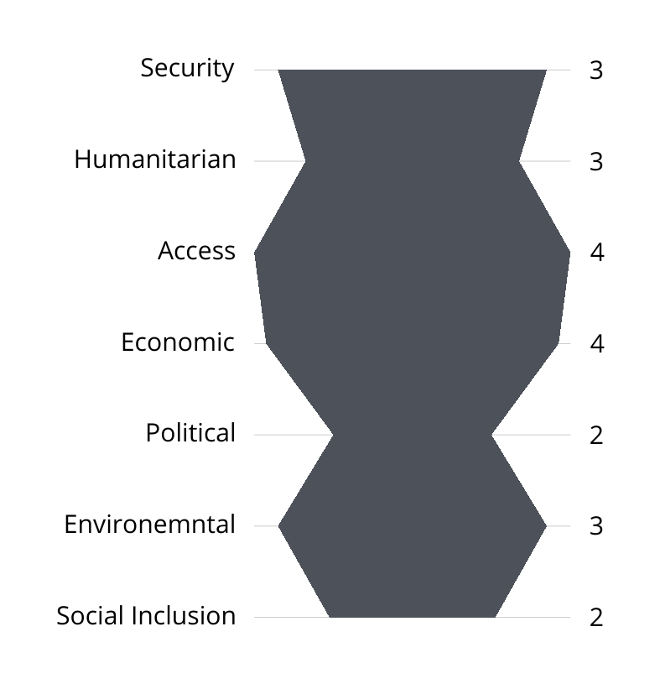
CAT Product Portfolio
Regular products and services:
Bimonthly newsletter/dashboard on displacement and access
Monthly analytical report on population movements
Operational context stability monitoring (SHAEPES)
Community acceptance and perception tracking
Partner and donor reporting, briefings, etc.
Ad-hoc (on request) products and services:
Stakeholder profiling and engagement
Crisis profiling and predictive models (scenarios)
Thematic analysis: rapid gender analysis
Staff perception context evolution & security (M23, CODECO crisis)
SHAEPES DIMENSION SCORE Q1 2024

Slide 12
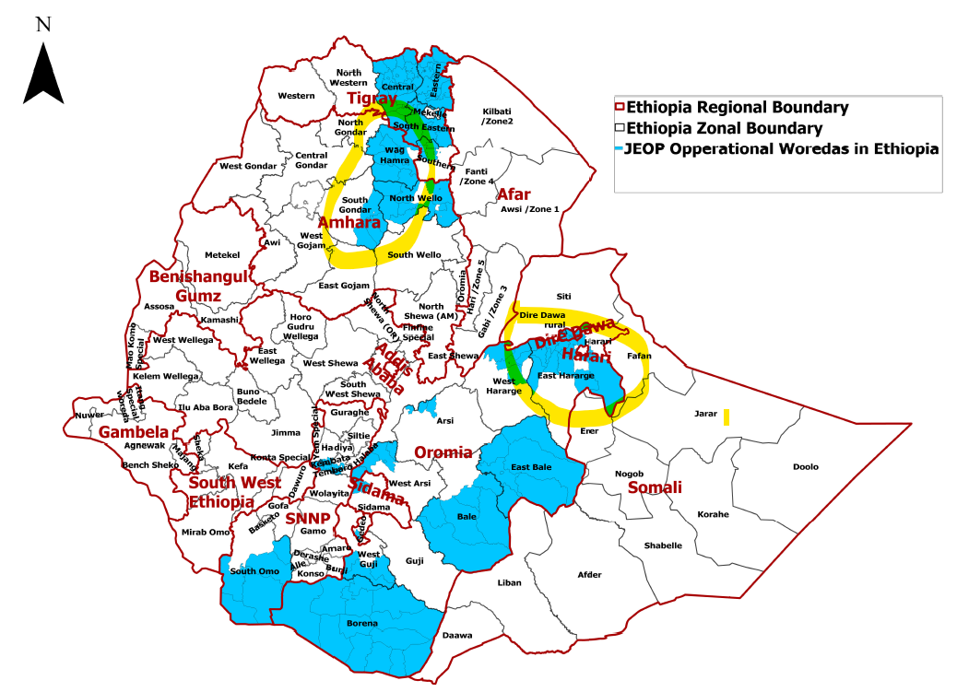
RFSA FHE led
Joint Emergency Operation JEOP
(CRS led)
ORDA
Resilience Food Security Activities
IFAA Resilience Food Security Activity
(CRS led)
Strengthen Productive Safety Net Programme Institutions and Resilience (SPIR II)
(World Vision led)
Poverty Reduced Sustainably in an Environment of Resilient and Vibrant Economy (PReSERVE)
(FHE led)
IFAA Implementing Partners
(CCL, HCS)
SPIR II Implementing Partners
(CARE, ORDA)
PReSERVE Implementing Partners

Slide 13
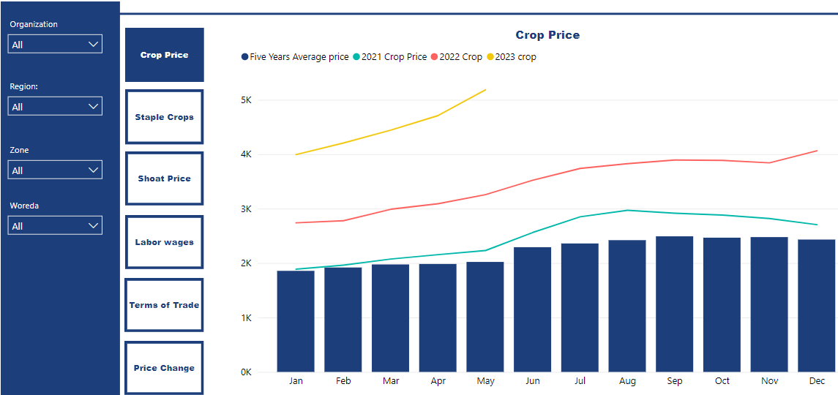
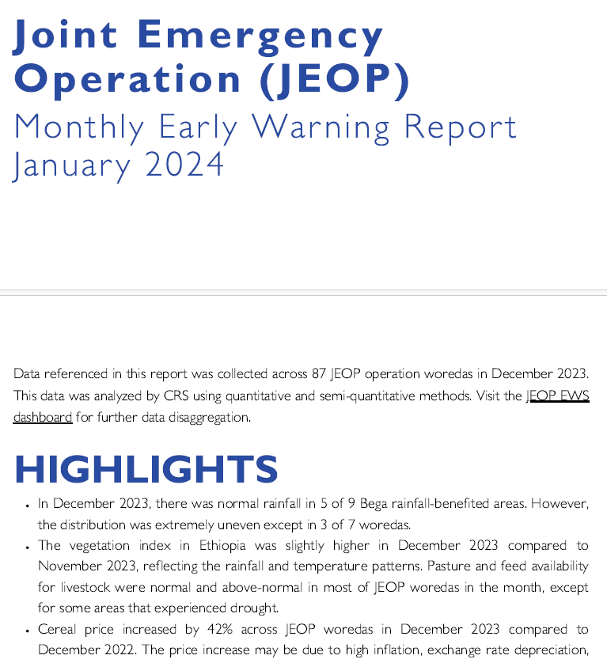
JEOP Early Warning System and Data Sharing
Kebele
Woreda Context monitoring data
Email
Analysis
Early Warning System Dashboard
RFSAs:
Iffa, SPIR II and PreServe
USAID
FEWSNET
World Food Programme
JEOP
Ethiopian Disaster Risk Management Commission
UN
NGOs
Narrative report

Slide 14
Q&A

Slide 15
HDP Coherence in Practice: Insights from the Implementing Community
Please join us for the next events in our series!
Promising Practices from Multi-Year Humanitarian Activities
May 8, 2024
Operationalizing HDP Coherence
June 5, 2024

Slide 16
Please click on the link in the chat to provide any feedback.
Thank you!

