Slide 1
Data Quality Assessments
July 27, 2023 | 9: 00 AM ET

Slide 2
Best Practices
Activate your video when you are speaking, if possible.
Mute your microphone when you are not speaking.
During Q&A, raise your hand if you’d like to speak out loud.
Use the chat box if you have any questions or comments!

Slide 3
Next Webinar
Date: Early September
Theme: Outcome Measurement in Humanitarian Settings
Format: Panel discussion
Interested in being a panelist or have a discussion question to contribute?
Share contacts and questions via this form or reach out to humelmanagement@gmail.com.

Slide 4
Developments in RDQA at International Medical Corps, lebanon Case Study (20 min, 10 min Q&A)
DQA for Feedback Complaints and Response Mechanism in Moldova (20 min, 10 min Q&A)

Slide 5
Developments in RDQA at International Medical Corps
Jennifer Majer, Sr Advisor, MEAL and Research, IMC HQ
Omar Makki, MEAL Officer, IMC Lebanon

Slide 6
New IMC guidance document and tool for conducting RDQAs
IMC Lebanon country team’s experience with RDQA

Slide 7
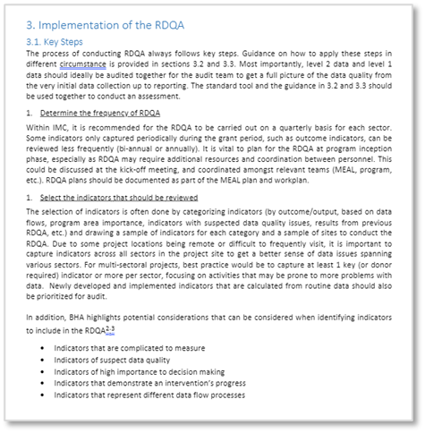
IMC Guide and Tool for RDQA
The guide is designed for staff in IMC program offices to reference when planning and implementing RDQAs. It provides step-by-step instructions and a tool to systematically assess and score data quality.
Contents
•Objectives and key concepts in RDQA
•Levels of data assessed
•Types of data quality issues
•Key steps to implementing RDQA
•Scoring approach
•Ethical considerations
•Recommended tool

Slide 8
Development and Roll-Out
RDQA Guide and Tool took around two years to fully develop and were completed in May 2023.
Development process was led by IMC’s M&E Unit in HQ, with input from Technical Unit advisors on sector-specific data considerations.
Complexities regarding “Level 1” data (individual patient/client records) needed to be worked through in developing the guide.
Rolled out to country teams through two orientation webinars in June and July 2023.

Slide 9
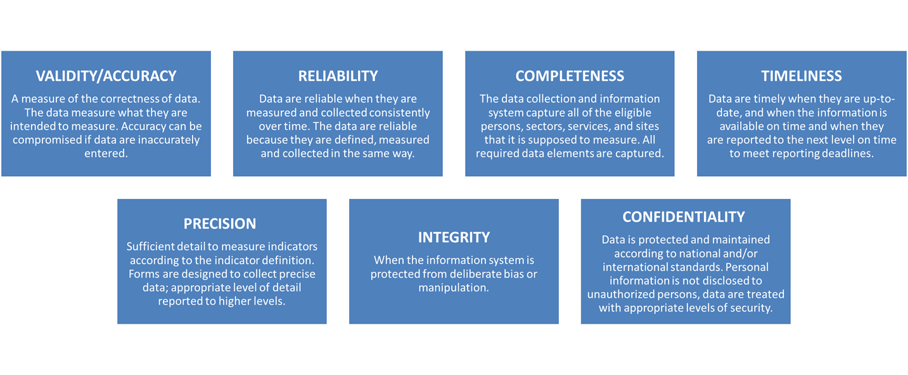
Data quality criteria assessed

Slide 10
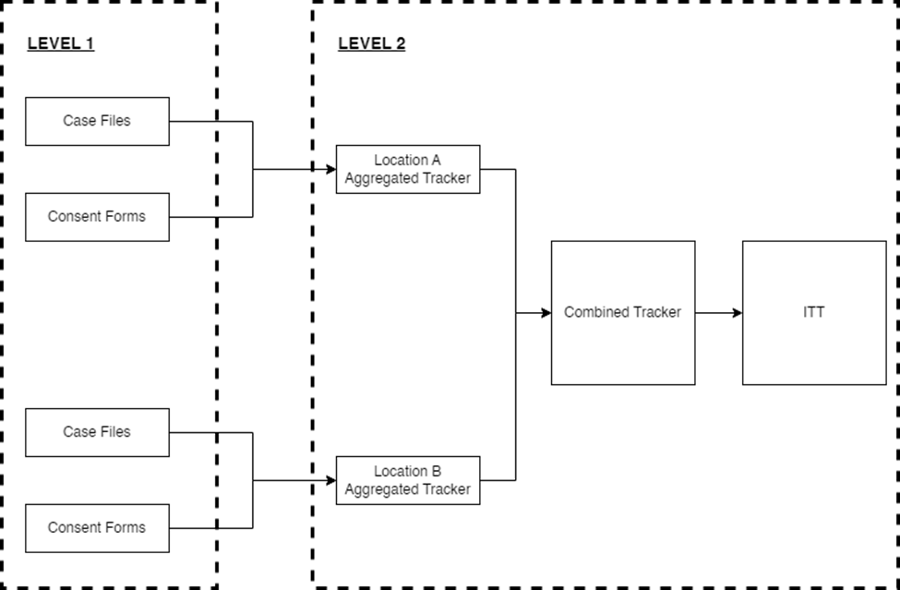
Common Data Flow

Slide 11
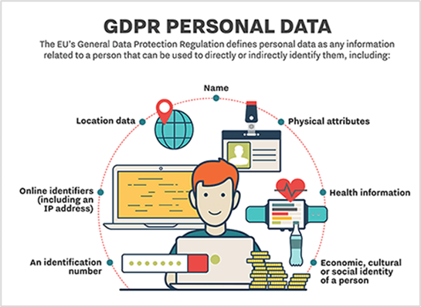
Levels of data & areas of focus
Level 1: Individual beneficiary records
Level 2: Aggregated data
Reviewing beneficiary records to ensure that all pertinent data have been correctly recorded.
With health services, for example, checking the front sheet or online patient records to ensure that the patient’s presenting problems, diagnosis and treatment have been recorded and are supported by documentation in the body of the medical record.
Reviewing data collection and management systems to ensure alignment of recorded data and reporting tools.
Aggregated data should match the disaggregated data in facilities, project sites, record keeping books, etc.
Note: For reporting, IMC aggregates all records of activity into the IPTT as a single data source for each grant. However, each mission may also employ several intermediary level 2 data tools (typically Excel “tracker” spreadsheets, DHIS2 in some cases) before data reaches the IPTT.

Slide 12
Implementation of the RDQA and key steps
Step 1 – Determine Frequency of RDQA
Step 2 – Select indicators for the RDQA
The selection of indicators is often done by categorizing indicators (by outcome/output, based on data flows, program area importance, indicators with suspected data quality issues, etc.) and drawing a sample of indicators for each category and a sample of sites to conduct the DQA.
BHA highlights potential considerations that can be taken into account when identifying indicators to include in the RDQA:
Indicators that are complicated to measure
Indicators of suspect data quality
Indicators of high importance to decision making
Indicators that demonstrate an intervention’s progress
Indicators that represent different data flow processes
Step 3 & 4 - Identify data sources for selected indicators & Timeframe

Slide 13
Implementation of the RDQA and key steps
Step 5 – Determine sample size
Review reported numbers from a quarterly or semi-annual report with IPTT and then with aggregated data to ensure data is the same across all the sources.
The team can select a few sites where they are realistically able to check both level 2 and level 1 data. The team can select a handful of sites and review numbers as a ‘spot check’.
The technical staff in the audit team can also check the quality of measurements and recording in hard copy files at the field sites to get an impression of overall data quality issues that may be plaguing other locations not part of the audit.

Slide 14
Implementation of the RDQA and key steps
Step 6 & 7 – Determine appropriate staff responsibilities for checks & Inform team of visit
Step 8 - Conduct the review (site visit and document review) using the appropriate tools and checklists

Slide 15
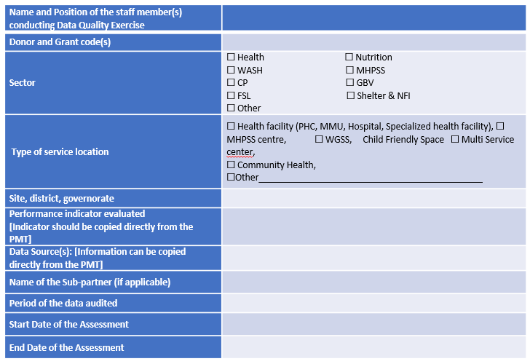
Snapshot of the tool

Slide 16
Ratings
This is the typical rating scale for points. So if you mark something ‘excellent’ in the tool, it would give 3 points for that sub-section.

Slide 17
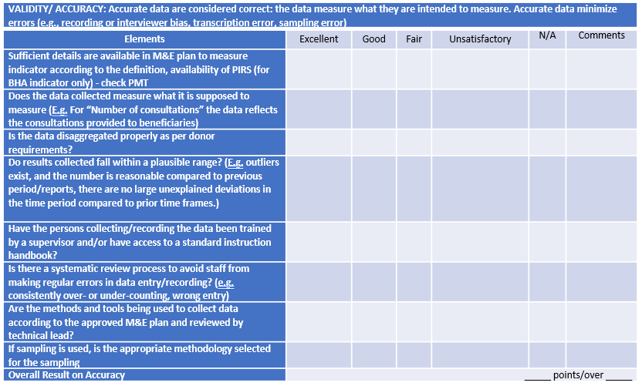
Validity items

Slide 18
Implementation of the RDQA and key steps
Step 9 – Data entry & Analysis
Step 10 – Draft report (Optional)
Step 11 – Discuss findings
Step 12 – Develop a tracking plan for remedial action

Slide 19
Country Case Example of RDQA:
LEBANON

Slide 20
Background
We initiated the DQA to ensure the reliability of our data, particularly the BHA KPIs.
The aim was to identify areas for improvement, strengthen our data reporting processes, and optimize our program outcomes based on reliable data.
We decided to start with the BHA KPIs related to health consultations.

Slide 21
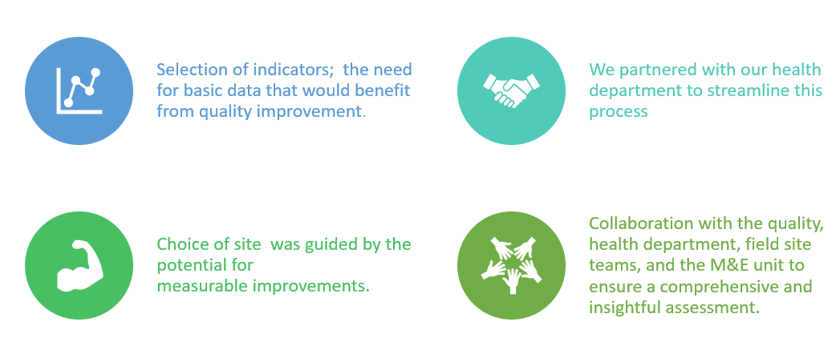
Background Cont.

Slide 22
Site Selection
The PHCC handles an average volume of patients and plays a crucial role in NCD consultations.
The PHCC is easily accessible for the assessment team and ensured smooth logistics and timely data collection.
The PHCC demonstrated a willingness to participate in the assessment and collaborate with our team.

Slide 23
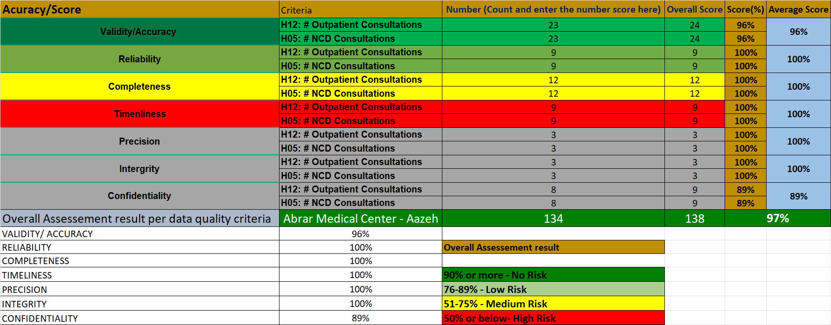
Findings
Demonstrating the strength of our current practices in maintaining good data quality.
Identification of a robust system for regular data quality assurance review.
Findings were both communicated to relevant staff and are being tracked for improvements.
This includes the development of a data cleaning Standard Operating Procedure (SOP) to further enhance our data quality.

Slide 24
Lessons Learned
The significance of teamwork and cross-departmental collaboration in driving data quality improvements.
The DQA process has reinforced our commitment to ongoing learning and quality improvement.
The importance of having dedicated data quality assurance staff who review data on a regular basis.
The efficiency of our monitoring tools
We also learned the benefits of starting with basic indicators and applying lessons learned to improve more complex KPIs.

Slide 25
Jennifer Majer jlmajer@internationalmedicalcorps.org Omar Makki omakki@internationalmedicalcorps.org
Q&A
For further questions:

Slide 26
DQA for Feedback Complaints and Response Mechanism in Moldova
Catholic Relief Services (CRS)
Wilson Gu, MEAL Technical Advisor

Slide 27
Project Details
Cash distribution project led by UNHCR started in March 2022
At the highest, 115,000+ approximate individuals benefited from cash distribution
CRS, Caritas Moldova, Diaconia are jointly implementing partners
Provide staff at enrollment centers services related to cash distribution – registration, verification, card distribution, and troubleshooting
Also operated helpline - 12 operators

Slide 28
Indicator: % feedback responded to in timely manner
Notes:
Project indicator that the DQA focused on

Slide 29
Standard | Definition
Validity | Are the data appropriately categorized/is feedback sufficiently captured/do beneficiaries have adequate access to give feedback?
Notes:
Adapted normal DQA questions to FCRM and timely response to feedback indicator.
Validity normally “the extent to which a measure actually represents what we intend to measure,” but for FCRM, we need to make sure we’re actually getting all the feedback that there is. It’s a static channel; we’re not getting data. So accessibility, knowledge of it, and trust are tied into validity of an indicator and its data.

Slide 30
Standard | Definition
Validity | Are the data appropriately categorized/is feedback sufficiently captured/do beneficiaries have adequate access to give feedback?
Reliability | Are data collection processes and analysis methods consistent over time?

Slide 31
Standard | Definition
Validity | Are the data appropriately categorized/is feedback sufficiently captured/do beneficiaries have adequate access to give feedback?
Reliability | Are data collection processes and analysis methods consistent over time?
Timeliness | Are feedbacks responded to in a sufficiently timely fashion/Is the data analyzed and used for decision making in a timely fashion?

Slide 32
Standard | Definition
Validity | Are the data appropriately categorized/is feedback sufficiently captured/do beneficiaries have adequate access to give feedback?
Reliability | Are data collection processes and analysis methods consistent over time?
Timeliness | Are feedbacks responded to in a sufficiently timely fashion/Is the data analyzed and used for decision making in a timely fashion?
Precision | Do the data have a sufficient level of detail to permit management decision-making?
Notes:
Adequate disaggregation.

Slide 33
Standard | Definition
Validity | Are the data appropriately categorized/is feedback sufficiently captured/do beneficiaries have adequate access to give feedback?
Reliability | Are data collection processes and analysis methods consistent over time?
Timeliness | Are feedbacks responded to in a sufficiently timely fashion/Is the data analyzed and used for decision making in a timely fashion?
Precision | Do the data have a sufficient level of detail to permit management decision-making?
Integrity | Do data collected have safeguards to minimize the risk of data entry error, data manipulation, and exposure of sensitive information?

Slide 34
FCRM standard operating procedures (SOPs) make it easier to assess data quality.
Notes:
Check instructions, categorizations, standardized FAQs, for operators. Invest in an SOP, not only clearer instructions but makes DQAs easier, more straightforward, clearer whether it happens or not. Of course, SOP doesn’t solve everything.

Slide 35
In-person monitoring of operators’ actions for a DQA can generate insights.
Notes:
Weekly check-ins to review feedback. Go to helpline room and see how they respond to calls. Led to observation that operators were not reading standardized messages and recommendation to improve the SOP by providing paper copies of standardized responses for easier access.

Slide 36
CommCare and a Power BI dashboard make it easier to assess data quality.
Notes:
Documented and standardized data analysis methods, analysis of timeliness in responding to feedback, regularly and automatically updated. Improve data quality, but it was easy and clear to answer many DQA questions. Invest in good data management system makes better data quality and easier to check data quality.

Slide 37
Identify opportunities for triangulation prior to assessing data quality.
Notes:
UNHCR PDM with helpline questions (to all cash recipients) and internal helpline satisfaction survey. PDM survey helped determine whether helpline is accessible, whether people knew about it. Internal survey helped corroborate objective figure of % of feedback responded to within 14 days (definition of indicator) that was taken from the dashboard.

Slide 38
SOP
In-person
Power BI

Slide 39
Wilson Gu wilson.gu@crs.org
Q&A
For further questions:

Slide 40
Questions? Contact HuMEL Management at humelmanagement@gmail.com
Thank you!

