Slide 1
QualME: Qualitative Toolkit for Monitoring and Evaluation
An online workshop | June 8, 2023
Notes:
CARE

Slide 2
QualME Peer Community
Qualitative​
Monitoring &​
Evaluation​
Community meetings every quarter
Hosted by implementers
Stay tuned for upcoming QualME events:
September 2023, info to come!

Slide 3
Best Practices
Activate your video when you are speaking, if possible.
Mute your microphone when you are not speaking.
Please raise your hand if you’d like to speak out loud.
Use the chat box if you have any questions or comments!

Slide 4
Hilary Cook, PhD Monitoring & Evaluation Advisor
Acting Team Lead USAID / Bureau for Humanitarian Assistance (BHA)
Opening Remarks…

Slide 5
QualME Workshop Objectives
Introduce the IDEAL Qualitative Toolkit: Qualitative Methods for Monitoring Food Security Activities Funded by the USAID Bureau for Humanitarian Assistance
Group application: Using the Qualitative Inquiry Planning Sheet (QuIPS)
Connect with QualME colleagues

Slide 6
Welcome and introductions
Opening remarks - USAID Bureau for Humanitarian Assistance
What’s in the Toolkit: An overview
Breakout groups: Designing a QuIPS and peer feedback
Closing and evaluation

Slide 7
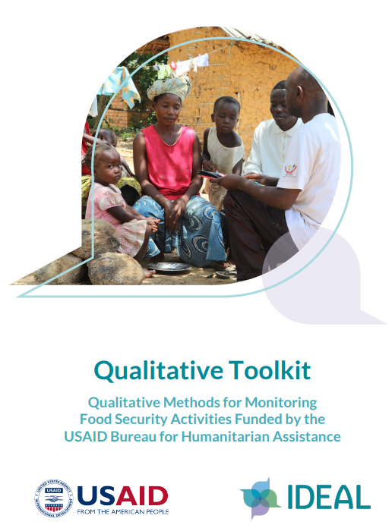
Why Qualitative?
Understand the how and why of:
intervention success or challenges
unexpected outcomes
variation across and within communities
Explore underlying dynamics and processes
Investigate sensitive and complex issues
E.g.: gender equity, environmental resource management, conflict and displacement dynamics, psychosocial attributes, resilience capacities
Monitor and inform program implementation
Contextualize and interpret quantitative findings
Notes:
Implementing partners and donors rely on
evidence collected through robust qualitative and quantitative methods to monitor and evaluate
emergency and food security activities—for documentation, learning, decision-making, and adaptive
management. While quantitative data allow for the measurement and tracking of a range of indicators,
they cannot tell the whole story.
Qualitative data are critical to contextualize and explain quantitative findings, to provide key insights into
less quantifiable aspects of activity interventions, and to ensure we are asking the right questions in our
quantitative work. Qualitative methods are crucial for the development of context-appropriate
quantitative indicators and to conduct meaningful, formative research that informs appropriate and
effective intervention design. Importantly, qualitative approaches help reveal why an intervention does or
does not work, how, and for whom. By engaging activity participants, qualitative methods of inquiry can
also help ensure Accountability to Affected Populations (AAP).
In USAID/BHA-supported emergency and non-emergency activities, qualitative data can be used to:
• Capture meaningful and varied perspectives of activity participants and stakeholders to inform
decision-making, improve programming, and inform adaptive management;
• Explore issues in conflict-sensitive programming, disaster risk reduction (DRR), climate adaptation,
and resilience trajectories;
• Monitor implementation processes such as behavior change sessions, food and non-food items
distribution, and training events;
• Explore changes in the protection environment and whether women and girls feel safe/secure;
• Identify regions with high rates of food insecurity and causes of high levels of mal- and
undernutrition;
• Study local responses to the effects of climate change shocks on agriculture and other livelihood
strategies;
• Explore recent patterns of water scarcity and availability of potable water, particularly how it
affects human health and hygiene;
• Assess progress towards activity objectives and explore underlying dynamics that contribute to
outputs and outcomes and add meaning to statistical findings and patterns derived from
quantitative surveys;
• Identify synergies across interventions and inform context-specific strategies to sequence, layer,
and integrate within and across emergency and non-emergency activities and identify linkages with
other activities and investments beyond an activity’s immediate implementation area;
• Explore unintended consequences or unexpected outcomes that might be overlooked in routine
quantitative monitoring; and
• Complement quantitative data in providing participant explanations to phenomena/results we are
not yet sure of the cause or effect.

Slide 8
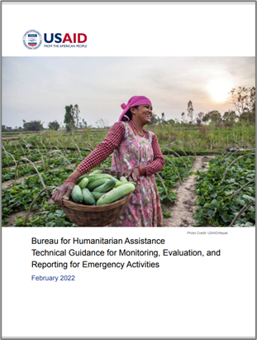
Using the Qualitative Toolkit
Complements BHA M&E guidance for RFSAs and Emergency Activities: the “what”
Provides general guidance to design and conduct rigorous qualitative inquiry: the “how”
Supports integration of qualitative methods in a comprehensive M&E system
Assessment and activity design, monitoring, Baseline / Endline studies, evaluations
Notes:
BHA integrated support for Qual Data collection into RFSA M&E after feedback from the implementing partner community. Felt that we have a lot of indicator and reporting requirements but that these have limited utility for adaptive management and gaining meaningful insights into program successes and especially challenges. Not success stories, but research.
Added Qual M&E into the BHA RFSA M&E Policy and Guidance to encourage it and support rigor.

Slide 9
Using the Qualitative Toolkit
Thoughtful, systematic design!
The Toolkit uses the USAID/BHA Qualitative Inquiry Planning Sheet (QuIPS) as a roadmap to guide the design of qualitative studies and communicate each step of the process.
Throughout the Toolkit there are core questions to consider at each step of the design process.
Each step also includes application questions or exercises to help you design your study and complete the QuIPS.
Companion Workbook in MS Word provides activities and templates, including the QuIPS, to help design your own qualitative inquiry.
Link to toolkit and workbook

Slide 10
What’s Inside: Steps in Qualitative Inquiry
Step 1: Draft Ideas - where would you use qualitative data?
Step 2: Define the Purpose, Objectives and Inquiry Questions
Step 3: Describe the Design and Methodology
Data source and methods
Sampling strategy and selection criteria
Data collection tools
Implementation plan
Frequency and timing
Training requirements
Data recording, data management, and quality assurance
Step 4: Data Analysis Plan
Disaggregating data
Deliverables and application
Step 5: Anticipate Limitations, Risks, and Ethical Review
Notes:
The QuIPS is similar to a qualitative inquiry protocol. The protocol documents all the steps the team will undertake to carry out a study or monitoring activity. The QuIPS distills the main components of a protocol and is sufficient to communicate the primary objectives, design, analysis, and intended use of a planned qualitative inquiry.
QuIPS Four Sections:
Section 1: Purpose, Objective, Research Qs and Data type
Section 2: Design and Methodology
Section 3: Data Analysis Plan, Deliverables, and Application of the Findings
Section 4: Limitations and Risks, Ethical Review, & Implementation Timeline

Slide 11
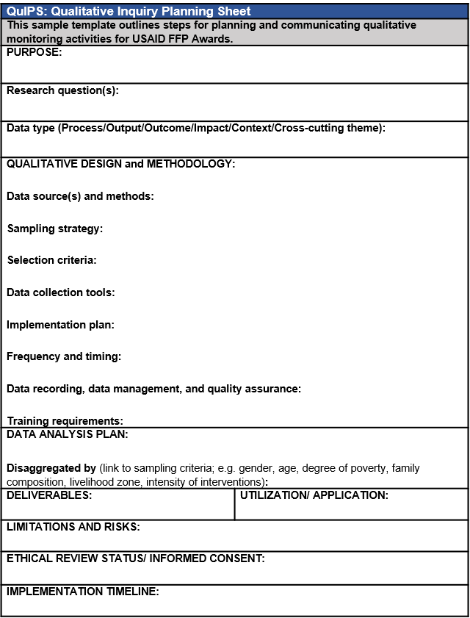
Qualitative Inquiry Planning Sheet (QuIPS)
A planning and communications tool to guide a systematic (non-linear) process.
A planning sheet should be developed for any qualitative data collection
Outlines minimum standards for qualitative data collection
Notes:
The QuIPS is similar to a qualitative inquiry protocol. The protocol documents all the steps the team will undertake to carry out a study or monitoring activity. The QuIPS distills the main components of a protocol and is sufficient to communicate the primary objectives, design, analysis, and intended use of a planned qualitative inquiry.
QuIPS Four Sections:
Section 1: Purpose, Objective, Research Qs and Data type
Section 2: Design and Methodology
Section 3: Data Analysis Plan, Deliverables, and Application of the Findings
Section 4: Limitations and Risks, Ethical Review, & Implementation Timeline

Slide 12
Qualitative Toolkit: Annexes
Annex 1: QuIPS Template
Annex 2: Qualitative Resource List
Annex 3: Selection of Qualitative Methods and Tools
KIIs, FGDs, Multi-criteria analysis, Case study, Life history, Venn diagram, Seasonal calendar, Community map, Wealth ranking
Annex 4: Sample Topical Outline Questions
Annex 5: Qualitative Data Entry Matrix Templates
Annex 6: Daily Debrief Template
Annex 7: Sample Data Analysis Matrices
Companion workbook
Notes:
The toolkit also contains a number of useful annexes that describe certain methods in more detail, provides templates and examples, and links to additional resources.

Slide 13
Let’s take a look inside…

Slide 14
Step 1: Draft Ideas
Articulate initial ideas about how qualitative inquiry could contribute to your Activity.
What do you want to know?
How would qualitative inquiry provide critical insights?
Which colleagues will you want to consult with as you design your qualitative inquiry?
Why is this question important to the activity?
What evidence gap does the inquiry fill?
Notes:
Robust qualitative work begins with a solid design, starting with clear and relevant questions and includes the sampling strategy, data collection, analysis, and use of the findings
Consider existing data sources;
Routine quantitative monitoring data
Annual survey quantitative data
Post-distribution Monitoring (PDM)
Rapid Feedback Monitoring System (RFMS) data
Implementation quality monitoring by an Activity and USAID

Slide 15
Step 2: Define the Purpose, Objectives, and Inquiry Questions
What will you study, why, and how?
The purpose is a broad statement that summarizes the goal of your qualitative work and establishes a foundation to carry it out.
The objectives specify your intended outcomes.
The research or inquiry questions are high-level summary questions that guide the overall inquiry.
Data type defines the type of data collected in relation to the Theory of Change, expected results (e.g., output, outcome).
Notes:
Robust qualitative design is guided by a set of core questions and intentional selection of methods and tools to ensure the validity and reliability of the inquiry. This begins with the purpose and research questions
The purpose and objectives should also clearly describe how the information being collected will inform programming or decision-making.
The RQs deserve a slide of their own: This is not the list of questions for an interview or focus group; rather, it is the set of summary questions that guide the overall inquiry and serve as the basis for developing interview questions.
Ensure the validity and reliability of the study:
Do the objectives align with the described purpose?
Are there any gaps between the purpose and the inquiry questions? If so, what are they and what additional questions should be added?
Given the stated purpose and objectives, can the goals be met by the questions?
Does the data type(s) align with the purpose and objectives?
Do the purpose and objectives suggest additional data types not currently documented?

Slide 16
To monitor or study?
Through routine qualitative monitoring (QM), collect data at consistent intervals that activity staff need on a regular basis
Process monitoring (behavior change sessions, demonstration plots)
Outcome monitoring (women’s empowerment).
A qualitative study (QS) is a discrete study to better understand dynamics or phenomena related to higher-level results or outcomes.
Provide explanations for patterns in quantitative data
Inform specific approaches or strategies.
Notes:
Clarify QS v QM, as these terms are somewhat specific to BHA programming.
The Toolkit uses the term “qualitative inquiry” to align with the USAID/BHA technical guidance. The guidance encourages two types of qualitative inquiry to better integrate qualitative work into an M&E System: routine Qualitative Monitoring (QM) and a stand-alone Qualitative Study (QS). Indicate on the QuIPS whether you are doing QM, which involves an iterative process of ongoing qualitative inquiry over the course of an activity, or a QS, which is conducted as a discrete study during a particular phase of the activity, e.g., baseline, midterm, or endline evaluations.

Slide 17
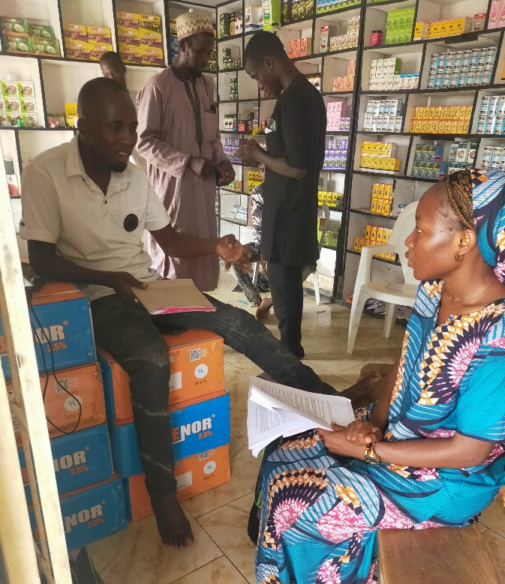
What makes a good research question?
Qualitative study questions focus on why and how
High-level and limited in number
Focused on a specific issue
Researchable/ knowable
Build on what you already know
Implicit knowledge from experience, data
Will produce actionable information
Realistic, able to do within reasonable time, practical
Timely and appropriate for activity cycle
Photo credit: Binomial Optimus Ltd., 2023
Notes:
Qualitative inquiry study questions focus on why and how, rather than the more quantitative aspects of what and how much.
Good qualitative research questions often start with:
How does…
Why do…
Under what conditions does…

Slide 18
Workshop Research Questions
Sample Research Questions: Gender Group
What is the nature of the shocks and stresses communities experienced in the last 6 months?
What are the gender-differentiated impacts of shocks? How do men and women experience shocks differently?
How do program interventions influence gender equality and women’s empowerment (GEWE)?
How have maternal and child health and nutrition practices changed in the last 6 months?
To what extent are improved health behaviors being adopted by households? What are barriers or facilitators to uptake of improved health behaviors?

Slide 19
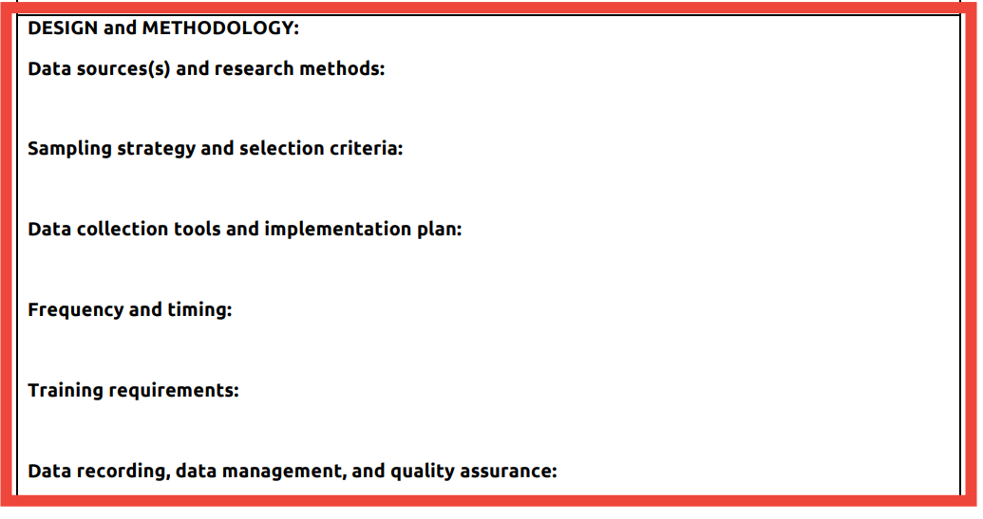
Step 3: Describe the Design and Methodology
Inquiry methods
Describe how you will conduct the inquiry.
How and when data will be collected to provide critical insights related to the inquiry objectives?
Which methodologies are best suited to the inquiry questions, i.e., which method(s) will be used to address each of the study questions?
Who is providing the data and what is their relationship to the activity (e.g., female farmers)?
Notes:
This next section of the QuIPS has more steps moving into the study design and may require more thought and discussion among your team than Step 2. Your design and methodology are driven by your inquiry questions, objectives, and data needs.
Consider, for example:
How and when data will be collected to provide critical insights related to the inquiry objectives?
Frequency and timing
When is information needed?
To inform Theory of Change?
For redesign?
Anticipate seasonal activities and events (e.g., harvest, rainy season, holidays, elections, etc.).
Which methodologies are best suited to the inquiry questions, i.e., which method(s) will be used to address each of the study questions?
Who is providing the data and what is their relationship to the activity (e.g., female farmers)?

Slide 20
Step 3: Describe the Design and Methodology
Data sources and methods
Interview-based
Key informant interviews
Focus groups
Case studies
Interactive/participatory
Seasonal calendars
Card sorting / grouping
Wealth ranking
Observation
Community Mapping
Proportional Piling
The most important instrument in
qualitative research is you.
Notes:
Data collection tools
Interview tools, such as for KIIs and FGDs, typically involve a topical outline, which is a list of questions or points of interest used to help focus the conversation on relevant topics.
Tools are are adapted for rich discussions with specific focus groups or individuals.
Important to note this is a limited list of examples (so limited!) -- reference the Annex 3 to the Toolkit.
Examples of qualitative interview methods include focus group discussions (FGDs), key informant interviews (KIIs), case studies, and multi-criteria analysis (MCA). More participatory/interactive methods include seasonal calendars, community mapping, and wealth ranking, among others. The section on “Data Collection Tools” below and the supplemental guidance in Annex 3, “A Selection of Qualitative Methods and Tools” provide more detailed information on various methods that may be used to collect qualitative data. Keep in mind, the choice for a particular method will depend on the purpose and objectives of the inquiry, defined in Step 2, as well as factors such as timing and resources.

Slide 21
Step 3: Describe the Design and Methodology
Sampling strategy in QuIPs
Does the sampling strategy capture the necessary range of variability to adequately address the inquiry questions?
Have you clearly defined the sampling criteria?
Will the sampling strategy enable robust analysis of the categories of interest?
Notes:
Sampling: Critical and often overlooked component in qualitative studies.
The sampling strategy defines the characteristics of individual or household-level respondents you plan to include in the qualitative inquiry.
For qualitative studies, sampling is critical. It typically involves deliberate selection of participants to ensure collection of thorough, detailed information that helps explain the phenomenon of interest. Validity in qualitative inquiry is reached by uncovering the worldview and experience of a range of diverse respondents. Thus, the goal is not to reflect the whole population (as is often true in quantitative studies), but to represent the varied views of the population.
Purposive sampling involves identifying one or more specific, predefined group(s) that the inquiry seeks to understand. Purposive sampling techniques include snowball and quota sampling: snowball sampling begins with selection of one or more individuals who are expected to have useful insight into the study questions, and then the participant refers the interviewers to similar individuals or groups who are subsequently contacted for an interview.
Quota sampling attempts to reflect the overall characteristics of the community being studied. It begins with estimations of various strata or cohorts within the community (e.g., male/female, youth, elderly, ethnic groups, wealthy, poor). Participants for qualitative research are then selected in a manner that approximates these same characteristics.
Does the sampling strategy capture the necessary range of variability to adequately address the inquiry questions? Have you clearly defined the sampling criteria? Will the sampling strategy enable robust analysis of the categories of interest?

Slide 22
Sampling Selection Criteria
Photo by Pablo Merchan-Montes on Unsplash
Define the target population: community/village/area
Identify selection criteria for the sample
Determine the sample size
Select the targeted number of sampling units
Saturation: how much is enough?
Notes:
Describe your selection criteria as part of your sampling strategy. The selection criteria identify the unit(s) of interest–an individual, household, group or cluster, or some other predefined entity.--and ensure adequate depth and coverage across all levels of analysis.
There is no formula for determining sample size. Rather, the team members establish a set of criteria that specifically addresses the questions and captures a desirable (and feasible) range of variation across the operating context.

Slide 23
Training Requirements
A critical component for qualitative inquiry
The researcher is a dynamic decision maker
Team with diverse experience, skills, perspectives
Allow adequate time to digest research questions, test and refine the tools, practice data entry and data management system
Photo credit: Binomial Optimus Ltd., 2023
Photo by Surface on Unsplash
Notes:
Allocate adequate time for team members to thoroughly understand the inquiry questions, selection criteria, tools, and data collection processes.
Plan 3-5 days for qualitative team training, depending on the experience of the inquiry team and time needed for an effective pilot test.
Minimum skill sets for qualitative team members: Qualitative teams should be gender-balanced, multidisciplinary, and may include a mix of both international consultants and national consultants or local researchers with knowledge of the technical and geographic areas. At a minimum, team members should demonstrate:
The ability to establish rapport with respondents and ensure that the interview is a positive, respectful, and mutually beneficial exchange.
Inquisitiveness, active listening skills, and the inclination to ask probing questions.
Group facilitation skills, since information will likely be collected in part through focus groups or other group activities. This involves the ability to manage dominant personalities, encourage participation from all group members, and a keen sense of timing and ability to facilitate flow of the discussion.
The ability to make quick decisions to facilitate a dynamic and focused interview or discussion. Since the topical outline is a guide for an inquiry activity, not a questionnaire, the team must be able to quickly tailor the outline to draw out the expertise of the respondent(s) and adjust the flow of inquiry to maximize data collection.
Analytical skills and the ability to apply contextual and operational knowledge.
Language and cultural competency skills appropriate for the specific study sites.

Slide 24
Data Entry, Data Management and DQA
A day for data collection = a day for data entry!
Use of recording devices as back up – take good notes.
Must have a clear system for data entry, file naming, review, data storage/backup, anonymization and communication.
Notes:
Common threats to data quality and credibility:
Incomplete or ambiguous inquiry definitions
Inadequately trained team members
Poorly constructed or poorly worded data collection tools
Poor sampling strategy
Inquiry team or respondent fatigue
Rushed data collection
Inadequate time for data entry
Extended recall period
Poor/incomplete field notes
Rushed analysis
Distrust among team and respondents
Lack of attention to implicit bias
Inappropriate extrapolation or attribution

Slide 25
Step 4: Data Analysis Plan
What methods will you use to analyze the data? E.g., software assisted, manual matrix approach? See QualME Data Analysis Tools meeting
Specify how you will disaggregate the data for analysis (geographic area, livelihood zone, intensity levels of activity intervention, gender, wealth group, age, etc.).
Integrate the various levels of disaggregation throughout the research, into the sampling strategy, selection criteria, tools and analysis.
Include a plan for sharing the findings and deliverables, including with participants, communities, and other relevant stakeholders, and identify the best format.
Notes:
Software assisted approach: e.g., Atlas-TI, NVivo.
Good for longitudinal studies, social network analysis, data management, coding by themes.
Consider time required to transcribe and code, and active engagement of research analyst (not automated).
Manual matrix approach: Uses Word/Excel to organize and synthesize data according to established themes.
Timely, user-friendly, facilitates iterative data analysis across categories of interest.
Must ensure consistent and coherent data recording tools and secure archiving.
Qualitative information may be transferred manually into spreadsheet matrices or entered into qualitative software, then analyzed to identify patterns in responses.
Some benefits of using a qualitative data matrix for analysis are that it:
Ensures that qualitative teams are consistently collecting and recording findings but does not require transcription from recordings;
Encourages concise recording of detailed data according to important themes;
For both methods, it is imperative that the analysts have a deep knowledge and understanding of the data set. In other words, the researcher carries out the analysis, not the software.
Facilitates iterative preliminary data analysis during team debrief sessions to identify patterns, information gaps, and key lines of inquiry;
Allows timely comparison of qualitative data among men, women, children, and among different geographic locations or other disaggregations/categories;
Enables consistent analysis of qualitative data from multiple groups;
Helps team members identify unanticipated findings (during manual review and synthesis of matrices); and
Does not require purchasing software or special training in software applications.
In your QuIPS, you will need to specify how you will disaggregate the data for analysis. For example, will the analysis be disaggregated by geographic area, livelihood zone, intensity levels of activity intervention? By gender? By wealth group? By age? By sex?

Slide 26
Step 5. Anticipate Limitations, Risks, and Ethical Review
Limitations of the study: Logistic constraints, access (e.g., security/ seasonality, timing, age/gender constraints), language/ ethnic/ religious diversity
Risks: Consider potential risks to study participants and make appropriate accommodations
Protection of people comes first! What are the required approvals (e.g., IRB)?
Notes:
Above all, a qualitative inquiry should “do no harm” for study participants and others involved in each step of the process. For all studies, it is important to anticipate the limitations and risks that may affect your interactions with study participants (and ultimately inquiry outcomes), as well as how you will minimize them.
Limitations and risks may include internal and external factors, such as timing, staff capacity, weather, or an uncertain security context, etc.

Slide 27
Karyn Fox, PhD Senior Research Advisor TANGO International kfox@tangointernational.com Robin Al-haddad Monitoring, Evaluation, and Research Specialist TANGO International robina@tangointernational.com
For questions on the toolkit, contact:
Hilary H. Cook, PhD Monitoring & Evaluation Advisor, and Acting Team Lead, M&E Team USAID/ Bureau for Humanitarian Assistance hcook@usaid.gov Nancy Peek Senior Monitoring & Evaluation Advisor USAID/ Bureau for Humanitarian Assistance npeek@usaid.gov

Slide 28
Small Group Discussions:
VSLAs: Groups 1 and 4
WASH: Groups 2 and 5
Gender: Groups 3 and 6

Slide 29
Instructions for Small Groups
Each team fills in only one QuIPS template.
Each team has assigned facilitator who gives some guidance and discussion Qs to consider.
Each team assigns note taker to fill in QuIPS (Google doc).
Working groups will remain in breakout rooms the entire 70 mins
QuIPS Section 1: Purpose, Objective, Research Qs (This section is prefilled). Review.
QuIPS Section 2: Design and Methods (60 mins)
Peer Review Feedback: (10 mins)
Return to plenary session.

Slide 30
M&E Qualitative Inquiry E-course
Sign up to beta test IDEAL’s M&E Qualitative Inquiry E-course here: https://forms.gle/vJi6EKfPQdQioRQu8

Slide 31
QualME Event Survey
Please complete our short event evaluation survey here: https://ideal.events/qualme

Slide 32
Questions?
Contact Robin Al-haddad at robina@tangointernational.com
Thank you!

