Slide 1
QualME: Qualitative Methods and Tools for Process Monitoring
March 29, 2023 | 9:00-10:30 AM ET

Slide 2
Best Practices
Activate your video when you are speaking, if possible.
Mute your microphone when you are not speaking.
During Q&A, raise your hand if you’d like to speak out loud.
Use the chat box if you have any questions or comments!

Slide 3
QualME Peer Community
Qualitative​
Monitoring &​
Evaluation​
Community meetings every quarter
Hosted by implementers
Stay tuned for upcoming QualME events:
June 2023, info to come!
Notes:
SAPLING was a $31M six-year, USAID-funded Resilience Food and Security Assistance activity that just ended in December. Because SAPLING was being implemented in the Chittagong Hill Tracts, a new area for BHA, it was a pilot project. Therefore, we spent a considerable amount of time learning about the context and our population and practicing adaptive management as we reflected, learned, and adjusted.
SAPLING was implemented in Bandarban District in the upazilas of Bandarban Sadar, Lama, Ruma, Thanchi, and Rowangchari. We were in 24 Unions, 2 Municipalities and 1,609 Paras with 44,175 poor and extreme poor households. Perhaps the most exciting and challenging part of SAPLING, besides the extreme topography and remoteness of some of our paras, was that we worked with 10 ethnic groups. They are Bengali, Marma, Mro, Tripura, Tanchangya, Chakma, Bawm, Kheyang, Lusai, and Khumi.

Slide 4
Welcome & Introductions
Using Participatory Action Research (PAR) methods (15 min)
Using Qualitative Monitoring Module (QMM) tools (15 min)
Small Group Discussions (30 min)
Report-out (10 min)
Wrap up

Slide 5
QualME Online Learning Discussion
PARTICIPATORY ACTION RESEARCH (PAR) AND PHOTOVOICE
March 29, 2023
Amina Ferati, i-APS President

Slide 6
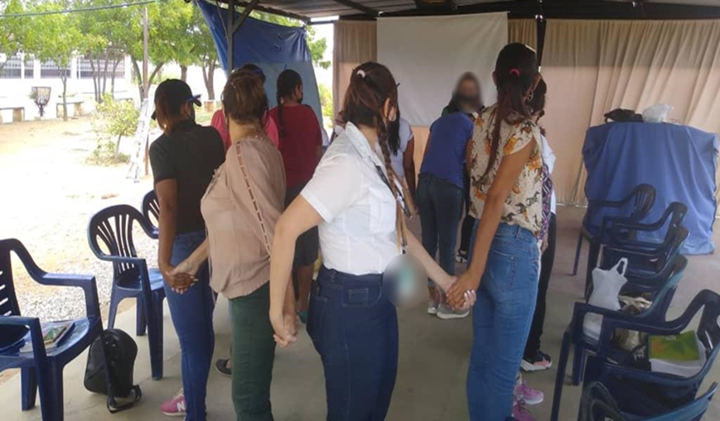
Note of Appreciation
i-APS designed this PhotoVoice pilot with the cooperation of i-APS and Venezuela (VZ-APS) staff members and implementing partners in both Venezuela and Syria.
We thank the implementing partners and the women participants of the programs for their invaluable support.
Note that given the highly sensitive operating contexts of both Venezuela and Syria, we have kept all names anonymous, and all photos have been deidentified.

Slide 7
Participatory Action Research (PAR)
Differs from traditional research which is more extractive
Key elements
research, action and reflection cycle
direct involvement of the people whom research is being done with (not on!)
Works with people or communities rather than merely studying them
Grounds data and action in “community realities, needs and expertise.”
Shifts power in the research process to those who are most affected – the people and communities are a partner in the research
Notes:
Participatory Action Research (PAR) is not new, it has been around since the 1940s and can include both qualitative and quantitative approaches. PAR is a type of approach to research, rather than a method itself. PhotoVoice is one such form of PAR.
PAR is “grounded in lived experience, developed in partnership, addresses significant problems, works with (rather than simply studies) people, develops new ways of seeing/interpreting the world (i.e. theory), and leaves infrastructure in its wake.” (Hilary Bradbury and Peter Reason, “Action Research: An Opportunity for Revitalizing Research Purpose and Practices,” Qualitative Social Work 2, no. 2 (June 2003): 155–75, https://doi.org/10.1177/1473325003002002003.)
In other words, PAR is a context-specific research method that involves community members in research processes to ground data and action in “community realities, needs, and expertise.” This translates into reflection, collective action, and collaboration between researcher and participant to understand and improve upon practices. (Linda Liebenberg, “Thinking Critically about PhotoVoice,” International Journal of Qualitative Methods 17, no. 1 (February 21, 2018): 160940691875763, https://doi.org/10.1177/1609406918757631.)

Slide 8
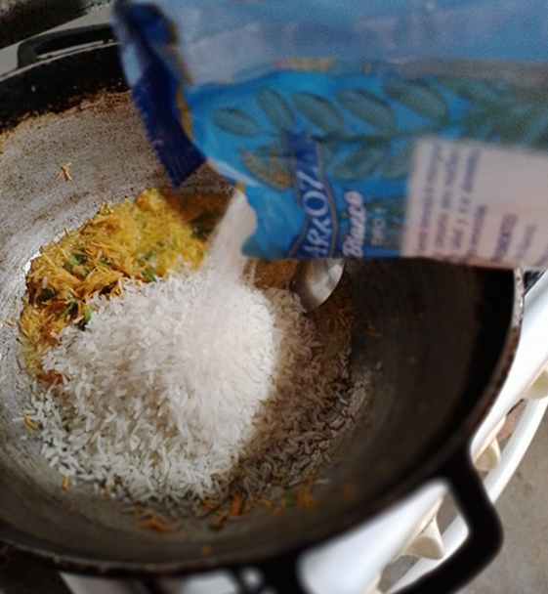
PhotoVoice as a form of PAR
Visual and participatory action methodology
Uses photographs to convey a message , stimulate a discussion and spark change.
Participants take photos about what is important to them and through discussion, present their “voice”
Notes:
PhotoVoice was established as a visual and participatory action methodology in the 1990s to promote creative expression and social change. Described by its creators as “a process by which people can identify, represent, and enhance their community through a specific photographic technique,” it is a qualitative community-based participatory approach that aims to document the reality of marginalized populations. Caroline Wang and Mary Ann Burris, “PhotoVoice: Concept, Methodology, and Use for Participatory Needs Assessment,” Health Education & Behavior 24, no. 3 (1997): 369–87, https://doi.org/10.1177/109019819702400309.
In PhotoVoice, photographs essentially serve as a prompt to stimulate discussion, develop critical thinking, and encourage listening to peers while at the same time bridging the gap between community and decision-makers.

Slide 9
Why PhotoVoice?
Qualitative approach that centers the perspectives of participants (or beneficiaries of a program, such as USAID food security)
Pilot PhotoVoice as a monitoring and evaluation tool in complex settings to demonstrate the methodology is feasible
Identify if PhotoVoice can support empowerment of women and engagement of participants (or beneficiaries)
Improve the assistance that is provided

Slide 10
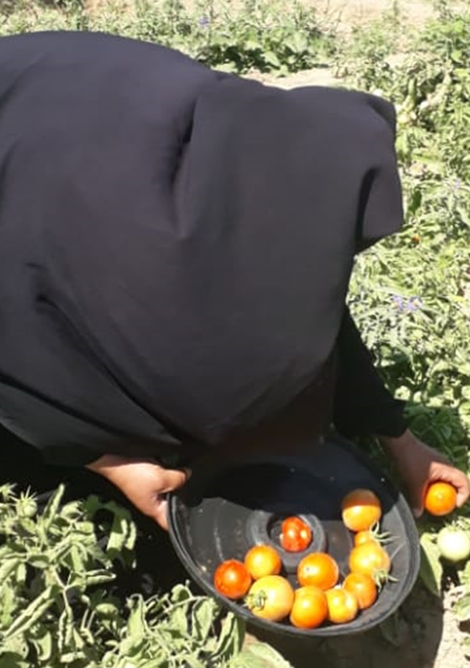
PhotoVoice Methodology
1
Select locations for conducting PhotoVoice in and implementing partner (IP) organizations to work with
Explain PhotoVoice purpose to IP. Conduct discussions with IP to explain purpose, roles and responsibilities. Establish memorandum of agreement (MOU) as an outcome that will guide engagement between researchers and the IP.
Conduct risk assessment of location and operating conditions
Notes:
i-APS developed and adapted the PhotoVoice methodology to the two locations selected for the pilot (Syria and Venezuela) after conducting a detailed desk review of existing literature on application of PhotoVoice in other contexts and reviewing the key steps of the methodology. To implement this pilot, i-APS determined it would work
with about 30 women participants in each country, divided between 2-3 locations. The methodology was developed by researchers and country-national teams to ensure that the approach was contextualized for the specific operating conditions and safety and security requirements.

Slide 11
PhotoVoice Methodology
2
Recruit and train local facilitators and develop context-specific training materials for both the facilitators and PhotoVoice participants
Modify PhotoVoice methodology to fit language and cultural context
Select facilitators who understand and come from the community where Participants are from (consider age, gender, cultural identities).
Conduct detailed training(s) of facilitators in their language, including deep focus on participant-driven research, informed consent and safety and security. Trainings may span 2-3 days and include core humanitarian standards of conducting monitoring and evaluation work.
Notes:
i-APS developed and adapted the PhotoVoice methodology to the two locations selected for the pilot (Syria and Venezuela) after conducting a detailed desk review of existing literature on application of PhotoVoice in other contexts and reviewing the key steps of the methodology. To implement this pilot, i-APS determined it would work
with about 30 women participants in each country, divided between 2-3 locations. The methodology was developed by researchers and country-national teams to ensure that the approach was contextualized for the specific operating conditions and safety and security requirements.

Slide 12
PhotoVoice Methodology
3
Select and train PhotoVoice participants
Determine the sampling method (such as purposeful) and the minimum conditions that will be needed for Participant of humanitarian assistance to participate in the project.
Determine mutually convenient time and location to train participants (led by the local facilitators) in their communities. Training may be done in a 1–2 days period, being mindful to not place burdens on participant’s time but giving enough time and space to fully understand the methodology.

Slide 13
PhotoVoice Methodology
4
Implement PhotoVoice
Agree on weekly or bi-weekly times to meet, discuss and share photos taken.
Agree on how to share photos amongst the group (e.g., WhatsApp channel) and key safety and security considerations.
During sharing sessions, reflect on photos taken as a group, have Participants identify common themes

Slide 14
PhotoVoice Methodology
4
Implement PhotoVoice (cont’d)
Continue to actively assess and mitigate risk and ensure safety and security.
Participants and Facilitators jointly discuss and agree on with whom to share the photos with and how (e.g., presentation with printed photos to the IP during a routine meeting)
Analyze results of PhotoVoice, including analyze and identify common themes from the photos, conduct survey with Participants to capture their feedback on the methodology and interviews with IPs to determine the degree to which they used or intend to use information generated from the methodology

Slide 15
Adapting PhotoVoice to Syria and Venezuela
Country Operating Contexts
Syria | Venezuela
Several locations where implementing partners operate are active conflict settings and have large numbers of displaced people. Disruption in routine civil society fabric is the norm. Flexibility and high awareness of safety and security are required due to active conflict. Assistance that was the subject of PhotoVoice Pilot: Food assistance: Home vegetable gardens (delivered in line with growing season). | Donor and implementing partner confidentiality remains paramount (identity of local IPs are often confidential to protect implementers and beneficiaries). Political sensitivity between U.S. government and Venezuela relations requires teams to maintain a “low profile” in their work. Crime and petty theft is a concern in some locations. Assistance that was the subject of PhotoVoice Pilot Food assistance: Food kits (delivered at routine intervals) and water, sanitation, and hygiene.
Notes:
At all times, given the complex operating conditions of these two countries, the PhotoVoice team adhered to ethical and safety protections including explaining informed consent, de-identifying photos and training participants on how to safely conduct photos. More details are available in the reports that will be published Spring 2023 on FSN network that present the results and mitigation strategies.

Slide 16
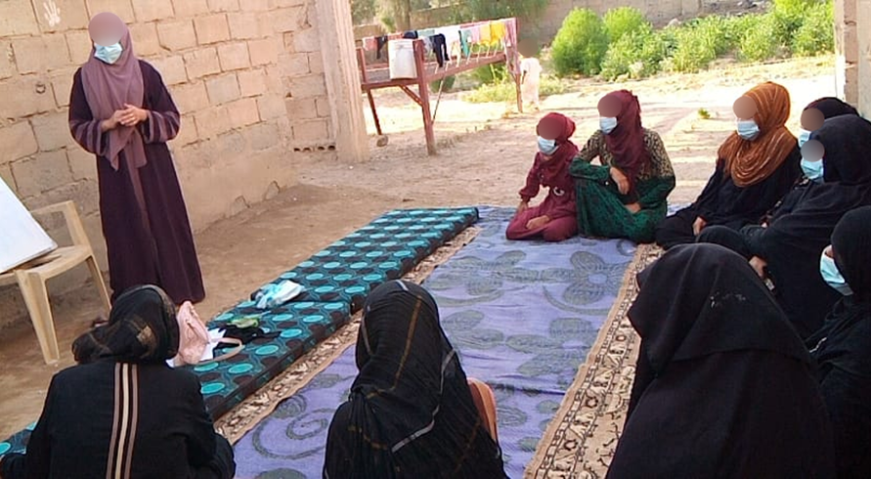
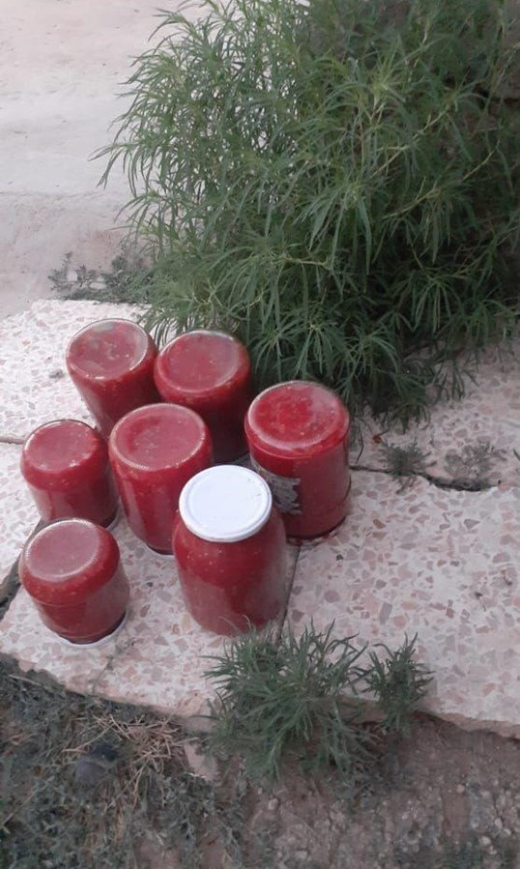
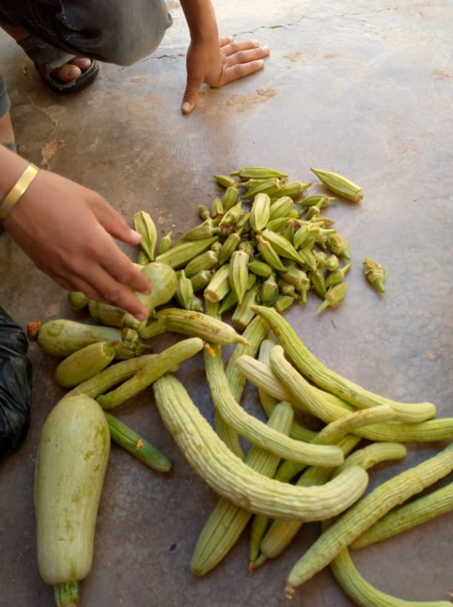
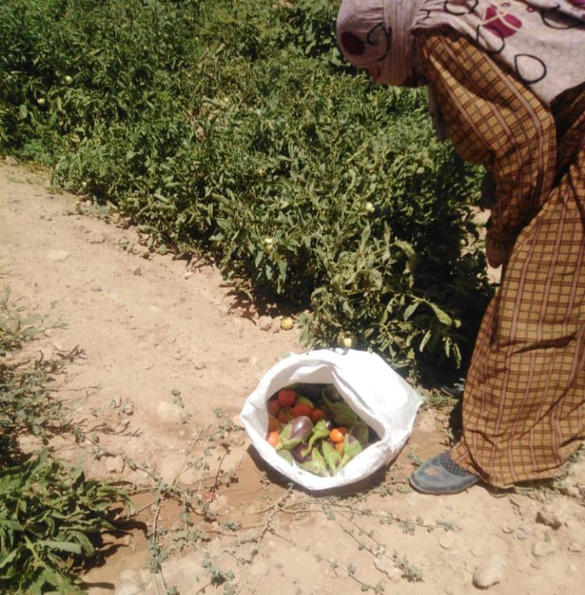
PhotoVoice in Syria
The process of storing and preserving food is a very important process, as housewives in the summer save and store vegetables to be a source of many winter meals. The picture shows the role of the rural woman in managing the affairs of the house and her interest in providing food for her family in the winter season. Rural women are the most important pillar in the operations of the home economy. What we see in the picture will be a raw material for many winter meals, and this raw material was obtained by the woman from her home garden.

Slide 17
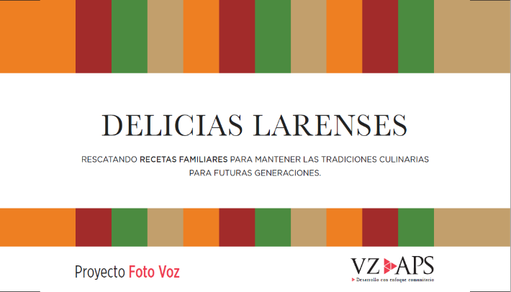
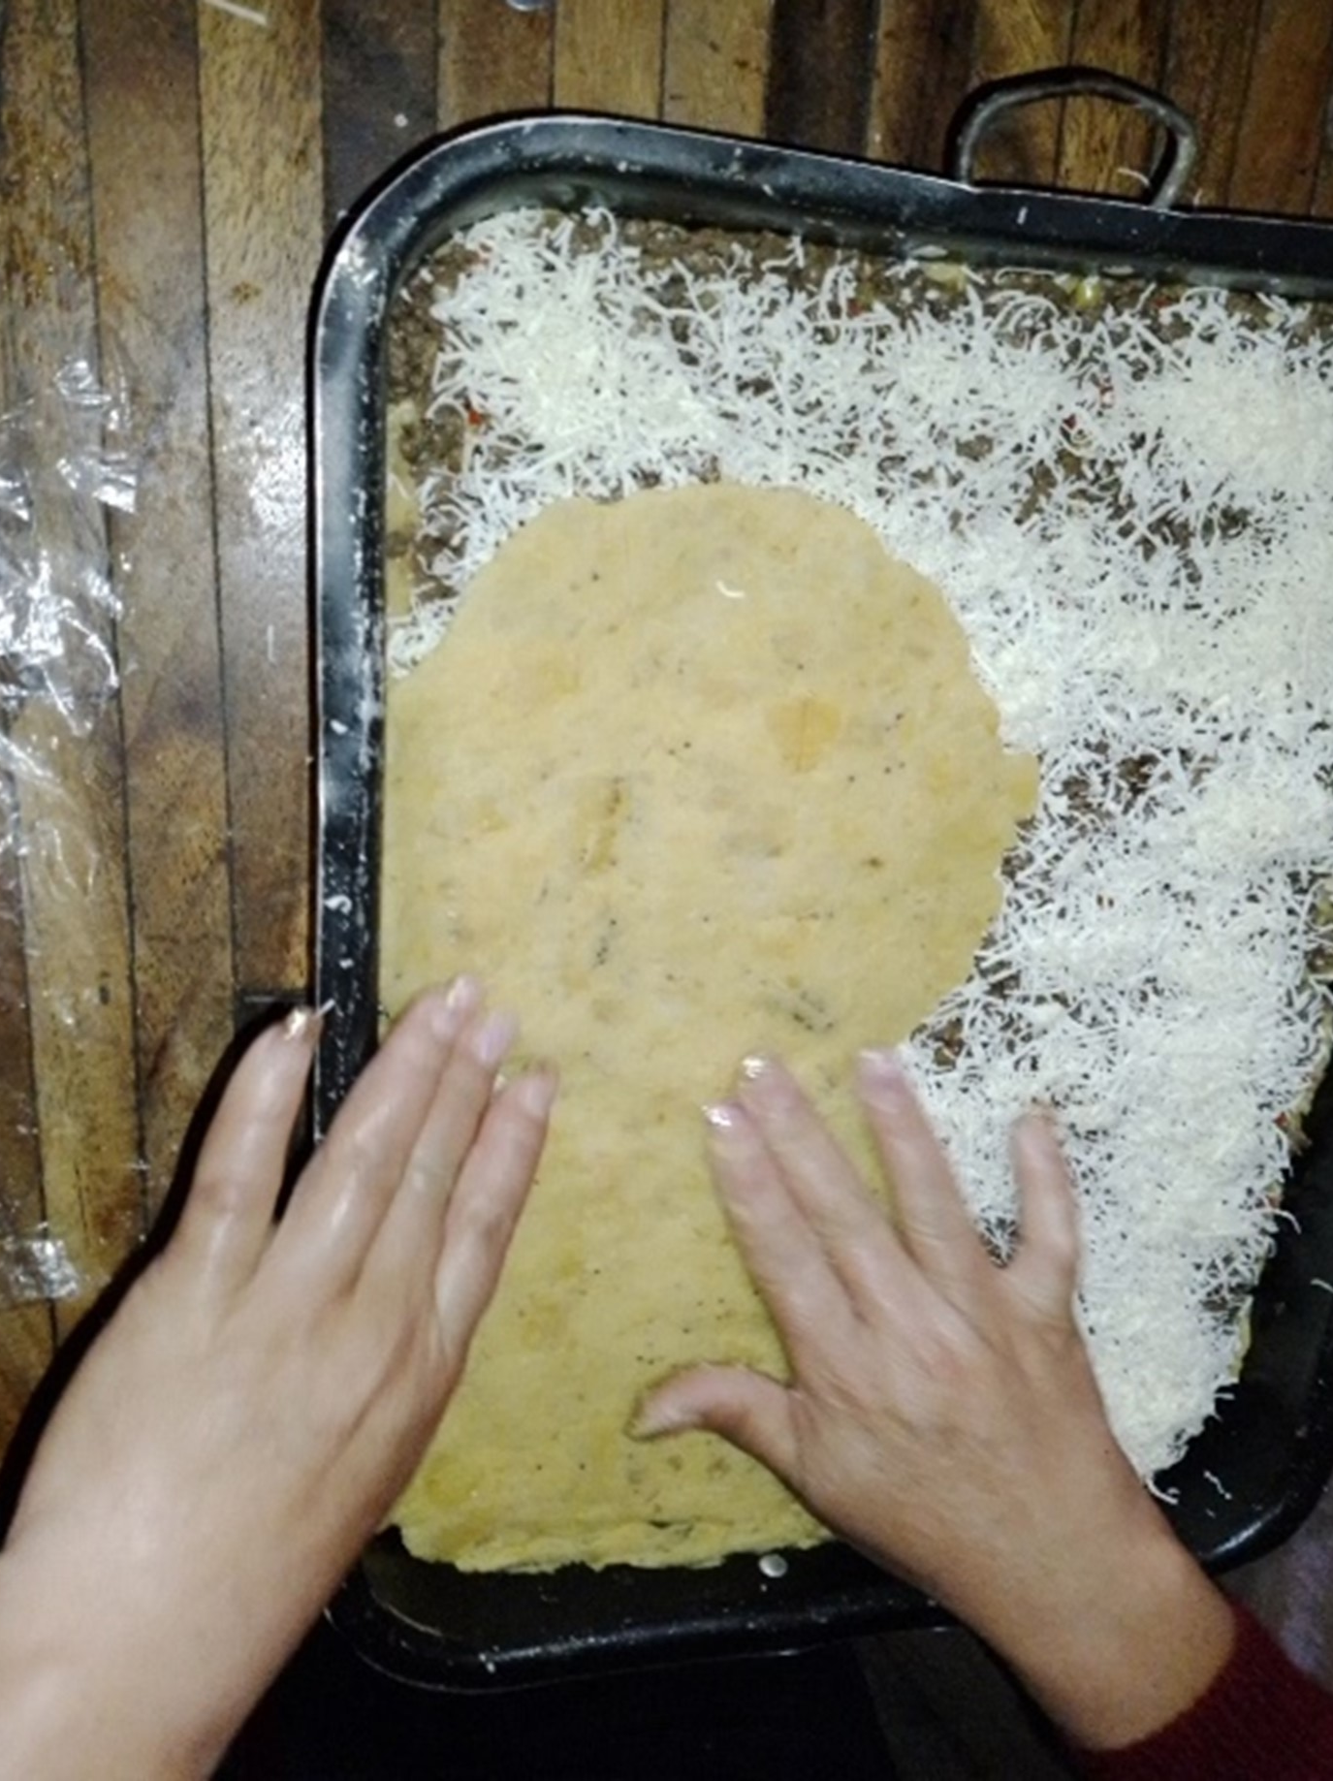
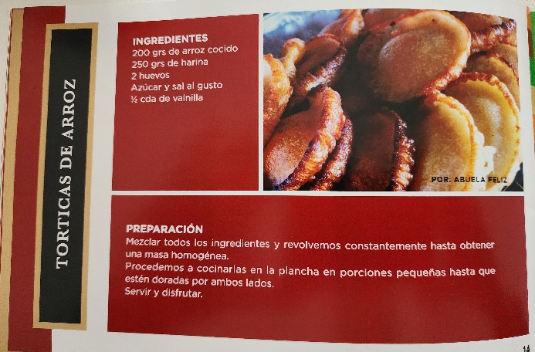
PhotoVoice in Venezuela
Creativity is key to keeping everyone in the family happy. In this case, a plantain pasticho with cheese and peas... precisely to make the peas in another way. The important thing is to find a new way of doing things

Slide 18
PhotoVoice Findings and Lessons
1
PhotoVoice is still a newer form of research and requires in-depth training.
2
Operational challenges can be mitigated in complex non-permissive settings
3
Women were empowered through their participation
4
Implementing partners play a key role
5
Method offered a creative way to share needs and feedback with decision makers
6
Key finding: The results from this pilot project indicate the process worked as both a research method and a social change initiative.

Slide 19
For more information, please contact: Amina Ferati, i-APS President
aminaferati@i-aps.com
Q&A

Slide 20
The Informal Actor and Local Governance Qualitative Monitoring Module
Sophie Turnbull & Portia Hunt (Causal Design)
March 29, 2023

Slide 21
Purpose of the Local Governance Module
Development of the Module
Piloting
Piloting Findings
Lessons and Recommendations
Guidance for future Deployment

Slide 22
Purpose: The Problem Food insecurity is a function of factors beyond project control, including community level governance and informal institutions Not always feasible to conduct full complex ethnography

Slide 23
Purpose: The Solution A cost-effective, repeatable qualitative monitoring module to probe for informal institutions & local governance dynamics Able to be integrated into quantitative surveys Produce data to fill context gaps, inform TOC, contribute to MEAL adaptations, enhance program outcomes

Slide 24
Development: Process
Development
In-depth literature & program review
Beta qualitative Module with 5 submodules
A priori codebook
2. Piloting
Field-tested in Malawi and Ethiopia
Alongside 2 surveys for food security activities
Analysis of pilot data
Enumerator feedback on process
3. Revisions and Lessons Learned
Revision of module and codebook based on piloting feedback
Assessing lessons learned for future deployment
4. Knowledge Sharing & Dissemination

Slide 25
Piloting: Data Collection
Piloted alongside 2 Causal Design-led surveys
Enumerator training
Included review of data collection objectives and processes, Module questions, translation, and comprehension
Malawi: 1 day in-person
Ethiopia: Remote training-of-trainers, followed by 1 day training by team supervisor
Country | Area | Program | Sample Size
Malawi | 4 districts in Southern Malawi | Feed the Future Agriculture Diversification Activity | 60
Ethiopia | Amhara Region | USAID Bureau for Humanitarian Assistance Resilience Food Security Activity | 50

Slide 26
Piloting: Findings
Module yielded high-level findings on local governance and informal institutions
Community members ascribe and expect different roles from informal and formal authorities
Interactions between formal and informal institutions
E.g. Interactions between NGOs and local leadership is instrumental in distribution of resources and benefits
Food/resource sharing customs exist

Slide 27
Piloting: Lessons and Recommend
CHALLENGES
RECOMMENDATIONS
Data quality (especially short responses)
Responsiveness
Sensitivity about talking about authorities and enumerator discomfort with probing
Unfamiliarity/Approachability of Module’s topics
Recording
Survey length
Technical/Logistical challenges
Further enumerator training (particularly on follow up and probes, and test interviews)
Tool modifications (approachability and length)
Field Piloting (as additional enumerator training, and inform modifications to sampling, tool, and technology)

Slide 28
Guidance for Future Deployment
Deployment timing and frequency
Scoping or regular monitoring
Intention of providing preliminary findings to guide implementation/MEAL
Follow up with more in-depth inquiry
Training
Rigorous training on qualitative methods and purposes
Test all processes
Piloting
Test all processes
Opportunity for further enumerator training
Advise revisions to tool for length, approachability and sensitivity
Recording vs Note-taking
Consider note-takings rather than recordings
May require additional enumerator training on note-taking protocols and guidance

Slide 29
For more information, please contact: sophie.Turnbull@causaldesign.com portia.hunt@causaldesign.com
Q&A

Slide 30
Small Group Discussions

Slide 31
Small Group Discussions
Groups 1 and 3: How have local governance & informal institutions affected development programming/outcomes?
Groups 2 and 4: Given what you have heard about photovoice as a form of participant-led research, do you see this as being of interest in piloting the methodology in your research or as an implementing partner? What adaptations do you think you would have to make to use photovoice?

Slide 32
Questions?
Contact Karyn Fox at kfox@tangointernational.com and Robin Al-haddad at robina@tangointernational.com
Thank you!

