Slide 1
Introduce yourself! Présentez-vous!
Please introduce yourself on the chat
Name
Organisation & Position
Location
Veuillez-présentez vous-même dans la boîte “Converser” (chat)!
Nom
Organisation titre d’emploi
Endroit

Slide 2
Before we begin...Avant Qu’on Commencions..
Select a language!
Click “interpretation” at the bottom of your Zoom window and select English or French.
Chacun doit choisir une langue !
Cliquez sur « interprétation » au bas de votre écran Zoom et sélectionnez anglais ou français.

Slide 3
HCDforWASH webinar
This webinar is made possible by the generous support of the American people through the United States Agency for International Development (USAID). The contents are the responsibility of the PRO-WASH Award and do not necessarily reflect the views of USAID or the United States Government.

Slide 4
AGENDA
Project Background
Methodology
Process
Findings
Tutorial
Case Study
Q&A

Slide 5
Background: Why are we here today?
In 2020, iDE piloted an HCD tool called the Sanitation Possibilities Map (SPM) with PRO-WASH and partners. Participants wanted to learn, create, and share possibilities and more importantly wanted to know HOW to execute on those possibilities.
To build on this success, there was a need for building a learning resource together with PRO-WASH.
Today is about presenting the result of the 1-year project towards building the HCDforWASH platform

Slide 6
Objective of this project
To make using Human-Centered Design (HCD) in WASH work exciting, useful, and accessible.
We created an online learning resource in English and French.
Providing on-demand access to tutorials, existing resources, videos, HCD tools and how-to guides to use HCD within a WASH project cycle.

Slide 7
Human-Centered Design is a methodology that puts people at the center of the design process to solve complex problems.
The methodology uses a variety of approaches, including qualitative research, co-designing, and rapid prototyping to develop a deep understanding of people’s needs, motivations, and behaviours.
By involving the target community throughout iterative testing phases, solutions become more sustainable and scalable.
Methodology: HCD

Slide 8
Notes:
Why is this slide here?

Slide 9
Research Methods
and Findings

Slide 10
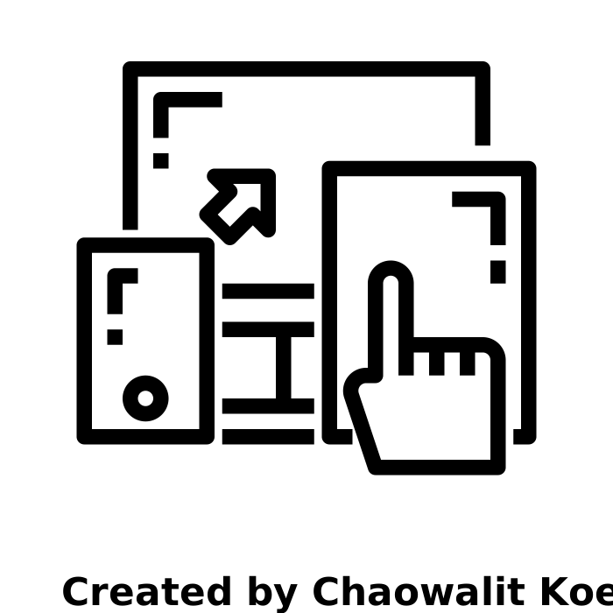
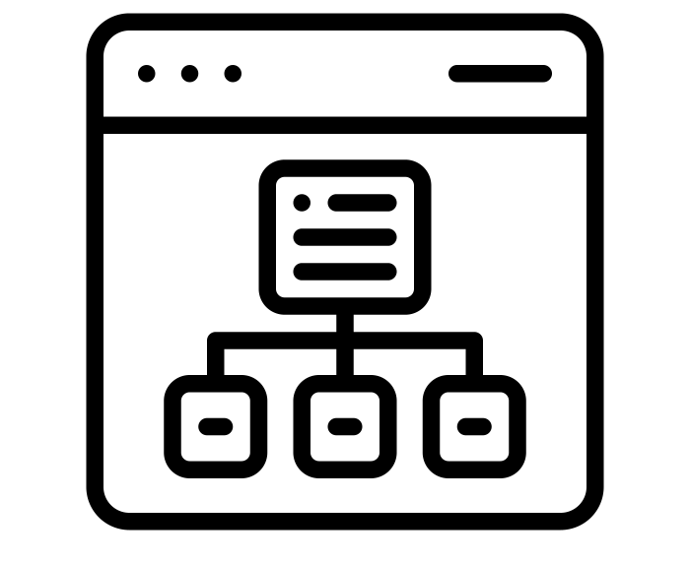
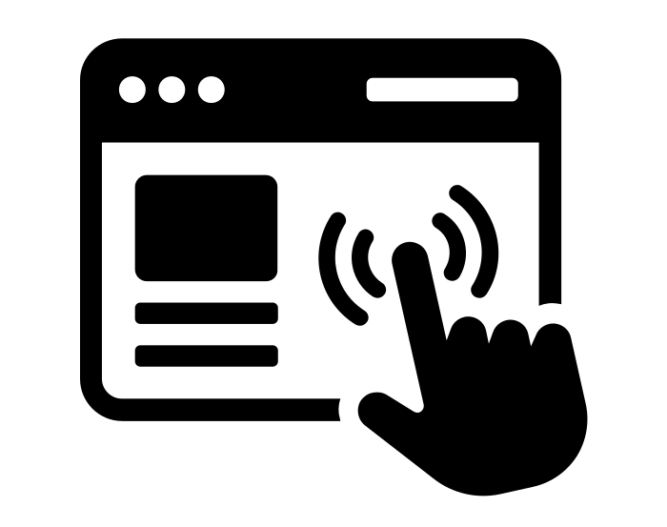
Research Methods & Tools
54
Explorative
Workshop with Key informants and Users
Experience in WASH from organisations such as USAID, PRO-WASH, FHI360, The Manoff Group, Catholic Relief Services, iDE, Helen Keller International, Save the Children, Mercy Corps, World Vision, and CARE International. From Ethiopia, Niger, Zimbabwe, Congo, Uganda, Madagascar, Burkina Faso, Cambodia, Bangladesh,the United States of America, and Ecuador.
30
In-depth User Interviews
From different WASH-related organizations from Africa and Asia, including employees from USAID, Catholic Relief Services, iDE, 100fontaines and FHI360, etc.
17
Review of
Existing Resources
From toolkits, methodologies, courses and online resources for design and human-centered design for WASH practitioners.
4
Early Testing Existing Resources
From different WASH-related organizations from Africa and Asia, including employees from USAID, Catholic Relief Services, iDE, 100fontaines and FHI360, etc.
13
UX (user experience) testing
Asked different users to organise the website based on their preferences. At the end we got a comprehensible site map as the building block to build the site.
2
Rounds of User Testing
Created wireframes to test the usability of the website. Making wayfinding more accessible to users
Notes:
Why is this slide here?

Slide 11
Key barriers to be unlocked by this digital tool
Integrating HCD in the current organisational structure
Barrier 1.1 HCD is not for WASH practitioners, HCD is for designers
Barrier 1.2 How to add existing HCD tools to a WASH program
Barrier 1.3 Structural barriers result in “business as usual” for teams on the ground
Barrier 1.4 Pressure to think just "like an engineer" limits HCD adoption in WASH teams
Barrier 1.5 Core WASH team members often miss out on the benefits of HCD
Advocating and demonstrating the value of HCD in a WASH program
Barrier 2.1 Lack of awareness of HCD
Barrier 2.2 Lack of perceived value of HCD in a WASH program
Barrier 2.3 Measuring the success of HCD in a WASH program
Recognising and embedding HCD methods in a WASH program
Barrier 3.1 Misinterpretation of what HCD looks like in practice
Barrier 3.2 Some WASH practitioners are using HCD tools without knowing
Barrier 3.3 Complicated design terminology makes many toolkits inaccessible to WASH practitioners
Barrier 3.4 Existing toolkits lack an intuitive user experience for non-designers
Barrier 3.5 Inconsistent design often makes practitioners second-guess the resource
Barrier 3.6 WASH program managers prioritize resources that can solve immediate challenges
Barrier 3.7 Useful resources are often lost across many different channels

Slide 12
Key drivers leveraged in the digital tool
Prioritizing incremental HCD adoption is the key to build confidence in WASH teams
The right mindset is the necessary element to unlock change
Highlighting how HCD tools can solve immediate challenges could drive uptake of the learning resource
Toolkits that go beyond the methodology are more engaging
Valued toolkits are concise and also provide guidance around soft-skills
Toolkits framed around a theme or organized by topics are easier to navigate
Information from well-known sources can help to build trust in the learning resource

Slide 13
HCDforWASH.org
Notes:
Why is this slide here?

Slide 14
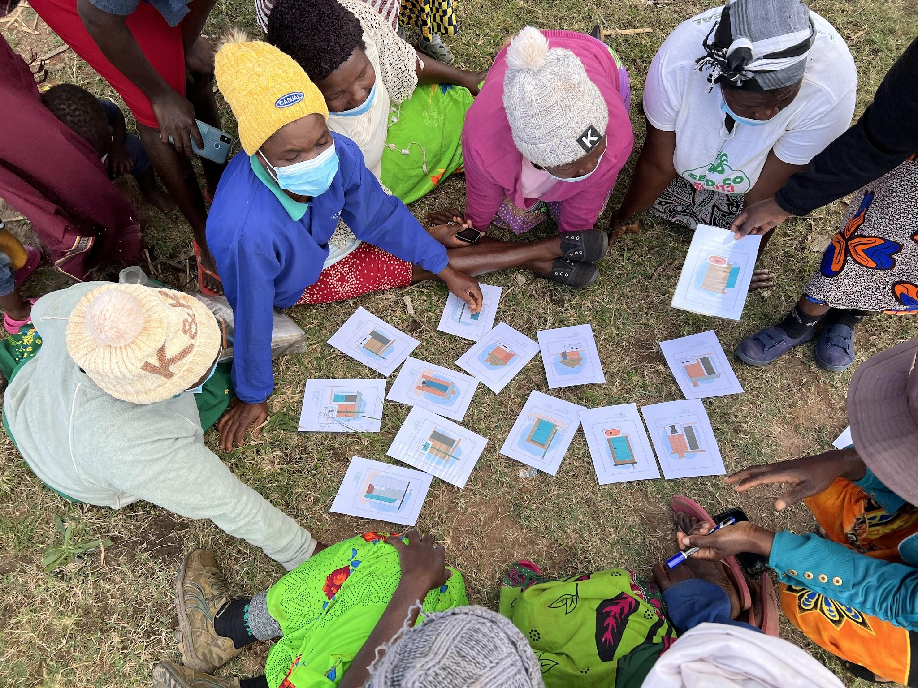
Human Centered Design Approaches for Sustainable Latrine Construction and Utilization in Takunda Target Communities
Notes:
Notes:
Font → Open Sans
Colors → PRO-WASH

Slide 15
Research Objectives
1
2
3
4
Assess preferences for different latrine designs for subsets of the Takunda target population
Assess the current presence, motivation, and capacities of local entrepreneurs
Assess potential existing financing options for households and businesses and their feasibility
Assess potential for private-sector partnerships with existing (and new) partners
Notes:
Identified in the initial Request for Proposals, this research project will be guided by four objectives:
Assess preferences for different toilet / latrine designs for sub-sets of the Takunda target population, including variations needed to adapt to local socio-economic context, geographic locations, gender, religious and social norms, and disability. An assessment of available / preferred designs / technologies should consider available materials, local capacities, environmental issues, and safely managed sanitation requirements.
Assess the current presence, motivation, and capacities of local entrepreneurs either those already trained and currently engaged in installation of improved latrines and those selling -related products, including hardware and construction materials.
Assess potential existing financing options for households and businesses and their feasibility (e.g. banks, micro-finance institutions, village savings, and loan associations (VSLAs) Takunda plans to establish and build capacity of VSLAs to save and invest money to meet various household needs. There is a genuine concern that this money may not be adequate and there is therefore a need to support the Takunda team to assess the possibility of other financing sources. This assessment will likely include consultations with the government for potential private partnerships in supporting improved sanitation in rural communities (see next point).
Assess potential for private-sector partnerships with existing partners operating in Zaka, Chivi, Buhera and Mutare districts, particularly around sanitation and hand-washing supplies and services.
RQ1 What household toilet/latrine features and designs will increase willingness to build and consistently use toilets/latrines and handwashing facilities at the household's level?
RQ2 How can toilet/latrine designs include features that are more conducive to women users, people living with disabilities, or any other family members, such children under 5, men, adolescent boys, and girls?
RQ3 What type of local entrepreneurs are available and what capacities do they have to design and construct alternative latrines that suit the needs and desires of communities? How readily available and affordable are the required materials? How might this work be a top-up to their existing businesses and how willing are they to take up the challenge?
RQ4 Is there potential for financial support for household improved sanitation construction, and, or partnership with private sector in this endeavor? What would it take to mobilize these financing options and partnerships?
RQ5 What behavioral and attitudinal issues impact the uptake of construction, continued maintenance and use of the improved latrines? How can we influence households' decision preferences towards prioritizing latrine construction using household financial resources? How can we improve willingness to re-build after latrines fall?

Slide 16
Human Centered Design
HCD is a process of rapid ethnographic research to help solve problems, which puts people at the center of the process. It is a type of Design Thinking.
HCD aims to find solutions that balance
user desirability
technical feasibility
market viability
HEAR
CREATE
DELIVER

Slide 17
HCD Guiding Question
How might we…
motivate (safe and) sustainable latrine construction and use
in Takunda target communities?
Notes:
What motivates sustainable latrine contruction and use in Takunda target areas?

Slide 18
HEAR (DISCOVER)
Phase

Slide 19
Deep Dive: 7 Villages and 2 Growth Points
The Takunda HCD team conducted “Deep Dive” research in five villages of varying sanitation coverage in Rural Mutare (1), Zaka (2) and Buhera (4). The study also explored the availability of sanitation supplies at two local growth points (Jerera and Murambinda) which supplied six of the villages.
Deep Dive research aims to for depth with a smaller sample, rather than breadth with a larger sample size. This allows the research to remain open to new lines of inquiry and to follow emergent stories.

Slide 20
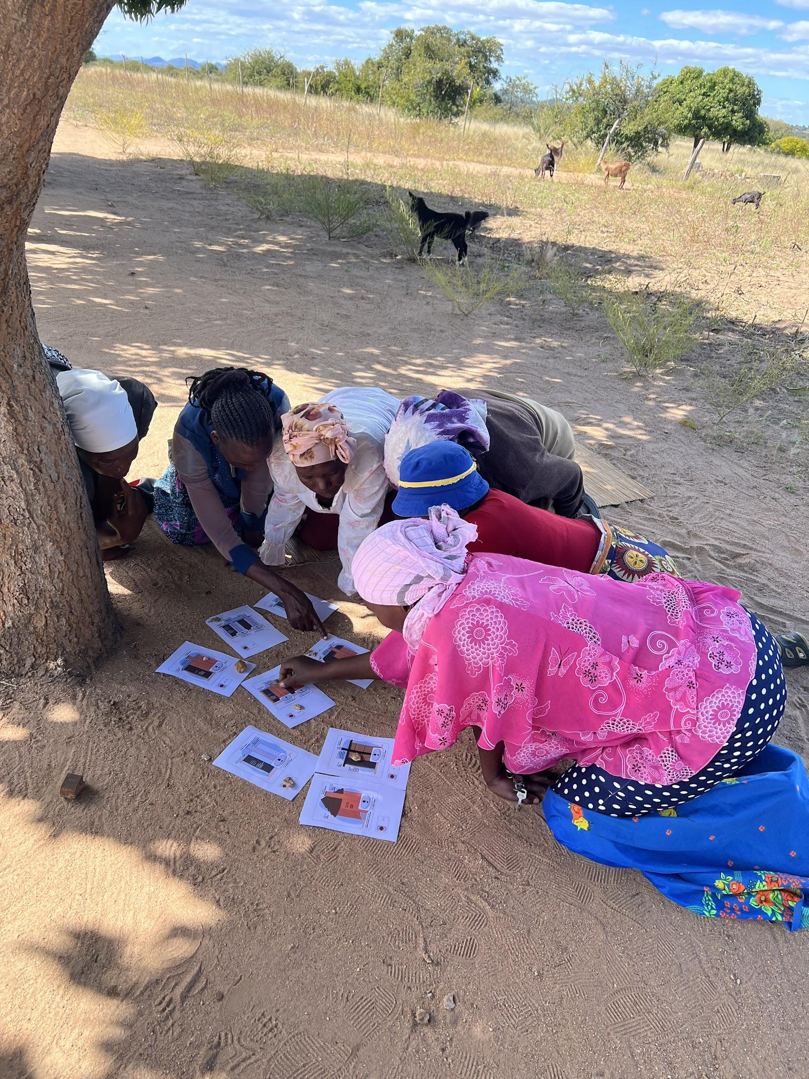
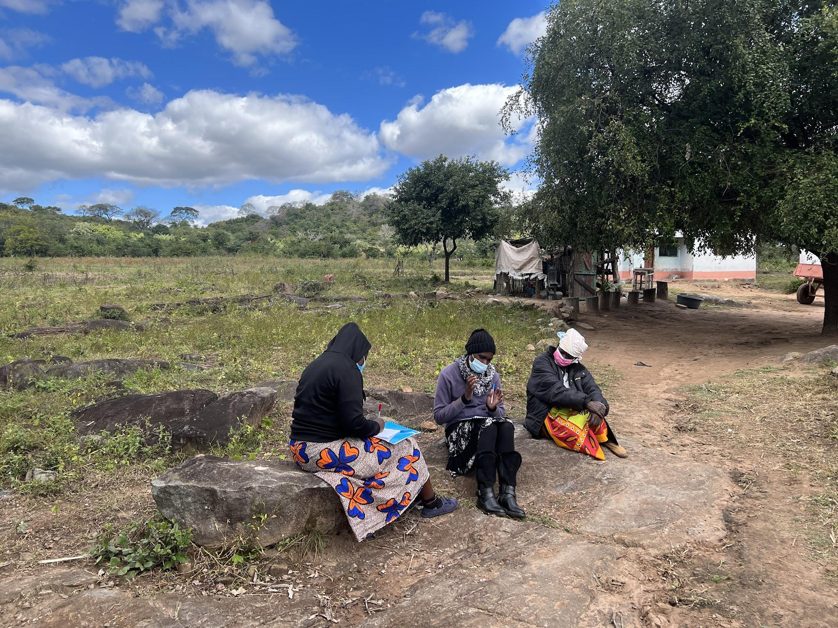
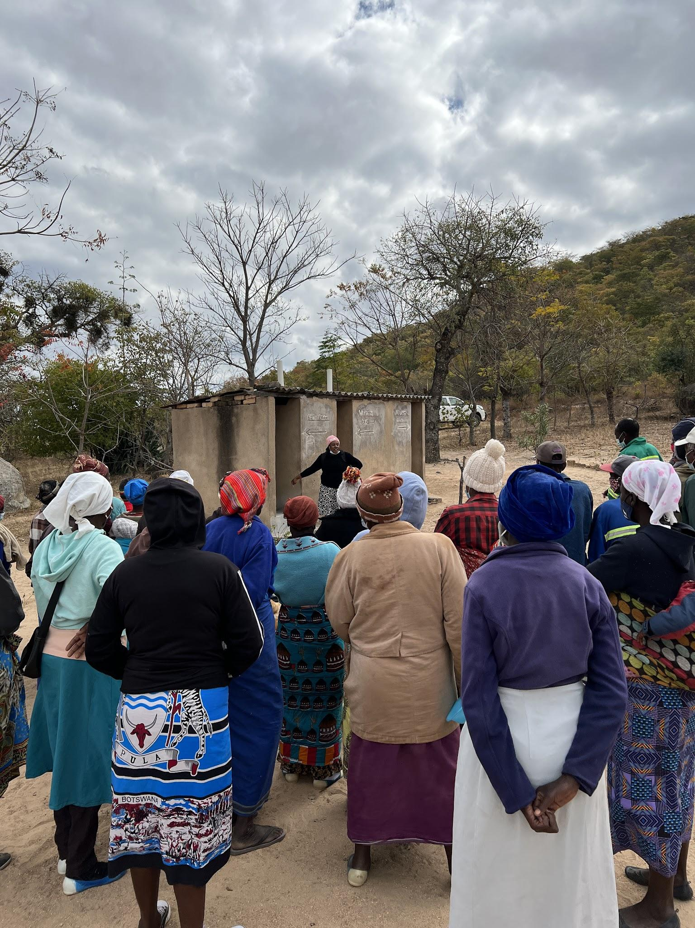
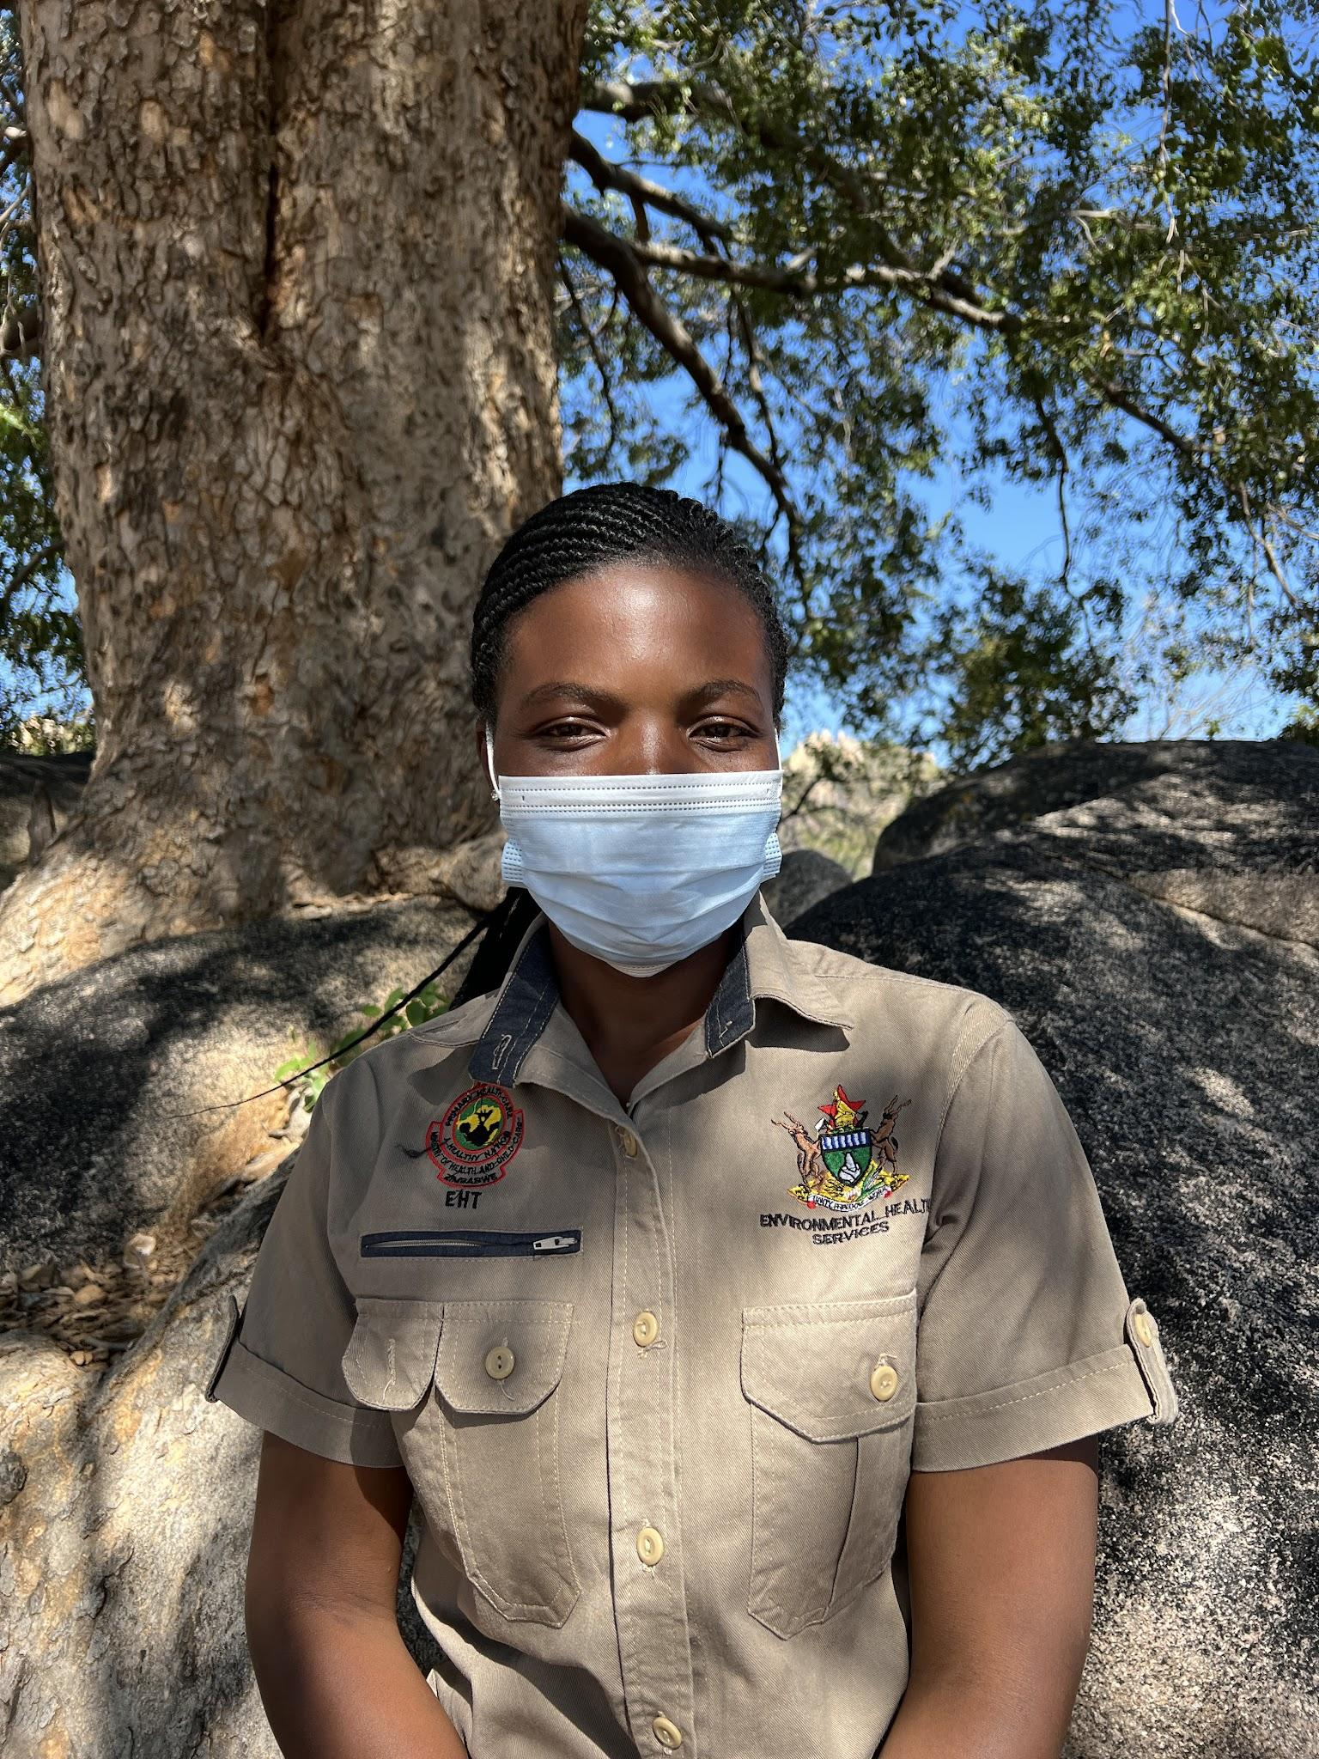
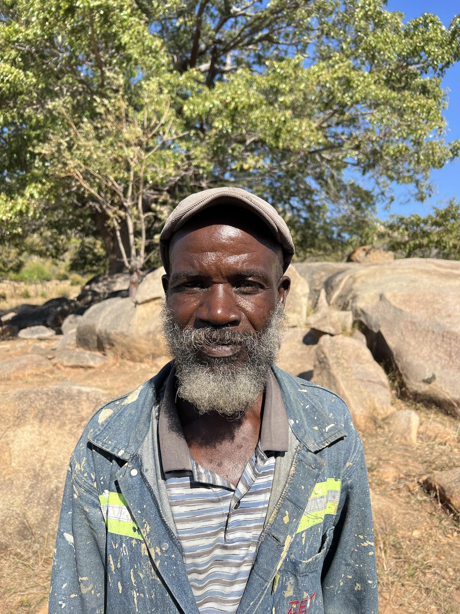
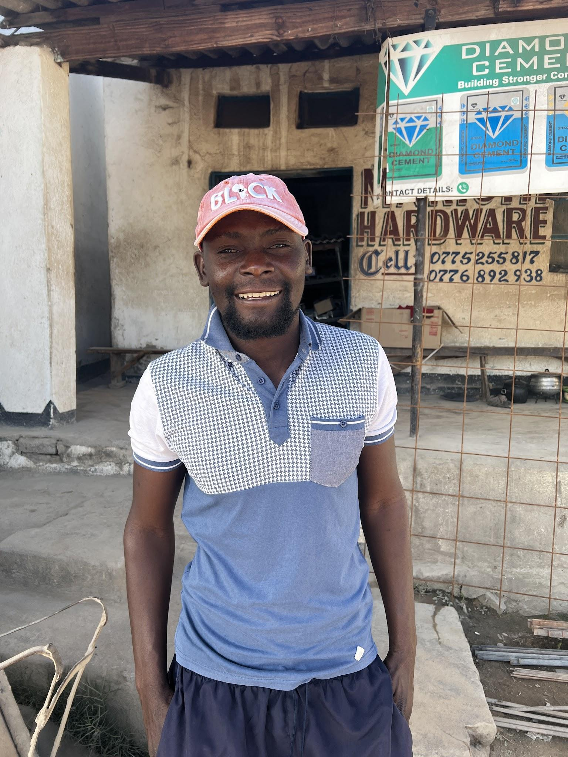
Village Transect Walks (7)
Focus Group Discussions (4)
Household Interviews (17)
Community Triggering Observation (2)
Local Government Interviews (11)
Local Builder Interviews (3)
Supplier Interviews (6)

Slide 21
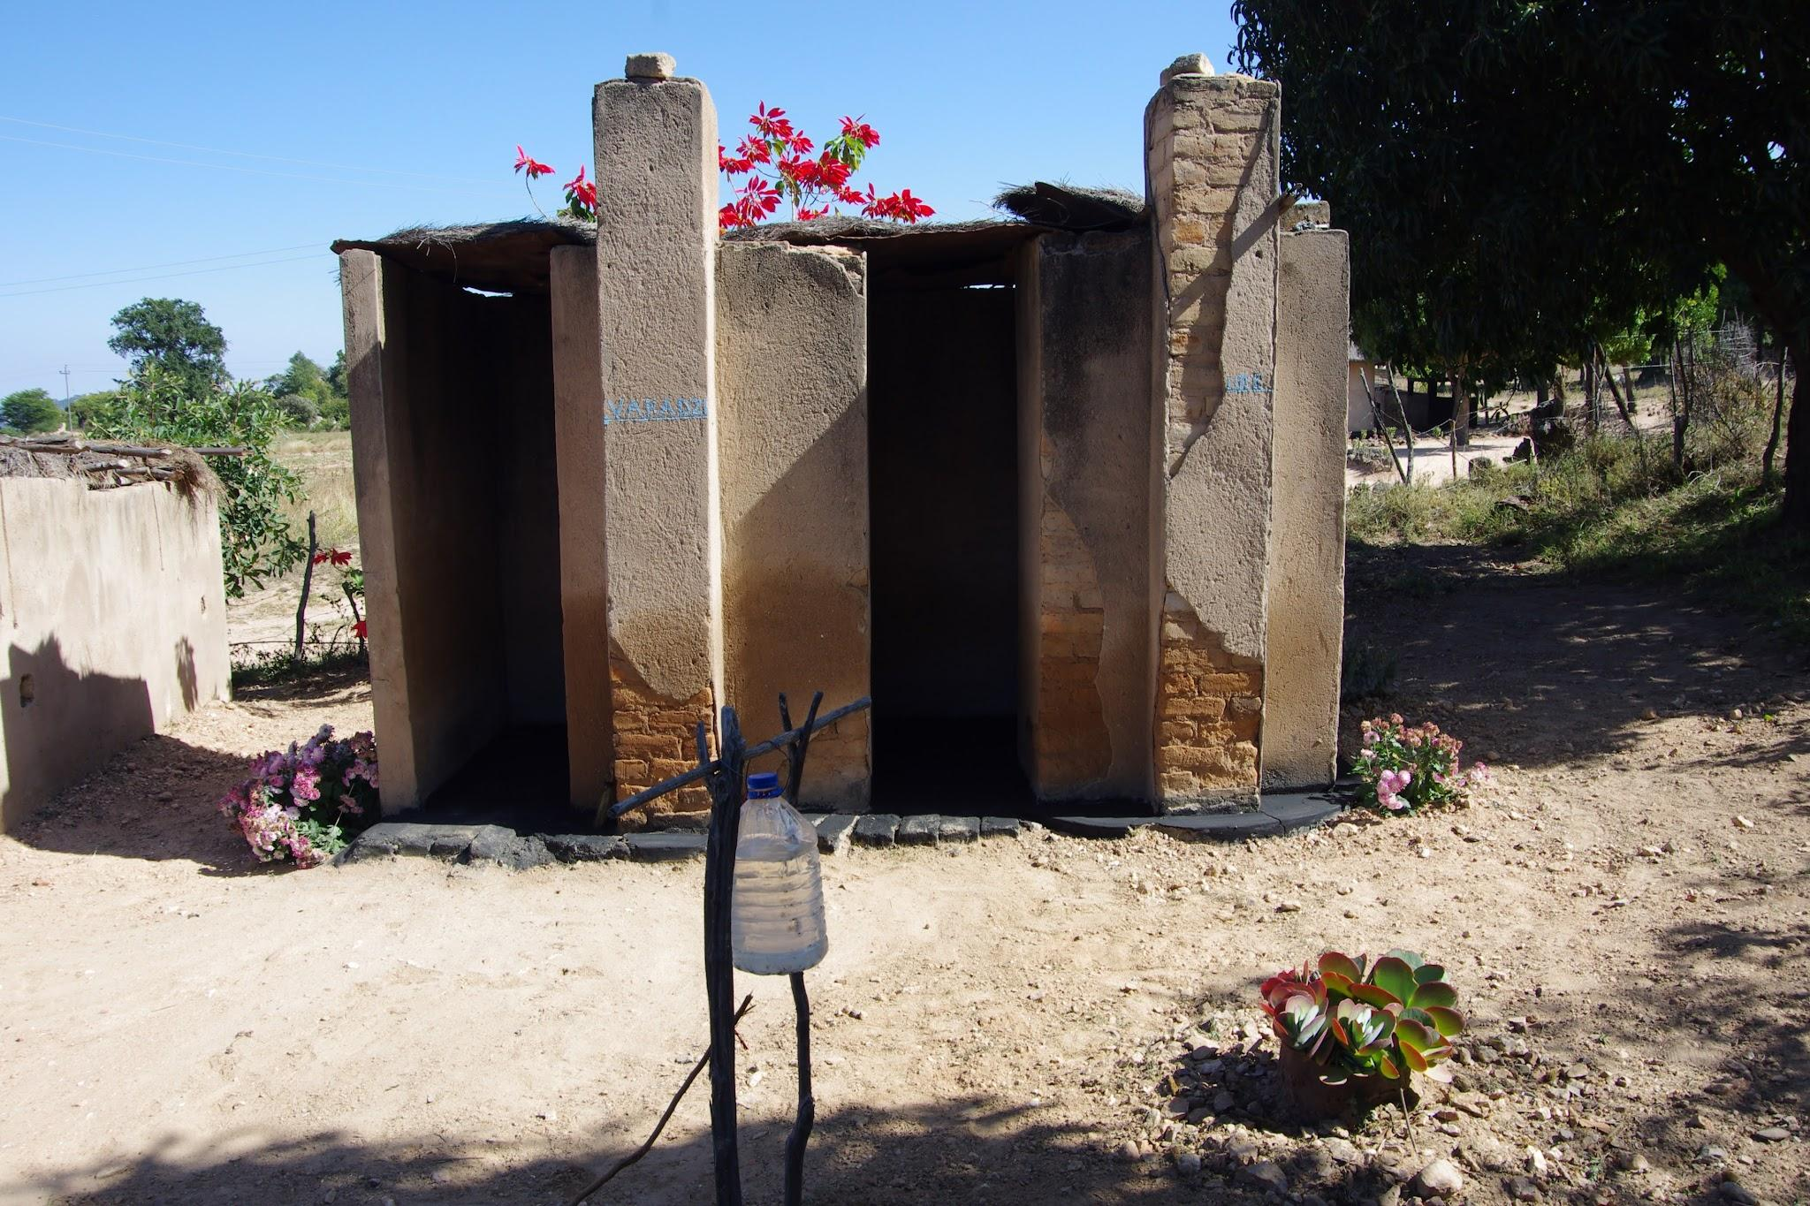
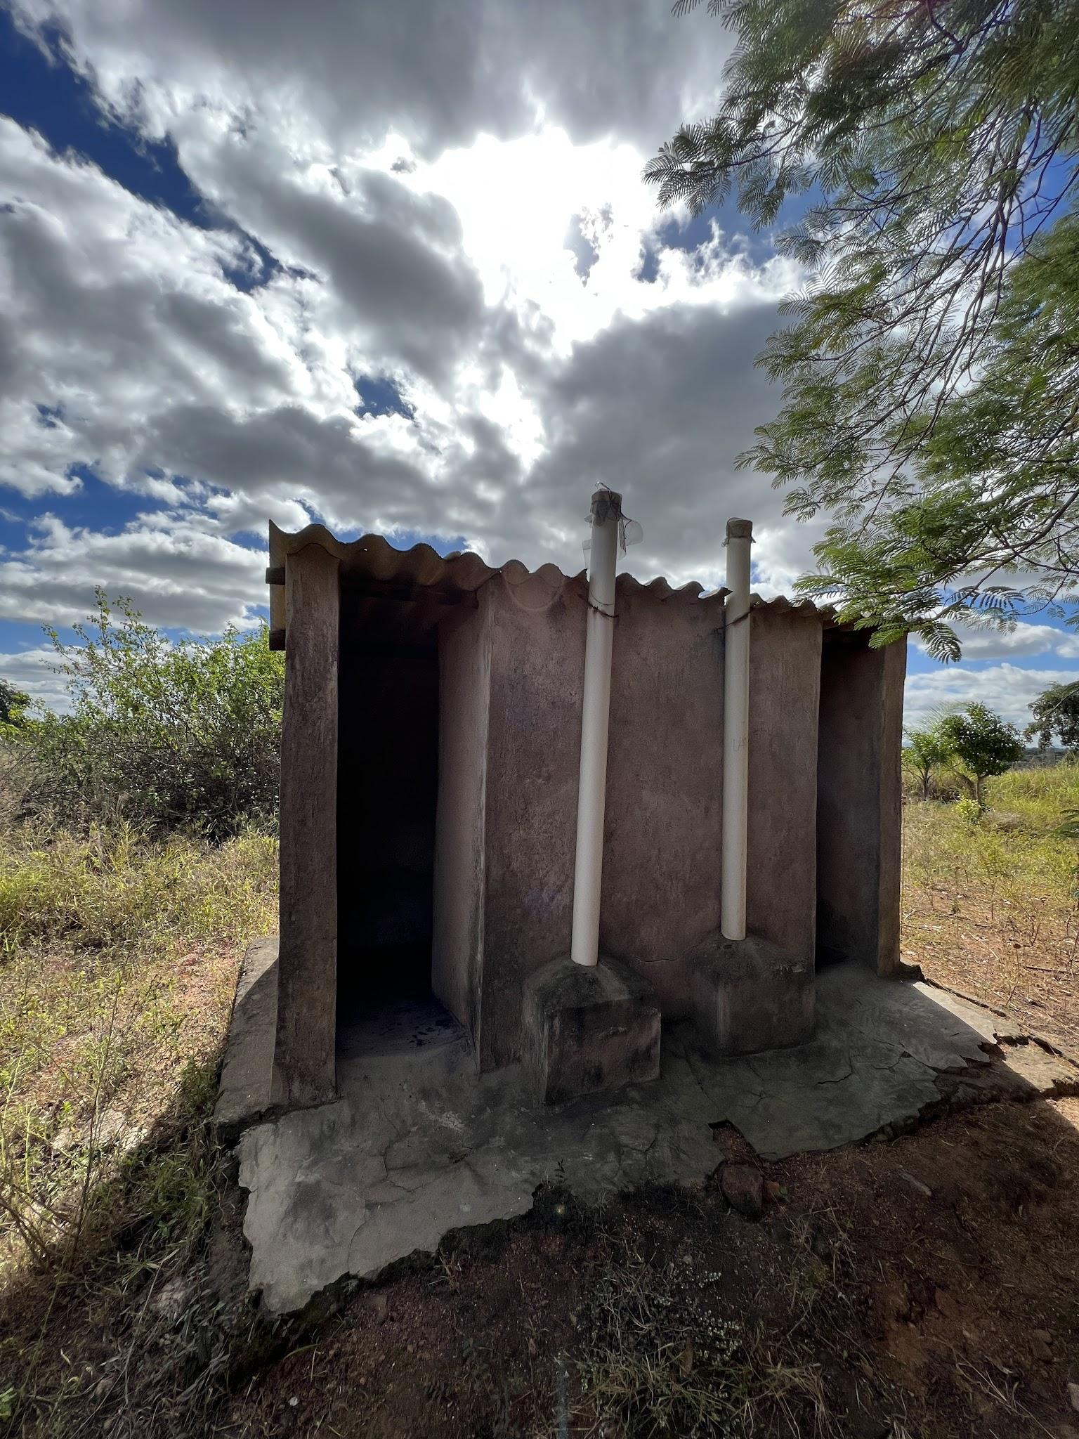
Technical Findings

Slide 22
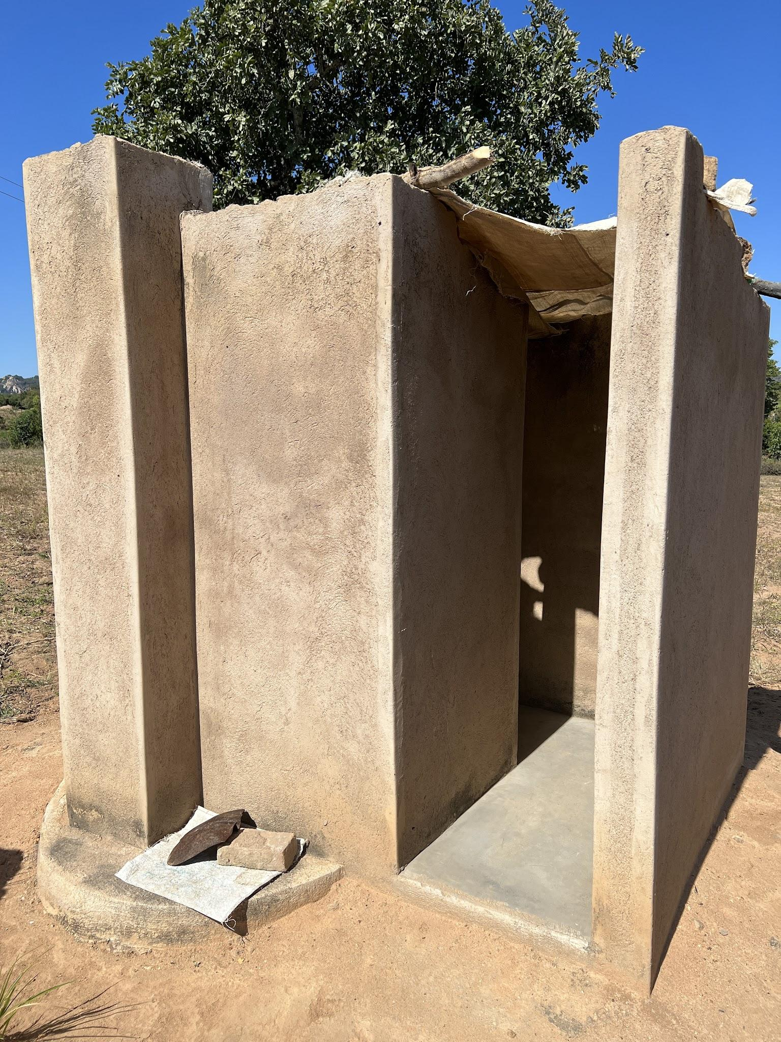
The standardized Blair Ventilated Improved Pit (BVIP) latrine is widely accepted by the majority of rural people. Yet, for the wealthy - the BVIP is seen as ‘old-fashioned’ and for the extreme poor - the BVIP is seen as ‘too expensive’.
Most households are not following the government approved upgradable approach, which promotes basic safe latrine that can be improved overtime.

Slide 23
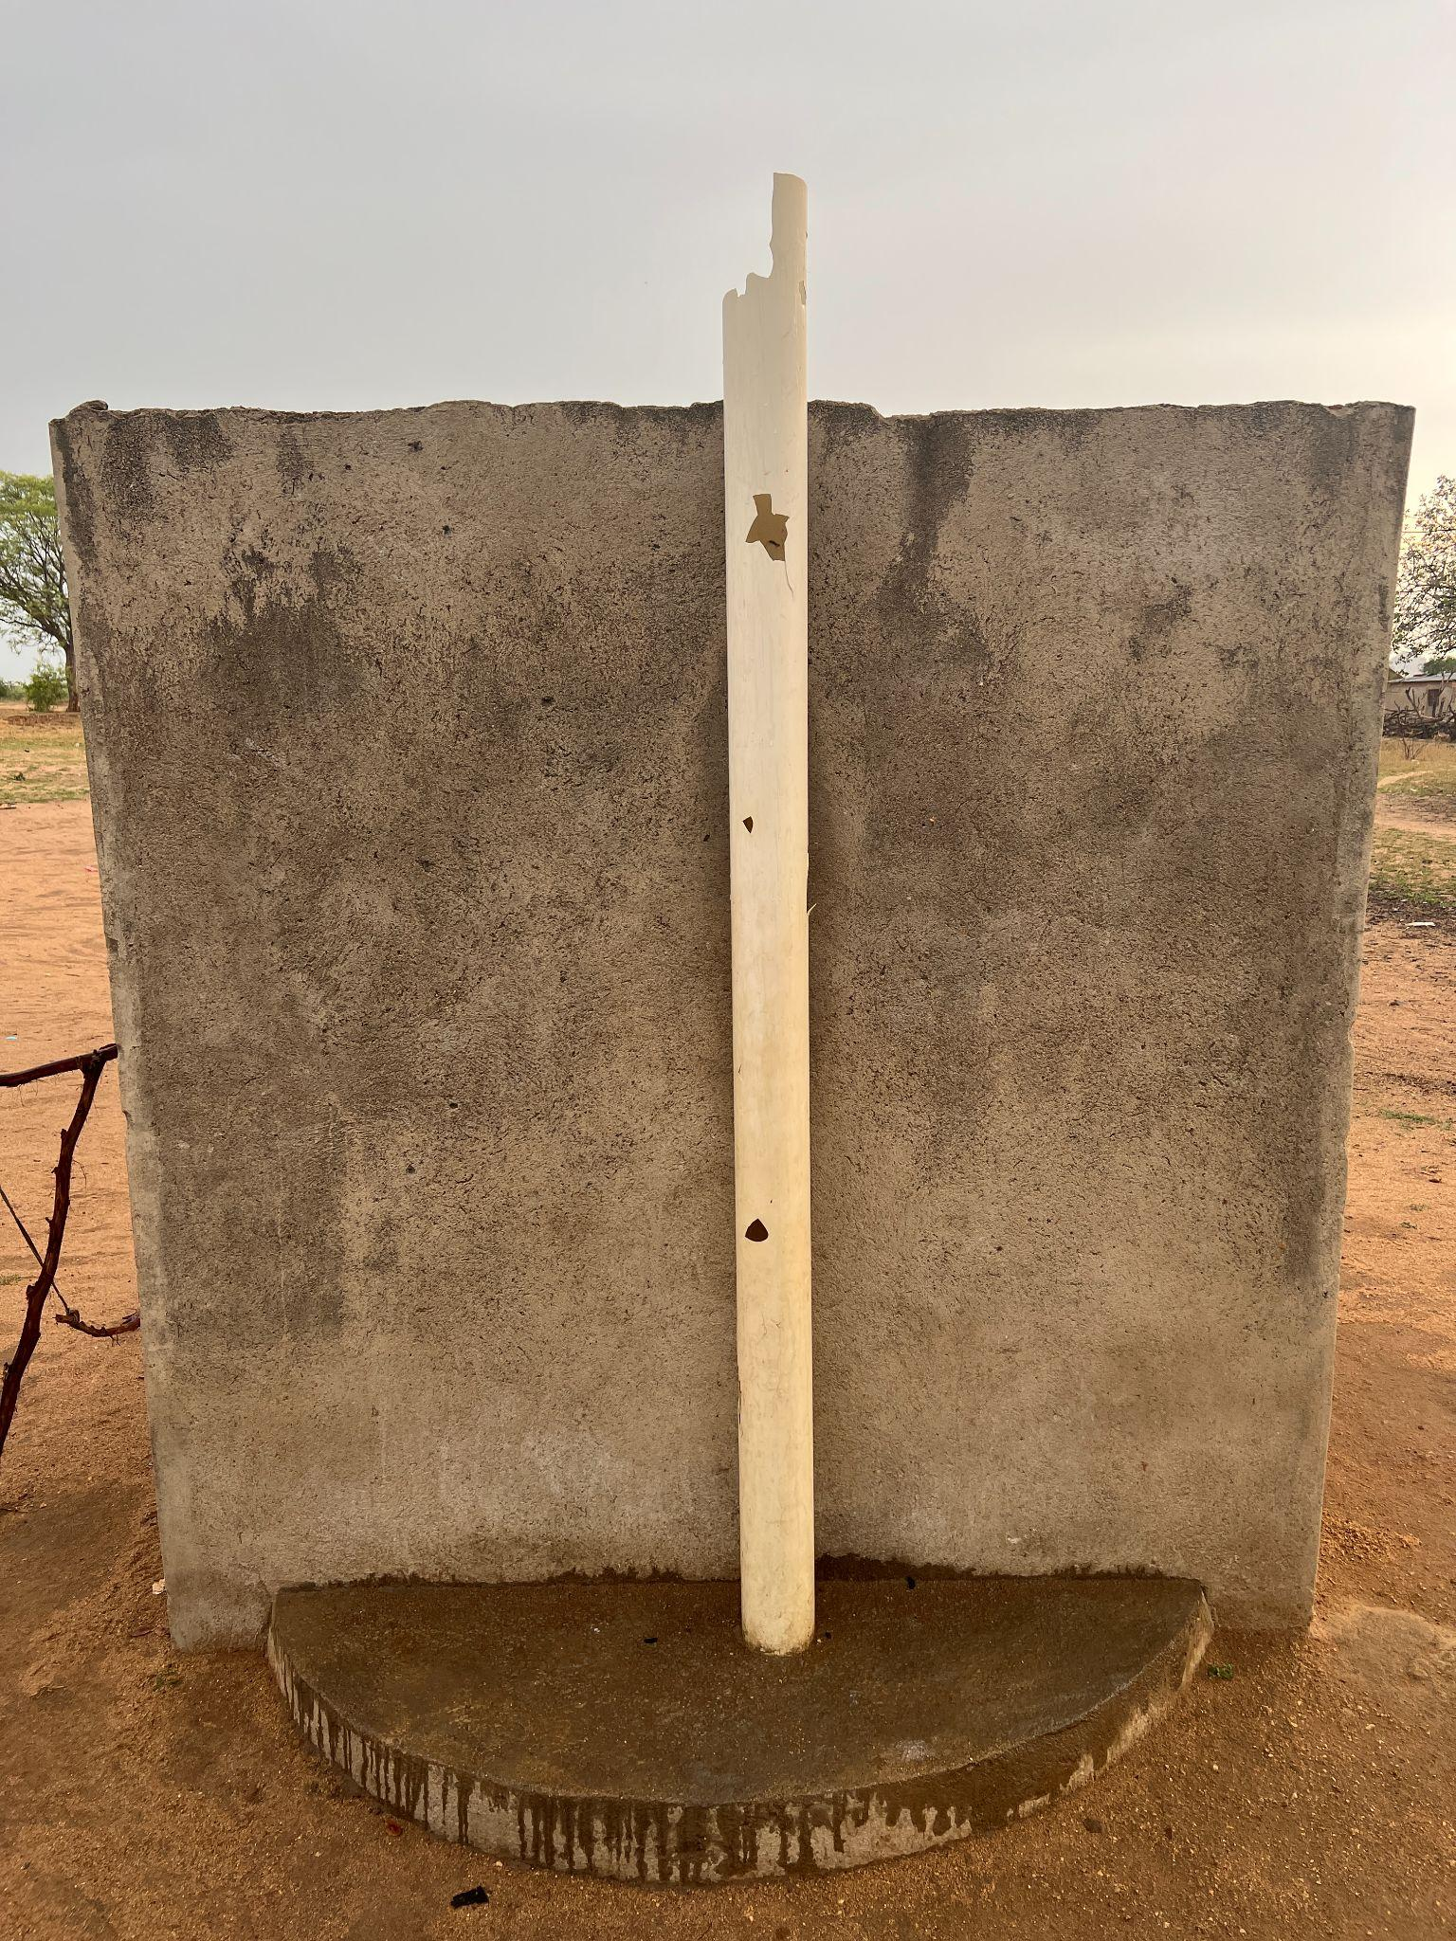
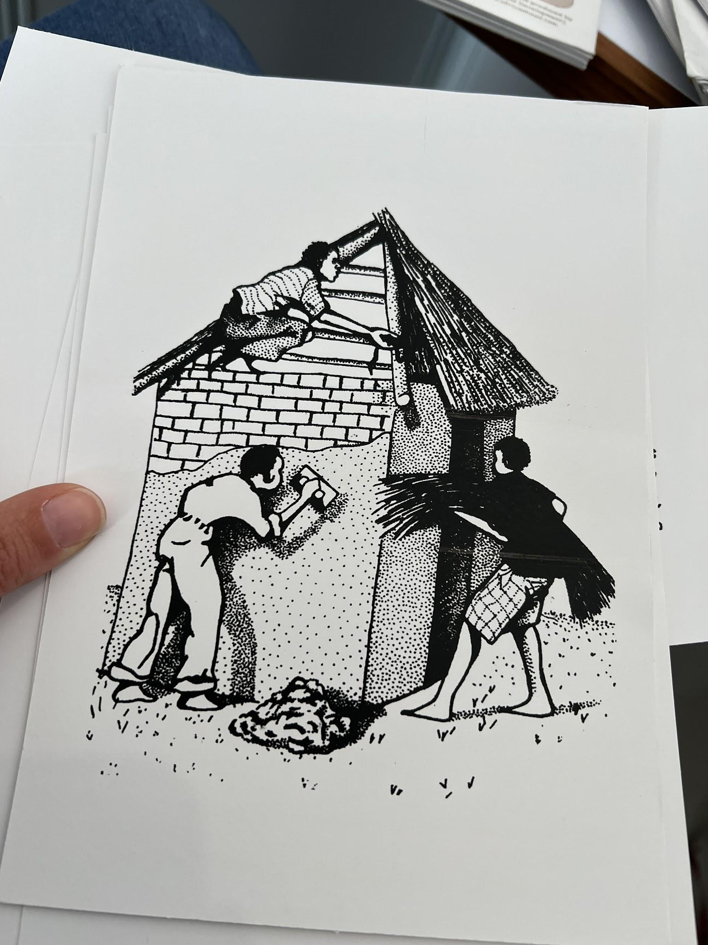
Introduced ten years ago, the low-cost version of the upgradable BVIP (with 1-bag of cement) has been deemed ‘unsafe’ by many users and builders who have seen them collapse, particularly in the wake of increased cyclones lately.
Most households desire to have a ‘bullet-proof’ cement plastered latrine with many bags of cement and a solid roof.
Notes:
There is little technical knowledge of cement quality and mixture ratios, only a perception that more is better.
Low-cost materials, such as thatch and mud are seen as not resilient enough for cyclones, daily use, insects and animals.

Slide 24
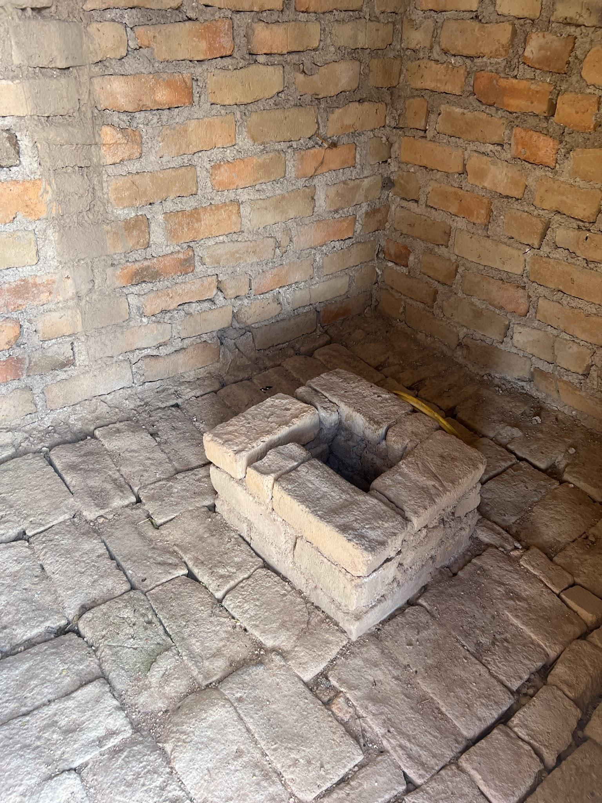
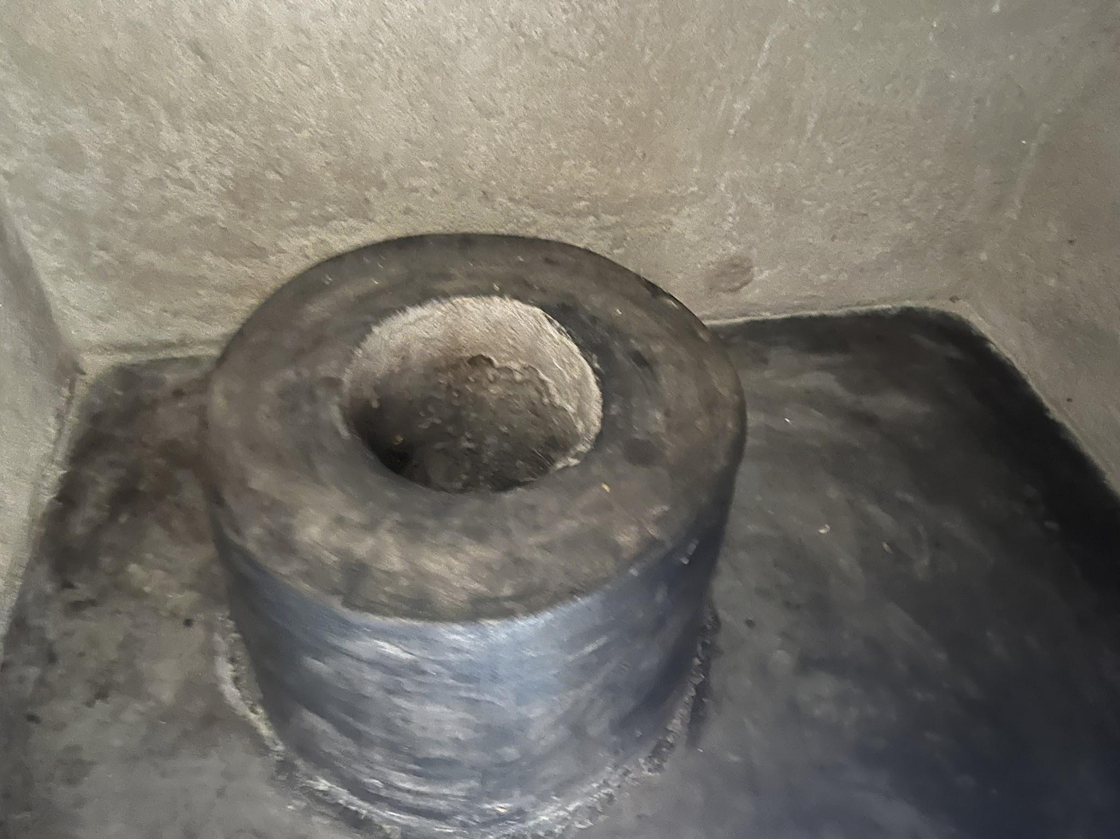
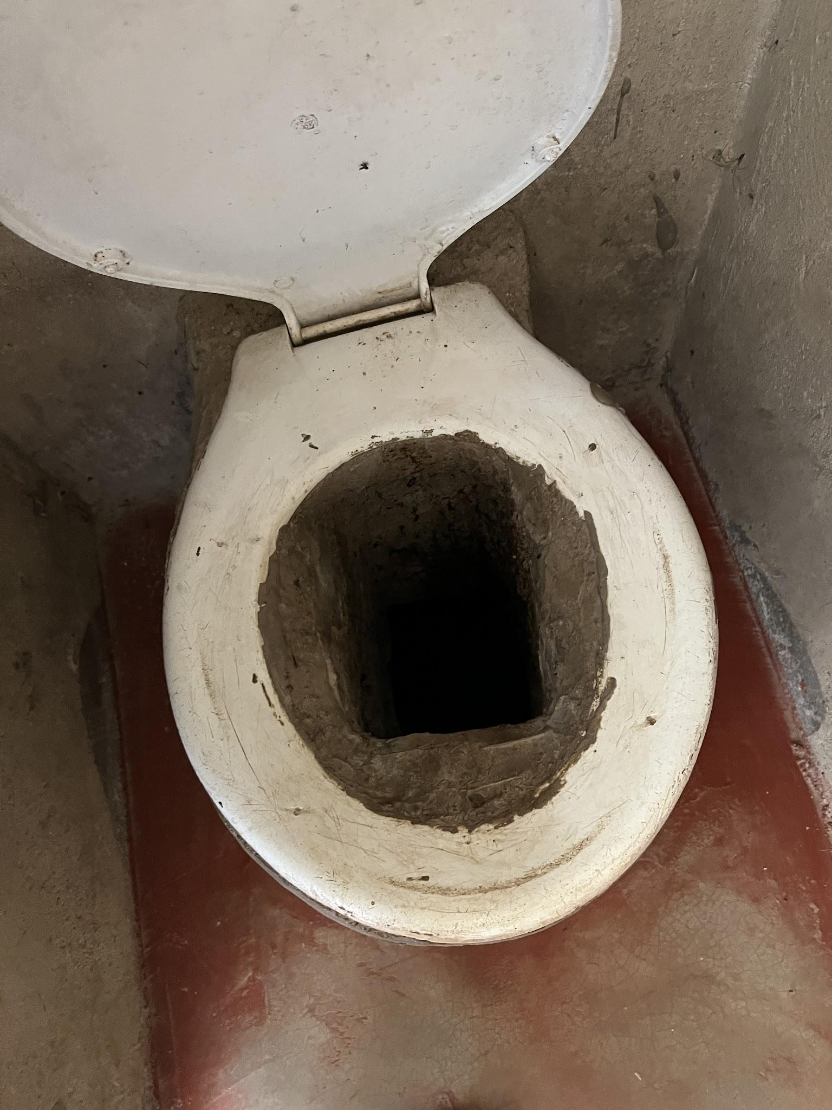
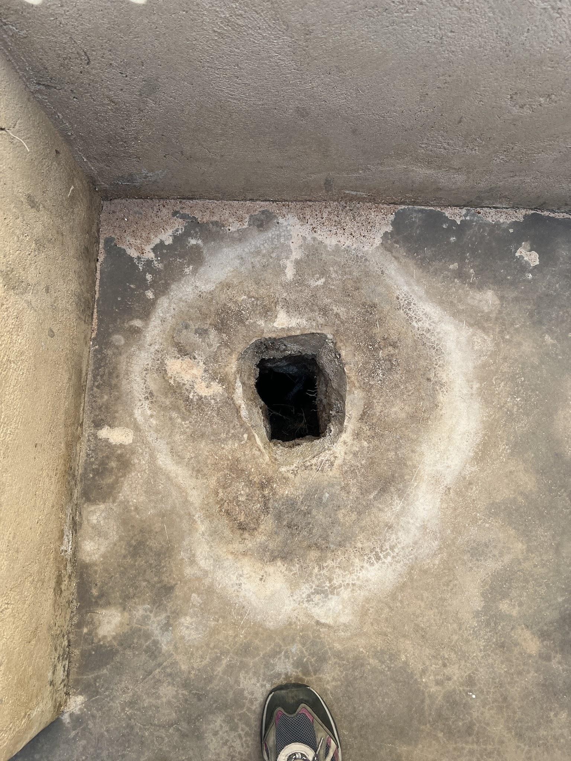
Many households are purchasing fiberglass seats (locally known as chambers) for their latrines motivated by elderly relatives who struggle to squat, and a desire for prestige.
Nearly everyone described challenges with squat hole shapes, as they are often cast incorrectly.
Notes:
Some women and girls desire a door on the latrine that they can lock from the inside, to keep male relatives from barging in while they are bathing.

Slide 25
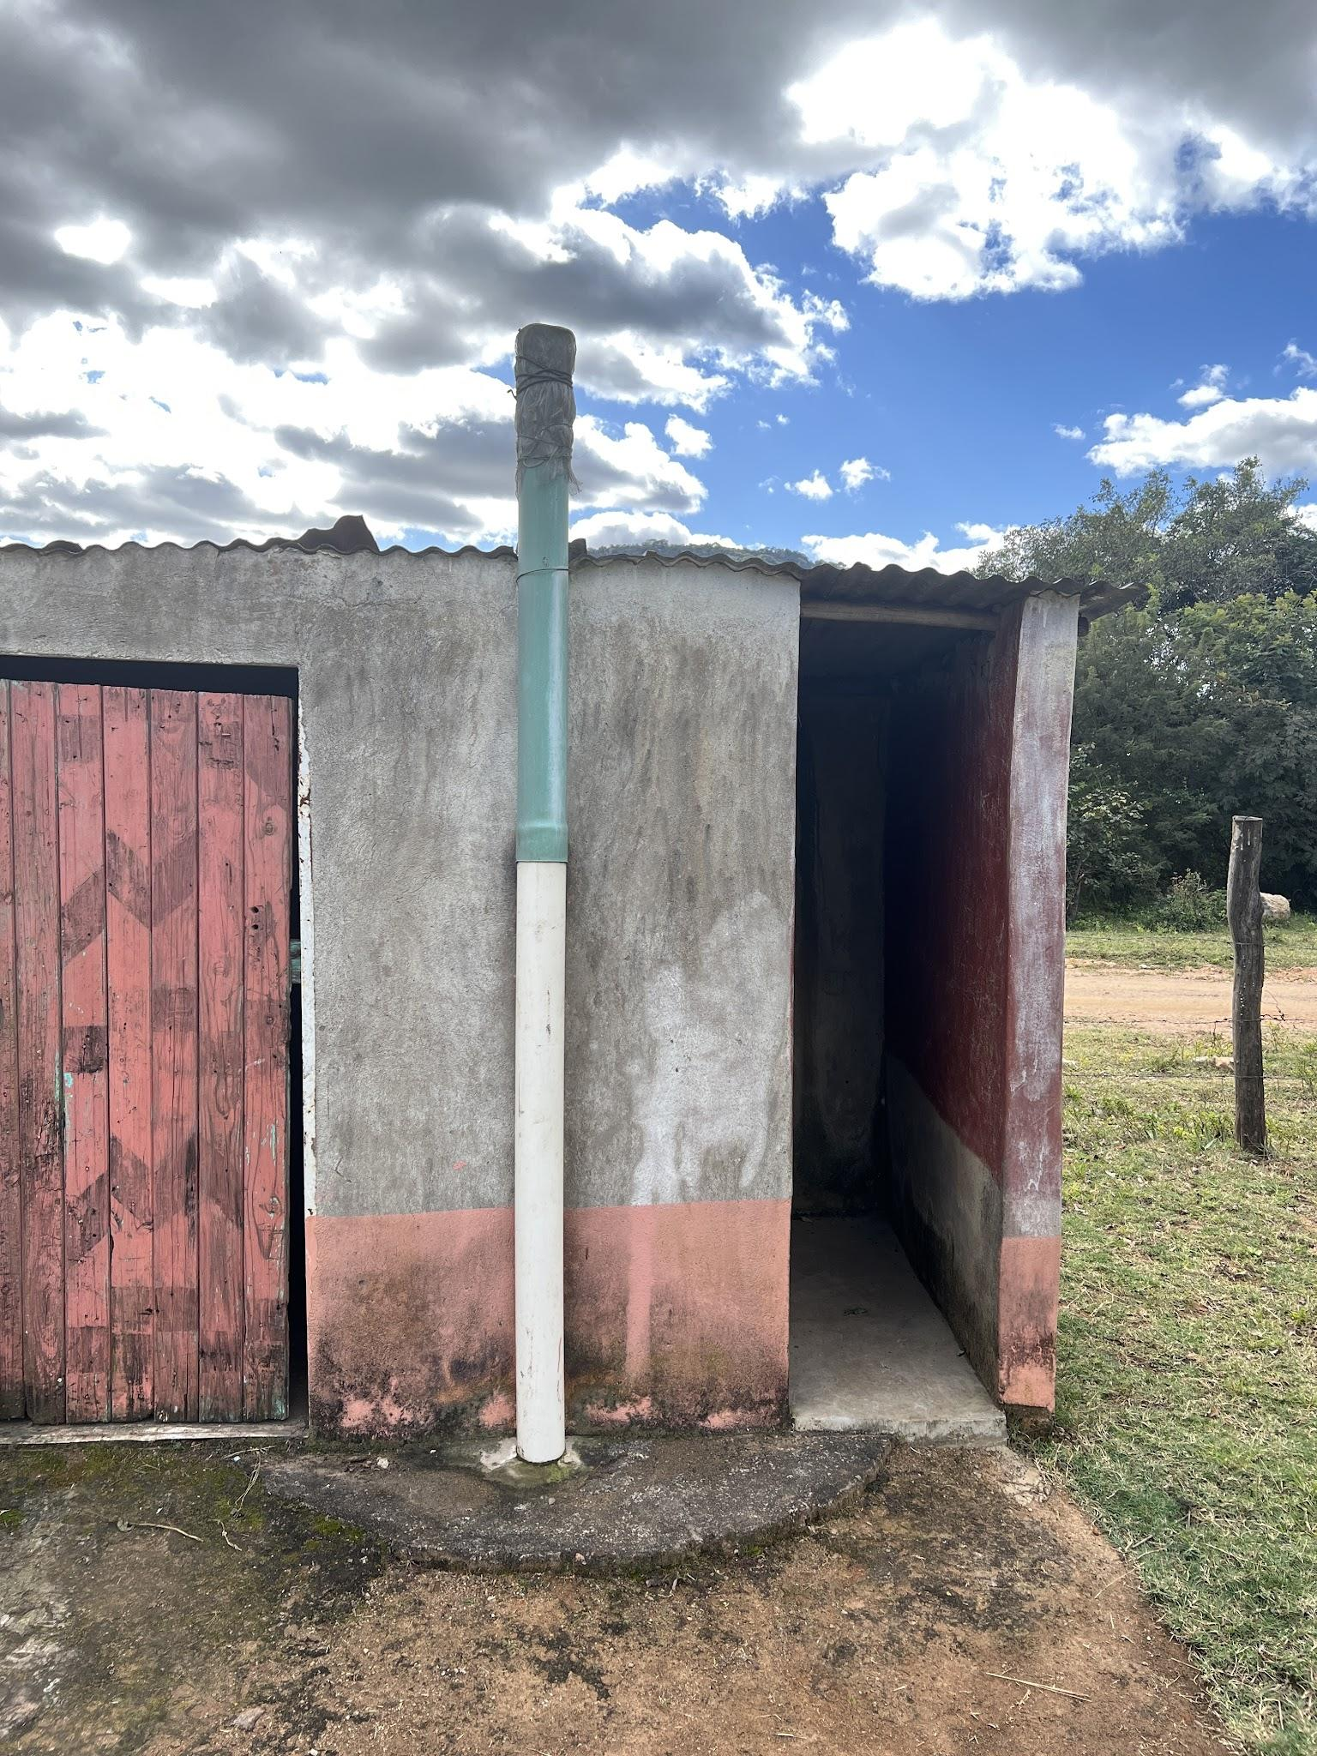
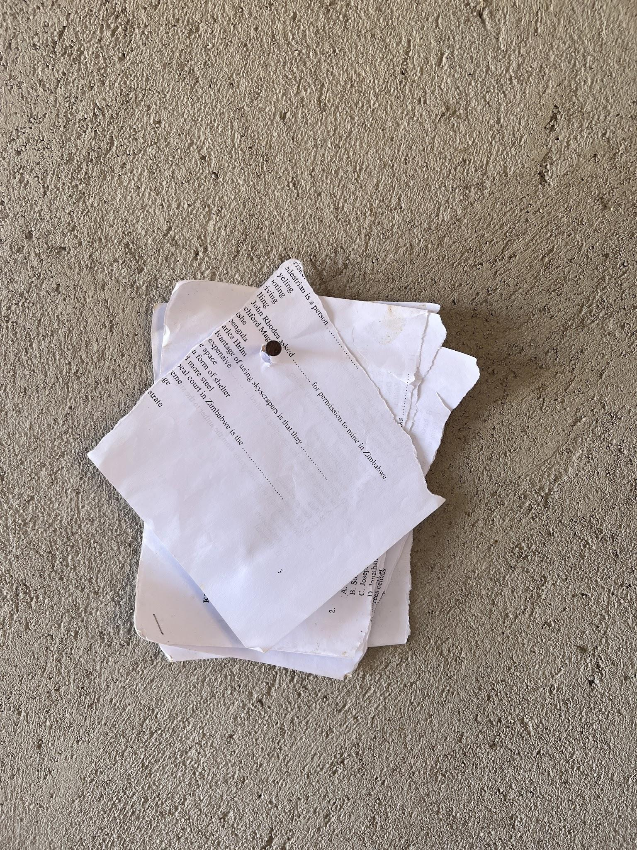
Some women and girls desire a door on the latrine that they can lock from the inside, to keep male relatives from barging in while they are bathing.
Almost all households struggled to obtain paper for wiping.

Slide 26
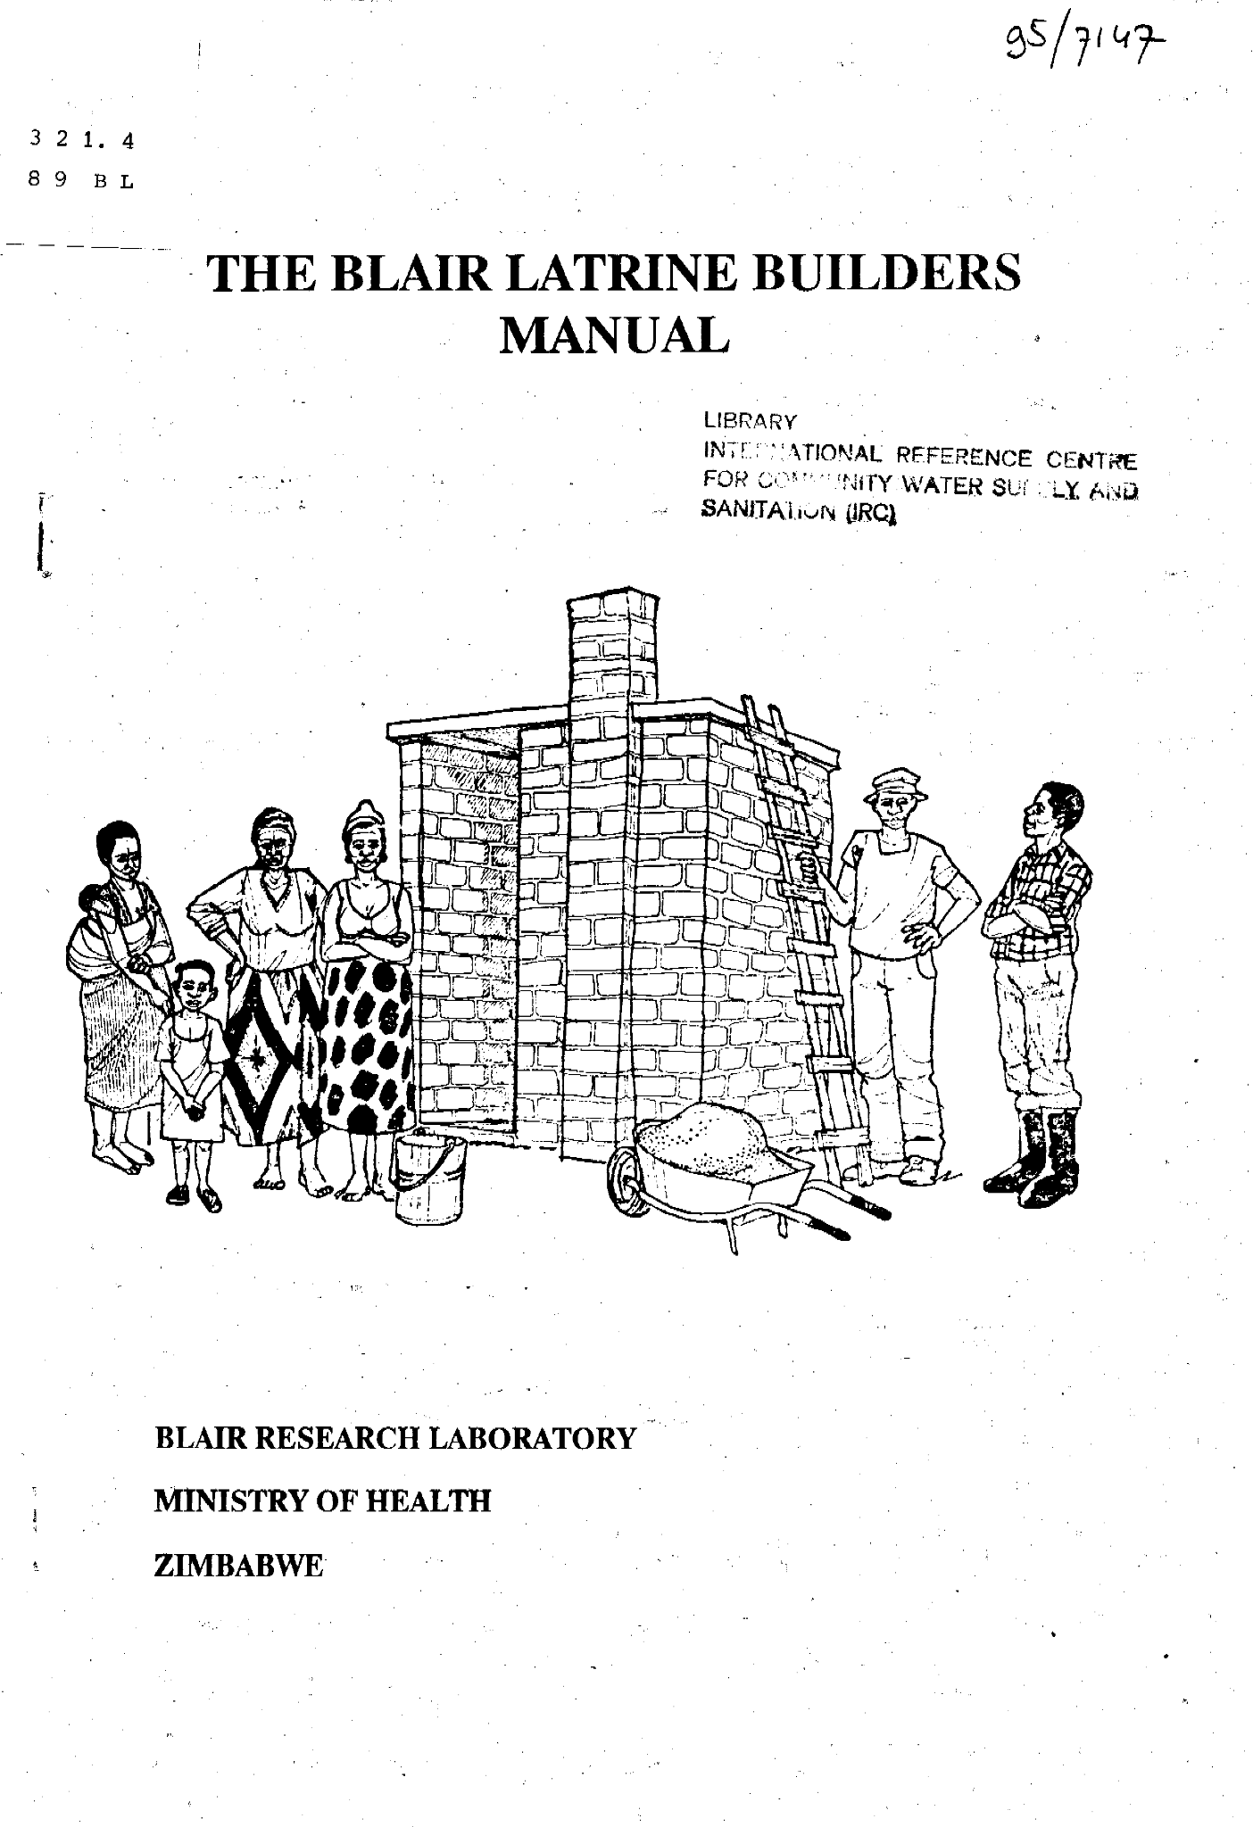
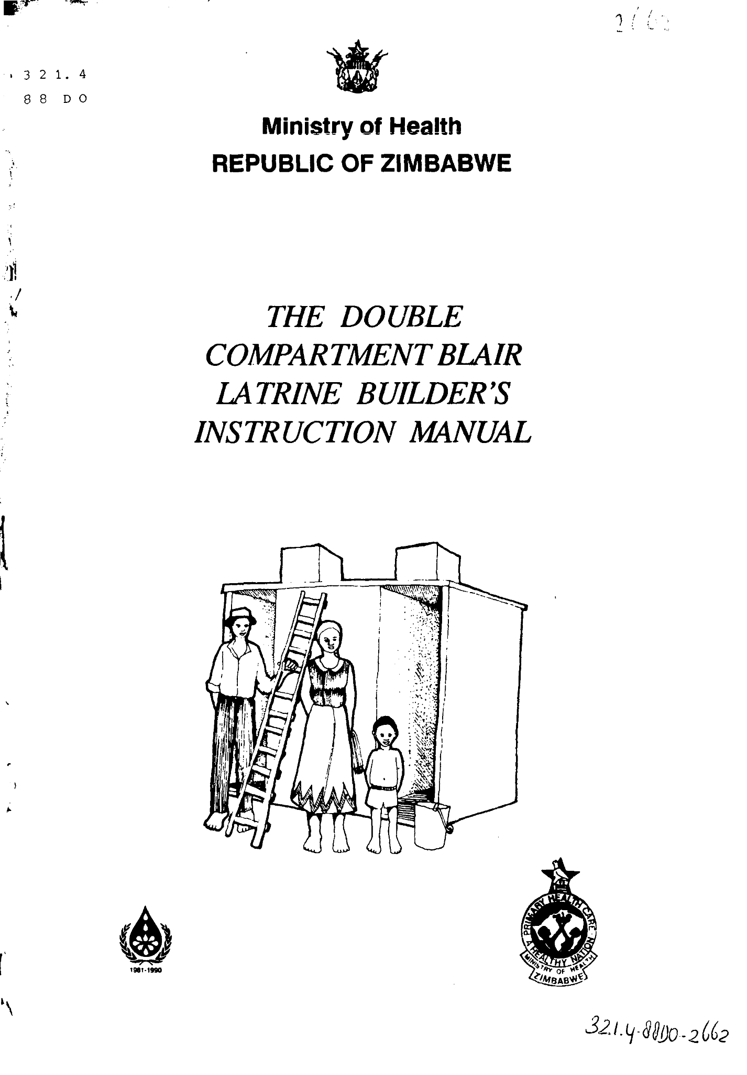
The existing Participatory Health and Hygiene Education (PHHE) materials have fostered unintended behaviors and practices.
The early BVIP instruction manuals (1987-1995) are still cherished by builders and environmental health officers/technicians.

Slide 27
CREATE Phase

Slide 28
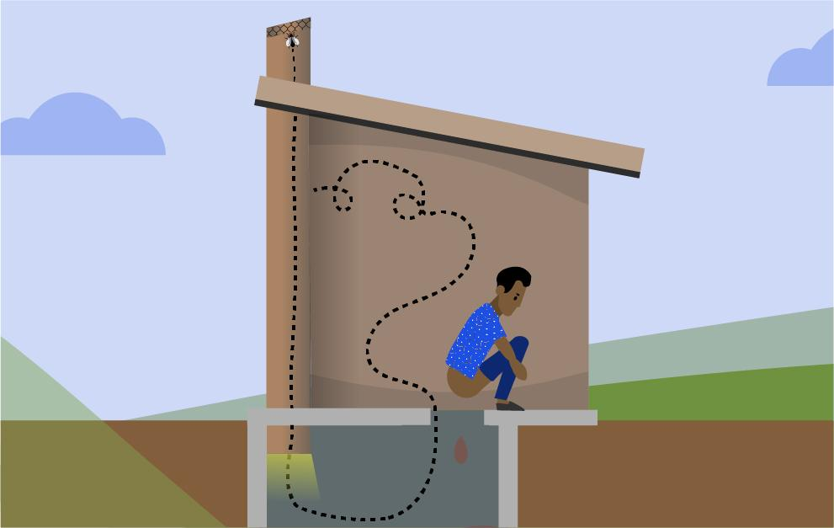
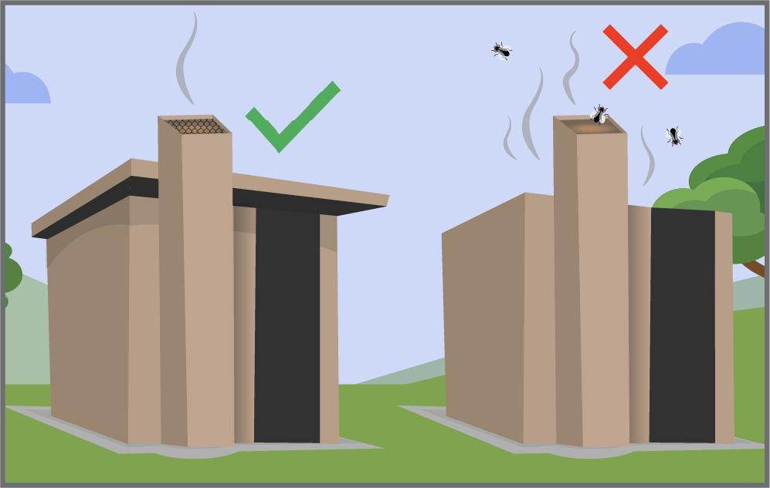
Review and design complementary behavior change tools
an animated video and poster on latrine safety aspects
a set of cards used in a game identifying unsafe latrines
a revised set of sanitation option cards
a latrine inspection checklist

Slide 29
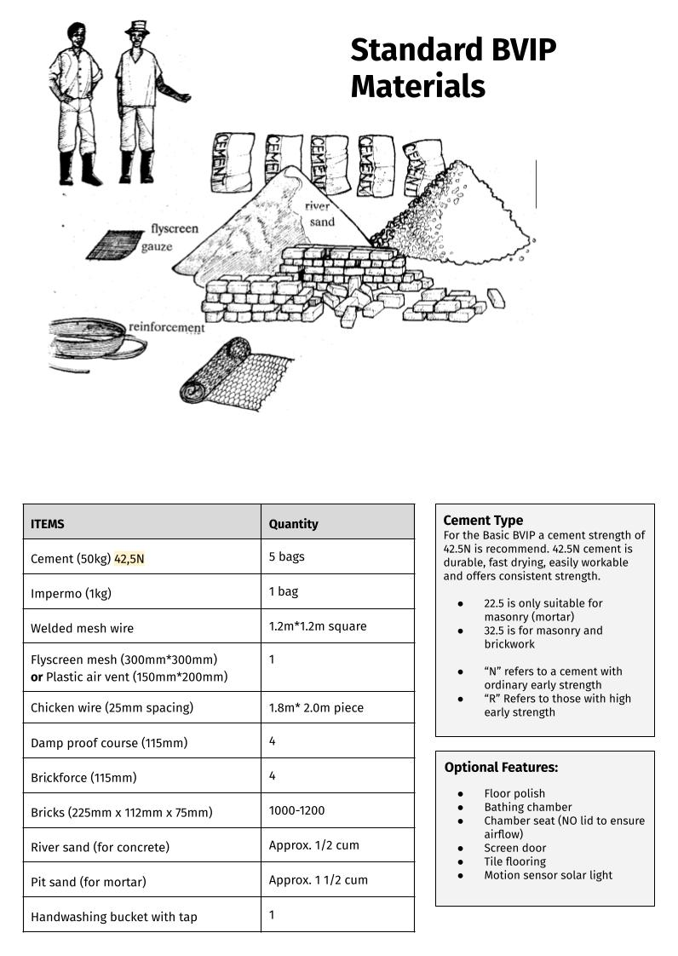
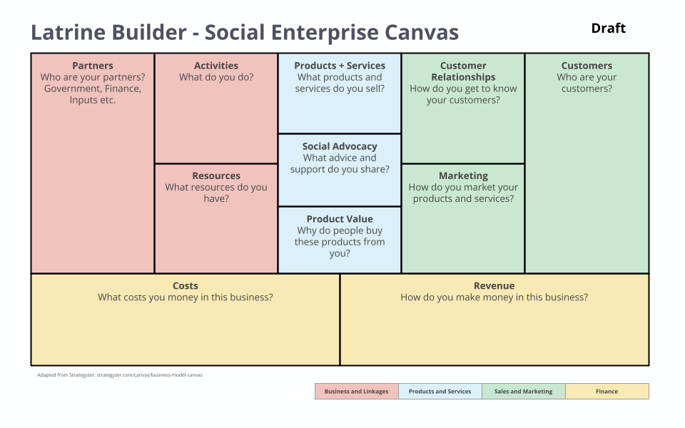
Design capacity strengthening tools for the private sector
a poster series on latrine components
a business model canvas to strengthen the services of latrine builders

Slide 30
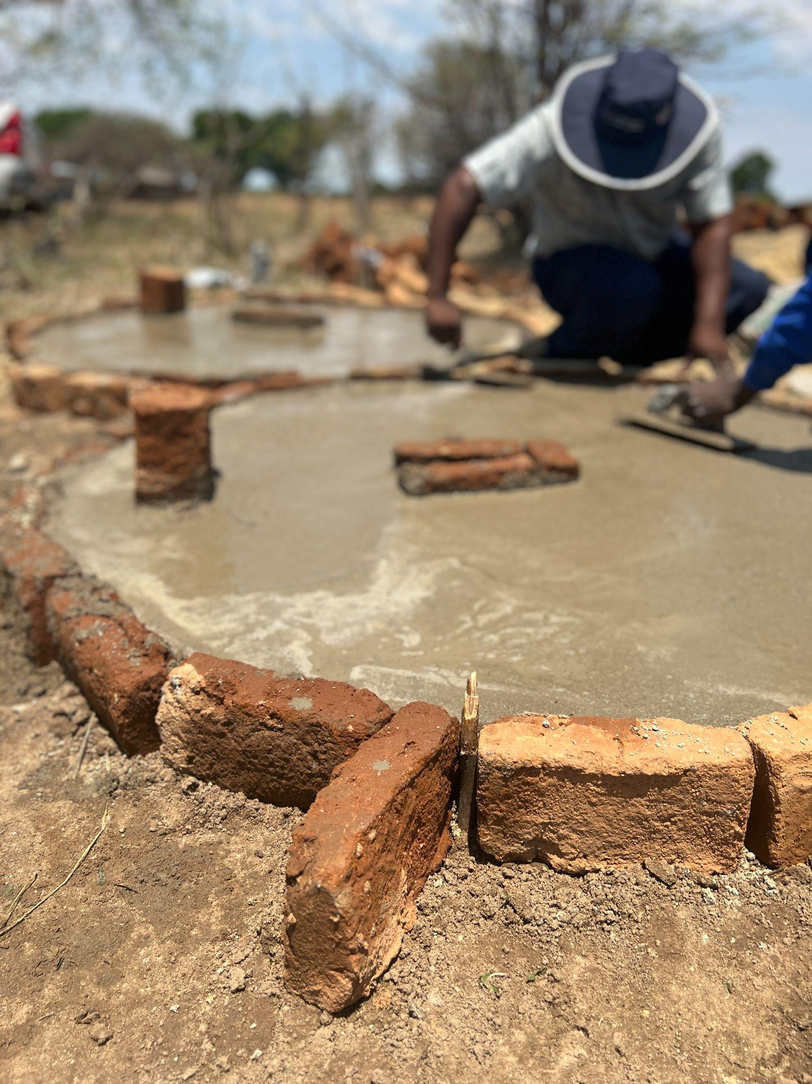
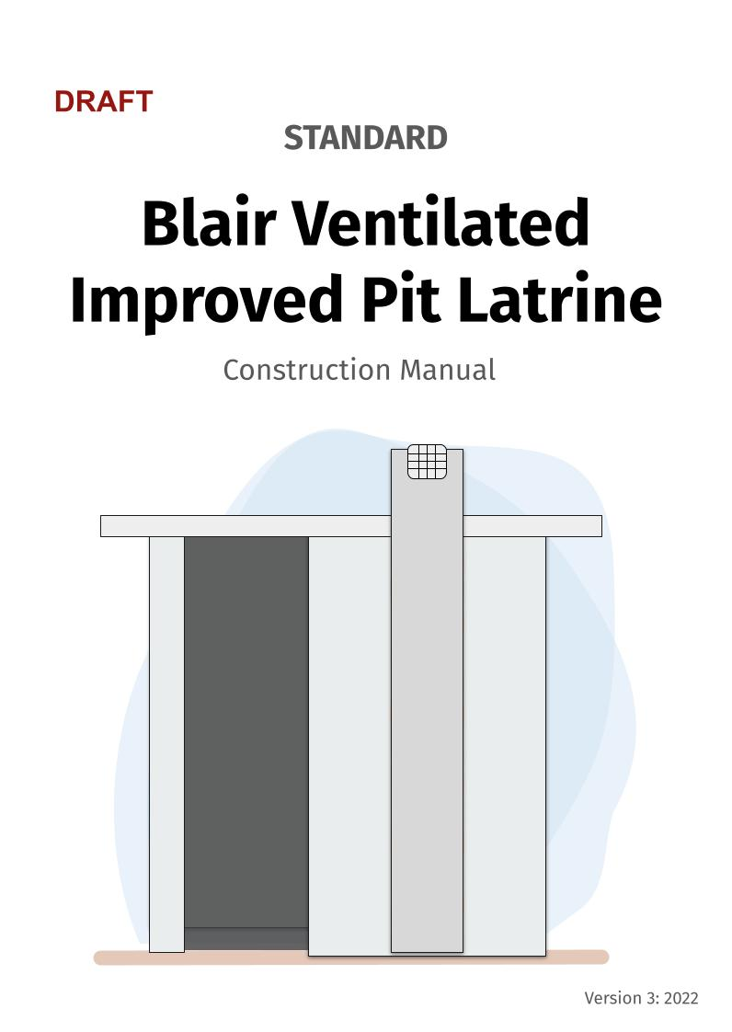
Update and clarify latrine designs and related technical documentation
Notes:
We found a significant lack of clarity around the standard latrine designs and opportunities to promote more resilient and desirable options. To address this, the team piloted a set of three versions of the BVIP with minor adaptations: Basic, Standard and Prestige.
Technical materials were also drafted to match these new versions aligned with the well-loved manuals from the 1980s and 1990s.

Slide 31
DELIVER Phase

Slide 32
Integrating complementary behavior change tools in community engagements
Reimagining the role of latrine builders to promote and construct improved latrines
Reinvigorating the local private sector to supply and encourage improved latrines
Educating and fostering relationships with the district, provincial and national private sector to improve components
Notes:
Integrating complementary behavior change tools in community engagements
The first strategy involves the integration of the newly designed behavior change communication tools into ongoing community triggering, and sanitation action group training alongside bundled activities with youth clubs, savings groups, health clubs and care groups.
Reimagining the role of latrine builders to promote and construct improved latrines
Latrine builders are seen primarily as contractors and not sanitation advocates. The team plans to integrate a business module into latrine builder training focused on four areas: business practices, linkages, and marketing alongside technical skills.
Reinvigorating the local private sector to supply and encourage improved latrines
Local latrine suppliers at growth points and town-centers are not actively part of the sanitation market in rural Zimbabwe. The team will pilot quarterly supplier check-ins helping to promote stable supply chains of improved latrine components.
Educating and fostering relationships with the district, provincial and national private sector to improve components
The final strategy involves education on latrine safety and relationship strengthening with private sector actors to help build capacity and improve supply chains of improved and appropriate latrine components. Additionally, the team will explore opportunities to partner with cement manufacturers, hardware distributors, plastics manufacturers, and paper manufacturers. Their current designs are influenced by cu

Slide 33
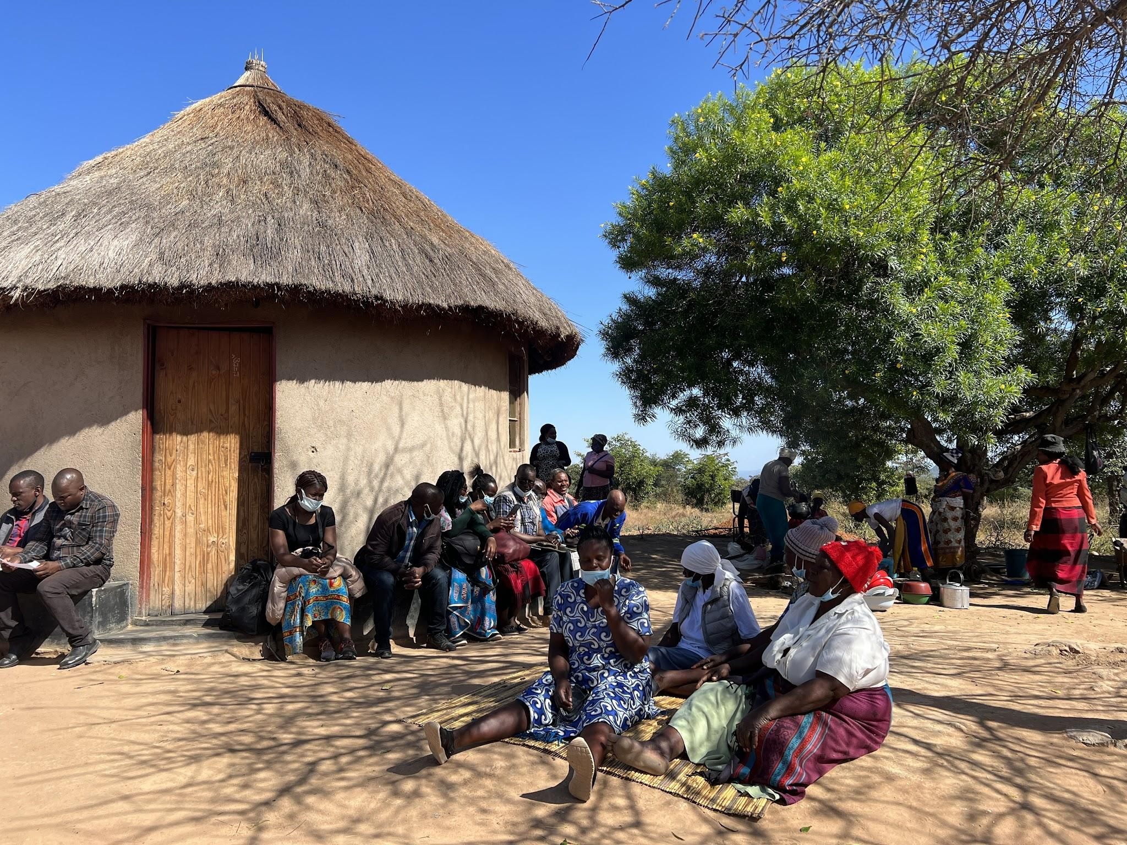

Slide 34
Q&A

Slide 35
Thank you!
This webinar is made possible by the generous support of the American people through the United States Agency for International Development (USAID). The contents are the responsibility of the PRO-WASH Award and do not necessarily reflect the views of USAID or the United States Government.

