Slide 1
HuMEL Meeting: SMILER+ and Virtual Participatory MEAL Systems
Tuesday September 29th, 2020 | 9:00-10:30am ET
Reminder: Please turn off video and mute your microphone

Slide 2
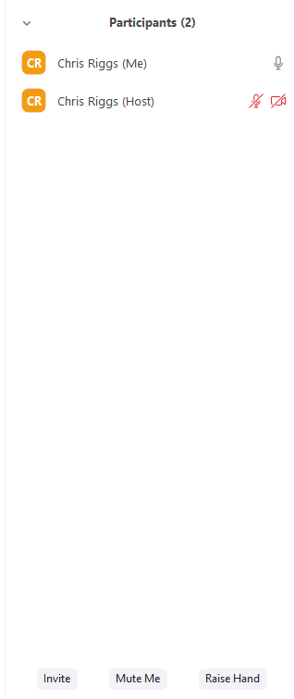
Q&A Instructions
Stay muted for now.
If you have a question, click the “raise your hand” button and the facilitator will call on you. Unmute and activate your video and ask your question!
Additionally ask questions in the chat!

Slide 3
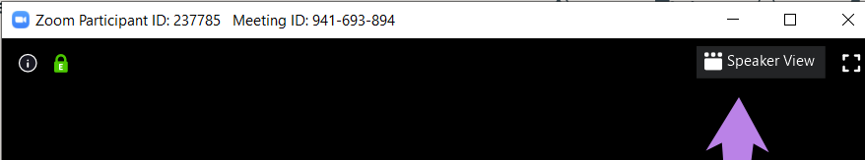
Zoom View Instruction
Turn on “speaker view”
Select this from the “view” option on the top right corner of your zoom window

Slide 4
HuMEL Community
Humanitarian
Monitoring
Evaluation &
Learning
Community meetings every quarter, hosted by implementers
Discourse.FSNnetwork.org → Communities

Slide 5
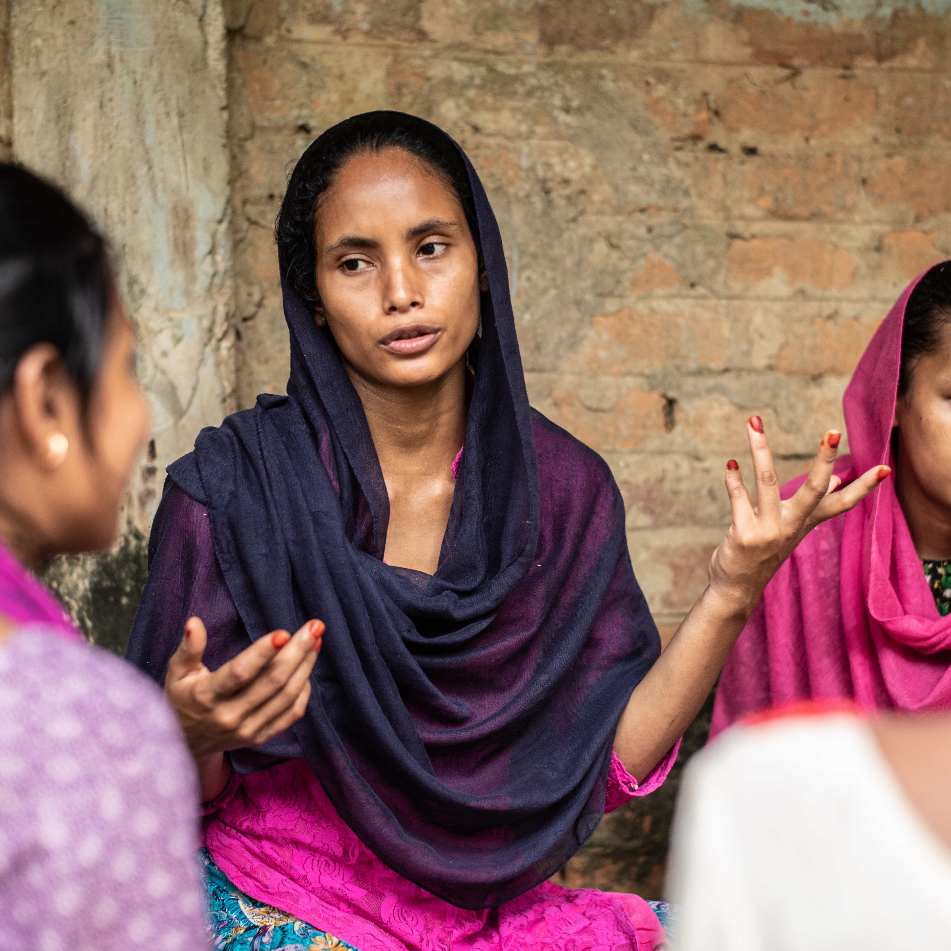
SMILER+ Introduction and Overview

Slide 6



SMILER+ Highlights
Prioritizes information needs of key stakeholders in MEAL system development.
Maps the flow of monitoring data through collection, data management, analysis and use.
Develops feedback, complaints and response mechanisms which uphold (CRS and donor) Safeguarding Policies and contribute to adaptive management practices;
Clarifies the roles and responsibilities of MEAL and program staff in MEAL system implementation; and
Focuses on data use for improved decision-making, accountability to stakeholders, reporting and communication and for project learning.

Slide 9
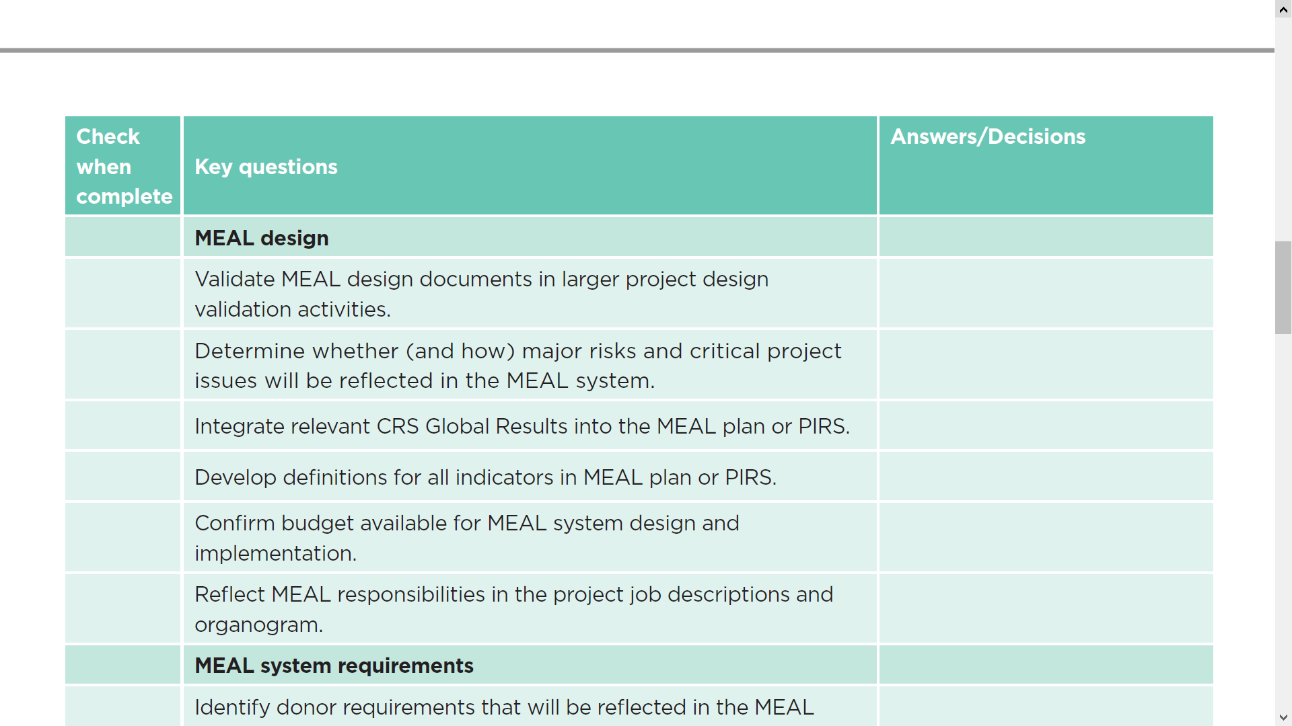

Slide 15

Recommendations from Virtual SMILER+ Workshops

Slide 16


Vary participant groups in different SMILER+ sessions

Slide 17

Draft MEAL system components in advance of virtual workshop

Slide 18

Prepare for good participant engagement in virtual sessions

Slide 19

Schedule shorter sessions over a longer period and include document review in agenda

Slide 20

Revise and validate draft MEAL components using SMILER+ quality checks

Slide 21

Plan for continuity of MEAL system development in action plan

Slide 22
www.ideal.events/humel
Thank you!
Please take a moment to fill out our brief event evaluation

