Slide 1
TOC Checklist: Quality and Completeness Review
[include date here]

Slide 2
Session Objectives
To understand how we will ascertain the quality and completeness of the TOC diagrams and complementary documentation using the same criteria as donor reviewers.

Slide 3
TOC Process and Timeline
 | Month 1 |  |  |  | Month 2 |  |  |  | Month 3 |  |  |  |  | Month 4 |  |  |  | Month 5 |  |  |  | Month 6
WEEK | 1 | 2 | 3 | 4 | 5 | 6 | 7 | 8 | 9 | 10 | 11 | 12 | 13 | 14 | 15 | 16 | 17 | 18 | 19 | 20 | 21 | 22 | 23
Data collection and organization
Problem Tree development
TOC diagram and Complementary Documentation development
Prioritize interventions
Refine TOC graphics
Log frame transfer and select indicators
Quality and completeness review
Notes:
Modify to align to your organizational timeline.

Slide 4
WHAT | WHO (examples only) | week | week | week | week | week | week
Checklist items related to general diagram elements (1- 4c) and general formatting (9-13); Evolving complementary documentation (external actor, rationales, assumption documentation). | 1-2 Team members responsible for checking the quality and thoroughness of the TOC diagram and Complementary Documentation Graphic lead.
Checklist items related to DFSA outputs (2b, 4b, 9, 10a) Pathways items (5- 8); Cross-cutting themes (23-26)
Final quality check, all checklist items
Notes:
Enter dates in top row.
Fill in appropriate staff.
Why is this process iterative? Why not just wait until the TOC and complementary documentation are complete to do the quality check?
Answer: Need time to make necessary adjustments.

Slide 5
The ToC Process
Collect and analyze data (identify problems)
Use causal analysis to create a problem tree
Flip to a solution tree
Identify assumptions and articulate rationales
Identify outcomes that the Activity and external actors will address
Prioritize intervention outputs
Identify indicators for each component of the TOC.
PLAUSIBLE!
FEASIBLE!
TESTABLE!
Notes:
The change demonstrated in the diagram must be:
Plausible: Offers logical evidence-based pathways that demonstrate how we expect change to occur
Feasible: Identifies realistic means of initiating change.
Testable: Clearly outlines how to measure change

Slide 6
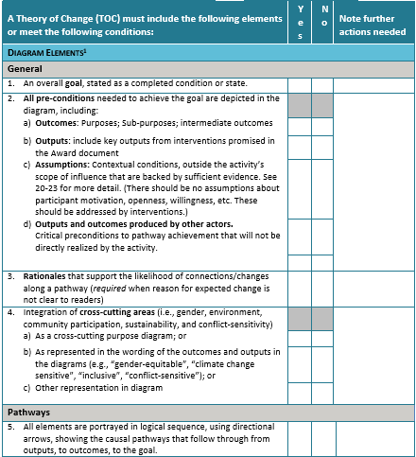
TOC checklist
A tool for determining quality and completeness of TOCs for FFP DFSAs
Notes:
In 2017, The TOPS Program and FFP collaborated to develop the TOC Checklist, a tool that allows TOC developers and reviewers to ascertain the quality and thoroughness of the diagrams and narrative. The checklist is a summary of FFP criteria outlined in document “USAID’S Office of Food for Peace Policy and Guidance for Monitoring, Evaluation, and Reporting for Development Food Security Activities”, and explained in detail in the TOPS TOC training materials. You can access the checklist in English and French at www.fsnnetwork.org/theory-change-training-curriculum

Slide 7
Iterative check
When first draft of the TOC is complete check:
  general diagram elements (1- 4c)
  general formatting (9-13)
  evolving complementary documentation (external actor, rationales, assumption documentation)

Slide 8
Iterative check
After outputs are added to the diagrams and the group output to outcome logic and sustainability reviw is complete, check:
  All items related to DFSA outputs (2b, 4b, 9, 10a)
  All items related to pathways (5-8)
  Cross-cutting themes (23-26)

Slide 9
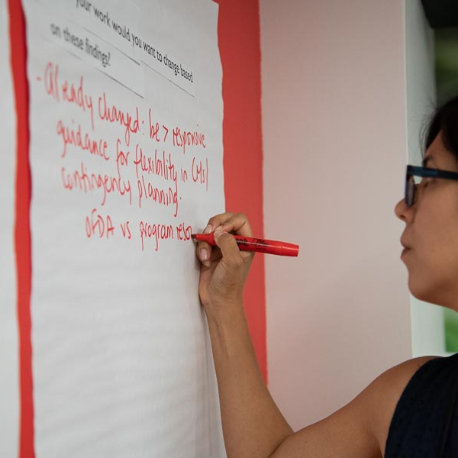
Complementary Documentation

Slide 10
What is the purpose of the TOC complementary documentation?
To add information not easily communicated graphically
To convey the degree of certainty that the pathways portrayed in the diagrams will occur
To outline conditions that could threaten progress along the pathways
Is not a stand-alone document
DO NOT use the TOC complementary documentation to summarize what is obvious in the TOC diagram (e.g., the problem analysis)
Notes:
Source: USAID Bureau of Democracy, Conflict, and Humanitarian Assistance Office of Food for Peace. 2016. Technical Reference for FFP Development Food Assistance Projects. Chapter II Mandatory Program Design Elements, pages 10-12.
Does not repeat anything that is already clearly presented in the TOC diagrams. (It does not begin with a summary of the TOC.)
Does not present the problem analysis. (This should be presented in the proposal or other activity documents).

Slide 11
What to include in the TOC complementary documentation
Details related to external assumptions
Articulation of and supporting evidence for rationales
Details on the efforts of external actors
Explanation of how the activity addresses cross-cutting areas
Explanation of how the activity will result in population-level change
Notes:
REFER TO SOURCE
M&E Policy and Guidance Section 2.1.4
December 2016
A number of practitioners find that it is most efficient to use matrices to convey this information, but it is also possible to share the text, web links, and references in paragraph form. FFP has no preference on how you convey the information as long as it is conveyed clearly.
Next set of slides offers examples.
TOPS matrix samples can be altered as a partner sees fit

Slide 12
Complementary Documentation
Sample Assumptions Matrix
Assumption | Likelihood assumption will hold through the LOA and evidence base | Risk to activity if assumption does not hold; if risk is high, what contingency measures will be taken ? | How will activity monitor assumption?
Example: GoN will continue to support expansion of micro health insurance | Example: The likelihood of this assumption holding is HIGH. Micro-health insurance has been piloted in two districts and it is planned to expand all over the country as a priority activity for the next 7 years. GoN has already allocated the budget for running the program. Social health security policy Country X: Program http: [insert link] Report of Ministry of Labor and Employment of Country X http://[insert link] Ministry of Health | Medium risk: HHs will be deprived from the effective insurance schemes, which may make them more economically vulnerable to managing health risks. However, because of the integration of efforts to improve HH income, and to develop informal safety nets, it is expected that HH will have alternative coping strategies to manage health risk. | Activity will routinely stay abreast of MLE and MoH workplans and budgets via Ministry annual reports [insert link]. Staff will dialogue with key informants twice a year at national health forums.
A1
Assumptions related to External Actors are not included in this matrix.
Notes:
Another example from FFP guidance:
“narrative could describe prevailing opinions about the stability of critical conditions and describes trends that indicate growing or declining stability and the sources of risk”
Can highlight the outcomes that are at greater or lesser risk if conditions change or the assumption fails.
Describes how the activity will monitor conditions and act to mitigate the risks or effects of changes.
Some partners elect to present complementary documentation in EXCEL, and for easy reference, include it in the same workbook that contains the TOC diagrams.

Slide 13
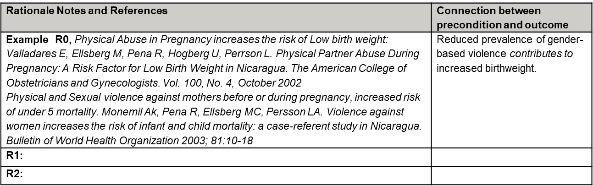
Complementary Documentation
Sample rationale matrices
R1 | Focus groups conducted for previous project gender analysis demonstrate that women are reluctant to attend healthcare centers because the majority of providers are male [ insert citation and link, if available, to gender analysis]
R2
R3
Notes:
Make them succinct. Use links to source.

Slide 14
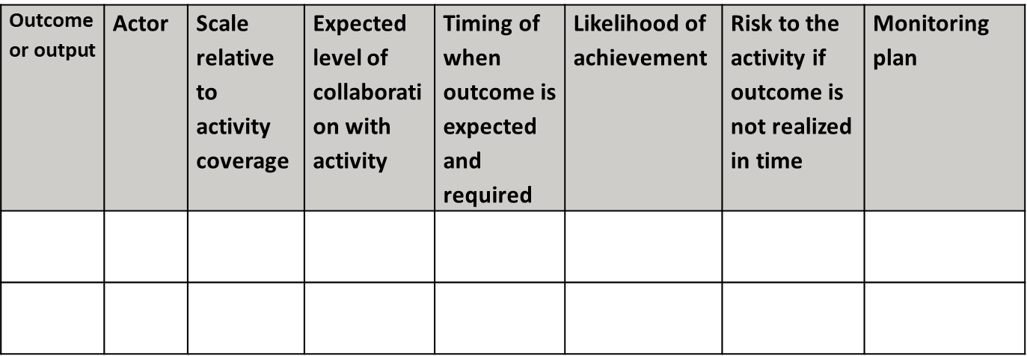
Complementary Documentation
Sample External Actor Matrix
Even though we add assumptions related to the efforts of external actors to the Log frame assumptions column, the information required in the Complementary Documentation about external actors is distinct from that of assumptions.
DO NOT use the Assumptions Matrix for external actors.
Notes:
Make statements succinct. Use links to sources.
TOPS Matrix samples can be altered as a partner sees fit. The important thing is to provide FFP with the requested information.
From FFP M&E Guidance:
“Identifies actors outside the activity who are intervening or will intervene to produce outcomes and outputs that are preconditions in a TOC pathway”
Also describes: the scale of their intervention relative to the activities coverage, a sense of the likelihood that the preconditions will be achieved by the time they are necessary to stimulate change in the pathway, and risks to the activity if they are not.
Describes activity’s level of collaboration with each actor, how that collaboration will better ensure the preconditions, and how the externally-produced outputs and outcomes will be monitored.

Slide 15
Explanation of how the activity addresses cross-cutting areas
Sample gender matrix
# | Outcome or Output | USAID Gender Domain influenced | How activity will address gender considerations
2.3.1 | Small farmer knowledge and skills on CSA practices improved | Access to and control over assets and resources; | Ensure equitable participation in farmer’s groups (portal for training) for men and women. Childcare provided during training activity
2.3.2 | Increased HH access to agriculture technology & climate smart inputs | Access to and control over assets and resources; Gender roles, responsibilities and time use | Promoted technology [specify] shows promising contributions to a decrease in women’s time burden. Promoted technologies are adapted to rural women’s needs and constraints.
Notes:
Source of Domains ADS Chapter 205. Integrating Gender Equality and Female Empowerment in USAID’s Program Cycle.
Laws, Policies, Regulations, and Institutional Practices that influence the context in which men and women act and make decisions:
Cultural Norms and Beliefs:
Gender Roles, Responsibilities, and Time Use:
Access to and Control over Assets and Resources
Patterns of Power and Decision-making:
Examples of how gender and age dynamics and roles are considered in interventions and outcomes at key steps in the ToC.
Use this to inform the Gender Analysis Summary: In the summary, the applicant should discuss illustrative points (three to four) along the proposed ToC where the applicant anticipates existing gender norms or gender relations could facilitate or impede progress towards results and provide examples of information that would be collected in order to clarify the issues identified.

Slide 16
Complementary Documentation
Population-based changes
Provide an explanation of how the about how targeting a limited number of direct participants will result in population-level changes.
Examples:
Developing interventions that will self-replicate
  Focusing on local service providers (linkages to institutions so LSPs can access resources after LOA)
  Strengthening and coordinating with local networks
Broadcasting knowledge across the whole population
Using participants as agents of change
Notes:
Questions to consider:
Do listed outputs demonstrate how the activity strengthens the capacity of individual participants to implement recommended practices or manage their resources?
Does the sequencing of outputs, or the pathways in the TOC demonstrate how individual participants will continue to have resources necessary to adopt and apply new practices ? For example, income & profits
Do listed outputs demonstrate how the activity collaborates with or strengthens the capacity of local service providers or resource management committees?
How will you demonstrate a sustained source or resources for each input originally provided by the activity?
For example, how will the support and provision of resources to service providers transition to external parties (e.g. gov. ministries, local institutions; fee for service) before EoA?
Resources that service providers offer to beneficiaries?
Resources for their own service delivery improvements?
Technical support and training to ensure provider capacity is maintained?
Financial incentives or in-kind benefits?
Does the sequencing of listed outputs demonstrate how responsibility of interventions will phase over to CBOs, individuals, or existing institutions (government, NGOs, private sector, etc.)?
In the complementary documentation discuss: what will motivate service providers to continue providing services after the EOA and what will motivate participants to continue applying newly adopted practices after the EoA. Example, financial incentives or in-kind benefits for service providers. Tangible and immediate results for project participants.

Slide 17
Thank you!

