Slide 1
From Problems to Solutions
[include date here]

Slide 2
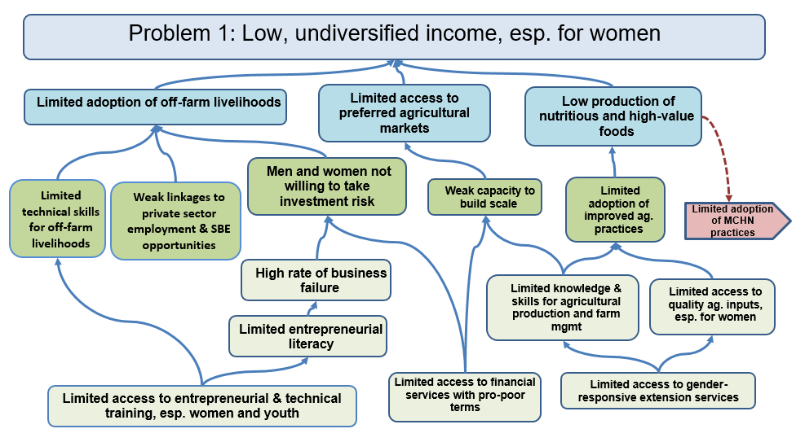
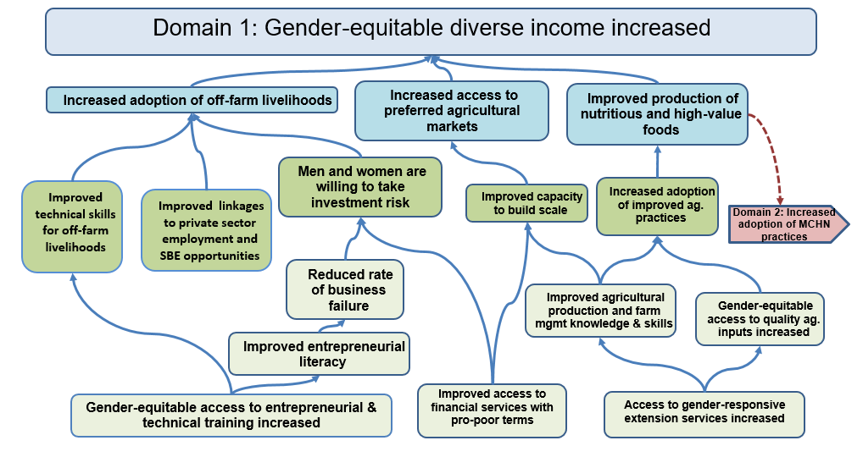
Session Objectives
To illustrate the transition from problem trees to solution trees (better known as the flip)

Slide 3
TOC Process and Timeline
 | Month 1 |  |  |  | Month 2 |  |  |  | Month 3 |  |  |  |  | Month 4 |  |  |  | Month 5 |  |  |  | Month 6
WEEK | 1 | 2 | 3 | 4 | 5 | 6 | 7 | 8 | 9 | 10 | 11 | 12 | 13 | 14 | 15 | 16 | 17 | 18 | 19 | 20 | 21 | 22 | 23
Data collection and organization
Problem Tree development
TOC diagram and complementary documentation development
Prioritize interventions
Refine TOC graphics
Logframe transfer and select indicators
Quality and completeness review
Notes:
Modify to align to your organizational timeline.

Slide 4
From Problems to Solutions
Start with the electronic version of the problem tree. Save the file as “solution tree” and begin to “flip” all problem statements.
Problem Trees Solution Trees
Problem statement overarching goal
Key problems domains of change (purposes)
Underlying causes solutions (outcomes)
State all solutions as measurable results.
Notes:
The easiest way to create a solution tree is to invert, or “flip”, the problem tree. The problem statement becomes the goal, the key problems flip into domains of change, and the remaining underlying causes flip into solutions. Later in the process, we will sort these solutions into outcomes and outputs. Of course, for this to work properly, the causal linkages in the problem tree must be logical and agreed upon, so if you haven’t put enough time into that effort….take a step back and complete before the flip!

Slide 5
Step 1: Convert problem statement to goal
To convert the overarching problem statement to a goal we reframe it in terms of the desired change and state it as if it has already been achieved.
Good example:
Sustained Food and Nutrition Security for small farm households in Southern Karamoja
Remember the what, who, where! But not the “how”
The “how” will be explained by our TOC diagrams and complementary documentation.

Slide 6
Goal Statements: Poor Examples
To improve food security, income, and resilience for chronically food insecure rural women through their social and economic empowerment.
To improve local facilities and to empower and engage 10,300 targeted households in agricultural productivity, income and employment towards improving their basic food needs in the districts of Jalapa and San Isabel.
Notes:
Ask participants to identify why these goals are poorly-worded. These are real samples from FFP-funded programs, with identifying factors changed!
First goal: Food security, income, and resilience = too many goals in one statement. Additionally, sufficient income and resilience to shocks are preconditions for food security. By refining the analysis we can usually determine the causal hierarchy of these multiple outcomes and simplify the goal statement.
“ through their empowerment” tells how the activity will do this…..the how should not be in the goal, but rather demonstrated in the TOC diagram.
The second statement also has multiple goals. This becomes problematic for M&E to determine whether the project achieves the goal, if for example, data show substantial improvement in income, but little for agricultural productivity.

Slide 7
Step 2: Convert key problems to domains of change
Main areas in which change must occur in order to be able to reach the goal
Identified based on the agreed-upon key problems
Reframe in terms of the desired change and state as a result
Choose words carefully, knowing that each of these steps will need to be measured with an indicator (e.g., increased or improved? Reduced? etc.)
Notes:
Identify the broad conditions in your problem tree that significantly contribute to the overarching problem. These are the key problems that you will “flip” to domains of change.
Domains of change (some or all of which will become FFP purposes) are main areas in which change must occur in order to be able to reach the goal. A number of domains of change may be necessary to achieve the goal. Domains of change are comprehensive; they are not limited to what one organization or one project will address.
This is a key difference between a results framework and a TOC! It is also the reason that we won’t use the term Purpose yet; there may be a domain of change that is produced by an external actor.
To “flip” the domains of change statements simply rephrase the key problems to demonstrate a desired, measurable result.

Slide 8
Step 3: Convert Underlying Causes to Solutions All solutions should be stated as results
Problem: High prevalence of childhood malnutrition
Underlying cause
Solution
Children under 5 years consume inadequate amounts of nutritious food
Children frequently suffer from diarrhea
Increased consumption of nutritious food for children under age 5 through MCHN education
Decreased prevalence of diarrhea
Notes:
Next, move through the problem tree to the myriad of underlying causes. Convert each problem/cause in a similar manner, ensuring that you restate each problem as a measurable result. The language should convey a condition already resolved rather than something that will happen in the future, or an action.

Slide 9
Exceptions to the “flip”
Contextual conditions
Many times it does not make sense to flip these problem statements (e.g. increased prevalence of drought; increase in commercial farms > limited availability of grazing land)
Leave them stated as challenging conditions at the bottom of the solution tree.
They serve as reminders when the time comes to design effective interventions that are responsive to the context.

Slide 10
Subset Impact Populations
Clearly identify groups who are disproportionately affected by the problem in the solution statement
e.g. improved access to business development training for women and youth

Slide 11
Cross-cutting: gender
Highlight gender inclusiveness in solution statements, as relevant
Gender-sensitive
Gender-responsive
Gender-inclusive
Men, women, girls, boys
Increased adoption of diversified livelihoods by men and women
Notes:
Even if the problem does not disproportionately affect one gender, as relevant, try to highlight gender inclusiveness in the solution statements (e.g., increased adoption of diversified livelihoods by men and women or access to gender-responsive extension services increased). We want to show that our TOC recognizes the importance of outcomes benefitting all genders equally.

Slide 12
Cross-cutting themes: key words
Gender / age groups | Community participation | Environment
Men and women Male and female youth | Inclusive | Climate change sensitive
Gender sensitive | With broad community input | Climate smart
Gender responsive | Participatory | Environmentally appropriate
Gender equitable |  | Good environmental practices
Male and female youth

Slide 13
Example: Converting Problems to Solutions
Notes:
Mouse clicks activate animations that “flip” the Problem Tree to a Solution Tree
It is important that the solution tree mirror every single limiting condition present in the problem tree. Again, this is because the TOC diagram is not limited to what one organization or project will address. External actors may be responsible for producing some of the critical outcomes.
In the long run, putting substantial effort toward the problem tree exercise will save time and improve the quality and rigor of the TOC diagram.

Slide 14
Sample: Linking Outcomes Across Domains (Purposes)
Notes:
FFP requires that each Purpose be presented on a separate page. If we followed the problem tree guidance, our diagrams should already be set up in this manner. If not, now is the time to correct the display.
In most cases, all the Domains of Change will become Purposes. But because, like outcomes, domains are not limited to what one organization or one DFSA will address, we we don’t use the term Purpose yet. In rare cases there is a domain of change that is produced by an external actor, and this is determined later in the TOC process.
We need to clearly demonstrate when we have cross-domain linkages. An easy way to do this is to repeat outcomes that cross pages on both pages using a different shape or color to indicate a linkage, and indicating the domain page that it will connect to.
This slide and the following slide demonstrate this concept.

Slide 15
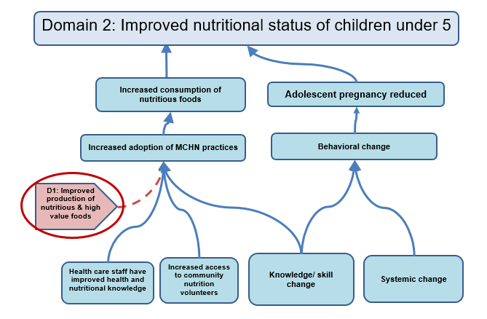
Sample: Linking Outcomes Across Domains (Purposes)

Slide 16
Thank you!

