Slide 1
Problem Tree Development, Validation, and Refinement
[include date here]

Slide 2
Session Objectives
To understand how to use causal analysis to identify the underlying causes of food and nutrition security
To develop a problem tree to explore cause and effect pathways, including cross-causal linkages
To understand the process we will use to document, prioritize and develop an action plan to fill remaining information gaps
To understand the process we will use to validate the problem tree with other stakeholders

Slide 3
TOC Process and Timeline
 | Month 1 |  |  |  | Month 2 |  |  |  | Month 3 |  |  |  |  | Month 4 |  |  |  | Month 5 |  |  |  | Month 6
WEEK | 1 | 2 | 3 | 4 | 5 | 6 | 7 | 8 | 9 | 10 | 11 | 12 | 13 | 14 | 15 | 16 | 17 | 18 | 19 | 20 | 21 | 22 | 23
Data collection and organization
Problem Tree development
TOC diagram and Complementary Documentation development
Prioritize interventions
Refine TOC graphics
Logframe transfer and select indicators
Quality and completeness review
Notes:
Modify to align to your organizational timeline.

Slide 4
Problem Tree Development, Validation, and Refinement
WHAT | WHO (examples only) | Week | Week | Week | Week
Critically analyze and organize problems and causes into a logical flow, including cross-causal linkages (Problem Tree) | Tech leads, M&E, SLA, NBD, CO staff (6-10 people representing diverse technical /contextual perspectives)
Identify and prioritize remaining information and evidence gaps
Capture the problem tree in electronic format | Graphic lead
Data collection Round 2: Attempt to fill priority information gaps through secondary data capture (or primary, if feasible) | Tech leads, M&E, SLA, NBD, CO staff, interns
Document the evidence for each problem statement in an easily referenced template (to be used by proposal writers and by CO post-award) | 1-2 person team (M&E, interns, etc.)
Vet the problem tree with other relevant stakeholders | In-country team; regional government if possible.
Refine the problem tree based on stakeholder feedback and filled information gaps | 2-3 person team (from original problem tree working group)

Slide 5
Holistic problem analysis/systems thinking
Improves ability to design and implement integrated programs that improve well-being outcomes.
  Does not mean bigger broader programs by one institution
  Is a non-sectoral or cross-sectoral approach
  Sectors and stakeholders working together to adopt complementary strategies to address common issues
Relies on rigorous causal analysis
  The identification of common constraints and opportunities, feedback loops, and underlying causes of food and nutrition insecurity
Notes:
Holistic analysis / systems thinking improves our ability to design and implement integrated programs. We all know the value FFP and other donors are placing on integrated interventions.
Integrated programming refers to a sector-neutral or cross-sectoral approach, with sectors and stakeholders working together and adopting complementary strategies to address common issues. It’s a “we’re in this together” methodology.
Holistic analysis does not necessarily mean bigger broader programs must be implemented by your organization, it simply means that you and your team explore the ‘big picture’. A “big picture” view of problems helps to develop a “big picture” TOC—one that portrays a holistic picture of how a goal might be reached, including the efforts of external actors. This in turn, helps you to identify the most effective approach for your program.
Holistic problem analysis relies on rigorous causal analysis, the identification of common constraints and opportunities, feedback loops, and underlying causes of food and nutrition insecurity before going further in the design process.

Slide 6
Causal Analysis
Helps to understand why a key problem exists
Explores cause-effect pathways, including cross-causal linkages
Identifies specific problems that can be acted upon
Notes:
Causal analysis allows you to identify the pathways between causes and effects, including cross-causal linkages between problems.
For example, why might a community experience low income security? Perhaps the causes leading to this problem include negative health issues, low crop production, or any number of other factors that are not directly within a finance and/or economic pathway. Any problem that interacts with one part of a system also interacts with other parts of the system. Thus, holistic problem analysis always aims to investigate cross-causal linkages.
By rigorously exploring cause-effect pathways, we are better able to identify the specific problems that can be acted upon.

Slide 7
Problem Trees
Represent a systems-thinking approach to analyzing cause and effect
  Helps to identify multiple causal linkages
Most critical (and overlooked) element of rigorous project design
Notes:
Food and nutrition security outcomes are typically multifaceted and much more complex than a simple, linear cause-and-effect stream.
Simple, linear models rarely allow for rigorous problem analysis – the most critical (and often overlooked) element of project design. A more effective means of organizing problems and causes is to create a problem tree.
Well-thought-out problem trees represent a systems-thinking approach to analyzing cause and effect and, in this light, are extremely useful for the TOC process because they help us to identify multiple causal linkages.

Slide 8
Prioritize an Overarching Problem
In FFP-funded DFSAs the overarching problem is often pre-determined to be food and nutrition insecurity.

Slide 9
Identify key problems, underlying causes, contextual conditions
Start with an inventory of problems/causes
Then, organize/shuffle into:
Key problems – broad conditions that negatively affect people (e.g., low income, poor health status), and contribute to food and nutrition insecurity Underlying / root causes – specific contributors to key problems (often the effects of other root causes).
Contextual conditions – social, economic, political, or natural conditions that contribute to underlying causes and often are the result of key problems (cycle of vulnerability).
Notes:
For the purposes of this training, problems are a condition or set of conditions that negatively affect people (e.g., death, infectious diseases, poor access to health or extension services, low agricultural production, inadequate housing) and contribute to compromised well-being outcomes.
We will use our evidence base (all our organized data) to create an inventory of problems. Writing the various problems down on sticky notes or index cards makes it easy to organize or shuffle them into three types of problems.
Key problems are broad conditions we recognize in many poorer parts of the world (poor health, inadequate income, etc.) that directly contribute to the overarching problem. A FFP RFA typically identifies key problems (e.g., low income, poor health status, inability to manage risk), but we should use our evidence base to confirm that they are indeed the main contributors to the overarching problem.
Underlying (or root) causes are the entire collection of causal contributors to the key problems. A city or rural region may have the same overarching problem (e.g., food insecurity) and key problems as other regions (e.g., low income, poor health status), yet the specific underlying causes will differ within each context, and will differ for distinct populations within each context.
Contextual conditions are the social, economic, political, or natural conditions (discussed in Module 1) that contribute to underlying causes and, at times, result from the overarching problem (i.e., the cycle of vulnerability).

Slide 10
Underlying Cause
What’s going on at the ------
Household and individual level?
Community level?
Systemic level?
HH and individual constraints (e.g., behaviors, knowledge and skill levels, and attitudes) that limit opportunities to achieve positive livelihood outcomes
Weak community cohesion or lack of shared values that hinder the delivery and maintenance of social and economic infrastructure.
Constraints that are external to the community, such as government policies, the delivery of social services, and market and social forces outside the community’s control.
Notes:
When thinking about the myriad of underlying causes for the key problems, it is helpful to consider how limiting factors present themselves at various levels of society. When we sort through our data, we’ll keep asking “What else?” Ask “ why does this problem exist?”
Discuss potential household, community, systemic causes.
Paying attention to causes at the systems level is critical as FFP rolls out the 2016 -2025 strategy.

Slide 11
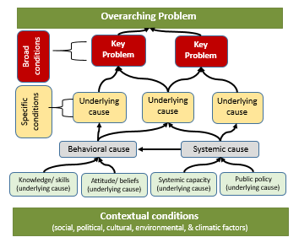
Notes:
This slide demonstrates the first basic sorting step, where we organize the evidence-based problems into various categories, and tiers, which provides the start to our problem tree.
Place key problems directly under the overarching problem.
Contextual conditions influence everything; therefore place them at the very bottom of the evolving problem tree.
In the middle of the evolving problem tree will be an assortment of underlying causes. They include:
Systemic weaknesses: problems such as low institutional capacities; limited access to basic infrastructure; or unjust public policy. These weaknesses are primarily influenced by contextual conditions, and often end up in lower tiers of the problem tree.
Knowledge and skill levels, beliefs, and attitudes include problems such as limited knowledge of optimal nutrition practices or conservation techniques, low financial literacy, a belief that women should never travel alone outside their community, or a youth’s attitude that there is no future for them in agriculture. Knowledge and skill levels, beliefs, and attitudes are rooted in contextual conditions and are influenced by systemic weaknesses. They often end up in lower to middle tiers of the problem tree.
Problematic behaviors and practices include limited adoption of WASH, agriculture, or IYCF practices, limited use of health and nutrition services, limited use of risk management strategies, or low participation of women and youth in local decision-making bodies. They may also include the behaviors and practices of system actors, not just individuals and households (e.g. traders and producers stock local markets with diverse, affordable, safe foods year-round). Behaviors and practices are greatly influenced by knowledge, skills, attitudes, and beliefs, as well as systemic weaknesses and contextual conditions. For individuals and households, these problems often end up in the upper tiers of a problem tree. For systems actors, these problems often end up in the lower to middle tiers of the tree.
Finally, some underlying causes do not fall into any of the three categories above. We can simply refer to these as specific conditions. They are typically the result of behaviors and practices and when they exist, we often find them in the upmost tiers of a problem tree, directly below the key problems. They include problematic factors such as high prevalence of early marriage, unprofitable enterprises, high rates of HIV/AIDS infection, low agricultural production, severe soil erosion, or low employment for young adults.

Slide 12
Underlying Causes
 | Behavior/ practices | Knowledge, skills, beliefs, attitudes | Systemic weaknesses
Primarily influenced by: | Knowledge, skills, beliefs, attitudes Systemic weaknesses Contextual conditions | Systemic weaknesses Contextual conditions | Contextual conditions
Primarily contribute to: | Specific conditions Contextual conditions. | Behavior/ practices Systemic weaknesses | Knowledge, skills, beliefs, attitudes Behavior/ practices Contextual conditions
Notes:
The matrix demonstrates the intricate linkages between problems and their causes and highlights how the relationships are not linear. Note how a particular type of underlying cause might be both the cause and the effect of another type of underlying cause.

Slide 13
Examples of Causal Streams
Condition
(broad)
High rates of HIV/AIDS Infection | Problem | Low Farm Family Income
 | Cause | Declining Crop Yields
People engage in unsafe sex practices | Cause | Severe Soil Erosion
 | Cause | Farmers use improper plowing techniques
Condom use is limited | Cause | Farmers unaware of benefits of contour plowing
Condom use has negative cultural connotations | Cause | No access to extension services or information
Condition
(broad)
Behavior
Condition
(specific)
Beliefs/
Knowledge
Beliefs/
Knowledge
13
Notes:
This is another simplistic example of how a chain of causes/conditions leads to a large problem. The arrows demonstrate that a lower cause leads to a higher problem.
To demonstrate the process of causal analysis is important to begin discussing the slide at the top and work down. For example, ask participants:
What are the causes of high rates of HIV/AIDS infection? (One answer: people engage in unsafe sex.)
Why do people engage in unsafe sex practices? (One answer: Condom use has negative cultural connotations.)
A causal stream is never this simple and linear. The higher we are on the causal stream the more underlying causes we can identify that feed into a problem.

Slide 14
Underlying Causes | Problem 1 Example: Limited food availability | Problem 2 Example: Low income security | Problem 3 Example: Inadequate nutrition
Behavior and practices | Farmers do not use improved practices | Early marriage (negatively affects girls’ education, leads to low wages for women) | Intra-household disparity re: allotted food Households sell nutritious foods produced
Knowledge, skills, attitudes, beliefs | Farmers do not want to risk investing in crops they are not familiar with | People do not have entrepreneurial skills People, esp. women are not educated | Limited nutritional knowledge. Taboos re: what PLW eat.
Systemic constraints | Markets unavailable and unreliable HH do not have land title deeds Poor extension services | Low prices for crops No institutions offer business development training. Predominant religion considers borrowing with interest a sin | District level health care services are understaffed. Existing staff are unable to share nutritional knowledge with health clients
Notes:
Engaging remote staff in the problem analysis before the problem tree workshop.
This organizing tool is an example of what you could send out to various team members (e.g., country-level staff) as a preliminary exercise to in-person workshops devoted to problem tree development.
During the pre-design assessment or “data capture” phase, matrices such as this can also be useful tools for organizing data as it comes in from the field.

Slide 15
Problem Statements
WHAT: determine the limiting condition
WHO: identify the population affected by the condition
  Overarching problem (impact population)
  Underlying causes (if a subset of impact population)
WHERE: the location of the population
  Necessary for overarching problem; optional for underlying causes
Food and nutrition insecurity for vulnerable pastoralist households in Fafan zone of Ethiopia.
Notes:
Problem trees are made up of a collection of clear, concise problem statements.
The over-arching problem needs to be specifically phrased so that it identifies what, who, and where. For example:
Food and nutrition insecurity for vulnerable pastoralist households in Fafan zone of Ethiopia.
Other levels of problems may or may not need to state who and where—it will depend on whether distinct populations or regions are disproportionately affected by the problem.

Slide 16
Problem Statements: Identify subset impact populations
If a problem disproportionately affects a subset of the population, specify it.
Impact group identified in overarching problem statement | Subset group identified for underlying cause
Food insecurity for vulnerable pastoralist households in Fafan zone | Inadequate amount of nutrients consumed by children under age 5
 | Limited access to extension services for women in rural districts.
 | Low agricultural yields for agro-pastoral households
Notes:
Sometimes a problem disproportionately affects a subset of the impact population (e.g., women, children, youth, elderly, farmers, the chronically food insecure, or people in one District or agro-ecological zone). In these cases, specify the subset impact population in the problem statement.
This will set the stage for specific TOC outcome statements and ensuring that our intervention targeting tightly aligns to the causal analysis.
Note that this example does not include all the causal linkages in between the underlying causes and the overarching problem statement. The purpose of this example is to demonstrate subset groups, not causal linkages.

Slide 17
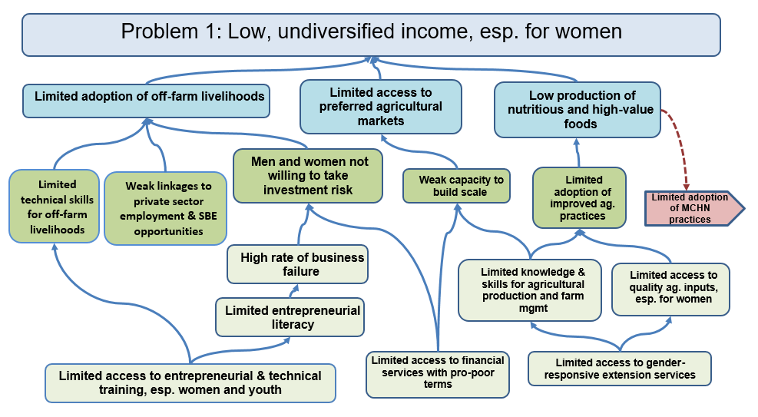
Checking logic
Notes:
Once a causal stream is in place methodically check causal logic:
Move down the stream using statements such as “Condition X exists…….because of Condition Y”. For example, “ there is a high prevalence of livestock disease because there is limited adoption of improved husbandry practice. “
There is limited adoption of improved husbandry practices because there is limited access to animal health care supplies (deworming meds; vaccinations, etc. ) and limited knowledge of how to protect livestock health
Check causal logic moving up the stream, e.g., Condition X and Condition Y and Condition Z are the main reasons Condition A exists.

Slide 18
Checking logic: distribution/ placement of problem types
Notes:
Does the diagram show:
contextual conditions at the very bottom of the evolving problem tree?
systemic weaknesses in the lower tiers?
Does the diagram document limited knowledge and skill levels, beliefs, and attitudes in the lower to middle tiers?
Do these knowledge/ skill problems (when combined with other factors) contribute to problematic behaviors and practices in the upper tiers? This may not just be the behaviors of individuals and households, but could also be behaviors of system actors (e.g., responsiveness of government to provide XYZ)

Slide 19
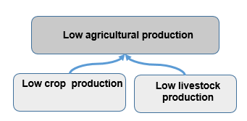
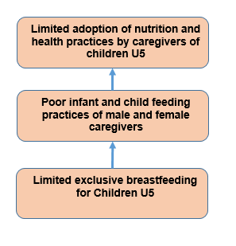
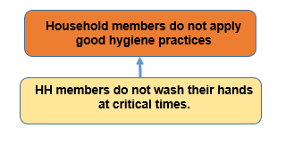
Checking logic: definitional versus causal relationship
Notes:
These are examples of a definitional relationship versus causal logic.
We want to set ourselves up for a strong TOC that shows a causal versus definitional relationship. Try to eliminate definitional links before flipping to a TOC.

Slide 20
Checking logic: foundation for prioritization
Poultry mortality and boda bodas
Pareto principle

Slide 21
Identify strong and flawed causal linkages in this sample
Notes:
Facilitator: It may be more effective to insert your own examples from past workshops. Or bring a wall-sized diagram from a past effort.
The next three slides contain example problem trees. They all contain strong causal linkages as well as flawed logic.
Ask the group to check the distribution and relationship of the four main types of problems.
Behaviors/ practices.
Knowledge, skills, attitudes, beliefs
Systemic weaknesses
Contextual conditions
Next, ask the group to identify strong and flawed causal logic.
Definitional relationships versus causal logic….etc.

Slide 22
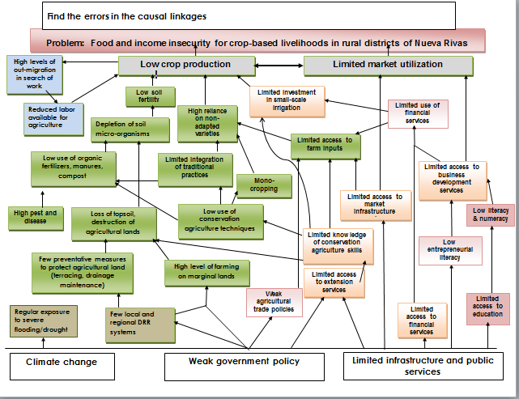
Identify strong and flawed causal linkages in this sample
Notes:
Some notable flaws:
FLAWED HYPOTHESIS- Limited knowledge of conservation/ ag skills is the only cause noted for low use of conservation ag techniques. Knowledge is necessary but not sufficient. Need resources ( sufficient human labor, physical resources, cultural acceptance of new practices, ability to take risk and try something different, etc. )
LOGICAL ORDER. Switched the order of “limited access to business development services” and “low entrepreneurial literacy”. Logic doesn’t flow here.
“high pest and disease” is not a cause of “low use of organic fertilizers
Limited knowledge of conservation ag skills does not cause limited access to farm inputs.

Slide 23
Identify strong and flawed causal linkages in this sample
Notes:
Very few problems related to behavior and practices.
Heavy on systemic problems.

Slide 24
Identify information and evidence gaps
During the logic check, information and evidence gaps will surface.
Designate 1-2 team members to keep a running list of gaps.
After the dust settles in the problem tree exercise, work with the group to prioritize data collection needs.
Initiate a 2nd round of data collections to fill priority information gaps ( secondary data capture or primary if feasible)

Slide 25
Logic Check: Document evidence gaps
Problem | Evidence | Source | Link
Low sales and profitability from produced goods and services |  | FFP Food Security Desk Review for Bangladesh
Low quality and quantity of sustainable production of on-farm and off-farm goods and services
Low adoption of improved sustainable technologies and management practices by commercial on-farm and off-farm producers
Limited producer’s knowledge and business management capacity
Weak linkages and limited participation in the market system
Limited access to market platforms
Increased access to market information
Notes:
Once the logic begins to hold, note the evidence base for each identified cause in an easily referenced matrix.
Great source for proposal writers and implementing staff post-award
Use shading or text distinctions to help sort hierarchical problem tree tiers. Essentially we are setting the evidence base up similar to a logframe.

Slide 26
Electronic problem tree
Once the logic begins to hold, capture the problem tree in an electronic format
  Creating a separate page for each key problem helps us meet the FFP requirement of having a separate page for each TOC purpose.
  Be sure to show how the problems link to one another across pages.

Slide 27
Sample of linking the problem tree across pages
Page 1

Slide 28
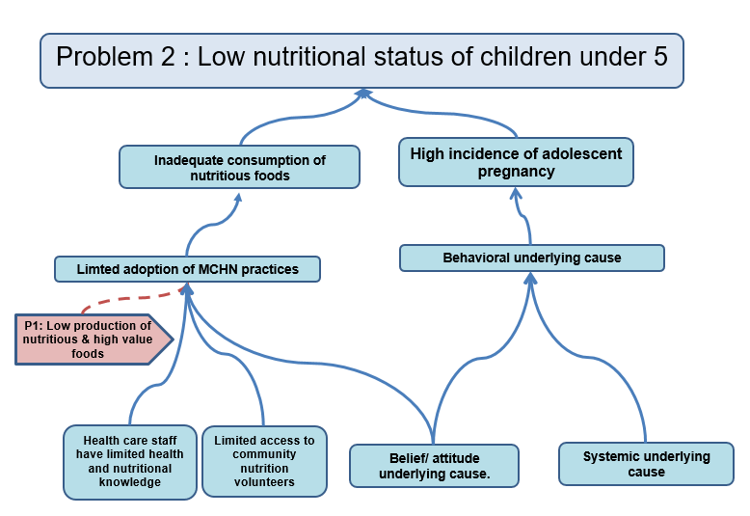
Sample of linking the problem tree across pages
Page 2

Slide 29
Sample of linking the problem tree across pages
Both pages

Slide 30
Summary
Different populations or different regions may appear to have the same broad categories of problems, yet it is critical that we identify context-specific underlying causes.
Causes occur at multiple levels (household, community, and systems) and in various forms (behaviors/ practices; knowledge, skills, attitudes, beliefs; and systemic weaknesses).
A problem tree helps us to visualize the non-linear causal logic of problematic conditions.
A problem tree with strong causal logic can be easily transformed into a TOC with strong causal logic.
Notes:
In the long run, putting substantial effort toward our problem tree will save us time and improve the quality and rigor of our TOC diagram.

Slide 31

Problem Tree Workshop

Slide 32
Problem Tree Development
1. Write a problem statement based on the goal in the FFP CSI:
WHAT: the condition the DFSA intends to address.
WHO: the population affected by the condition (e.g., target population).
WHERE: The geographic location identified in the CSI
2. Identify key problems (typically based on what the FFP CSI identifies as the key drivers of food insecurity) and draft concise problem statements.
Notes:
Facilitator: You may wish to have the uppermost tiers of the Problem Tree already in place before you begin the workshop. If so, remove this slide and explain the logic of the preliminary problem tree to the group .

Slide 33
Problem Tree Development
3. Document underlying causes on sticky notes
Write as concise problem statements
Make it clear if a problem disproportionately affects a subset population
Be sure to include the various types of causes (systemic; knowledge, skills, attitudes, beliefs; behavior/practices). Coding on different color sticky notes helps!

Slide 34
Problem Tree Development
4. Begin causal analysis to develop the problem tree
Organize causes to demonstrate how they occur sequentially or simultaneously.
Start by putting contextual constraints at the bottom of the tree.
Next work your way down from the key problems
Ask “ what are the key reasons problem X exists?” Keep asking “any other reason”, until all causes that can explain most of the problem are identified.

Slide 35
Problem Tree Development
4. Once a causal stream is in place re-check causal logic:
Move down the stream using statements such as “Condition X exists…….because of Condition Y”. For example, there is a high prevalence of livestock disease because there is limited adoption of improved husbandry practice.
There is limited adoption of improved husbandry practices because there is limited access to animal health care supplies (deworming meds; vaccinations, etc. ) and limited knowledge of how to protect livestock health
Check causal logic moving up the stream, e.g., Condition X and Condition Y and Condition Z are the main reasons Condition A exists.
5. Check the distribution and relationship of types of constraints

Slide 36
Thank you!

