Slide 1
Prioritizing Data Collection Efforts &
Organizing Data for Analysis
[include date here]
Notes:
This session introduces two frameworks (a resilience framework and the FFP 2016-2025 Strategic Results framework) as sample tools to inform the comprehensive data collection and analysis that is necessary for TOC development.

Slide 2
Session objectives
To demonstrate how the team will prioritize data collection needs for TOC development
To articulate team expectations for early and ongoing stakeholder mapping
To agree on the matrices that will guide data organization prior to analysis

Slide 3
TOC Process and Timeline
 | Month 1 |  |  |  | Month 2 |  |  |  | Month 3 |  |  |  |  | Month 4 |  |  |  | Month 5 |  |  |  | Month 6
WEEK | 1 | 2 | 3 | 4 | 5 | 6 | 7 | 8 | 9 | 10 | 11 | 12 | 13 | 14 | 15 | 16 | 17 | 18 | 19 | 20 | 21 | 22 | 23
Data collection and organization
Problem Tree development
TOC diagram and Complementary Documentation development
Prioritize interventions
Refine TOC graphics
Logframe transfer and select indicators
Quality and completeness review
Notes:
Modify to align to your organizational timeline.

Slide 4
Data Collection, Organization, and Pre-analysis
WHAT | WHO | Week | Week | Week | Week | Week | Week |  | Week |  | Week |  | Week
Develop and/ or agree on data synthesis and stakeholder mapping templates | Technical leads, M&E, SLA, NBD (4- 8 people representing diverse perspectives)
Enter all secondary information into templates |  |  |  |  |  | ONGOING
Identify and prioritize data gaps for primary data collection.
Draft data collection tools & review with team
Preliminary analysis; draft problem statements based on available data Create high-level basic problem tree (top tiers) based on secondary data
Vet basic problem tree with full team
Collect primary data
Enter primary data into data synthesis and stakeholder templates | E.G. 2-3 person team; M&E staff
Notes:
Enter dates in top row of calendar.
Fill in responsible staff for each task. IDEAL’s TOC Roles, Responsibilities and Timeline Guidebook offers suggestions on adequate number of staff needed for each step.

Slide 5
Prioritizing What Data to Collect

Slide 6
What information do we need to collect to inform TOC development?
Comprehensive data collection and analysis is necessary for TOC development
YET…
Often there is so much potential information it is hard to know what to collect and when to stop.
To help prioritize data collection efforts start by referencing relevant conceptual frameworks.
Notes:
As noted earlier, a strong evidence base sets the TOC process apart from other project design processes.
A strong evidence base requires comprehensive data collection that allows us to identify context-specific problems, rather than simply relying on generic analyses of the problems of the poor.
Yet often, there is so much information out there it is hard to know what to collect and when to stop.
Creating a list of information categories based on the components of a conceptual framework helps to prioritize what information should be collected either through secondary literature or through primary research.

Slide 7
Conceptual Frameworks and the TOC Process
Conceptual frameworks are particularly useful as organizing devices for comprehensive data collection efforts.
They help us to ensure we are collecting the right kind of information that will allow us to carry out the rigorous and thorough causal analysis necessary for TOC development.

Slide 8
Conceptual Frameworks and the TOC Process
Once we prioritize categories of information to collect, the next step is to identify several key questions within each category.
After data are collected, we can use the same frameworks to design data analysis matrices that help us systematically document & identify what we know and what we don’t know.
Notes:
Two frameworks that can be especially helpful to prioritizing data needs when responding to FFP RFAs are the Resilience Framework and the FFP Strategic Results Framework.

Slide 9
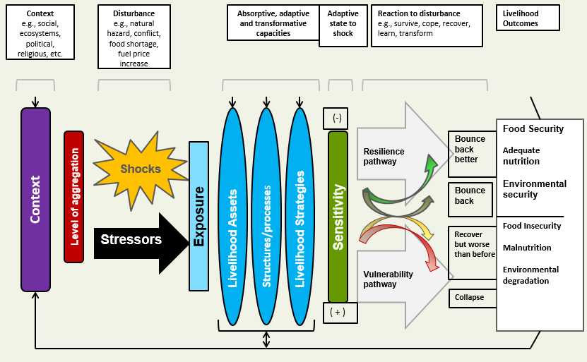
Resilience Framework
Source: Frankenberger, T., T. Spangler, M. Langworthy, and S. Nelson. 2012. Enhancing Resilience to Food Security Shocks in Africa. Department for International Development and TANGO International.
Notes:
The resilience framework integrates a livelihoods approach, a disaster risk reduction (DRR) approach, and elements of a climate change approach to address the underlying causes of vulnerability:
The livelihoods approach emphasizes the importance of access to diverse assets, institutional structures and processes, and the livelihood strategies pursued by households.
The DRR approach focuses on preparedness, response, and recovery activities formulated in response to potential shocks and stressors.
The climate change adaptation approach is similar to that of DRR, but focuses specifically on actions to be taken in response to and preparation for ongoing changes in climate. It gives considers potential threats caused by the loss of biodiversity and a decrease in ecosystem services.

Slide 10
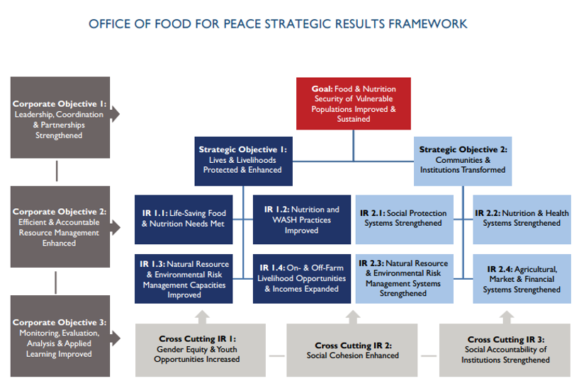
Notes:
The FFP Strategic Results Framework demonstrates that “sustained improvement in food and nutrition security is an outcome of change at both an individual and an institutional, or “systems,” level, no matter what the operational context.”
Similar to the Resilience Framework, it emphasizes “risk management that, in addition to natural hazards like drought and flooding, addresses risks posed by fragility, conflict, pandemic disease, and climate change, as well as idiosyncratic shocks, like the death of a household head. “
Finally, the FFP Strategic Results Framework highlights the importance of women and youth empowerment, enhanced social cohesion, and strengthened social accountability in the quest to improve food and nutrition security.
To learn more about each component in this Strategic Results Framework visit this link: https://www.usaid.gov/sites/default/files/documents/1867/FFP-Strategy-FINAL%2010.5.16.pdf

Slide 11
Information Categories
Contextual factors: broad social, economic, political, environmental, demographic, and historical trends
Often identified through secondary literature
Level of aggregation: make sure to capture information that helps you analyze the root of problems at various levels—individuals, households, communities, and systems.
Shocks and stressors: what types are impacting the populations of interest? Who is most exposed and why?
Notes:
What information needs should we prioritize? We’ll identify critical information categories by breaking down the components of the Resilience Framework and highlighting how these relate to relevant components of the FFP Strategic Results Framework.
Encourage participants to reference hard copies of both frameworks while you review the components.
Understanding the context is critical to conducting a thorough causal analysis—an early step in TOC development. Contextual factors include broad social, economic, political, environmental, demographic, historical, and infrastructural trends that influence the range of strategies individuals and households are able to use. We can often obtain this information through secondary literature.
Level of aggregation is the unit of analysis for determining resilience of what or whom (the individual, household, community, institution, government, or ecosystem). When planning data collection to inform a TOC, our data collection tools must be designed to capture information that will help us analyze the root of problems at various levels—individuals, households, communities, and systems.
Shocks and stressors: To design plausible TOCs and effective development programs, it is critical that we collect data that help us understand precisely which types of shocks and stressors are impacting populations.
Sample key questions:
What types of shocks and stressors impact the populations of interest? How frequently?
In addition to geographic considerations, does exposure to shock vary by age? By gender? Ethnicity? Why?

Slide 12
Information Categories: Assets
Notes:
Households have access to both tangible and intangible assets that allow them to meet their needs.
Tangible= financial, physical, natural capitals
Intangible = human, social, political capitals
The ability to adopt various practices (e.g. nutrition and WASH, NRM, or the pursuit of a particular livelihood) is dependent on a sustainable combination of assets (in addition to other factors)

Slide 13
Key Questions: Assets
We need to understand:
Which assets do males, females, youth, and other sub-populations have access to?
Who has greatest access? Who has least access? Why?
What is the quality of those assets?
Notes:
Households have access to both tangible and intangible assets that allow them to meet their needs. Understanding which assets males and females have access to, and the quality of those assets, is critical to informing TOC development.

Slide 14
Information Categories: Structures, Systems, and Processes
Notes:
Structures, systems, and processes: To design plausible TOCs and effective development programs, it is essential to collect data that help us understand the structures and systems in place.
Data collection efforts should seek to identify the multiple institutions and organizations that directly influence individual, household, and community well-being outcomes. In the public sector, this typically includes national, regional, and local governments as bodies or structures that manage and implement political, judicial, and legislative processes. In civil society, examples of typical structures are nongovernmental organizations (NGOs), community-based organizations (CBOs), religious institutions, and trade associations. There also may be structures within the private or commercial sector.
We also need to collect information on the services they provide (e.g., humanitarian aid, social protection, nutrition and health, NRM and ERM, Ag., market, or financial).
Structures that influence well-being outcomes also include cultural, social, gender, and religious norms, so data collection efforts should seek to identify what prevails in the area of interest. Similarly, you will want to identify the laws, regulations, and policies that influence people’s lives.

Slide 15
Key questions Structures, systems, and processes
What institutions and organizations are operating?
What services do they provide? Who has access?
What systems are in place? (e.g., information, NRM, ERM, Ag., Market, Financial, etc.)? How well do they function?
To what extent are institutions socially accountable to different populations?
What laws, regulations, and policies influence people’s lives? Is there recognition and respect for human rights?
What cultural, social, gender or religious norms exist?

Slide 16
Information Categories: Individual and household strategies
Notes:
Individual and household strategies: Data collection tools should include questions that allow teams to determine the strategies individuals and households are using to enhance overall well-being. This includes livelihood strategies, risk management strategies, coping strategies, decisions about how various assets are used, etc.
Are different populations taking preventative measures and using appropriate coping strategies to avoid permanent, negative impact?
Are they making proactive and informed choices that allow for an effective response to changing environmental, climatic, social, political, and economic conditions?

Slide 17
Key questions Individual and household strategies
How are different populations securing a living (production and/or IGA)?
What opportunities are available to men, women, youth?
What strategies do different populations use to avoid or reduce exposure to risk?
How do they cope with the effect of shock?
What decisions do they make to enhance overall well-being (e.g., dietary choices, advocacy, marriage, education, diversification, WASH investment?)
Are different populations taking preventative measures and using appropriate coping strategies to avoid permanent, negative impact?
Are they making proactive and informed choices that allow for an effective response to changing environmental, climatic, social, political, and economic conditions?

Slide 18
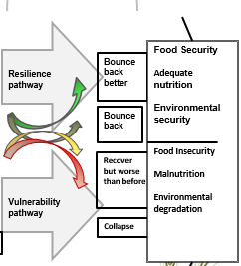
Information categories Well-being outcomes
What is the current prevalence of food insecurity?
Malnutrition?
Illness?
Poverty?
Literacy?
Environmental degradation?
Conflict?
How does it differ by age? Sex? Ethnicity?
Notes:
The level of exposure to risk combined with the strategies an individual, household, or community implements leads to a well-being outcome.
There are a variety of well-being outcome measures that provide information on the extent to which households are successfully reducing and managing risk in order to reach desired outcomes.
When collecting data to inform TOC development we must gain a general understanding of well-being outcomes because these measures will be key to determining domains of change in the TOC.

Slide 19
Collecting, Organizing, and Analyzing Data

Slide 20
Iterative rounds of data collection/ analysis
Desk review
Data organized in analysis matrix
Evidence gaps prioritized
Primary data collection
Secondary/ Primary data collection
Evidence gaps prioritized
Problem Tree
Data organized in analysis matrix
Additional data collection OR action learning plan for Y1
Data organized in analysis matrix
Problem Tree Revision
TOC
Evidence gaps prioritized
Notes:
Iterative rounds of data collection and organization helps us fill data gaps so that we can more accurately determine the causal links between problems.

Slide 21
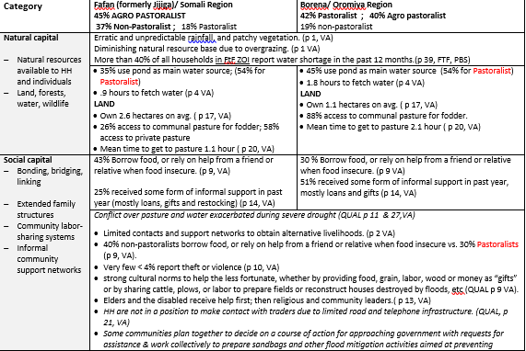
Organize data by key themes
Notes:
Arranging data by the key components of a conceptual framework is a critical first step. It allows your team to clearly see what you know and what you don’t know. At a glance, you will be able to determine the type of information that has been sufficiently collected as well as identify critical data gaps.
Organizing data by key themes in a conceptual framework also aids data interpretation. It helps identify where strengths and weakness lie that may influence the capacity of various populations to achieve optimal livelihood outcomes.

Slide 22
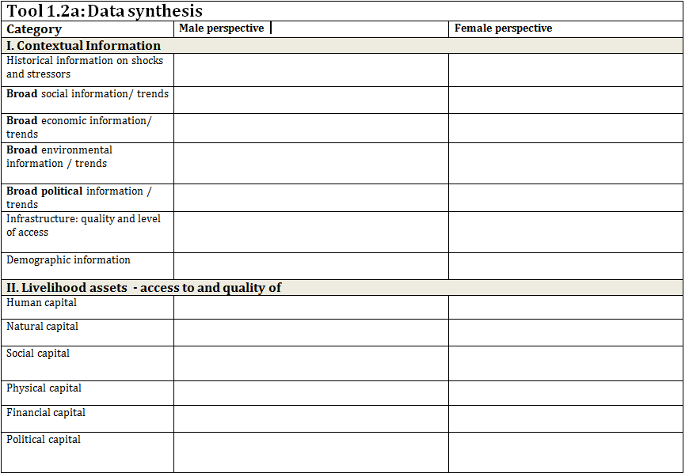
Notes:
This sample matrix helps to synthesize all collected data into categories that correspond to the resilience framework. Data can be separated by well-being groups (e.g., poor, middle, or better-off), sex, occupational groups, urban/rural dwellers, or ethnicities.

Slide 23
Stakeholder mapping
Technical Area | Name of agency/ Contact info | Type of agency | Scope of assistance (time) | Scope of assistance (geographic) | Scope of assistance (participants) | Successful interventions/ & why | Un-successful Interventions/ & why | Relationship with other stakeholders
Component: Health and Nutrition
WASH
Prevention/ treatment of childhood illnesses
Family planning services
Nutrition services
Component: Agriculture and Livelihoods
NRM
Notes:
To build a case for assistance, we must develop a comprehensive picture of what support exists and what is needed. Stakeholders’ templates are a way to track existing activities implemented by external actors (e.g., national and local government agencies, NGOs, UN agencies, CBOs, etc.). It is important to include all types of agencies in the template, even if our project does not anticipate forming partnerships with these agencies. Additionally, in order to highlight complementarity and collective efforts toward a achieving the goal in a TOC, it is critical to include all types of activities, even the project partners do not intend to implement similar activities.
Stakeholders’ templates typically include:
Name of agency: Be specific. If a government agency, list the specific ministry, not just “government.” List the contact/source of information so that if you need to go back and clarify or confirm information you can.
Type of agency: Government, local NGO, INGO, UN, CBO, private business, etc.
Scope of assistance: For ‘time’, identify project lifespan (when implementation began & when it is due to end). Include all phases, not just the current funding cycle. (Example: 2012 – 2017). For ‘geographic’, list all Districts and/or agro-ecological zones in which activities have been implemented. For ‘beneficiaries’, when possible, identify specifics (e.g. urban women, children under 5, etc.) and planned total of direct project beneficiaries (exclude indirect beneficiaries).
Successful activities: List activities that have directly contributed to achievement of project objectives and/or those that show some sign of leading to lasting impacts. As much as possible, describe why these activities were successful.
Relatively unsuccessful interventions: Identify activities that could not be implemented as planned or were not helpful in achieving project objectives. To the extent possible, describe the reasons why these activities were ineffective.
Relationship with other stakeholders: Describe the role of other stakeholders in implementing or monitoring project activities. Identify complementarity and coordination with similar projects implemented by other stakeholders.

Slide 24
Thank you!

