Slide 1
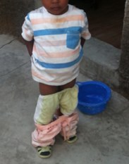
Children’s Sh*t: it’s crucial for total sanitation and development
Sanitation Working Group
Introduction Practices in Bangladesh Programs in Bangladesh Emerging Lessons
Emily Rand and Libbet Loughnan
April 1, 2014
Notes:
Today we’re going to talk about the management of child feces.
I’ll do an introduction, then Libbet will go over current Practices and Existing Interventions and then I’ll talk about some emerging ideas.
Before I start, I’d like to also acknowledge Therese Dooley and Louise Maule at UNICEF, who are likely on the phone, and with whom we’ve been collaborating on the profiles we will present today.

Slide 2
Introduction Practices Programs Emerging Lessons
Notes:
This slide is blank on purpose.
I’d like to also start out by saying this is a work in progress. This is emerging thinking, not results.
We’ve started to pull together what we can find related to children’s sanitation, and it ain’t much.
This is an area where we see a gap of evidence and honestly, part of why we’re here today is to advocate for more work to be done in this area.

Slide 3
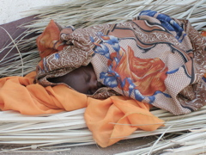
Diarrheal disease claims the lives of 1,600 children under five each day
Introduction Practices Programs Emerging Lessons

Slide 4
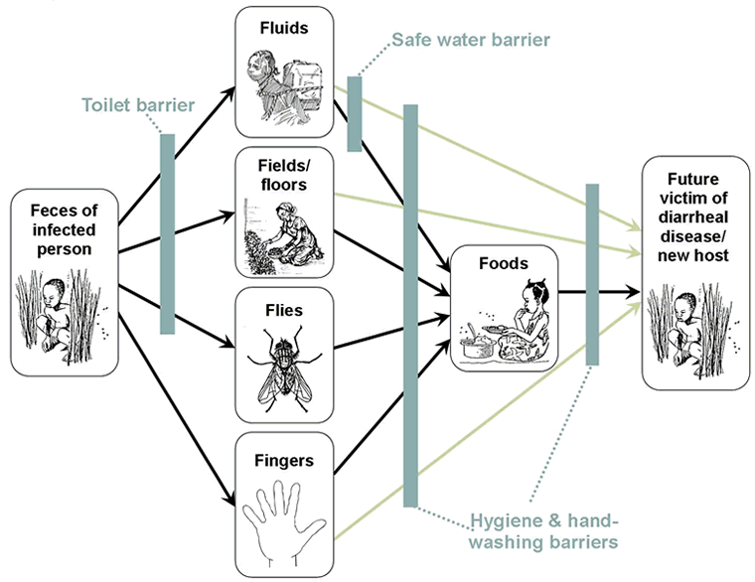
Sanitation prevents 36% of diarrheal disease
Introduction Practices Programs Emerging Lessons
CHERG (2010)
Notes:
We are usually talking about increasing the access to household sanitation. As you will see in Libbet’s presentation, a household having sanitation does not mean that a child has sanitation. While we measure the impact on children, sanitation interventions almost always target adults.

Slide 5
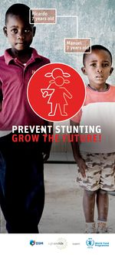
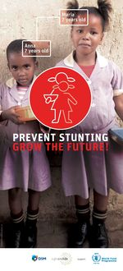
162 million children, ¼ of under-five children, were stunted in 2012
Introduction Practices Programs Emerging Lessons
UNICEF-WHO-World
Bank Joint Child Malnutrition Estimates (2013)

Slide 6
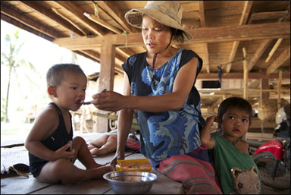
Intake Interventions can only reduce stunting by 36% and mortality by 25%¹
Introduction Practices Programs Emerging Lessons
Photo UNICEF ¹ Bhutta (2008)
Notes:
Intake interventions can only reduce stunting by 36% and mortality by 25%. So what can make up the rest of the difference?

Slide 7
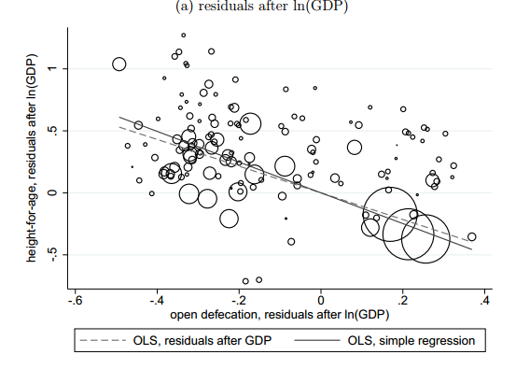
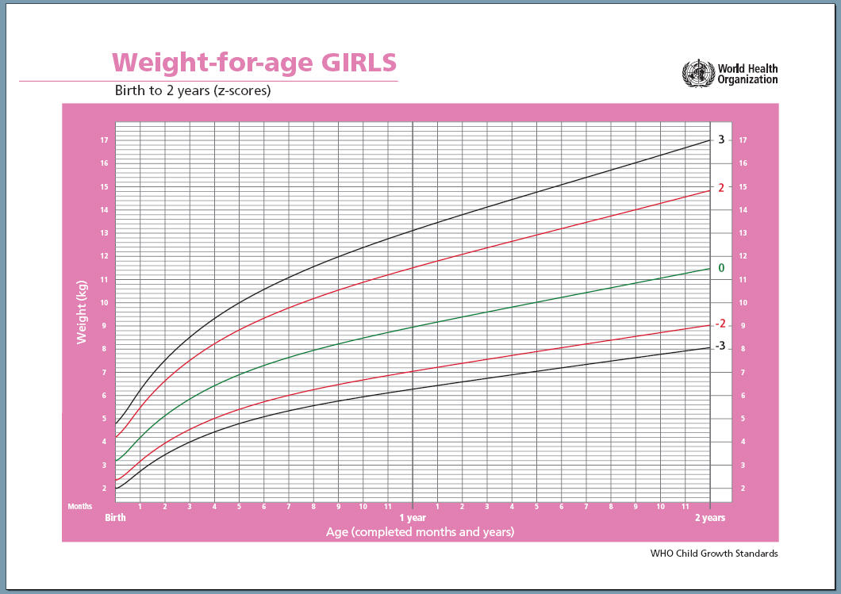
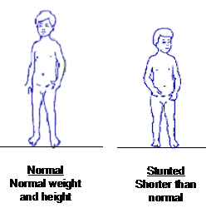
Sanitation explains 54% of international variation in child height
Introduction Practices Programs Emerging Lessons
Spears, 2013
Notes:
Emerging research shows that Sanitation alone explains 54% of international variation in child height. Just in case you wondered, GDP only explains 29% of international variation in child height.

Slide 8
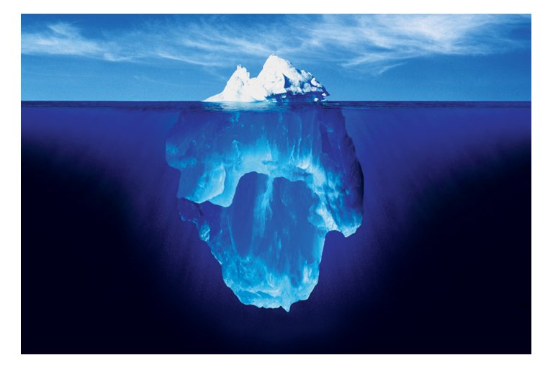
People with Environmental Enteropathy can be asymptomatic without diarrhea
Introduction Practices Programs Emerging Lessons
SHINE
Notes:
The real problem might be below the surface in the intestines with Environmental Enteropathy.

Slide 9
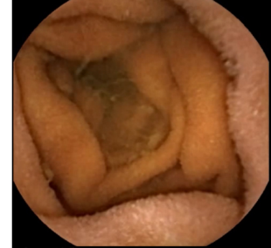
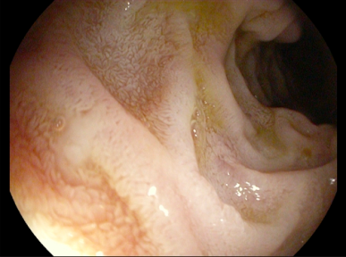
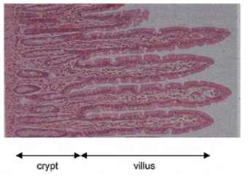
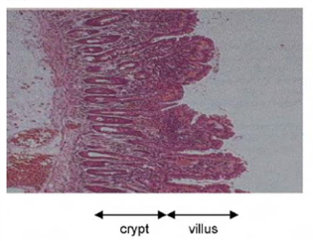
Environmental Enteropathy deranges intestinal absorptive and immunologic functions
Introduction Practices Programs Emerging Lessons
Duodenum
Muscosa
Healthy Unhealthy
Notes:
Stay tuned to the results of SHINES work to see if we can stop having to use the word “hypothesis” whenever we talk about this work.

Slide 10
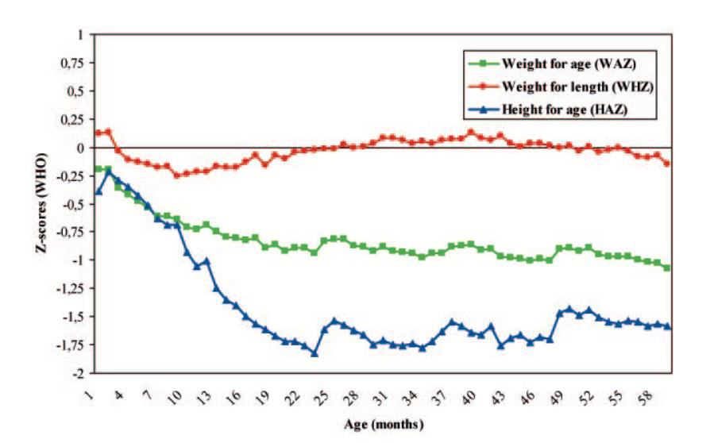
The first 1,000 days of life are forever
Introduction Practices Programs Emerging Lessons
Victora et al. (2008)
Notes:
What is lost in height for age cannot be reversed.
While we don’t have evidence directly on the health impact of safe disposal of child feces, we do know that child feces are more pathogenic.

Slide 11
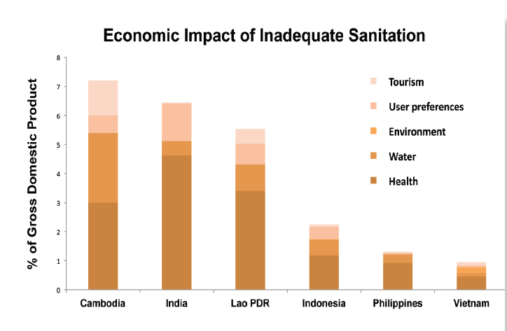
Inadequate Sanitation costs the world at least 260 billion US dollars each year
Introduction Practices Programs Emerging Lessons

Slide 12
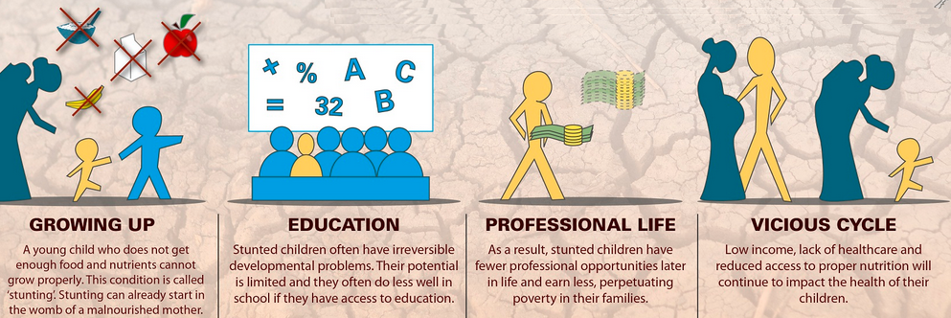
Stunting has lifelong implications
Introduction Practices Programs Emerging Lessons
UNICEF
Notes:
260 billion figure is likely an underestimate, because it didn’t take into account the lifelong costs of stunting.

Slide 13
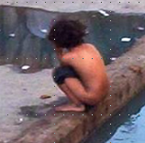
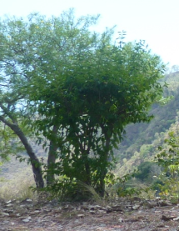
By 2025, no one practice open Defecation
Introduction Practices Programs Emerging Lessons
Notes:
post 2015 sustainable development goals

Slide 14
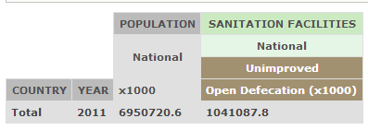
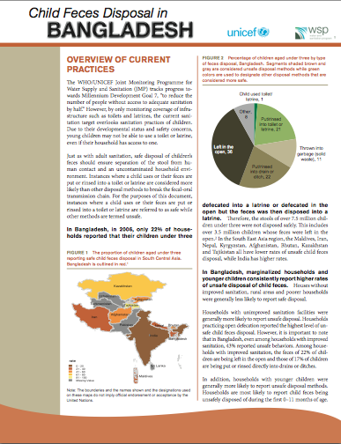
WSP and UNICEF are working to publish data on management of child feces
Introduction Practices Programs Emerging Lessons
Afghanistan
Burkina Faso
Cambodia
Chad
Ethiopia
India
Indonesia
Kenya
Lao PDR
Madagascar
Malawi
Mozambique
Nepal
Niger
Nigeria
Pakistan
Philippines
Senegal
Sierra Leone
South Sudan
Sudan
Tanzania
Uganda
Zambia
Notes:
To start to learn how many children are open defecating, WSP and UNICEF are working together to create 25 profiles that will:
outline child feces disposal behavior
highlight programs that are working to improve the management of child feces
identify emerging lessons
The aim of these profiles, and our discussion today, is to help stimulate conversation in country and also to identify best practices that can then be included in global practical policy and program guidance related to the safe collection, transport, and disposal of child feces.

Slide 15
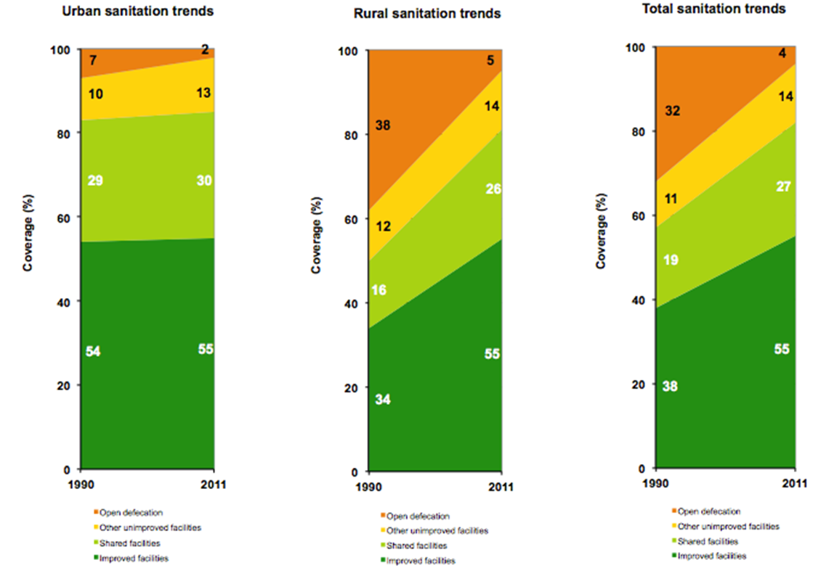
Bangladesh has high sanitation coverage
Introduction Practices Programs Emerging Lessons
JMP 2013

Slide 16
Current CFD Practices in Bangladesh

Slide 17
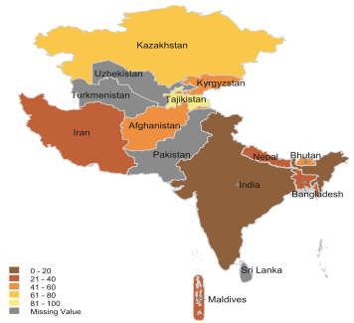
Bangladesh has the second lowest safe disposal rates in the region
Introduction Practices in Bangladesh Programs in Bangladesh Emerging Lessons
Latest MICS/DHS per country
Notes:
Just as with adult sanitation, safe disposal of children’s feces should ensure separation of the stool from human contact and an uncontaminated household environment.
Instances where a child uses or their feces are put or rinsed into a toilet or latrine are considered more likely than other disposal methods to break the faecal-oral transmission chain. For the purposes of our analyses, instances where a child uses or their feces are put or rinsed into a toilet or latrine are referred to as safe while other methods are termed unsafe.
This map is based on the latest available Multiple Indicator Cluster Survey or Demographic and Health Survey for countries in the South Central Asia region (survey years range from 2006-2011):
Bangladesh rates worst bar India among all countries for which we have data in South Central Asia (i.e. Maldives, Iran, Nepal, Kyrgyzstan, Afghanistan, Bhutan, Kazakhstan and Tajikistan all have lower rates of unsafe child feces disposal).

Slide 18
Only 22% of child feces is disposed of “safely”
Introduction Practices in Bangladesh Programs in Bangladesh Emerging Lessons
Percentage of children aged under 3 by household’s type of sanitation Facility, Bangladesh
Note: Although it looks like the large bracket should add to 24%, this is due to rounding
MICS 2006
Notes:
So let’s break it down for Bangladesh. The trends we see here are emblematic of trends we are seeing in all countries studied so far.
These next few slides are based on self-reported child feces disposal behaviour collected in the Bangladesh MICS 2006, which is the latest MICS/Demographic and Health Survey (DHS) on file for Bangladesh that records child feces disposal behaviours.
There is global evidence, as well as evidence from Bangladesh, that self-reports may overestimate safe disposal. Regardless of this issue, self-reports are currently regarded as the most efficient method for gauging safe disposal of children’s feces.
In Bangladesh, in 2006, only 22% of households reported that their children under three defecated into a latrine or defecated in the open but the feces was then disposed into a latrine – i.e. only 22% of children had safe feces disposal: basically only a fifth of children!
Segments shaded brown and gray are considered unsafe disposal methods while green colors are used to designate disposal methods that are considered more safe.
Therefore, the stools of over 7.5 million children under three were not disposed safely.
This includes over 3.5 million children whose feces were left in the open – literally open defecation.

Slide 19
Only 11% of child feces is disposed of into an improved sanitation facility
Introduction Practices in Bangladesh Programs in Bangladesh Emerging Lessons
Percentage of children aged under 3 by household’s type of sanitation Facility, Bangladesh
Note: Although it looks like the large bracket should add to 24%, this is due to rounding
MICS 2006
Notes:
Even among those 22% of households with safe child feces disposal, only half (11% overall) have an improved sanitation facility into which they could easily dispose the feces. This stricter definition of disposal type is called “improved disposal” in this figure.
Although our profiles focus on data from the latest MICS/DHS for each countries, we did also look at all other evidence we could locate. Some evidence on feces circulating in the environment from other (non MICS/DHS) sources: In rural areas of Bangladesh, crawling infants come into contact with animal feces, the baby’s own feces and those of its brothers and sisters. According to one study, half of mothers in two villages near Dhaka had also seen their infants eating or touching feces during the previous two weeks.” (Zeitlin et al., 1985).

Slide 20
Even among households with improved sanitation, the feces of 54% of children is not safely disposed of
Introduction Practices in Bangladesh Programs in Bangladesh Emerging Lessons
Percentage of children aged under 3 by household’s type of sanitation facility and type of child feces disposal, Bangladesh
India NFHS05-6
Notes:
Marginalized households and younger children consistently report higher rates of unsafe disposal of child feces.
What do we mean by marginalized?
Houses without improved sanitation
Rural
Poorer
We will see a series of slides now on this.
Even among households with improved sanitation:
53% reported unsafe behaviours (all disposal types except “child used toilet/latrine” and “put/rinsed into toilet or latrine”).
This includes:
22% of children have their feces left in the open
17% of children have them rinsed into drains or ditches.

Slide 21
Meanwhile almost all children living in households practicing open defecation have unsafe feces disposal
Introduction Practices in Bangladesh Programs in Bangladesh Emerging Lessons
Percentage of children aged under 3 by household’s type of sanitation facility and type of child feces disposal, Bangladesh
India NFHS05-6
Notes:
Here we see that HHs practicing open defecation reported the highest level of unsafe child feces disposal.

Slide 22
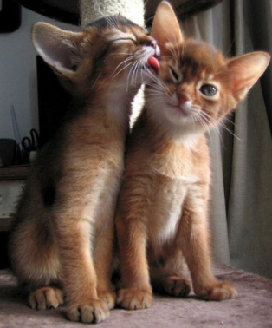
Introduction Practices in Bangladesh Programs in Bangladesh Emerging Lessons
Notes:
This slide is here because everyone pays more attention if kittens are involved! And maybe it will mean you have nicer associations in your minds now with this topic than you did before.
No, more seriously, this is to remind me to mention that we are talking about very young ages groups – 0-2 years old. Thus, it is important to remember that the child feces disposal behavior is really about how the caregivers (usually mothers) are managing child feces, and then how children are beginning to learn behaviors from their caregivers.

Slide 23
Younger children’s feces are more likely to be left in the open
Introduction Practices in Bangladesh Programs in Bangladesh Emerging Lessons
Percentage of children aged under three by type of feces disposal and
type of child feces disposal, Bangladesh
MICS 2006
Notes:
Here we see the tendency for HHs with younger children to have worst disposal practices.
Especially in the first year of life.
There is also a peak in open defecation (feces “left in the open”) for children aged 12-23 months, the same age when the majority of children have just started walking.

Slide 24
Poorer children’s feces are even more likely to be left in the open
Introduction Practices in Bangladesh Programs in Bangladesh Emerging Lessons
Percentage of children aged under three by type of feces disposal and type of child feces disposal, Bangladesh
MICS 2006
Notes:
- Here we see the tendency for poorer to have worst disposal practices.

Slide 25
Current Interventions in Bangladesh
Notes:
A range of efforts to increase demand, improve supply, and create an enabling environment for the safe disposal of child feces during the first years of life are underway by various organizations in Bangladesh.
There seem to be three main ones – but you make know of more! - and they address different aspects of the collection, transport, and disposal of child feces and toilet training.

Slide 26
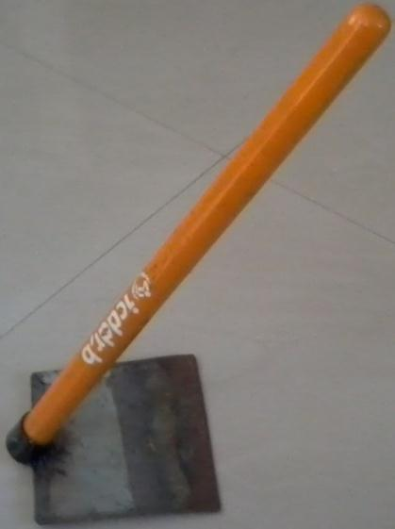
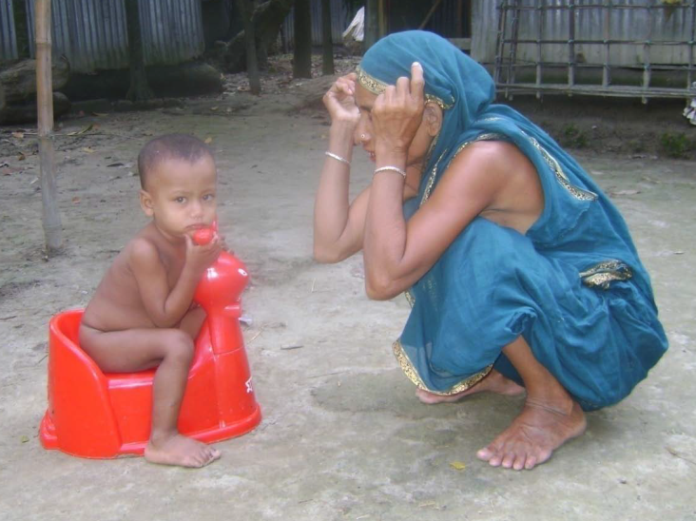
WASH Benefits and icddr,b examined and re-purposed current products
Introduction Practices in Bangladesh Programs in Bangladesh Emerging Lessons
Icddr,b & Luby (2013)
Notes:
WASH Benefits and the International Centre for Diarrheal Disease Research, Bangladesh (icddr,b) is trialling an intervention emphasizing safe removal of feces from the compound:
a sani-scoop hoe for picking up feces,
plastic child potties with a removable tray
a new or upgraded dual pit latrine for each household in its compound.
What is its impact?
A randomized controlled trial (RCT) is being carried out to measure impacts.
Self-reported data about the respondent’s use of the interventions indicated improvement.
However, observations of feces in the household environment found only a statistically insignificant difference (Luby, et al. 2013).

Slide 27
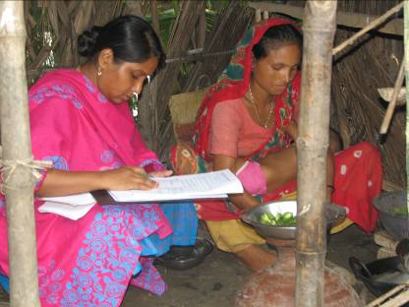
UNICEF’s SHEWA-B program trained 10,000 local community workers
Introduction Practices in Bangladesh Programs in Bangladesh Emerging Lessons
icddr,b & Amal Krishna Halder
Notes:
Second project: UNICEF’s Sanitation, Hygiene Education and Water Supply in Bangladesh (SHEWA-B)
This project trained 10,000 local community workers provide hygiene instruction to their neighbours, primarily focusing on the mothers of children under five (UNICEF, 2013). Total target population is 20 million people.
What’s its impact?
According to a study conducted in 2012, structured observations did not record statistically significant increases in the proportion of child feces disposed in a latrine or pit (Luby, et al. 2013)

Slide 28
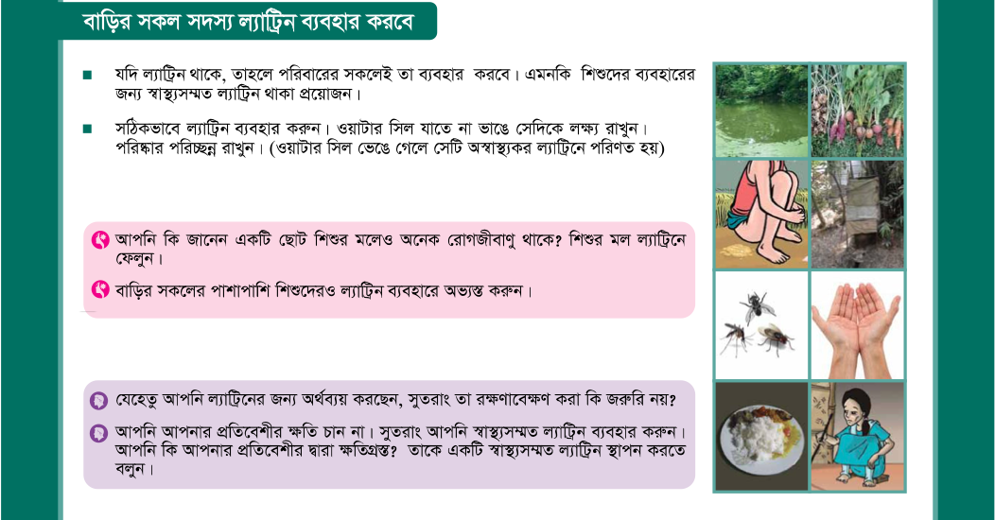
BRAC is targeting over 17 million people in Bangladesh with safe feces disposal interventions
Introduction Practices in Bangladesh Programs in Bangladesh Emerging Lessons
BRAC flipchart 2014
Notes:
BRAC was formerly Bangladesh Rural Advancement Committee.
The project’s 2006-7 baseline survey found that adults placed less importance in the contamination potential of children’s than adults’ stool and only 11% of respondents regarded “after cleaning children’s stool” to be an appropriate time for handwashing (BRAC, 2008).
In response to these findings, the organisation is targeting over 17 million people in Bangladesh with safe feces disposal interventions.
The program educates children under five and their mothers about proper hygiene practices, through the use of flipcharts and brochures that include messages such as:
Did you know that the feces of small children can be dangerous? Try to throw the children feces into the latrine.
Your children need a hygienic latrine and need to use it.
After cleaning the child’s bottom throw the child feces into the latrine; it is important to wash both hands with soap (BRAC 2013).
What is it’s impact?
The authors could not locate an evaluation of these efforts.

Slide 29
Emerging Ideas
Increase Demand
Strengthen Supply
Create an Enabling Environment
Notes:
Given the relatively few programmes focusing on children’s sanitation in Bangladesh and also globally, there is not a strong evidence base on what works best for effectively increasing the safe disposal of child feces.
Significant knowledge gaps must be filled before comprehensive practical evidence-based policy and program guidance will be available.
Nevertheless, the organizations mentioned previously plus other experts working in or researching children’s sanitation globally have published a number of recommendations and possible methods for incorporating child feces management into existing programs.

Slide 30
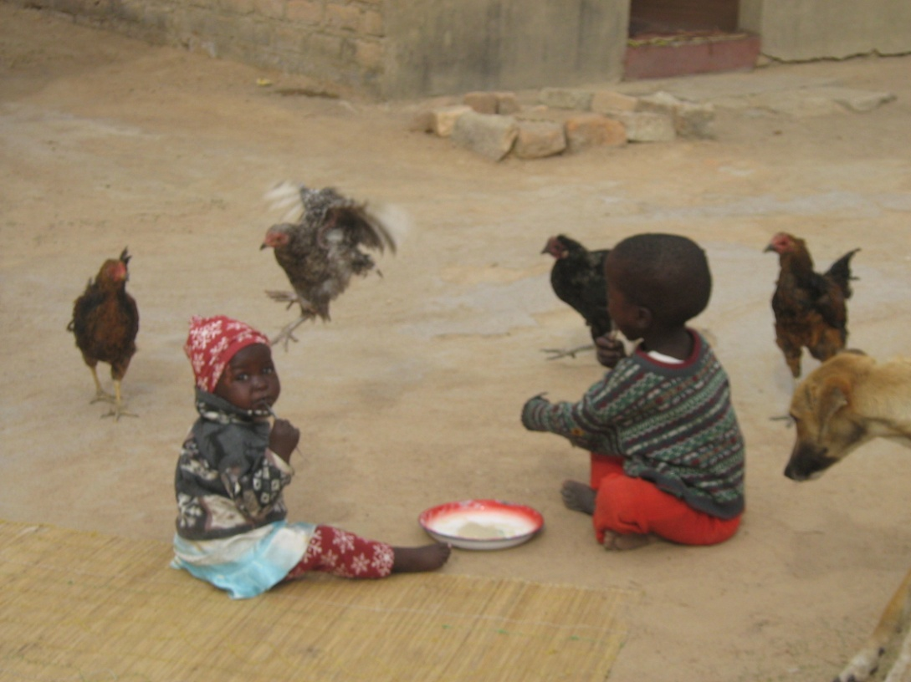
Changing children’s behavior requires caregivers help
Amount of E. Coli ingested by an active one year old baby per unit weight:
1 gram of soil from a laundry area = 69 E. coli counts
1 gram of water = 2 E. coli counts
1 gram of chicken feces =10 million E. coli counts
Ngure et al. (2014)

Slide 31
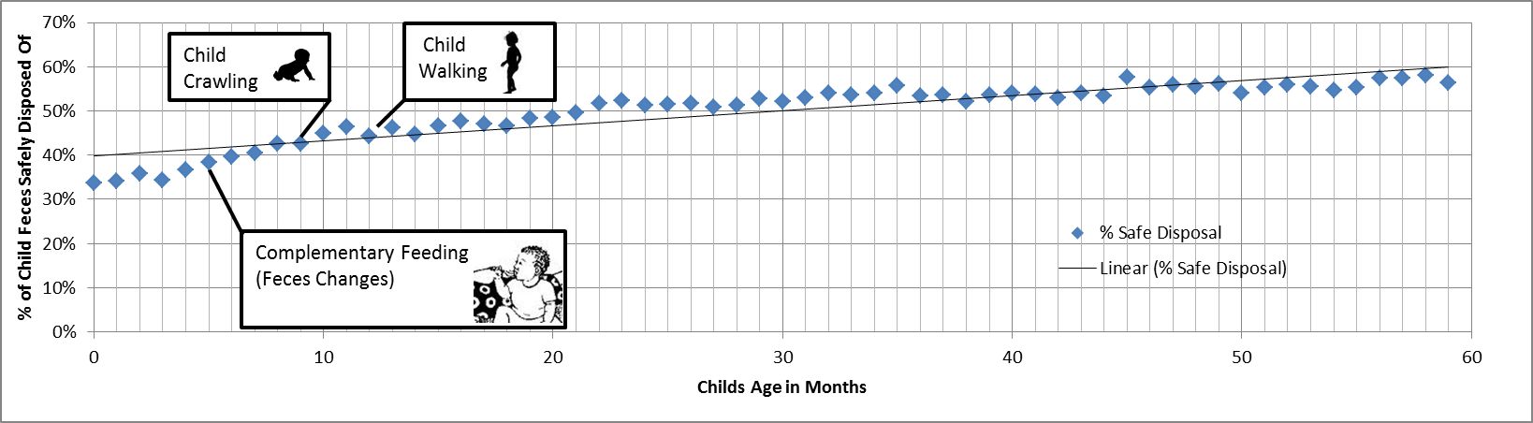
As children age, who is in charge of their defecation pattern changes
Introduction Practices in Bangladesh Programs in Bangladesh Emerging Ideas
Photos: Kov and Null
Notes:
As Libbet pointed out, many people consider children’s feces as relatively inoffensive and so real work needs to be done to create demand for sanitation for children
We have quite a bit to do in order to create a social norm where people dispose of infant feces into a toilet/latrine and safely dispose of water used to clean soiled clothing

Slide 32
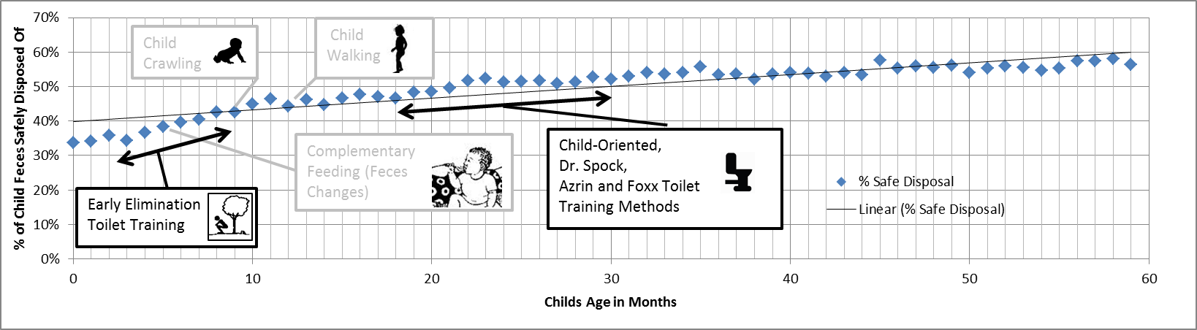
Increase Demand for Safe Disposal and Training by Caregivers
Introduction Practices in Bangladesh Programs in Bangladesh Emerging Ideas

Slide 33
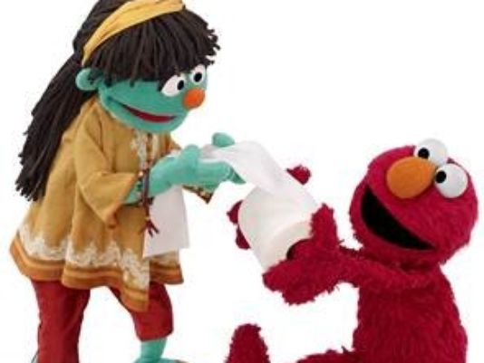
Increase Demand for Sanitation from Children
Introduction Practices in Bangladesh Programs in Bangladesh Emerging Ideas
© WSP

Slide 34
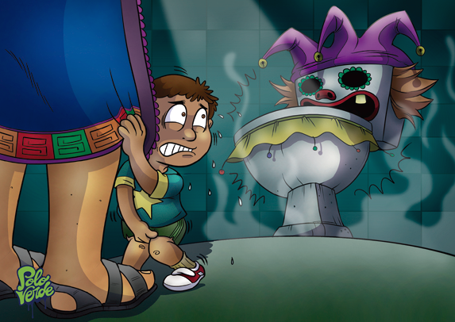
Strengthen Supply of Sanitation at a location convenient for disposal
Introduction Practices in Bangladesh Programs in Bangladesh Emerging Lessons
© The World Bank. Artist: Jesus Felix-Diaz
Notes:
We also need to strengthen the supply of sanitation products targeted at children and investigate what that means. There are sometimes local tools already available in the market, such as child potties, or other products, such as the hoe that can be re-purposed for sanitation.

Slide 35
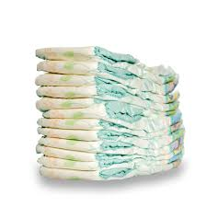
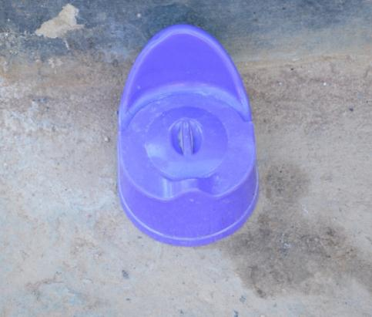
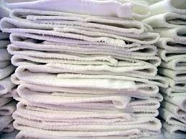
Strengthen Supply of products that fit the context
Introduction Practices in Bangladesh Programs in Bangladesh Emerging Ideas
Notes:
We also need to have a real conversation about what products work at each age.

Slide 36
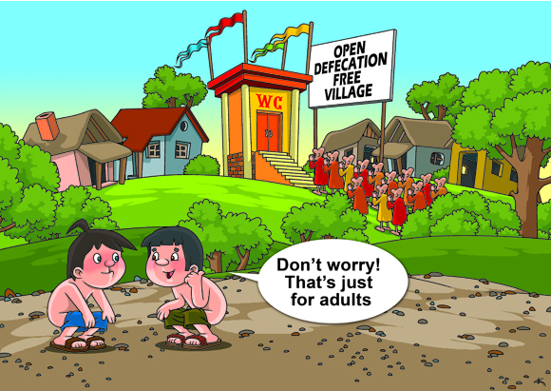
Create an Enabling Environment
Introduction Practices in Bangladesh Programs in Bangladesh Emerging Ideas
© The World Bank Wisnoe Lee
Notes:
We need to create an enabling environment by working with governments to incorporate safe disposal of child feces into existing interventions. For example, in locations using community-led total sanitation, some countries are including the idea that a community cannot be certified as open defecation free unless everyone’s feces are safely disposed of. In other words, child feces disposal is required during verification of ODF

Slide 37
WSP and UNICEF are working to publish data on management of child feces
Introduction Practices in Bangladesh Programs in Bangladesh Emerging Ideas
Afghanistan
Burkina Faso
Cambodia
Chad
Ethiopia
India
Indonesia
Kenya
Lao PDR
Madagascar
Malawi
Mozambique
Nepal
Niger
Nigeria
Pakistan
Philippines
Senegal
Sierra Leone
South Sudan
Sudan
Tanzania
Uganda
Zambia

Slide 38
Discussion
Introduction Practices in Bangladesh Programs in Bangladesh Emerging Ideas
What do you think are the ways to increase demand, supply and the enabling environment?
Do you have any suggestions on how these profiles could be tailored to reach your colleagues who can use it to make a difference?
Do you know of any existing efforts to increase safe child feces disposal or toilet train children?
We've already meet with Shine, WASHBenefits, WaterAid, and LSHTM, and as mentioned are collaborating with UNICEF on all these country profiles. Do you know anyone we should talk with?

Slide 39
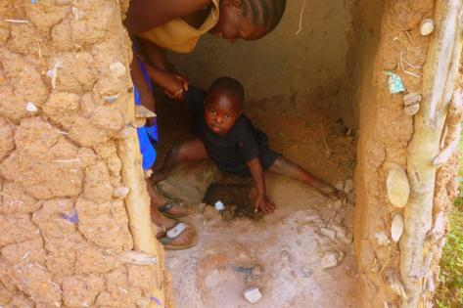
We want your ideas
Van Schoyck (2012)
Please contact Emily Rand at erand@worldbank.org or Libbet Loughnan at lloughnan@worldbank.org to share what your organization is doing related to infant sanitation

