Slide 1
Linking Vulnerable Households
With Markets
Lessons from PSNP Plus and GRAD Projects
Jay Banjade
Chief of Party
PSNP Plus and GRAD Projects
13 June, 2012

Slide 2
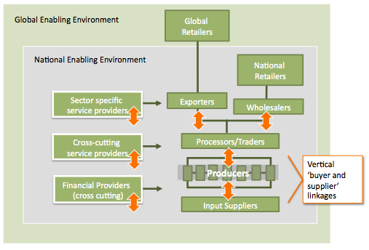
A Value chain Map
How can value chains be used to benefit very poor producers? Graduate them out of food insecurity?

Slide 3
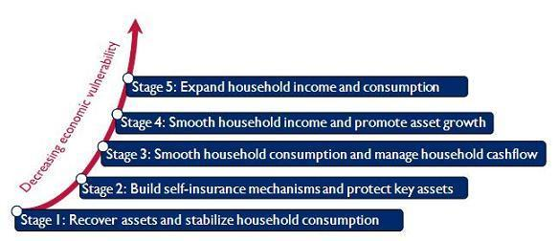
General Perception About Pro-poor Value Chain
Value chain is not for the very poor because they cannot produce in
Quality,
Quality,
In a timely manner
As demanded by the market.
They are usually far away from markets
Infrastructural challenges
Can’t take risk
Are not organized
Cannot be trusted
Pathway out of Poverty
Traditional Value Chains Only Reach Stage 5 to Stage 3
The very poor (Stages 1 and 2) are usually left out of Value Chains
But Development organizations are trying to make VC approach work for the poorest – as a tool to achieve food security, and promote livelihoods and employment among the poorest.

Slide 4
What do we do in VC development?
Where and how can
the Poorest be
Accommodated in here?
Service Provisions
Opportunities identification
Inputs
Information
Linkages
Skills training, extension
Imbedded services
Business development
Sector assessments (VCA, feasibility), technology development
Engaging the private sector
Promote input/output markets
Develop producer groups
Approaches (contract farming)
Sector development:
Policy issues
Forums and networks (MSP)
Systems
Organizations
Deliberate effort needed to engage the poorest (client selection)
Approaches that create room for the poorest in the VC needed (production units of lead firms, collectives and farmer organizations
Extra helping hand may be needed (PSNP, community assets)
Incentives to the private sector to work with the poorest (smart subsidy, tax incentives)
Farmer to farmer skills development (Model farmers, agro-vets,)
Farmers/local entrepreneurs to provide input markets (as the scale may not be large enough for an outsider)

Slide 5
USAID Tool: Pathways Out of Poverty
Design & Implementation Principles
Program Design & Analysis
Program Implementation
Use evidence-based design - formal and informal rules and norms; vulnerability & spatial poverty analysis
Take a holistic, market systems perspective
high potential points of engagement in market systems; employment opportunities, informal.
Design and advance a vision for sustainability
self-reliance, ability to adapt to change; incentives, networks, behaviors, and skills needed in order to achieve self-reliance
Address underlying constraints
Risks, lack of confidence, networking, finance
Use end markets to drive transformation and upgrading while understanding risks
Look for catalytic and system-changing interventions
Understand, create and leverage incentives to drive growth and change
financial and social networks, and formal and informal enabling environments
Foster mutually beneficial relationships
social and market relationships
Strengthen ability to organize and operate
Design and use subsidies strategically
The tool also suggests illustrative intervention options: Enterprise development, employment development, financial services, enabling environment and complementary social assistance

Slide 6
World Vision: Integrating Very Poor into Value Chains Manual
Understanding the context of the very poor
Concepts of linkages, building relationships
Information flow
Multi Stakeholder Platforms (MSP) and Negotiation
Dealing with buyers
Integrating very poor into producer groups
Critical constraints of very poor and dealing with them
Inclusion of women
USAID Pathways tool and the very poor

Slide 7
SEEP Network: Economic Strengthening Pathways for the Bottom Billion
How do practitioners define and identify very poor? (<$1.25; vulnerability)
How do they ensure they reach to them? (deliberate targeting; widow, refugees, etc.)
How programs attempt (considerations) to move them out of poverty? (combination and sequencing; sequencing tailored to the immediate needs of the poor as they move along the graduation path; Pull/Push; direct services vs. enabling environment; incentives to graduate;
What services/programs are most effective?
Challenges (implementing, strategic, donor related)?

Slide 8
Other Programs
BRAC – Poverty reduction and Ultra Poor program
CGAP/Ford Foundation – Graduation Program: Targeting, Consumption Support, Savings, skills, asset transfer/loan. 24 months.
ACDI – Pathways out of Poverty Approach (no clear path out of poverty, HHs jump back and forth)
CARE – Pathways out of Poverty
The Livelihood and Food Security Assistance (LIFT) – Several tools developed
Grameen Foundation – Livelihood Pathways for the Poorest: Livelihoods and financial services, SH groups and savings, confidence building and linkage to welfare programs, supplemental earning opportunities, training. 24 months.

Slide 9
PSNP Plus and GRAD: Key Interventions
B. Resiliency Strategies
Demand driven
Extension services
C. Enabling
environment
Gender Primacy
Consumption support
PMA – Savings, IGAs
Confidence/leadership/solidarity
Business opportunities
Skills, TA
Asset transfer/loans
Market linkages (production to sale)
A. Direct Services:
Working closely together with HABP and Line agencies
Climate
Change
Adaptation
Model Farmers
Nutrition
Knowledge
Management,
Policy
improvement
Microfinance
Industry
Building
Aspirations

Slide 10
Linking Vulnerable HHs with Markets: Lessons from PSNP Plus
Farmers’ collectives (PMAs) to create critical mass needed
While selecting VCs consider market opportunities but also the capacity and resource base of the poor
Capacity development beyond skills of the trade (financial literacy, solidarity, governance, technical skills, extension service, etc.)
Risk diversification and multiple sources of income (multiple VC/IGA)
Leveraging on model farmers (though not poorest)
Quick wins
Prepare/train producers to link: linkages through MSP, other networks
Contract production/farming. HHs developed as production units
Address more than markets and finance (food support, aspirations, climate change, gender, and enabling environment – policy, enablers/disablers, health, education, infrastructure, water)
Have a program to ‘graduate into’.

Slide 11
PSNP Plus Conclusion
In pro-poor value chain development you got to plan the program with a wider developmental perspective, not just commercial perspective.
Private sector development programs look at VCD from business point of view (business viability) and assumes that development impacts will trickle down
But we need to look at it differently – more widely, as a development tool with more attachments/services – if VC approach is to be used to tackle poverty and food insecurity.

