Slide 1


Agriculture Programming to Improve Nutrition:
Why is it so hard to demonstrate impact?
Patrick Webb
Nutrition Collaborative Support Research Program (N-CRSP)
FSN Network Meeting
November 2012

Slide 2
Minister of Health:
“There is no empirical evidence of agriculture’s supportive role in achieving faster nutrition gains. So we’re sticking with large-scale supplementation.”
Chief of Party:
“We’ll fund a baseline, but there’s no need for an end-line. Our M&E system will tell us how much impact we’re having.”

Slide 3
“Data are not disaggregated enough to tell if it’s working”
“We need a common language (agriculture and nutrition)”
“We need to think about the economics”
“Are we promoting the most cost-effective decision?”
“What are the basics that have to be done?”

Slide 4
Outline of this session
Overview of key issues in building evidence of impact
Outline of Nutrition CRSP research agenda
Discussion of roles of empirical evidence in policy and programming
I’m neither nutritionist nor ‘academic’
Please, please, please interrupt me whenever you want!

Slide 5
“Nutrition can serve as a bridge between agriculture, food security and health to strengthen a coordinated approach across sectors.”
“The main challenge…lies in urging decision makers to use evidence based analysis to target resources in a more disciplined way.”
Source: USAID Country X
Feed the Future Implementation Strategy (FY 2010)

Slide 6
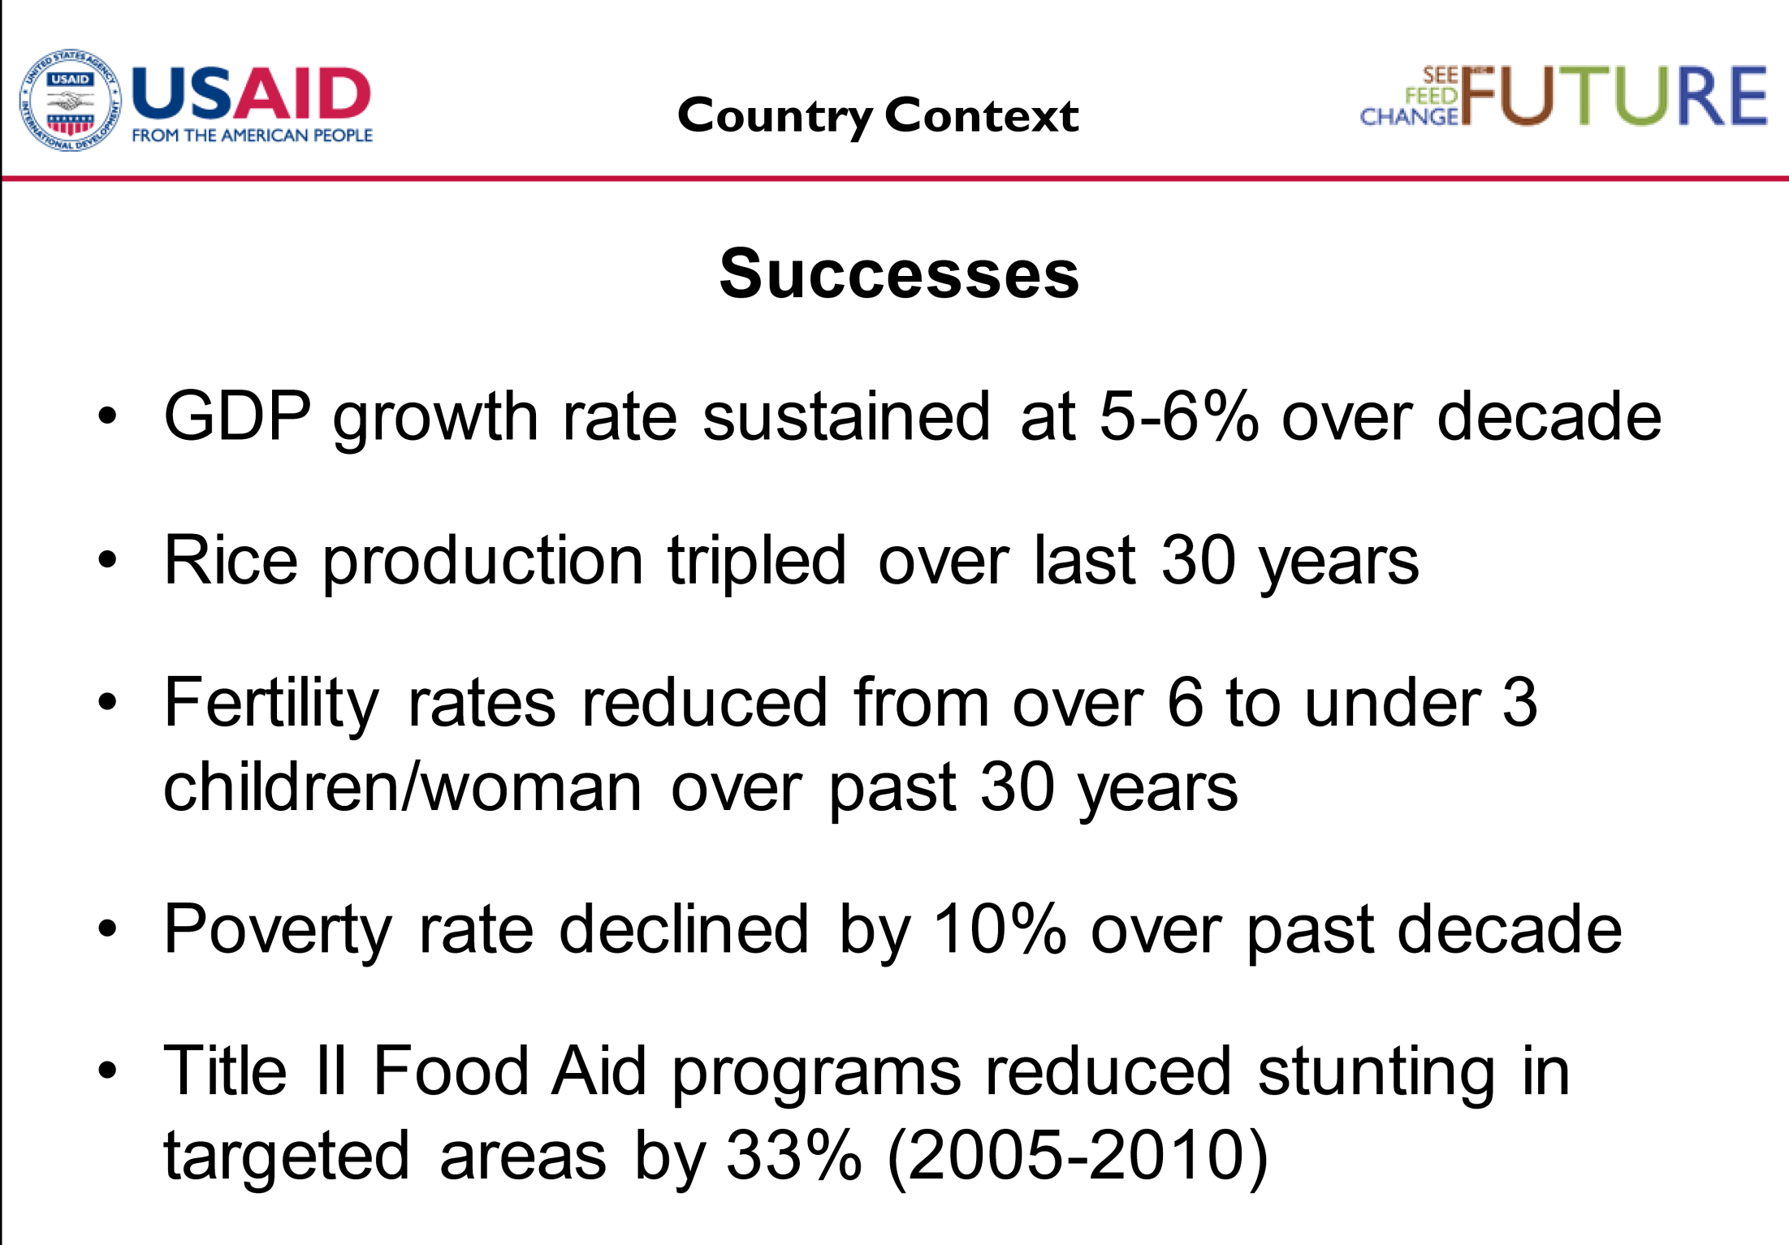
Source: USAID Country X
Feed the Future Implementation Strategy (FY 2010)

Slide 7
Critical discussion on “the type of evidence used in policy making, and … the type of question that evidence is used to address.”
We know “very little about the institutional-implementation factors that might make a given program a success in one place, or at one scale, but not another.”
Martin Ravallion, World Bank
(March 2012) Jou. Econ. Lit.

Slide 8


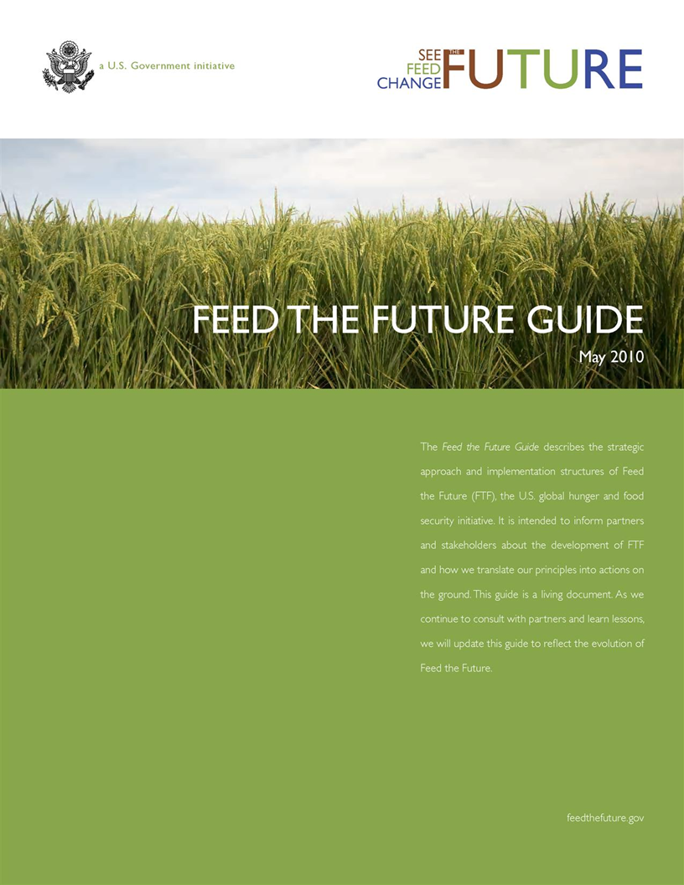
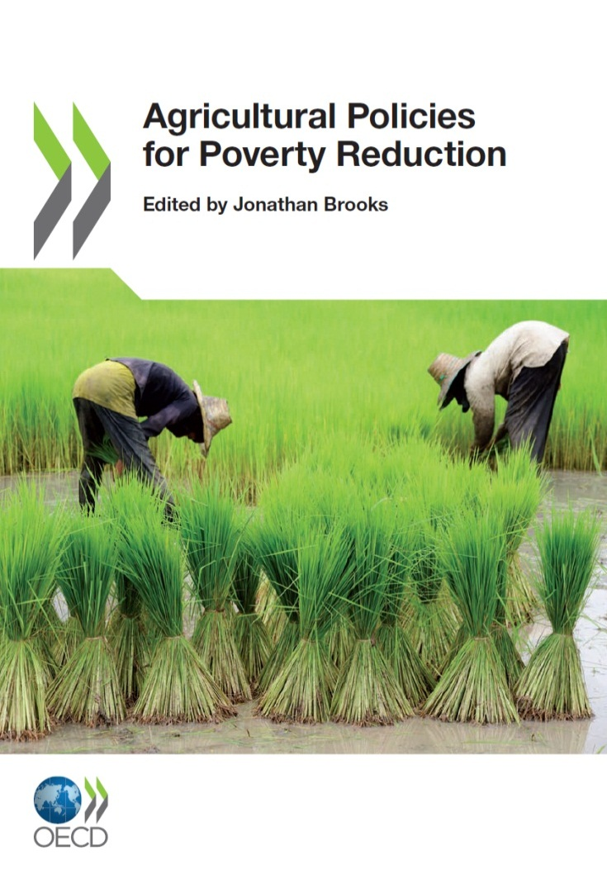

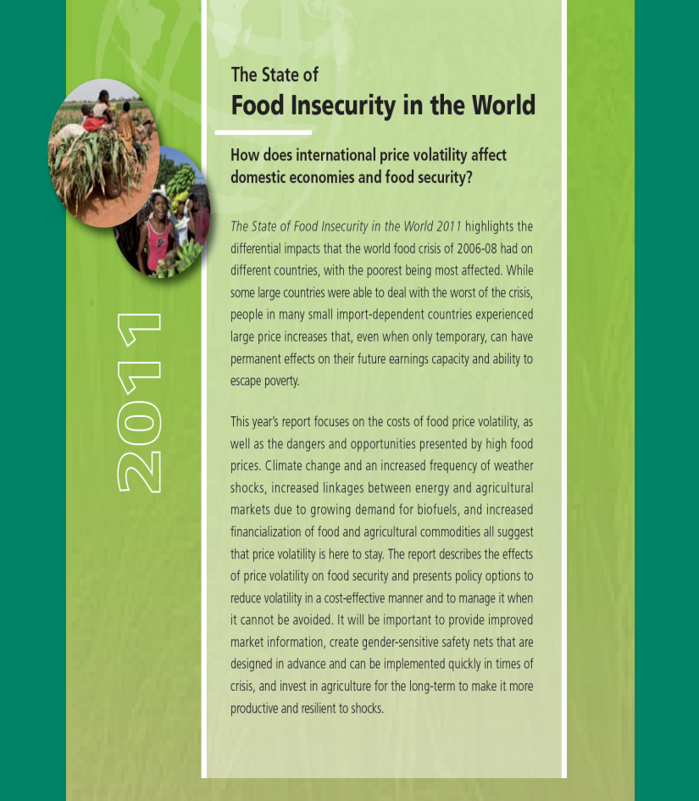

Slide 9
‘Ask not what you can do for agriculture…’
Reduce global food price volatility
Be more efficient (productivity, less expansion)
Support rural livelihoods (without subsidies)
Produce fewer side-effects (methane, carbon)
Use less water
Pollute less, be more sustainable
Produce more food to meet growing demand
Promote good nutrition outcomes (particularly among mothers and children <2y)

Slide 10
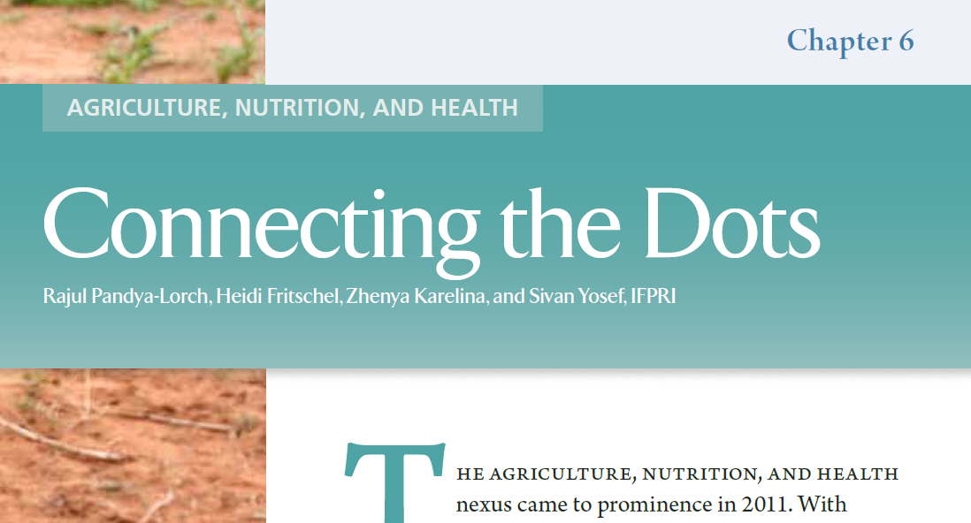

Slide 11

20 core principles in 45 manuals
“high degree of alignment”
Linking agriculture and nutrition is inhibited by four “main constraints”:
information on what to do,
how to do it,
how much it will cost (per benefit gained), and
how it will be supported or rewarded.

Slide 12
FAO
“Agricultural development programmes…
are by themselves often not enough to accelerate
reductions in hunger and malnutrition.
Similarly, direct reductions in … poverty and
improved purchasing power do not generally result
in proportional reductions in malnutrition.”
Thompson and Meerman (2010)
FAO

Slide 13
IFPRI
“Our review of …agricultural programs concludes that evidence of the impact of these programs on child status is scant.”
Leroy et al. (2008) Impact of multisectoral programs focusing on nutrition.
We need to “improve understanding of the "disconnect“ between economic and agricultural growth and nutrition outcomes.”
Gillespie, S. (2011) Measuring the effects
of integrated agriculture-health interventions

Slide 14
29 developing countries, 1980 - 2007
Child stunting fell from 40 percent in 1990
to 29 percent in 2008.
UNICEF/SAVE (2011) Progress in Child Well-Being
Log GDP/per capita
Source: Webb and Block (2012)

Slide 15
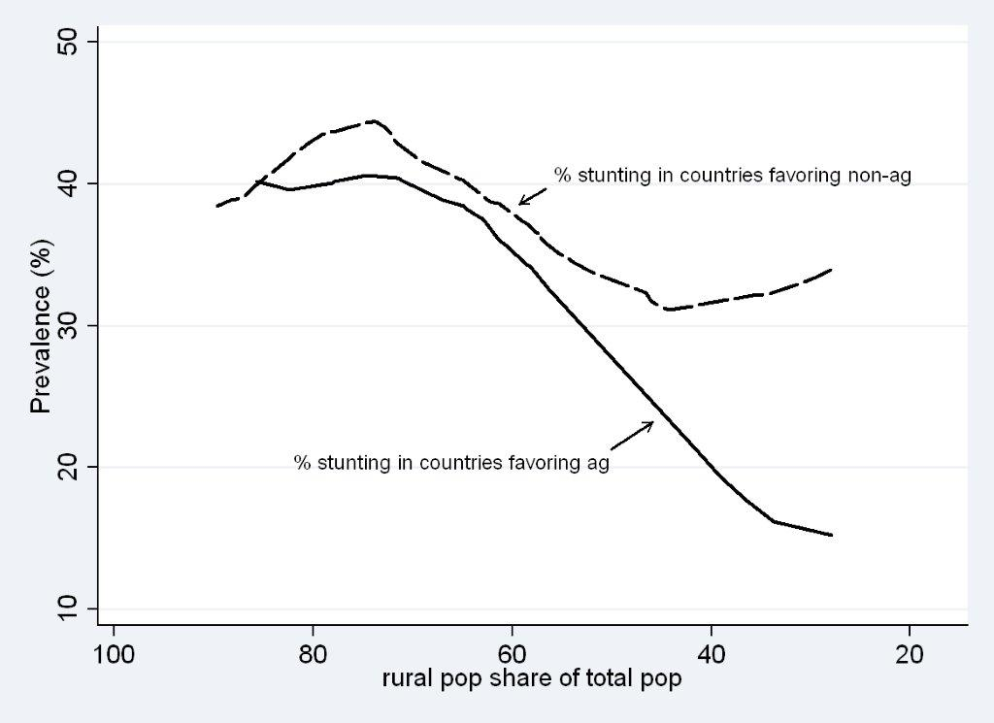
29 developing countries, 1980 - 2007
Elasticity of stunting with regard to Agric. GDP = -0.21.
(i.e. doubling per capita income through agriculture associated with 21 % point decline in stunting.)
Share of agriculture in GDP
Source: Webb and Block (2012)

Slide 16
In other words…
Poverty reduction is faster (especially in rural areas) if agriculture is supported during the process;
Poverty reduction strongly reduces stunting, especially with support for ‘agriculture’ (what exactly?).
(iii) Because there are more undernourished children in
rural areas, decline in undernutrition stronger there.
(iv) But…poverty reduction and agricultural growth do
not resolve undernutrition fully or always quickly.

Slide 17
“Our knowledge needs to improve where there are both significant knowledge gaps and an a priori case for [public] intervention.”
So we need “integrated, multipurpose surveys linked to geographic data…and tailoring of data collection to the problem at hand.”
Martin Ravallion, World Bank
(March 2012) Jou. Econ. Lit.

Slide 18
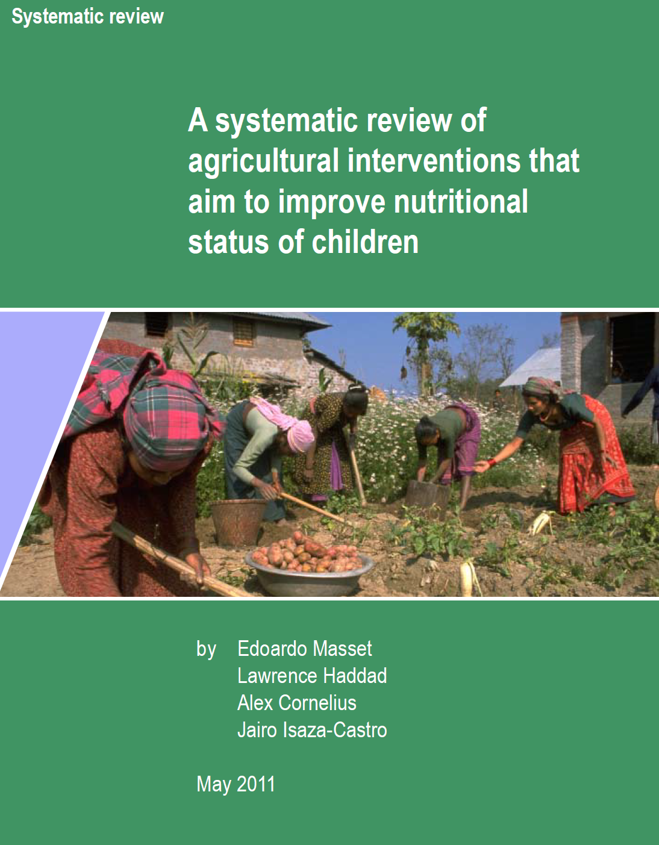
Systematic review of
agricultural interventions
that aim to improve children’s
nutritional status by
improving the incomes and
diet of the rural poor.

Slide 19
Masset et. al. (2011)
Agricultural interventions show...
Positive impact on farm output.
“Poor evidence of impact on households’ income.”
“Little evidence…on changes in diets of the poor.”
None assessed if interventions improve quality of whole diet.
9 studies tested impact on Vitamin A (only 4 were positive).
“No evidence of impact on stunting, wasting.”
Masset et. al. (2011)
7,000 studies considered.
Only 23 qualified for final inclusion (i.e. having
credible counterfactual and rigor in methods).

Slide 20
Review paper | System. review? | Number of studies screened | Studies reviewed | Period of studies retained | Agriculture activities included | Important conclusions
Ruel (2001) | N | Not specified | 14 | 1995-1999 | Home gardens, aquaculture, BCC* | “information now available is inadequate.” “basic information on efficacy is needed.“
Berti et al. (2004) | N | 36 | 30 | 1985-2001 | Home gardens, animals, cash cropping, credit | “mixed results in improving nutrition.” “negative effects were not uncommon.”
Leroy and Frongillo (2007) | Y | Not specified | 14 | 1987-2003 | Animals aquaculture, poultry, credit, BCC | “only 4 studies evaluated impact on nutritional status and found effect.” “integrated [activities] generally found positive results.”
World Bank (2007) | N | Not specified | 52 | 1985-2007 | All forms of agriculture | “agricultural interventions not always successful in improving nutrition.‟
Bhutta et al. (2008) | Y | Not specified | 29 | 1985-2004 | Home gardens, animals, small ruminants, BCC | “dietary diversification strategies have not been proven to affect nutritional status or micronutrient indicators on a large scale.”
Kawarazuka (2010) | Y | Not specified | 23 | 2000-2009 | Aquaculture | “data on improved dietary intake to nutritional status were scarce.” “nutritional outcomes not demonstrated.”
Masset et al. (2011) | Y | 7,239 | 23 | 1990-2009 | Biofortification, home gardens, aquaculture, husbandry, dairy | “very little evidence was available on changes in the diet of the poor.” “no evidence of impact on stunting, wasting and underweight.”
Arimond et al. (2011) | N | >2,000 | 39 | 1987-2003 | All forms of agriculture | “few agricultural interventions with nutrition objectives scaled up.” “many of the studies… weakly designed.”
Girard et al. (2012) | Y | 3,400 | 37 | 1990- | Home gardens, biofortification, BCC, husbandry | “estimates for effects on stunting…were not significant.”

Slide 21
Nutrition CRSP
Research and Capacity Building
Leader with Associates award (Tufts as ME)
Deep-dive research: Nepal and Uganda
  Malawi, Mali, exploring others in Asia
Human and Institutional Capacity Building
  Degree programs, skills trainings

Slide 22
N/CRSP Research Approach
Operational focus (but public goods).
Wrap around integrated programs (but wider lens).
Not RCTs, but randomized sites/counterfactuals/pre-post.
Focus on country-ownership (supporting research that informs local priorities AND policy decisions).
Larger grants at scale (not myriad small grants).

Slide 23
N/CRSP Research Foci
1
Agriculture-Nutrition Pathways
Greater clarity on cause-and-effect (agric.-nutrition)
2
Program Impact Pathways
What design/processes support success at scale? How?
3
Integrated Programming Pathways
What combinations work best, in what context?
What efficiency gains of integration (and costs)?

Slide 24
World Bank
“The logic of the transmission mechanisms
between agricultural production and
nutritional outcomes is not…clear.”
John Newman, World Bank
Patrick Johnson, Booz | Allen |Hamilton
South Asia Food and Nutrition Security Initiative
May 2011

Slide 25
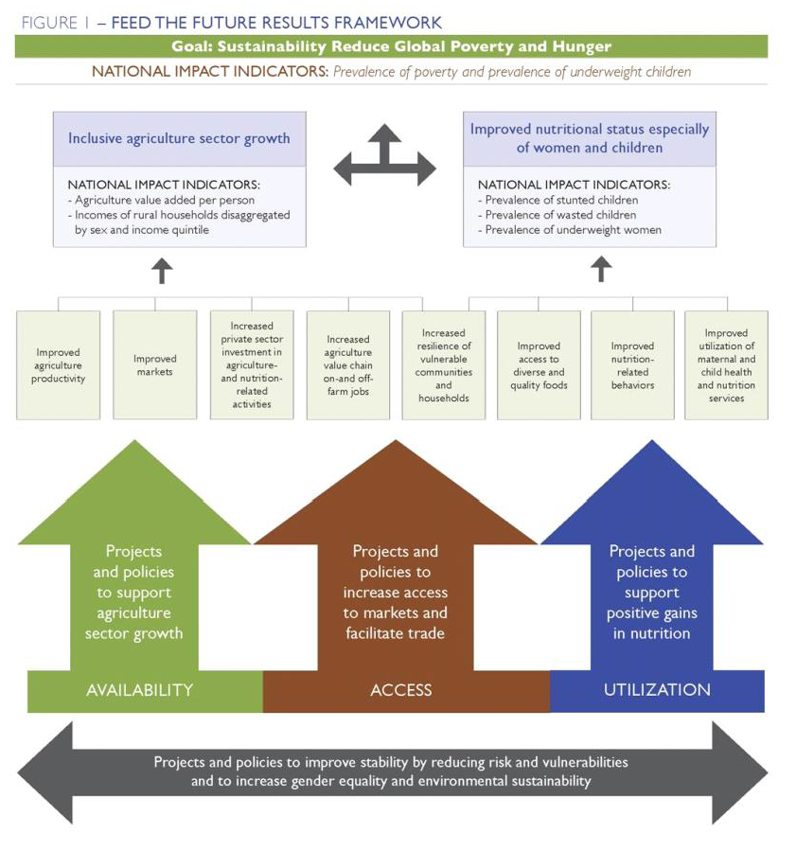
3
1
2
2

Slide 26
How agriculture (interventions) impact nutrition…
1. Rapid productivity growth (income, maybe staples supply)
2. Enhanced consumption of nutrient-rich or animal source foods
3. Entry point for women’s empowerment (knowledge, exposure
to ideas, control over resources, management responsibilities)
4. Reduced exposure to toxins/diseases (enhanced storage, food
safety, vector control, environmental enteropathy)
5. Platform for nutrition/health services or resource delivery

Slide 27
Commercialization/value chain
Crop/animal productivity
Higher per capita food consumption
Women's Diet Diversity Index improved
Prevalence of anemia among women of reproductive age
Reduced neonatal complications/ reduced wasting/ reduced stunting
Higher maternal BMI/less Low Birth Weight
Staple
foods
?
Home gardens/
Small ruminants
?
Protein quality
?
Nutrient density/
disease environment
Aflatoxin exposure

Slide 28
Micronutrient deficiency
iron deficiency anemia
Maternal diet?
Nutrient deficiencies
Nutrient imbalances
Nutrient malabsorption
Vitamin C?
Deworming?
Bednets?
Low bioavailability
Binding/ adverse interactions
Toxins/ Parasites/ diseases
Food Processing?
Pigeon pea?
Few nutrient dense foods consumed
Antinutrients in diet
Unsafe foods consumed
Poor diet quality

Slide 29
Stunted child
Nutrient deficiencies
Nutrient imbalances
Nutrient malabsorption
Wasting
Micronutrient deficiencies
Inadequate breastfeeding
Inadequate care and stimulation
Diseases/ infections
Low Birth Weight
IUGR
Maternal workload
Low maternal BMI
Inadequate care

Slide 30
2
Program Impact Pathways
“A major obstacle to program success is the nearly complete lack of information on the cost, effectiveness and process of scaling up interventions.”
Darmstadt, et al. (2008)
Health Policy and Planning. 23:101–117.
The shortcomings of cross-country regressions in explaining ‘how’ to achieve rapid stunting reductions at scale lie in their inability to disentangle “experiences within a relationship.”
Headey (2012) IFPRI 2020

Slide 31
“The lack of ‘pathway’ thinking is associated with the general problem that programs have not used an explicit program theory framework to plan the intervention components.
[Such thinking] is largely absent from the evaluations of the types of programs reviewed.”
LeRoy et al. (2008)

Slide 32
Defined Goal: Health and Well-being of Nepalis Improved and Sustained
Strategic Objective: To Improve the Nutritional Status of Women and Children Under Two Years of Age
IntermediateResult 1: Household (HH) health and nutrition behaviors are improved. | Internmediate Result 2: Women and children increase use of quality nutrition and health services. | Internmediate Result 3: Women and their families increase consumption of diverse and nutritious foods. | Internmediate Result 4: Coordination on nutrition between government and other actors is strengthened.
Notes:
Finally, the N/CRSP will aim to understand if effectiveness of an integrated program such as Suaahara and that its key goals have been achieved – ie a. behaviors are improved 2. access to health services is improved 3. there is increased consumption of diverse and nutritious foods and 4. there is improved coordination.

Slide 33
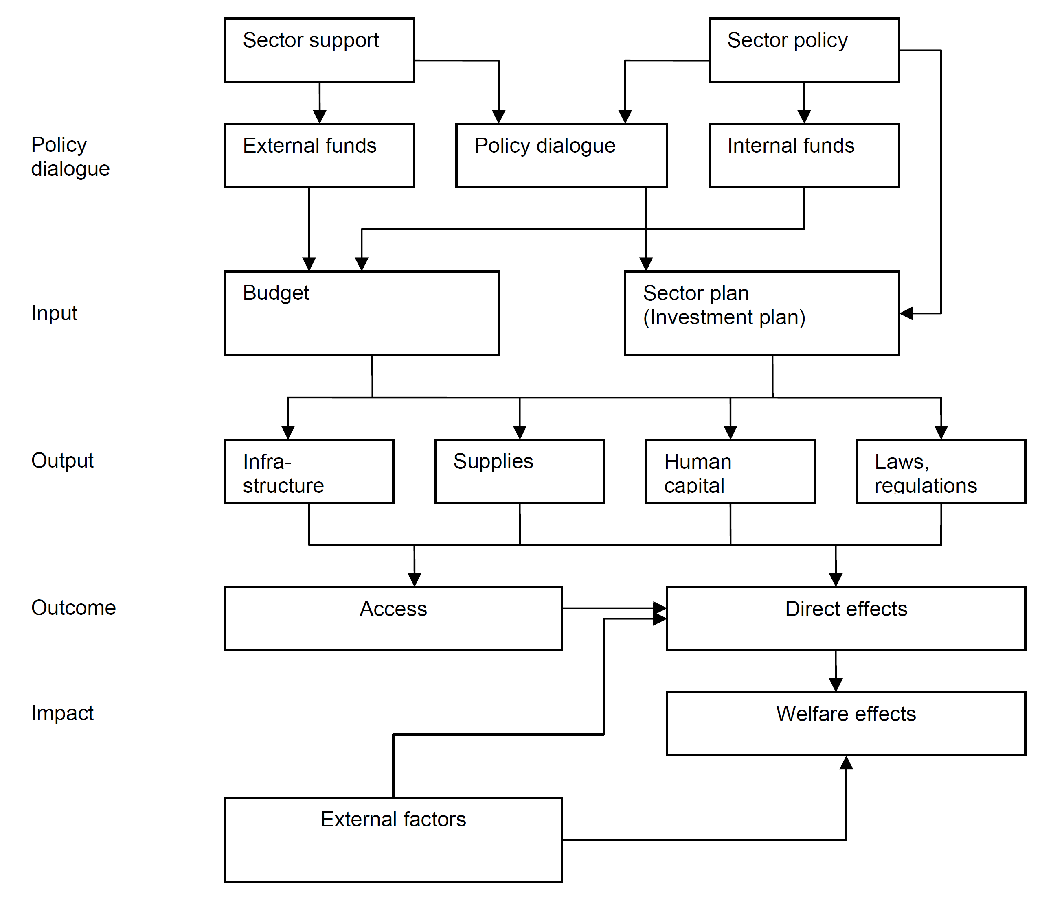
ENA/EHA
Agriculture
Data collection
foci on Integrated
Programming
Implementation team M&E
Training
Activities
Health Delivery
Project Management
Model Farms
Inputs and
Activities
BCC, health service delivery (IR4)
Seeds, fertilizer, model farms (IR4)
Tufts
Outputs
Changed behaviors (IR1)
Service usage
(IR2)
Income growth
Crop diversity
Harvard
Purdue
Outcomes
Better birth outcomes, health status, micronutrient status
Diet diversity (IR3)
JHU
Impacts
Child Stunting (SO)
IFPRI
Mothers’ Nutrition (SO)
Notes:
N/CRSP research activities are being implemented by Tufts and JHU. To address the three focus areas, complex data collection needs to be undertaken in collaboration with different entities/partners. The data collection will be complementary to the activities of IFPRI who is conducting the baseline and maybe the endline of the Suaahara evaluation. Data collection will include both qualitative and quantitative methodologies with household surveys,, key informant interviews, surveys and semi-structured interviews at program, district, facility level. Data on integrated program management will also be obtained from Suaahara team which Tufts will obtain through semi-structured interviews

Slide 34
CRSP program impact pathways research
Central policy level (government policy decision process, donor processes, implementing partner management).
District level (fidelity of program implementation, incentives for inter-ministry cooperation, value-added of multisector investment).
Facility level (enhanced quality and fidelity of service delivery, best practices and protocols, new products).
Community level (effectiveness and coverage of health/nutrition services; reduced discrimination and inequity by gender, caste, ethnicity).
Household level (exposure to/uptake of program elements, intensity of program interaction, frequency of program engagement, intrahousehold dynamics around behaviou change, demand for services, resource use).
Notes:
Research around program impact pathways will focus on different levels

Slide 35
What was learned?
Effective transmission?
Fidelity of transmission?
Effective integration?
Effective transmission?
What was learned?
Effectively applied?
Notes:
For example at the program level (Suahaara program), the research will examine how the training is delivered through the cascade of training evaluating what was learned, whether it was effectively transmitted across the different training levels (from Master Trainers to Trainers down to the district and then village level training), what was the fidelity of transmission, were the messages/materials of health, nutrition and agriculture effectively integrated and transmitted and finally were the messages/inputs/transfers effectively applied at the mother support group level

Slide 36
Planned N/CRSP STUDY SITES
FAR-WESTERN REGION
HUMLA
DARCHULA
MID-WESTERN REGION
BAJHANG
MUGU
BAITADI
BAJURA
Kathmandu
DADELDHURA
DOTI
JUMLA
DOLPA
ACHHAM
KALIKOT
KANCHANPUR
DAILEKH
MUSTANG
WESTERN REGION
KAILALI
JAJARKOT
SURKHET
RUKUM
MANANG
BARDIYA
SALYAN
MYAGDI
GORKHA
CENTRAL REGION
ROLPA
BAGLUNG
KASKI
LAMJUNG
BANKE
PYUTHAN
PARBAT
RASUWA
DANG
GULMI
SYANGJA
TANAHU
EASTERN REGION
ARGHAKHACHI
DHADING
NUWAKOT
SINDHUPALCHOK
PALPA
KTM
DOLAKHA
SULUKHUMBHU
KAPILVASTU
RUPANDEHI
NAWALPARASI
CHITWAN
BKT
SANKHUWASABHA
LALIT
KAVRE
RAMECHHAP
TAPLEJUNG
Suahaara Districts
MAKAWANPUR
OKHALDHUNGA
PARSA
BARA
SINDHULI
KHOTANG
BHOJPUR
TERHATHUM
RAUTAHAT
PANCHTHAR
Feed the Future Districts
SARLAHI
MAHOTTARI
UDAYAPUR
DHANKUTA
DHANUSA
SIRAHA
ILAM
SAPTARI
SUNSARI
MORANG
JHAPA

Slide 37
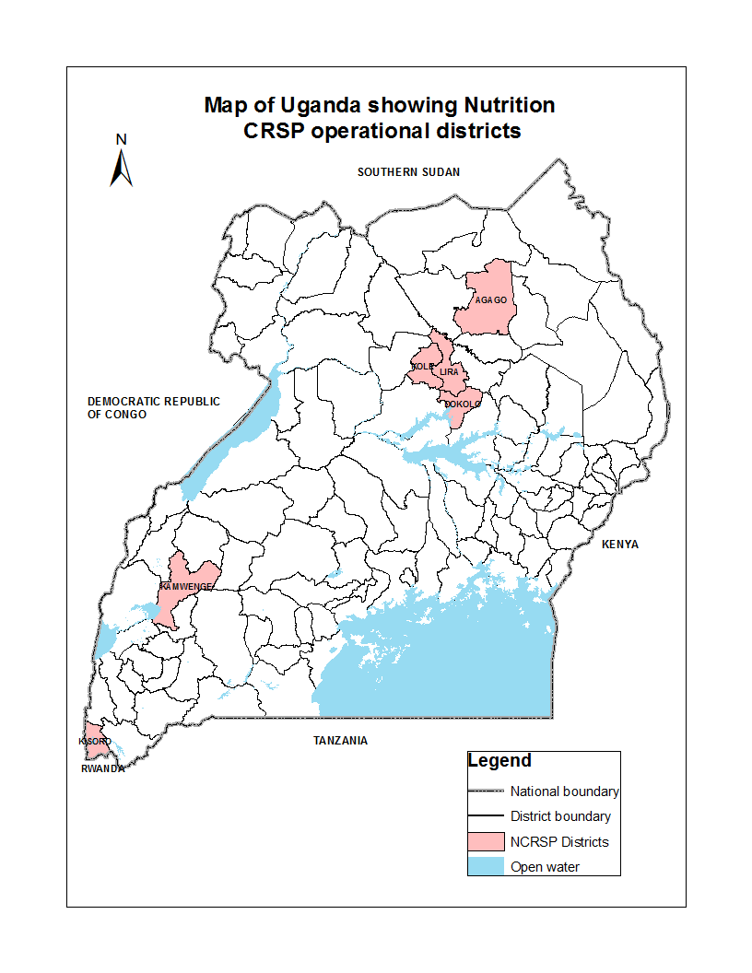

Slide 38
3
Integrated programming
  “The effectiveness and cost-effectiveness of nutritional interventions. Both single and packaged interventions that affect general nutrition and micronutrient intake should be assessed for their effect on stunting.”
Lancet series on Maternal and Child Undernutrition (2008)
Notes:
Upcoming donor meetings with ODI on ‘Public Works Integrated Programming’ –
activities designed to simultaneously address “social protection , poverty reduction, livelihoods, and growth as well as human capital outcomes (nutrition and health).”

Slide 39
Suuahara
FTF program
Agric. Extension
Behavior change
New seeds
Diet
Quantity (and Quality)
Diet Quality
Home gardens
Service Quality
Irrigation
Poultry, goats
Sectoral coordintn
Rural finance
?
?
?
Maternal/Child Nutrition

Slide 40
Costs and Benefits
“At an average cost per death averted of about $65, vitamin A
supplementation in Ghana, Nepal and Zambia is highly
cost-effective.”
Cost per Child
Program-specific costs $0.42
Personnel costs $0.55
Capital costs $0.17
Total costs $1.14
Fiedler et. al. (2004) Report for MOST

Slide 41
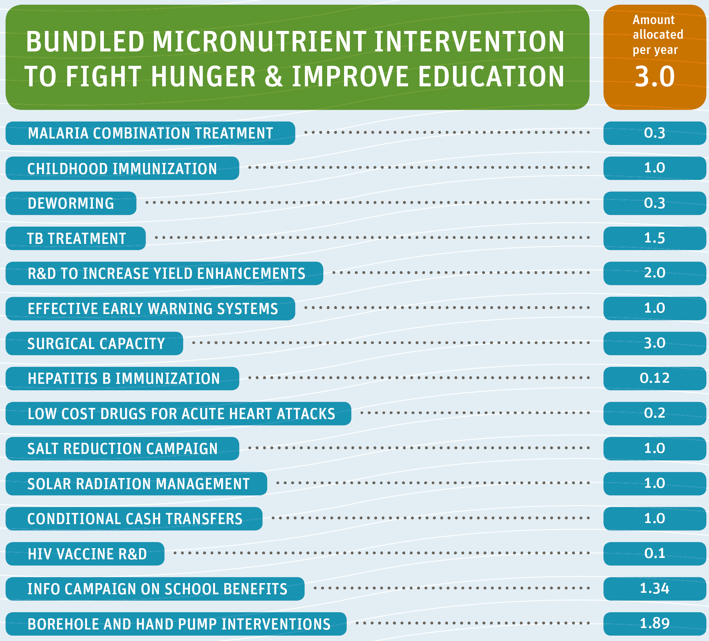
Copenhagen Consensus 2012
If you had $75bn for worthwhile causes,
where should you start?

Slide 42
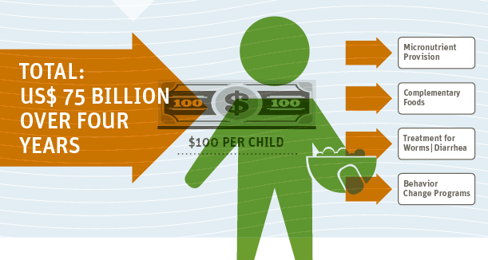
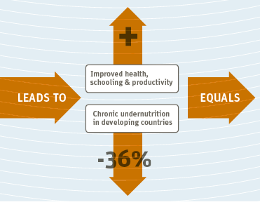

Slide 43
Malawi
Agency | Annual Cost | Inputs and services provided
World Bank | $30 per child | Vitamin supplements, deworming, iron fortification of staples, salt iodization, CMAM
REACH | $36 per child | Soap, bednets, malaria treatment, home gardens, clean water
SNRP (EU) | $61 per person | Nutrition education, water, hygiene, seeds, village savings banks, extension services
WALA (USAID) | $61 per person | Seeds, irrigation, nutrition and health education, health services, microfinance
Millennium Villages | $120 per household | Village storage, seeds, clinics and schools, seeds, internet access, phones
IFSP Mulanje | $46 per person | Seeds, irrigation, food-for-work (trees, roads), livelihoods (training, inputs), food technology
  “How much investment is needed remains an unanswered question of fundamental importance.”
  World Bank (2010) Scaling Up Nutrition

Slide 44
SIMI (2003-09) – Nepal Smallholder Irrigation Market Initiative
Intensive Participatory Learning Approach (PLA) program, literacy embedded with health nutrition training for 2,700 hhs - $100/hh (over 2 years)
Program w/out literacy training for 11,600 hhs - $50/hh (2 years)
Significant gains in stunting (vs control) p<.001
  USAID/Nepal Flood Recovery Program (2008-12) - integrated approaches for improved food security and nutrition
  $150/farmer for all training, technologies, inputs and supervision
  GAFSP – Togo
  integrated investments in agriculture, diet diversification and market development
  $98/farmer for all inputs, administration
  World Bank (2010) Scaling Up Nutrition
  $36/child per year to resolve stunting globally among 356 million children <5 (targeted health and nutrition inputs/services only – no agriculture)

Slide 45
Conclusions
1. Agriculture =/= nutrition.
2. Nutrition goals = a) accelerate pace of change; b) at scale;
c) what to measure, based on intent? (not about ‘hunger’)
3. Process may be more crucial than content of programs?
4. Focus of learning (M&E and research) on how, not just what.
5. “No impact” is a result (but only if we know why not…)

Slide 47
Wasted child
Micronutrient deficiency
Stunted child
Low BMI women
Type I nutrients
Type II nutrients
Diseases/ infections
Inadequate care and stimulation
Inadequate breastfeeding
Maternal workload
Animal protein
Nutrient density
Energy sufficiency
Key nutrient deficiencies
Inadequate diet
Small Ruminants
Home gardens
Irrigation

Slide 48












Nutrition $f\left(x\right)=a_{0}+\sum_{n=1}^{∞Σ}{\left(a_{n}\cos{\frac{nπx}{L}}+b_{n}\sin{\frac{nπx}{L}}−\frac{x^{2}}{2}\right)}$
$$a_{0= In utero development/insults}$$
$$Σ$$
$$∞$$
$$Σ$$
$$=$$
$$Genetic potential$$
$n=$1
$$a_{n}$$
$=$ perinatal health, breastfeeding practice,
$$b_{n}$$
$=$ macro and micronutrient intake
$$\frac{x^{2}}{2}$$
$=$ disease, sanitation, hygiene-based nutrient losses

Slide 49
Wasted child
Oedema?
Metabolic impairment
Nutrient deficiencies
Nutrient imbalances
Nutrient malabsorption
Type/II growth impairment
Lack appetite/hydration
Gut permeability
Inappropriate diet
Inappropriate care of sickness
Diseases/ infections
Prior Stunting
Prior failure to thrive
Compromised immune system

