Slide 1
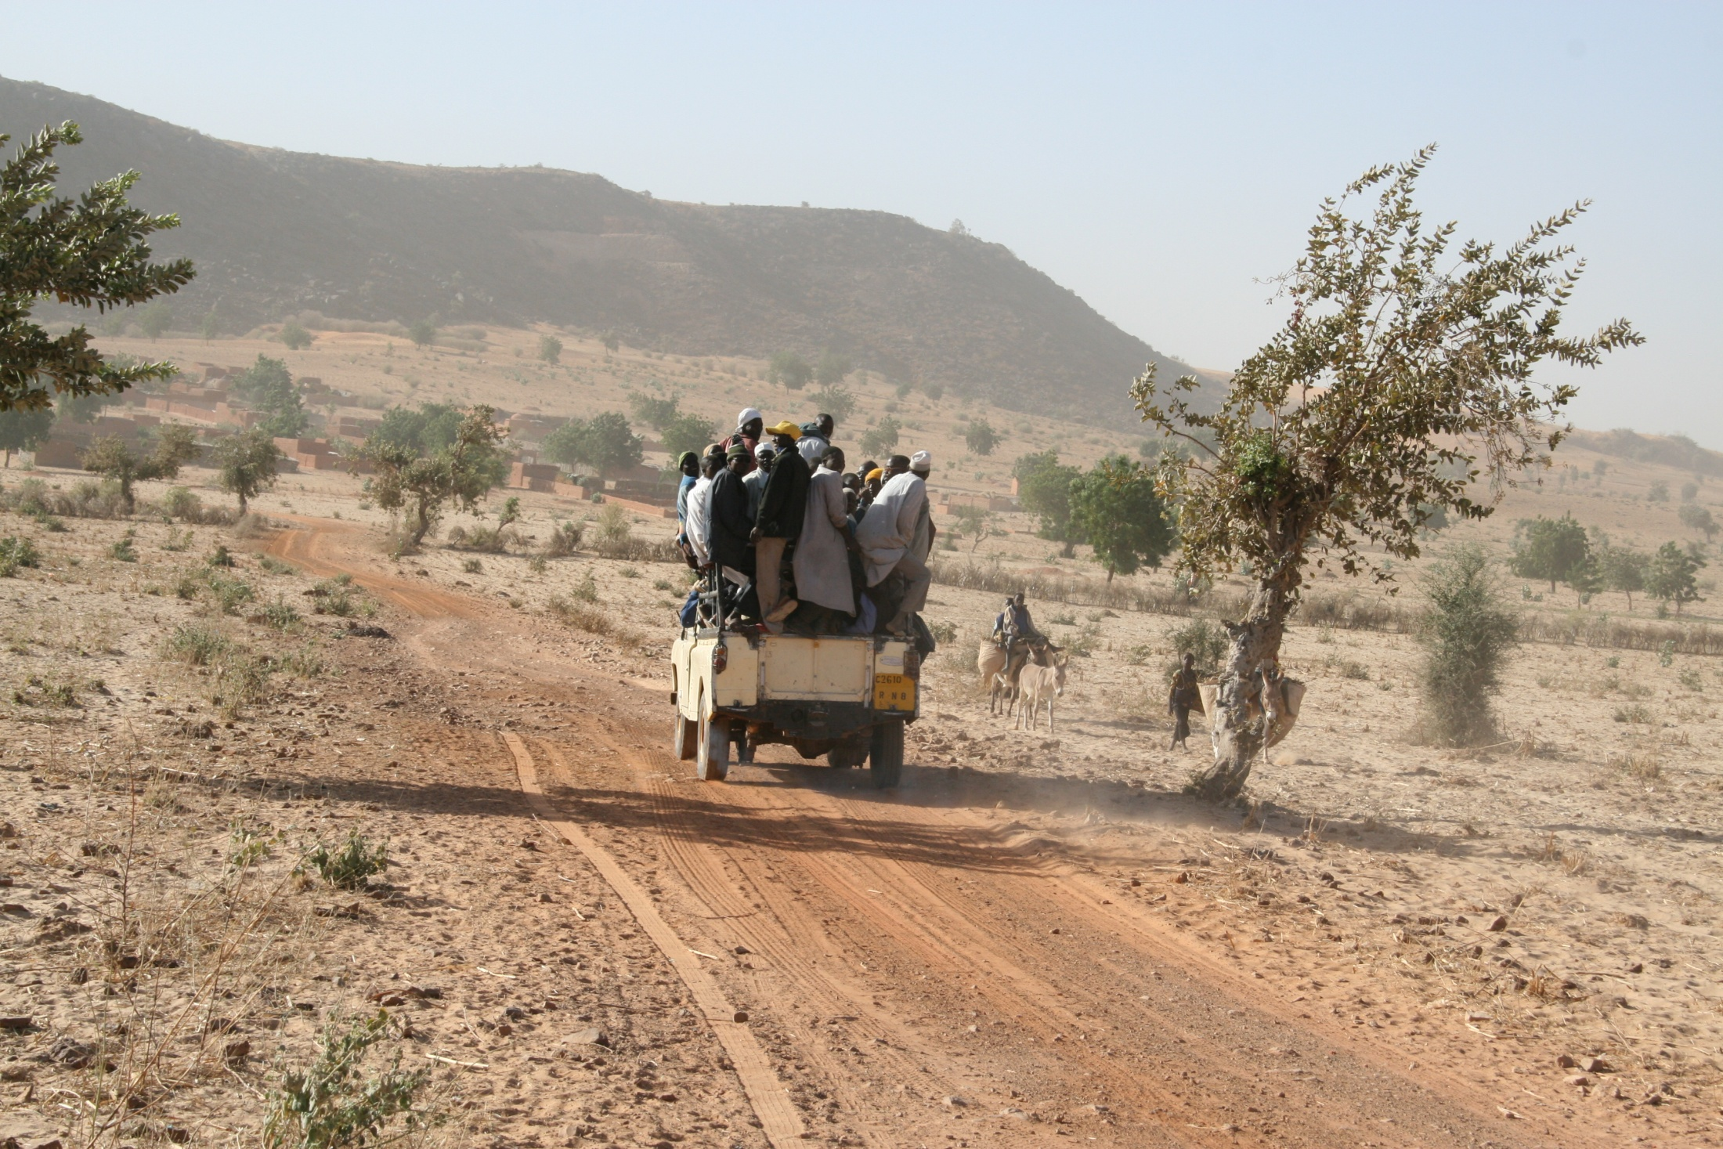
THE ROAD TO RESILIENCE:
Measuring Resilience in
Niger MYAP Communities
TOPS Knowledge Sharing Workshop
Washington, DC November 13, 2012
David Leege, Catholic Relief Services

Slide 2
Background and Context
Sahel Drought Crisis
Five Year PROSAN MYAP nearing completion
Challenge from USAID to measure impact
(MYAP vs. non MYAP households)
Desire for agency-level learning as well as contribution to broader resiliency debate

Slide 3
PROSAN Multi-Year Assistance Program (2007-2012)
SO1: Protect livelihoods through increased agro- pastoral production and agro-enterprises
SO2: Improved health and nutrition status
SO3: Protect resilience and ability to identify and respond to recurrent shocks

Slide 4
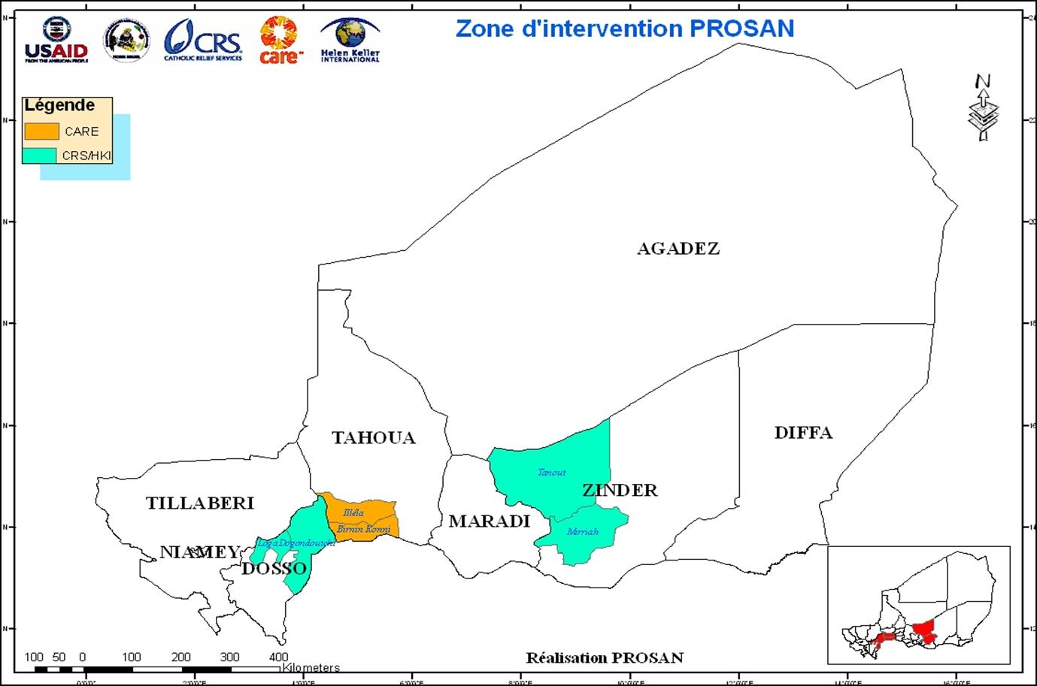
Target Geographical Zones
Targeted MYAP Communities
Population Reached : 273,036
Number of women: 135,855
100 villages
70 villages
70 villages

Slide 5
MYAP Interventions
Agricultural Production: drought-resistant seeds, soil conservation, livestock restocking
Livelihoods: agro-enterprise and income generation: processing and value-added; business planning, literacy training, IGAs
Natural Resource Management: land reclamation, irrigation trenches, half moon construction, CFW/FFW
Water/Sanitation: Community Led Total Sanitation, latrine construction , hand dug wells and drip irrigation
Health and Nutrition: BCC, training of community health workers, clinic rehabilitation

Slide 6
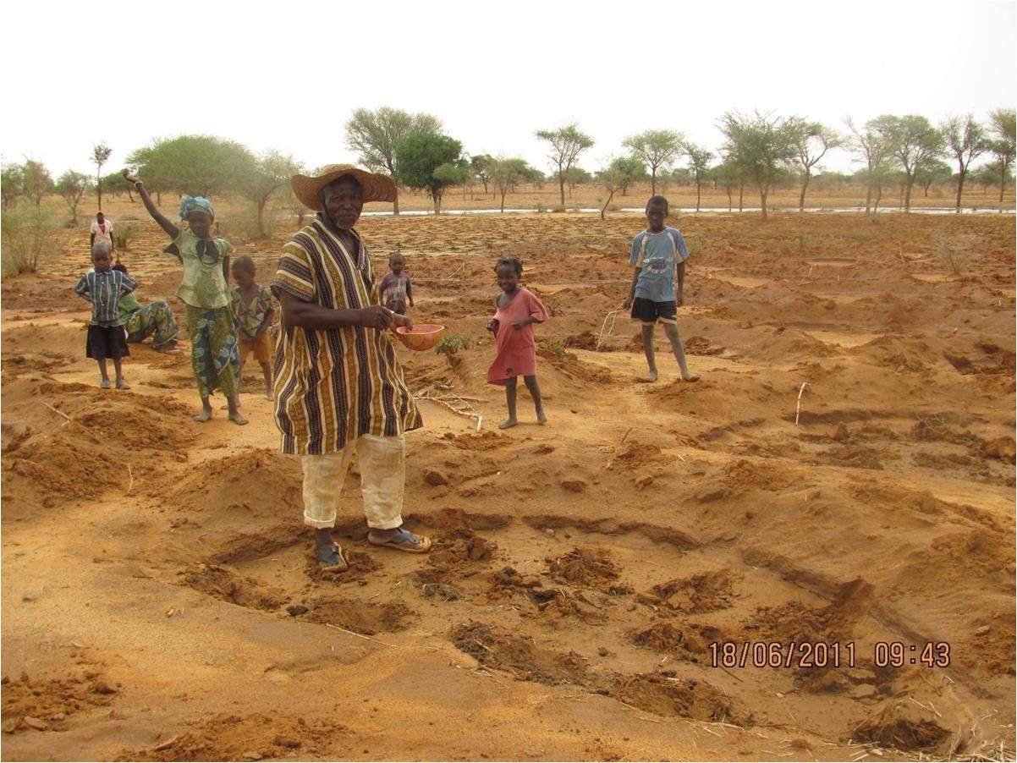
Notes:
Planting in the half moons.

Slide 7
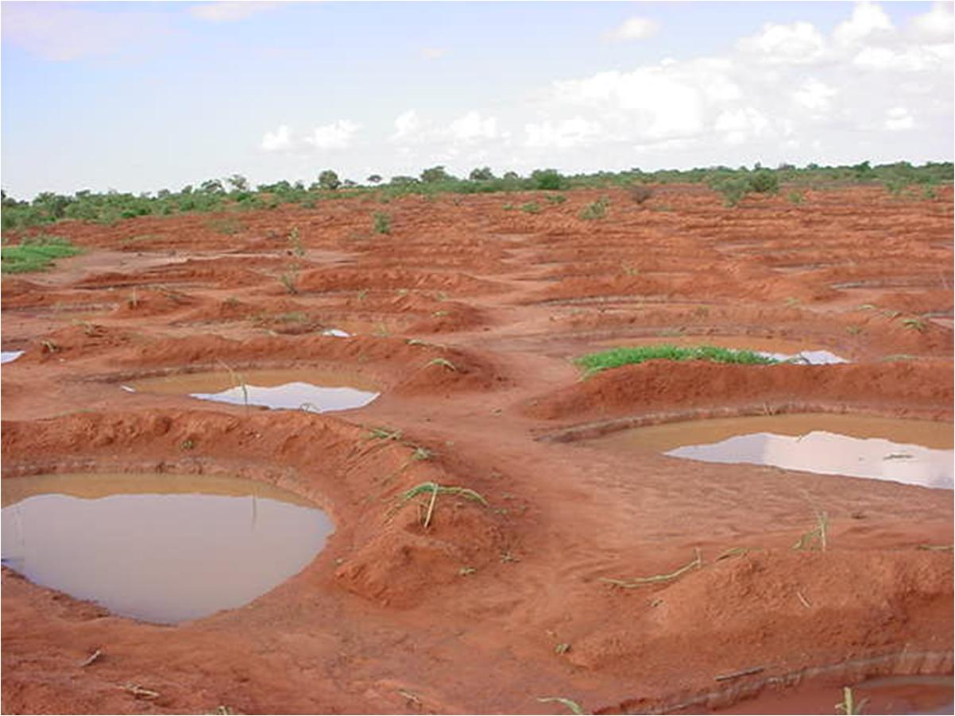
Notes:
Water capture in the half moons.

Slide 8
Objective of the Study
To assess the resiliency of selected households that have benefited from the Multi-Year Assistance Program in Niger compared with households who were not supported.
Key Questions:
Are households supported by Food for Peace more food secure during crises than households not supported by Food for Peace?
Do Food for Peace households consume more diverse and higher quality foods than households not supported by Food for Peace?
Do Food for Peace households have greater assets that effectively buffer against shocks? Do Food for Peace households use more positive coping strategies?
Are communities better equipped with social and physical infrastructure that mitigates shocks?

Slide 9
Methodology
Quantitative survey
(n = 1,680 beneficiary & non-beneficiary households in 74 villages)
Food security status indicators
Household shocks
Household livelihood activities
Household adoption of specific risk management strategies
Household ownership/access to all forms of capital
Contextual information
Qualitative research to provide deeper understanding of
HH perception of most severe shocks and particular problems faced
HH strategies to cope with or adjust to shocks and factors which constrain HH from reacting to shocks in ways that protect their resilience
Structures and processes in selected communities within the survey

Slide 10
Methodology
Determination of household resilience is based on an index comprising four key indicators that reflect three key dimensions of food security (availability, access, utilization)
Household hunger and coping strategies (FANTA III Household Food Insecurity Access Scale)
Dietary Diversity
Proportion of household expenditures on food
Livestock owned (measured in kg)
Vulnerability to poverty model (Chaudhuri et al., 2002)
Use of Propensity Score Matching (PSM) to account for the influence of targeting bias in explaining key differences in outcomes among comparable groups of beneficiary and non-beneficiary households. (modified n = 1,128)

Slide 11
Preliminary Results/Findings
Higher percentage of beneficiary HH adjusted food consumption (less quantity, lower quality)
Lower percentage of beneficiary HH resorted to sale of land (2.9% vs. 7.3%) or non-productive assets (20.7% vs. 25.8%), or had family members temporarily migrate (7.3% vs. 13.1%)
Beneficiary HH are more likely than non-beneficiaries to report having income-generating activities (42% vs. 32%)
Beneficiary HH report higher household dietary diversity than non-beneficiary HH (4.39 vs. 4.04)

Slide 12
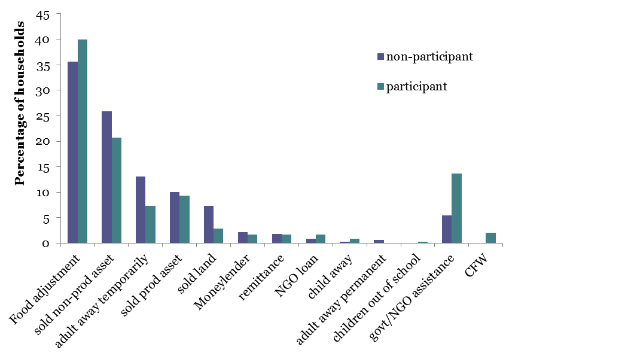
Preliminary Results/Findings
Coping strategies adopted during drought

Slide 13
Preliminary Results/Findings
Significantly more beneficiary HH having adopted positive agricultural changes (25% vs. 16%), and also plan to adopt positive agricultural changes in the future, compared to non-beneficiary HH (84% vs. 77%).
Significantly more beneficiary HH have access to irrigated land compared to non-beneficiary HH (18.1% vs. 8.4%).
Changes in agricultural practices that beneficiaries plan to adopt are related to intensification – using improved seed varieties and adoption of irrigation.
Both males and females in beneficiary HH report slightly higher educational attainment than non-beneficiary HH.

Slide 14
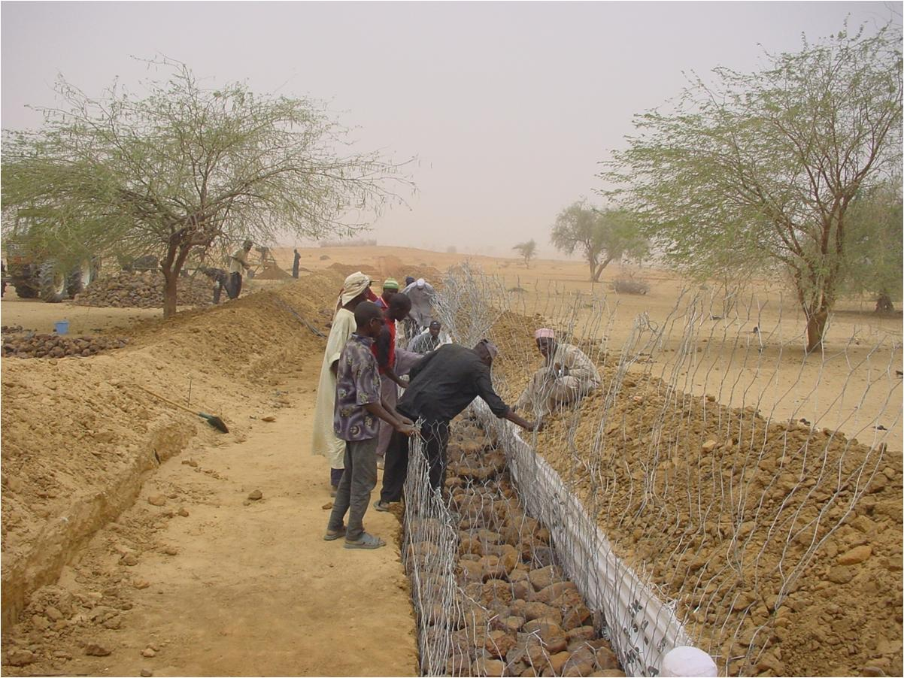
Notes:
Cash for Work – digging irrigation trenches.

Slide 15
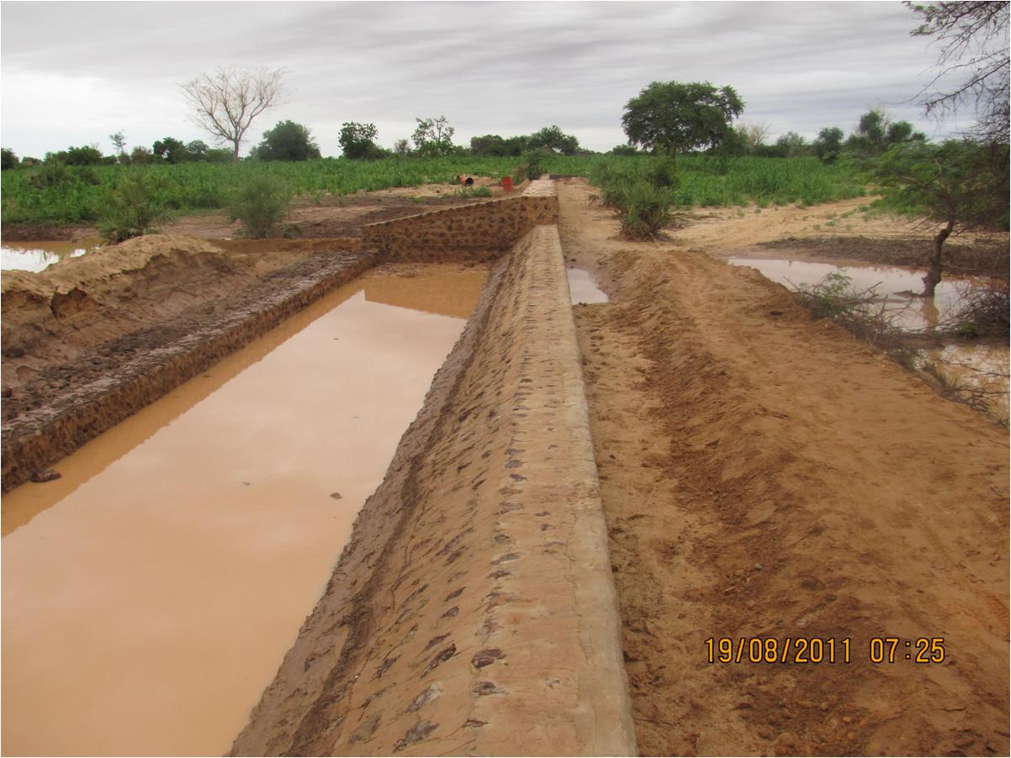
Notes:
Completed irrigation Trench

Slide 16
Lessons Learned
It was challenging to identify a true control group that has not benefitted from other forms of assistance or has similar characteristics as treatment group (We resorted to Propensity Score Matching to resolve this).
Perceptions of what constitutes shocks, adaptive and coping strategies may not be clear in a situation where “shocks” have become the norm. HH decisions not seemingly made based on risk assessment/mitigation.
Need to have a better understanding of indicators of community resilience vs. HH level outcomes.
Limited usefulness of expenditure data as a proxy for income in context where “successful” HH make fewer market purchases.

Slide 17
Lessons Learned
Analysis of vulnerability using a single cross-year, cross section data was less informative than expected. The vulnerability to poverty model, which looks at variation between predicted and actual values of outcome variables, was also not able to explain as much of the variation in the data as was anticipated.
This highlights the importance of having observations of households over time, to be able to look at how specific households react to specific shocks. (CRS may commission a follow-on study.)
HH with a larger number of IGA’s were less vulnerable, and it was important to note that virtually all of the IGA’s were agriculturally based, which underlines the value of business oriented training as a means of coping with shocks.
However, training is not a low-cost or quick return solution. This underscores the need for longer-term engagement with communities (3-5 years) in order to effectively improve adaptive capacity.

Slide 18
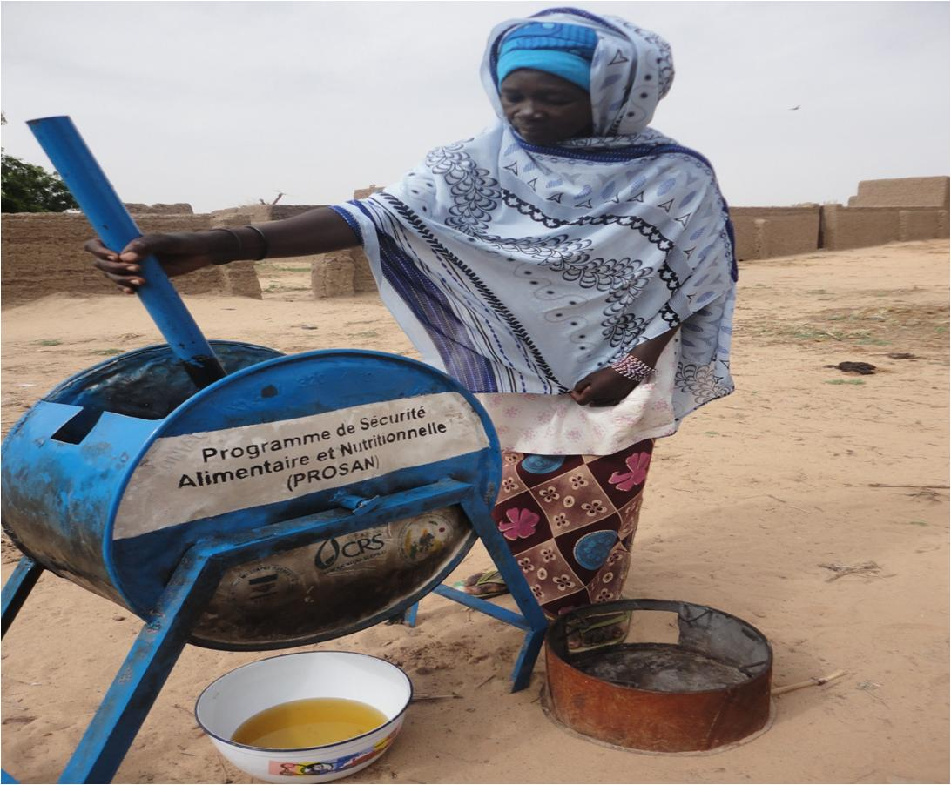
Notes:
Agro-enterprise activities – peanut oil and peanut meal.

Slide 19
Next Steps
Further analysis of data (in particular access to irrigation, small ruminants and IGAs)
Further assessment of lessons learned
Publication and dissemination of findings
Workshops and webinars to share learning across CRS MYAP programs
Application of lessons to existing programs
Contribution to broader dialogue on resilience

