Slide 1
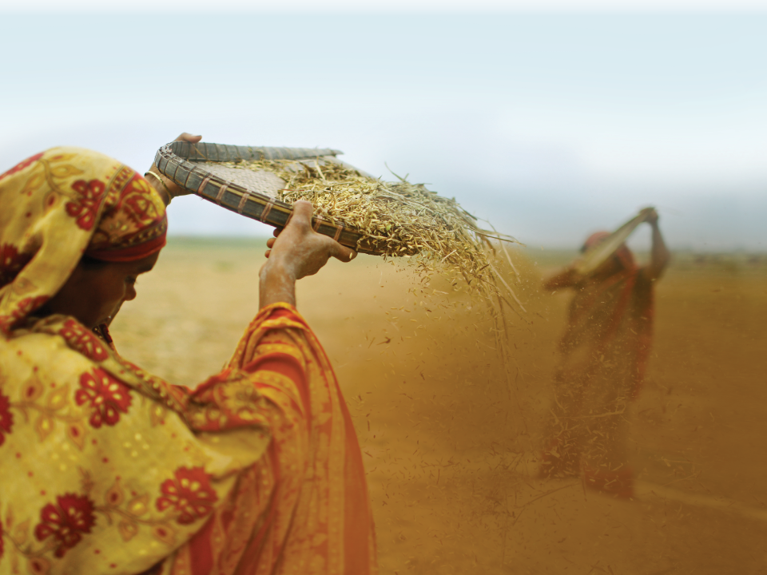
Maternal / IYCF Practices +
Behavior Change +
Caregivers +
Persons of Influence =
Who, What, When, Where & Why

Slide 2
TYPICAL SETTINGS & TODAY’S OBJECTIVE:
THINKING THROUGH THE COMBINATIONS
SMALL GROUPS
EXISTING GROUPS?
LARGE COMMUNITY GROUPS
HOME VISITS

Slide 3
WHO TO REACH IN A “MOTHERS GROUP”:
PRIMARY CAREGIVERS
All mothers?
Mothers divided by “timing” of targeted messages?
Mothers only?
PRIMARY CAREGIVERS +
ADDITIONAL PERSONS OF INFLUENCE?
Grandmothers?
Husbands?
Leaders? (TBAs, CHWs, religious, community)

Slide 4
WHO TO REACH IN OTHER GROUPS:
PERSONS OF INFLUENCE
Grandmothers?
Husbands?
Leaders? (TBAs, religious, community)
Separately?
With mothers?
Mix? Mix all the time or some of the time?

Slide 5
WHO TO REACH IN A HOME VISIT:
Mother alone?
Mother and father alone?
Mother, father and other persons of influence?
Children as caregivers?

Slide 6
WHAT PRACTICES (M / IYCF):
MATERNAL NUTRITION
Additional meal(s) for pregnancy and breastfeeding
Diverse diet
Reduced workload
OPTIMAL BREASTFEEDING
Early initiation & colostrum
Exclusive breastfeeding
Continued breastfeeding
COMPLEMENTARY FEEDING
Frequency
Density (thickness, texture)
Amount
Diverse diet

Slide 7
WHEN
How often with each target?
Mothers
Husbands
Grandmothers
TBAs or CHWs
Community leaders

Slide 8
WHERE
SMALL GROUPS
EXISTING GROUPS?
LARGE COMMUNITY GROUPS
HOME VISITS

Slide 9
WHY? SMALL GROUP ACTIVITY
WHO: Alone or mixed
WHAT: What practices to focus on
WHEN: How often
WHERE: In small group(s) or large
WHY: Rationale

Slide 10
This presentation was made possible by the generous support of the American people through the United States Agency for International Development (USAID) Office of Food for Peace.
The contents are the responsibility of Save the Children and do not necessarily reflect the views of USAID or the United States Government.

