Slide 1
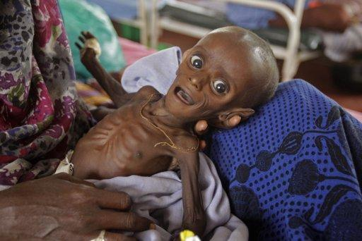
Baby Minaj on admission at the IRC stabilization centre in Hagadera, Dadaab refugee camp

Slide 2
"Using new food aid products for prevention to enhance resiliency“
The nutri butter experience _ Dadaab refugee camp ,Kenya
Dr. Kahindo Maina
Public Health Officer
UNHCR
Presentation on behalf of Terry Njeri Theuri, Nutrition officer UNHCR

Slide 3
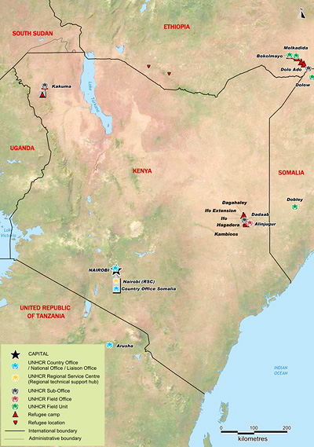
Notes:
By September 2011, Dadaab had received more than 140,000 new refugees, predominantly Somalis. The refugee population reached 450,000, further stretching infrastructure and services far beyond the original intended capacity of the three camps in Dadaab of a total of 90,000 refugees.

Slide 4
Background
Nutributter® is a Lipid-based Nutrient Supplement in the form of a ready-to-use paste, intended to fortify the food supplements of young children, aged between 6 and 24 months, and aid in their motor and cognitive development.
Nutributter® does not require any prior cooking or dilution and does not need to be refrigerated. The package is simply opened and the contents eaten or mixed into the child’s complementary food after it has been cooked and is no longer steaming hot.
Nutributter® is a supplement and does not replace breastfeeding or varied and nutritious complementary foods. Children 6-24 months receiving Nutributter® should continue to be breastfed and to receive their usual complementary foods.

Slide 5
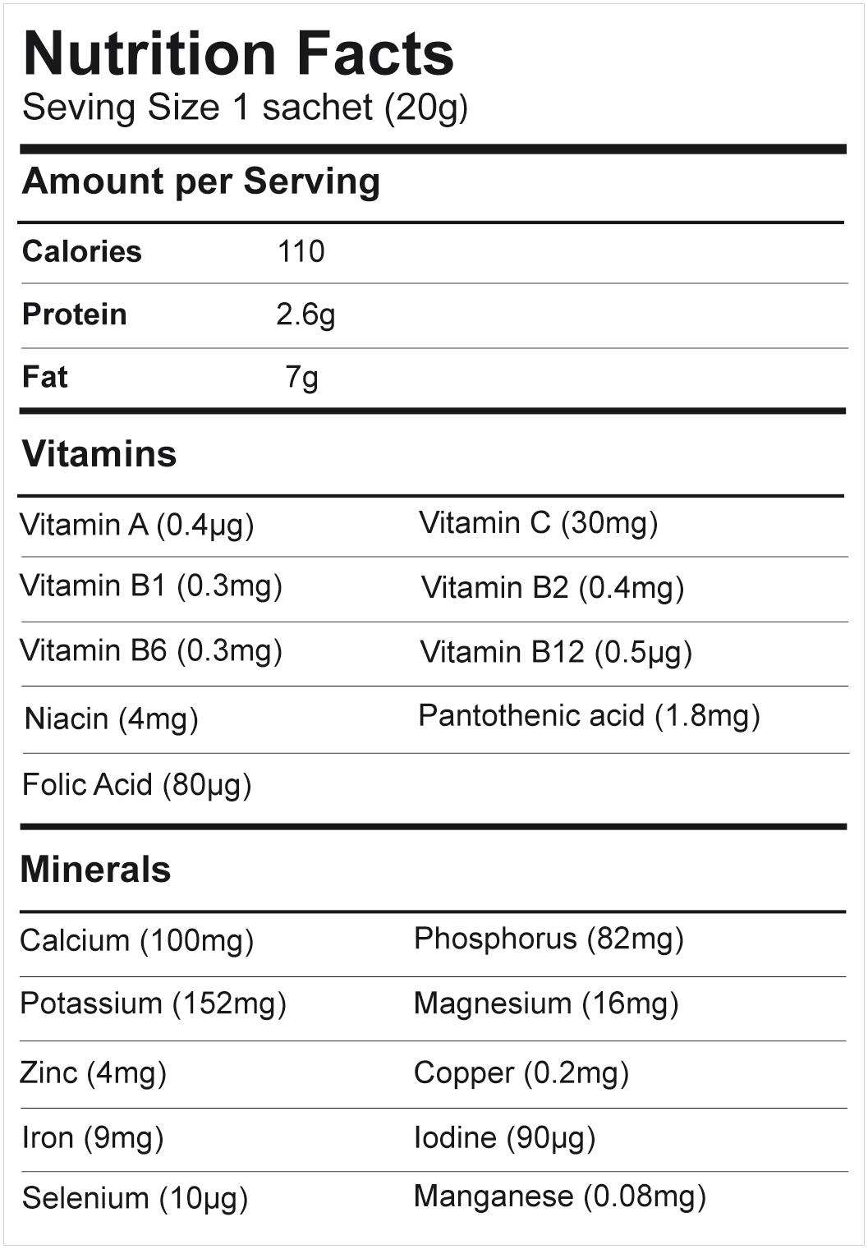
Notes:
Ingredients:peanut, vegetable fat, sugar, dry skimmed milk powder, whey, maltodextrin, vitamin and mineral complex, emulsifier: lecithin. May contain traces of soy.
• Nutributter® does not contain any product of animal origin, except dairy products.

Slide 6
Justification
Anaemia prevalence among under-fives in Dadaab refugee camps exceed 40% thus a public health concern
This is consistently due to: household food insecurity (mainly dilution of the food basket through sale of food rations to purchase non-food items, etc.); poor infant and young child feeding practices and high incidences of diseases (RTIs and diarrhea).
Inadequacy of appropriate complementary foods thus children aged 6-23 months have higher malnutrition rates.
Notes:
Around 6 months of age, due to lack of sufficient food (especially high quality foods), mothers tend to avoid introducing complementary foods to their infants until 9-10 months of age or later, despite World Health Organization (WHO) recommendations that complementary foods should be introduced to infants at 6 months of age.
Exposure to contaminated water and food products, leads to the development of frequent bouts of diarrhea.

Slide 7
Modalities (First Phase)
A 6 month blanket distribution targeting children aged 13-36 months was carried out between January to June 2010.
Older age-group reached since children aged 6-12 months were receiving fresh food vouchers.
UNHCR population database used to screen eligible children on monthly basis.
One 140g jar per child per week (20g per day)

Slide 8
Modalities( First Phase)
Post distribution monitoring indicated high( >90%) acceptability and compliance.
IEC and counseling on appropriate infant young child feeding provided.
8000-12000 children were reached per month for 6 months

Slide 9
Challenges(First Phase)
Congestion at the SFP sites
Lack of enough staff to take care of the extra work load
Lack of adequate commodity transportation to the SFP centres for distribution
Sharing at the household level

Slide 10

Modalities( Phase 2)
A second phase was started from December 2010 through to August/September 2011.
Children 6-24 months were targeted.
Nutributter was provided in a new package of 20g satchets per day (monthly basis), providing 110 kcal, 2.6 g protein, 7.0 g lipids and micronutrients including 9 mg iron.

Slide 11
Modalities (Phase 2)
The 2nd phase the nutributter intervention was also tied to the objectives below:
Micronutrient Supplementation
Early detection of malnutrition and action taken
Growth monitoring and promotion

Slide 12
Improvements
  Distributions were carried out at health-posts and staggered throughout the month to avoid congestion. This was done at the growth monitoring areas
  Regular staff specific to growth monitoring and nutributter distribution were recruited.
  Intensive information campaign was done including the change in the nutributter package
  Mobilization and scheduling of beneficiaries also took place prior to the start of the second phase. This was done by staff in the nutrition and outreach program.
Notes:
In the height of the emergency blanket supplementation of 6-59months using CSB++ was introduced in place of nutributter ( end of September 2011)

Slide 13
Improvements
  Standardized messages across the 3 camps were designed on nutributter and translated to Somali.
  Questionnaires were developed for post distribution monitoring
  Children’s MUAC was taken during the distribution as it was an opportunity to screen and identify malnourished children and those at-risk
  The GFD partner on ground provided logistics supporting the transportation of nutributter cartons to the health posts.
Notes:
In the height of the emergency blanket supplementation of 6-59months using CSB++ was introduced in place of nutributter ( end of September 2011)

Slide 14
Results
Improved recovery rate and reduced length of stay among children in SFP
Nutrition survey conducted after end of the program used as proxy to determine impact. Reduction in malnutrition levels from 13% in 2009 to 5.6% (Hagadera camp), 10% to 7.6% (Ifo) and 14% to 10.7%(Dagahaley) in 2010 could be attributed to nutributter.
Reduction in anaemia prevalence among under-fives could be attributed to nutributter in addition to the other interventions (fresh food vouchers; 6-11 months)
Notes:
Note:
A satchet of nutributter has 9mg of iron which is 100% RDA for the under fives.
Nutributter delivers a daily dose of zinc, which has been shown in clinical trials to reduce the incidence and severity of diarrheal illness. Therefore, we anticipate that Nutributter supplementation will also impact diarrheal illness and interrupt the infection-malnutrition cycle.
Note:Provision of food vouchers is quite expensive and needed approximately 12000 dollars per month for the commodities only thus exclusive of operation and distribution costs.

Slide 15
Notes:
The charts shows the anaemia prevalence from nutrition surveys in children aged 6-23 months since
2009. This Figure was drawn to aid in the assessment of the impact of Nutributter® to reduce anaemia in
children 6-23 months. For comparison purpose, children who joined the camp in 2011 were excluded from
analysis because they may not have been exposed to Nutributter® as of 6 months of age or may have been
malnourished before joining the camp. Comparison with results from 2010 shows a significant decrease in
anaemia among children 6-23 months (p<0.05).

Slide 16
Notes:
In all three main camps, the 6-23 months age group had the highest prevalence of anaemia with the prevalence declining with increasing age, as seen in the surveys in 2009 and 2010. Trend analysis comparing anaemia levels in children 6-23 months from 2009 to 2011 and excluding children who arrived in the camp in 2011 shows a sharp decrease in anaemia in this age group which can most likely be attributed to Nutributter® targeted to children 6-23 months. In Hagadera, the prevalence of anaemia in children aged 6-23 months significantly decreased from 82.2% (77.4-86.9 95% CI) in 2010 to 60.7% (52.0-69.4) in 2011 (p<0.05) ), a 26% relative decrease; in Ifo, anaemia decreased from 79.8% (74.5-85.0) to 65.7% (56.8-74.6) (p<0.05), an 18% decrease; and in Dagahaley, anaemia decreased from 72.1% (65.5-78.8) to 60.5% (53.1-67.9) (p<0.05), a 16% decrease.

Slide 18
Lessons learnt
Nutributter is an effective mode to deliver essential nutrients to children through complementing locally available foods.
Distribution of nutributter is an opportunity to enhance growth monitoring, IYCF counseling, referral of sick and/or malnourished children for treatment.

Slide 19
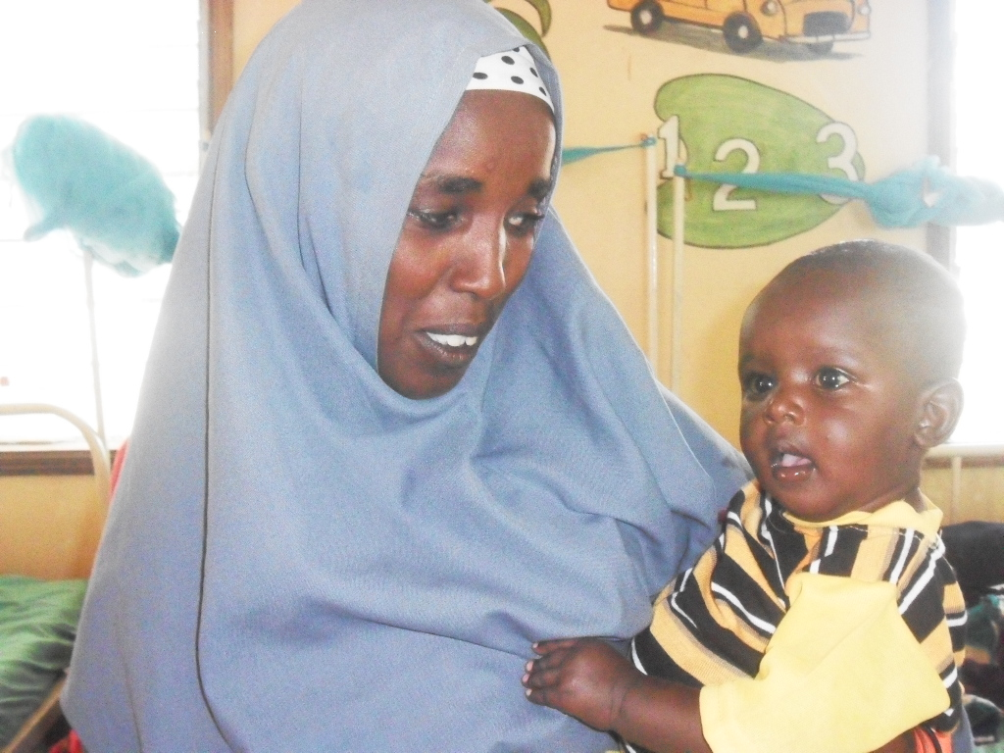
Baby Minaj on Discharge

