Slide 1
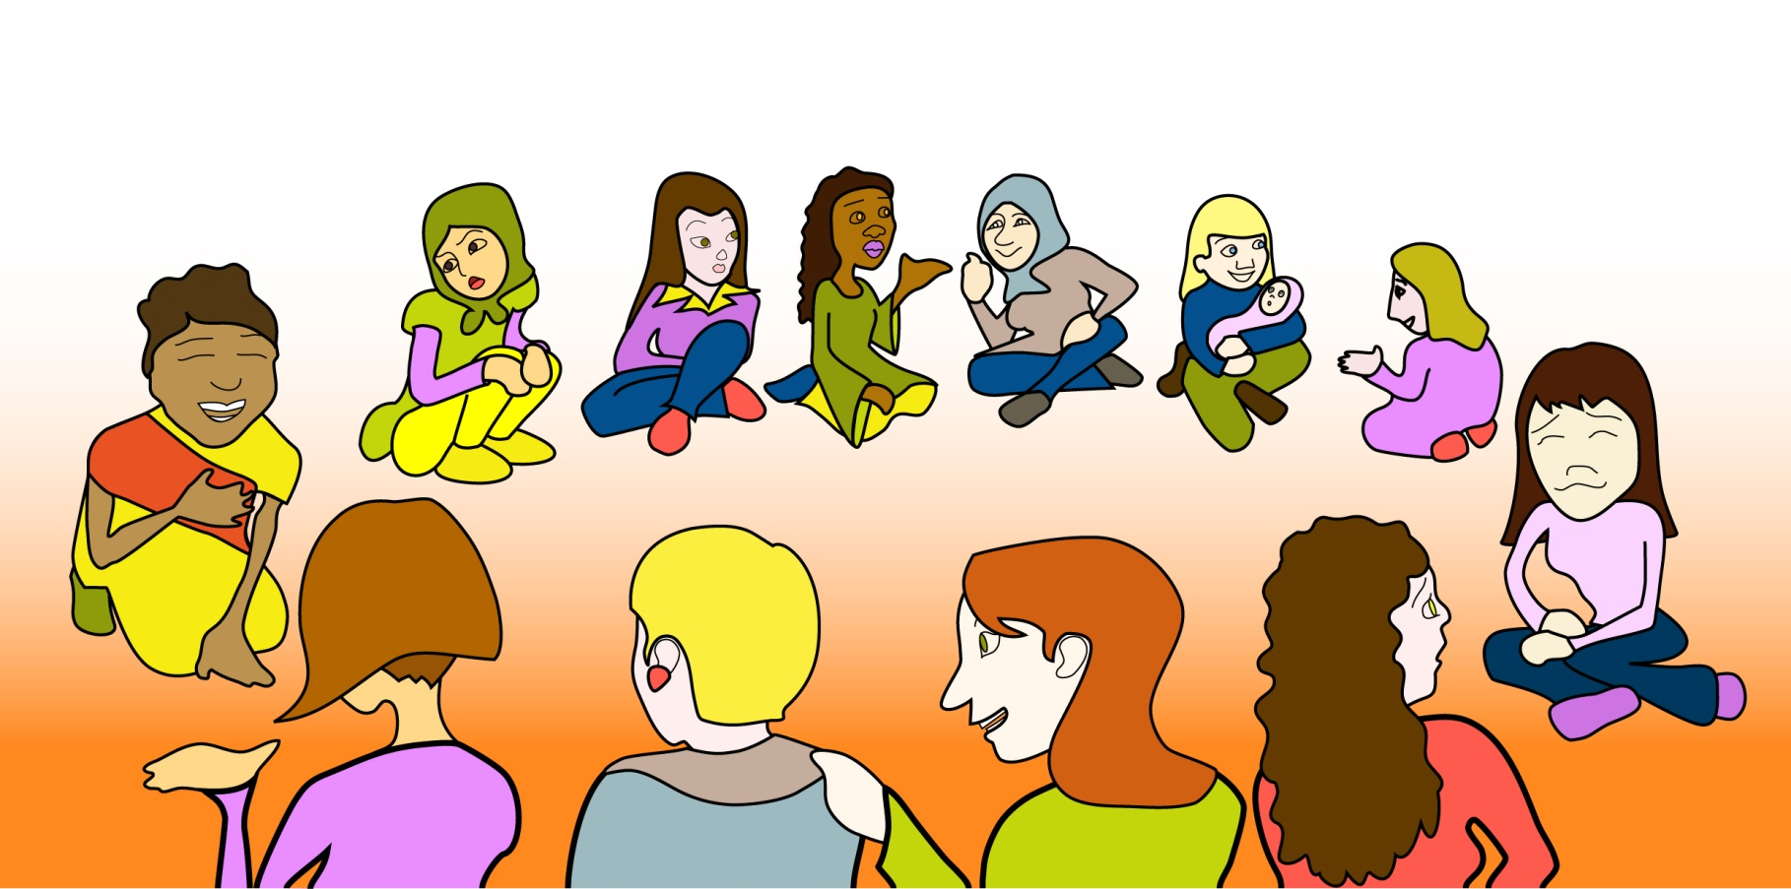
Support Groups
TEAMS Model
Maria J. Joya Suarez

Slide 2
Sample Structure of this Support Group
Check-in
Left over feelings and announcements
Agreements
Talk on Topic of Interest (if there is one)
Personal support time
Wrap up and appreciations

Slide 3
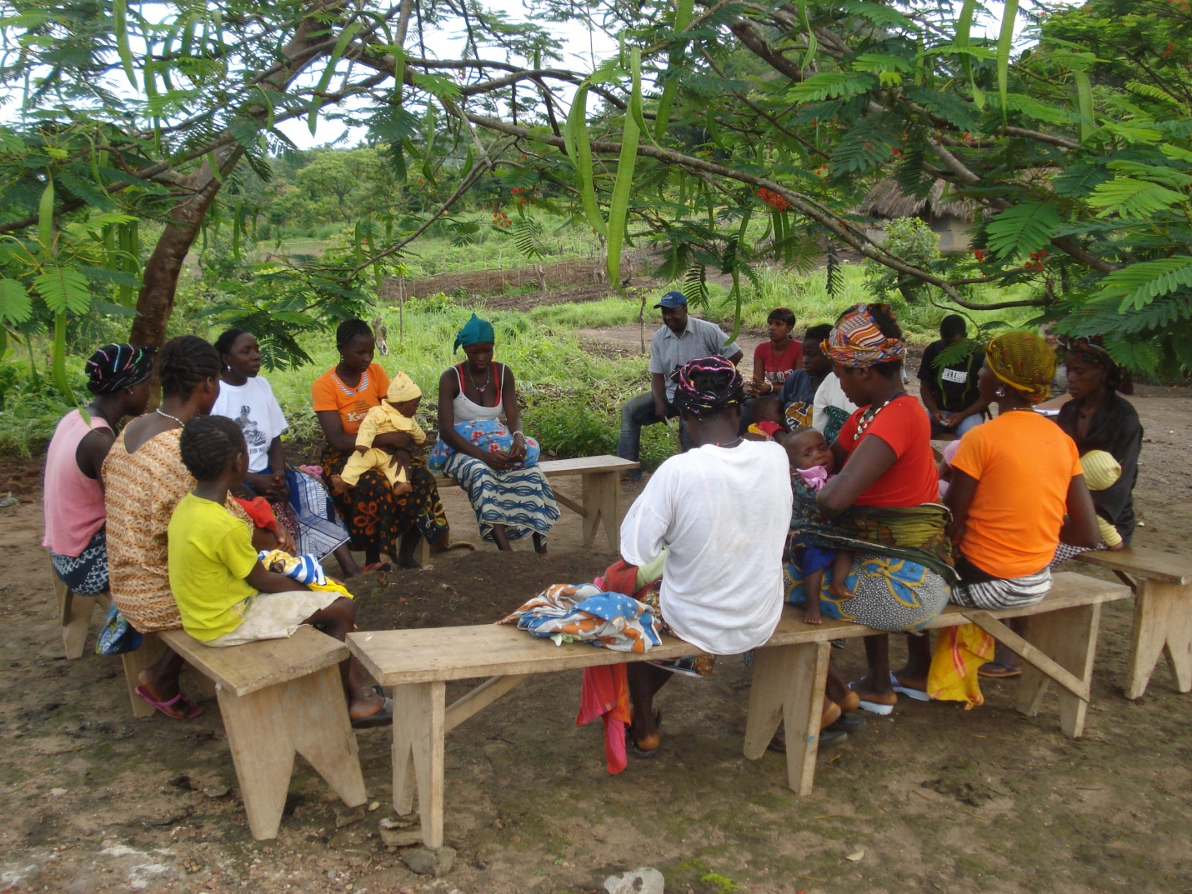
Kefa TOT

Slide 4
Basic Skills a BFSG Facilitator Needs
Basic Communication Skills
-Listening skills
-How to ask questions
-Non-verbal communication
Group facilitation skills to make the group feel safe and effective for all participants
How to manage common problems that arise in a group.
Breastfeeding Knowledge/experience

Slide 5
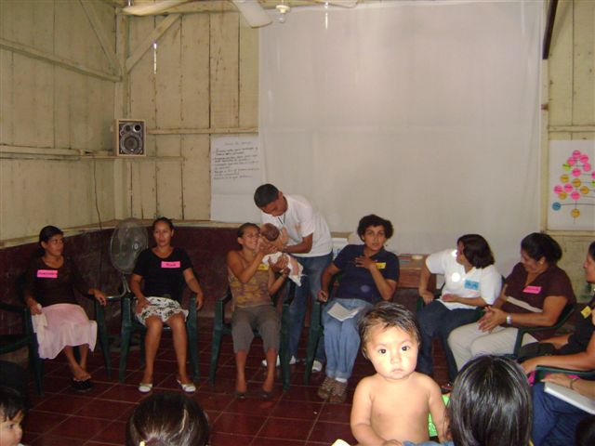

Slide 6
Process
Develop Prototype for a facilitation Curriculum
Train trainers with the prototype
Master trainers adapt the prototype (owneership)
Master trainers train the Community Facilitators with the new Curriculum
Debriefing after each session and insert in the curriculum the learners experience and knowledge (ownership)
New Facilitators have their first support group

Slide 7
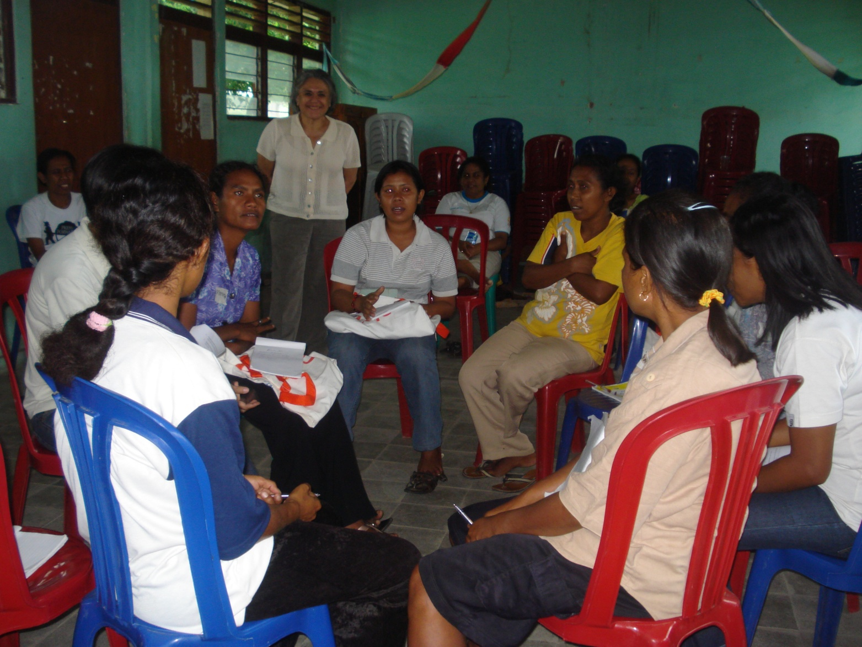
Community training in Kefa, West Timor

Slide 8
Mentoring for the First Support Group Meeting
Who will facilitate the support group?
Who can help facilitate the group (co-facilitator)?
Who and how do we invite?
Where will the group meeting be held?
When will the group meeting be held?
Will the group provide refreshments?
What do we do with the children that come to the group?

Slide 9
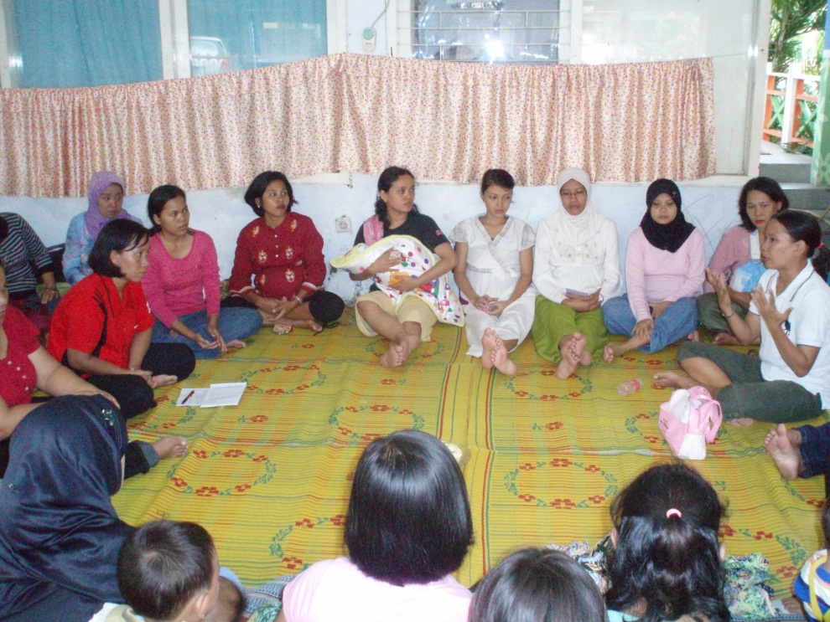
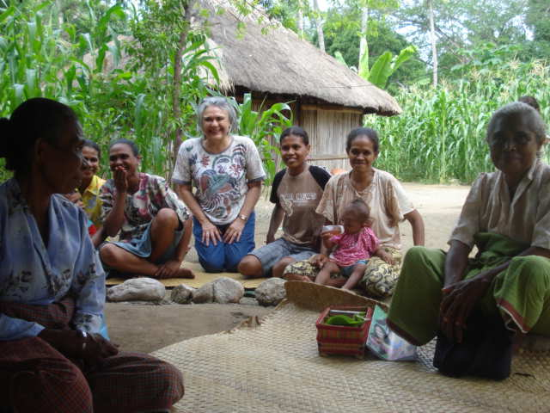
First Support Group
Master trainers observe the first meetings
Master trainers mentor the community facilitator in how to form/facilitate her/his first group
Debrief with the new facilitator after the session
Set a date for the next mentoring session

Slide 10
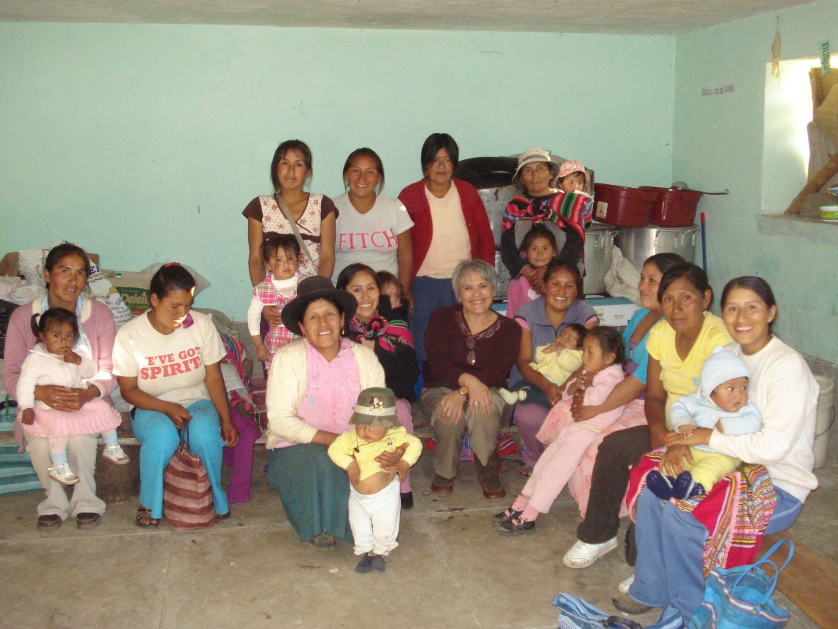
Curahuasi, Peru

Slide 11
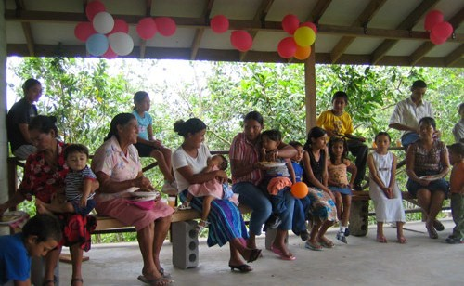
THANK YOU!

