Slide 1
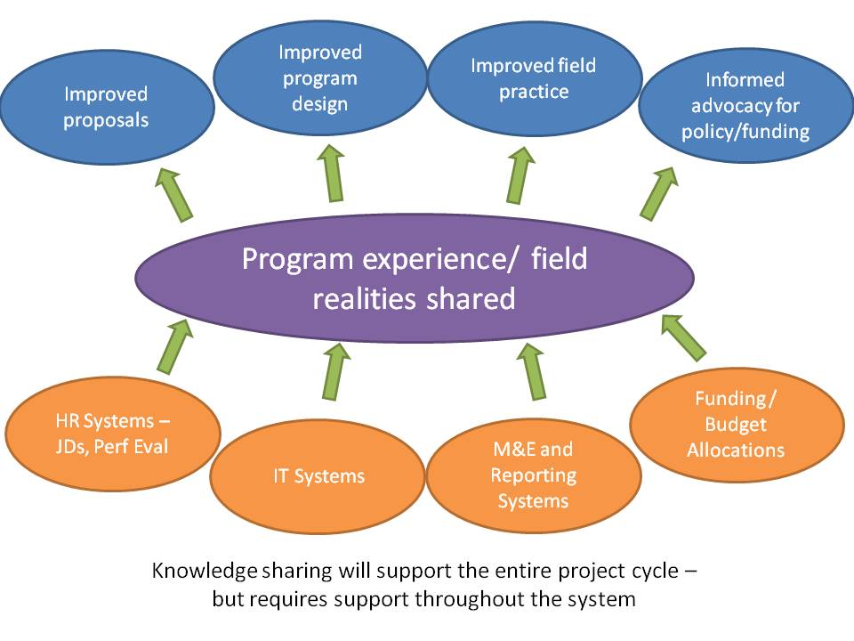
Program learning from an
implementation perspective
.
Notes:
1

Slide 2
Program learning throughout
the project cycle
Assessment
Design
Implementation
Evaluation

