Slide 1
Opportunities and challenges of conducting research in large scale programs
Presented by: Deanna Olney and Jef Leroy, IFPRI

Slide 2
Program and research activities
planning
implementation
Health
Program
BCC
Food distribution
time
Formative
Research
Impact
Operations
Cost

Slide 3
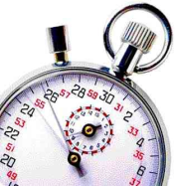
Formative research
planning
implementation
Health
Program
BCC
Food distribution
time
Formative
Research
Impact
Operations
Cost

Slide 4
Formative research
Purpose
Identify needs in the community related to potential programmatic interventions
Design appropriate interventions
Refine existing interventions
Timing
Ideally done before the program begins – realistically need 6 months to 1 year to conduct formative research for something like designing a BCC strategy
Opportunities
Ability to identify specific areas and beliefs to target for behavior change (e.g. belief among mothers in Guatemala that breast milk does not “quench thirst”)
Ability to identify areas that do not need to be emphasized for behavior change (e.g. the majority of mothers in Guatemala continue breastfeeding until 2 years of age)
Challenges
Program expected to start immediately after funding received
Formative research, if done, needs to be done quickly
Becomes irrelevant if done too late or takes too much time
Not particularly useful if it is not done thoroughly
Notes:
Program interventions designed based on strong formative research are more likely to achieve optimal impact

Slide 5
Impact study
planning
implementation
Health
Program
BCC
Start
Food distribution
time
Formative
Research
Impact
BL
EL
Operations
Cost

Slide 6
Impact study
Purpose
Evaluate the impact of the program on a variety of child, maternal, household and community outcomes
Timing
Baseline: Just before program implementation
Endline: After a sufficiently long period of program implementation to ensure that exposure to program has had an impact
Opportunities
Having evidence that a program is successful (and information related to how this happened)
Having the ability to replicate a successful program in different settings (or adjust the design to make a more successful program)
Challenges
Timing, timing, timing
Convincing partners that an ethically sound study can include a control group

Slide 7
Operations research
planning
implementation
Health
Program
BCC
Food distribution
time
Formative
Research
Impact
Operations
R1
R2
Cost

Slide 8
Operations research
Purpose
Identify program components that are working or not working as planned
Understand the potential of the program to have the desired impacts (and potential differences between treatment arms) based on how it the program components are being delivered by implementers and utilized by beneficiaries
Identify program components that are feasible to improve within the context and timeline of the on-going program
Timing
Round 1
1 year after program implementation
Round 2
1 year after the first round (after identified changes have been implemented)
Opportunities
Ability to identify program components that can be improved to increase impact
Ability to identify any potential problems in program implementation and/or utilization that may explain a lower than expected of effect (or differences in effects between different treatment arms)
Challenges
Perception that operations research implies an evaluation of the program implementers
Conducting the operations research in a useful and timely manner
Notes:
Program interventions designed based on strong formative research are more likely to achieve optimal impact

Slide 9
Cost study
planning
implementation
Health
Program
BCC
Food distribution
time
Formative
Research
Impact
Operations
Cost

Slide 10
Cost study
Purpose
Estimate the cost of the program
Estimate the cost of specific program components
Estimate the programs cost effectiveness (e.g. $ per cm of child linear growth)
Timing
Continued data collection throughout program implementation
Opportunities
Estimate the cost per unit of benefit: “How much does it cost to improve child growth by 1 cm?”, “How much does it cost to reduce the prevalence of household food insecurity by 10 percentage points?”
Compare the cost of the PM2A approach to other approaches
Ability to identify program components that are expensive and contribute relatively little to the overall program impact
Challenges
Perception that cost study implies a program financial audit
Time commitment of program staff
Notes:
Program interventions designed based on strong formative research are more likely to achieve optimal impact

Slide 11
The Biggest Opportunities
Having a well-designed program grounded in program theory and based on strong formative research
Having a study design that allows for the impact of a program to be adequately assessed
Having the ability to adjust program components that are identified as “not working” during operations research
Having evidence that a program is successful or less successful and information related to how this happened
Having the ability to replicate a successful program in different settings (or adjust the design of a less successful program)

Slide 12
The Biggest Challenges
Having different priorities
Speaking different languages
Having different (and sometimes competing) sets of expectations/deliverables
Having a different timing

Slide 13
Formative research
, Impact study
Operations research
, Cost study
planning
implementation
Health
Program
BCC
Plan, plan and plan some more
Talk, talk and talk some more
Start
Food distribution
time
Formative
Research
Impact
BL
EL
Operations
R1
R2
Cost

Slide 14
Plan, plan and plan some more
Plan a year of start-up activities for large-scale programs (especially for those that will include a significant research component)
Schedule planning meetings between program implementers and researchers early on in the process
Understand each other’s priorities, expectations, concerns, etc.
Decide what is feasible and adequate
Determine what is needed to carry-out the program and research simultaneously
Obtain approvals from appropriate government officials (and other as needed) for program activities as well as research activities
Acquire any special products and/or equipment
Preliminary research activities
Formative research
Acceptability tests for new products
Baseline study
Preliminary program activities
Hire appropriate staff
Design program activities based on formative research
Design trainings based on program activities

Slide 15
Talk, talk and talk some more
Out-posted researchers
Regular meetings between program implementers and researchers
Workshops based on research findings
Programmatic changes based on research findings
Dissemination of research findings

Slide 16
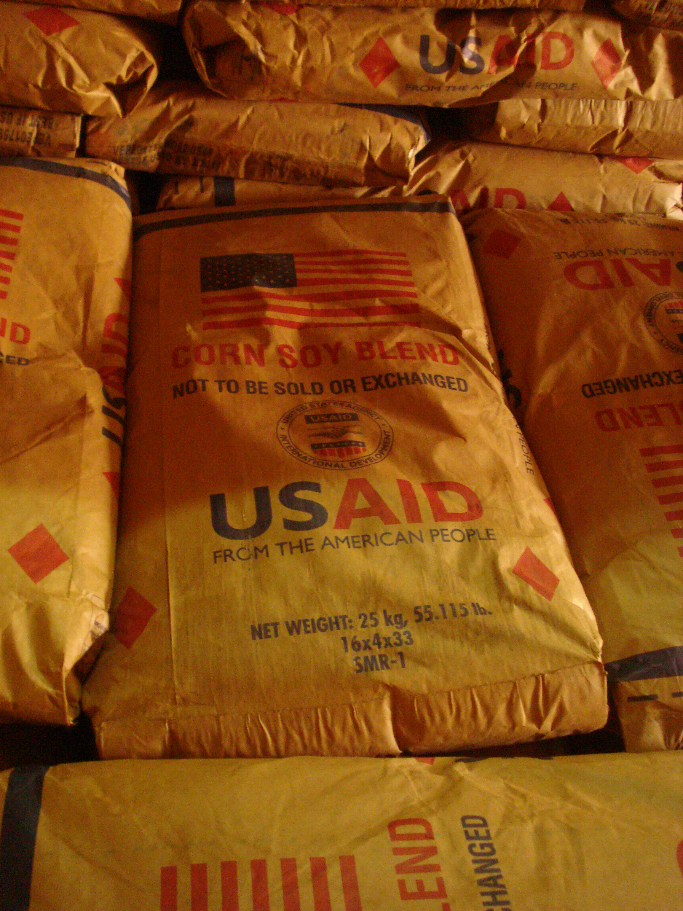

Slide 17
Have fun
Researchers and program implementers both bring a bit of entertainment to the table
I will take one sample size calculation and raise you two call forwards –
I will take your two call forwards and raise you 100 randomized collines
I will see your 100 randomized collines and raise you 52,500 plastic buckets for commodity distribution

Slide 18
In the end – everyone wins!
Better designed programs
Improved impact on targeted outcomes (e.g. reduction of stunting among children < 2 years of age)
Better publicized results
The Economist reports, “fewer stunted children in Alta Verapaz, Guatemala as a result of PM2A program”; “and significantly better household food security in Cankuzo and Ruyigi in Burundi”
More money for programs that work
“Did you hear about these programs in Burundi and Guatemala? I want to donate some money to that – finally something that works!”
Fewer malnourished children in the world
Well designed programs + money to implement programs + documentation on how to implement programs ----- increased chance of success ----- increased likelihood of positive impact

Slide 19
