Slide 1

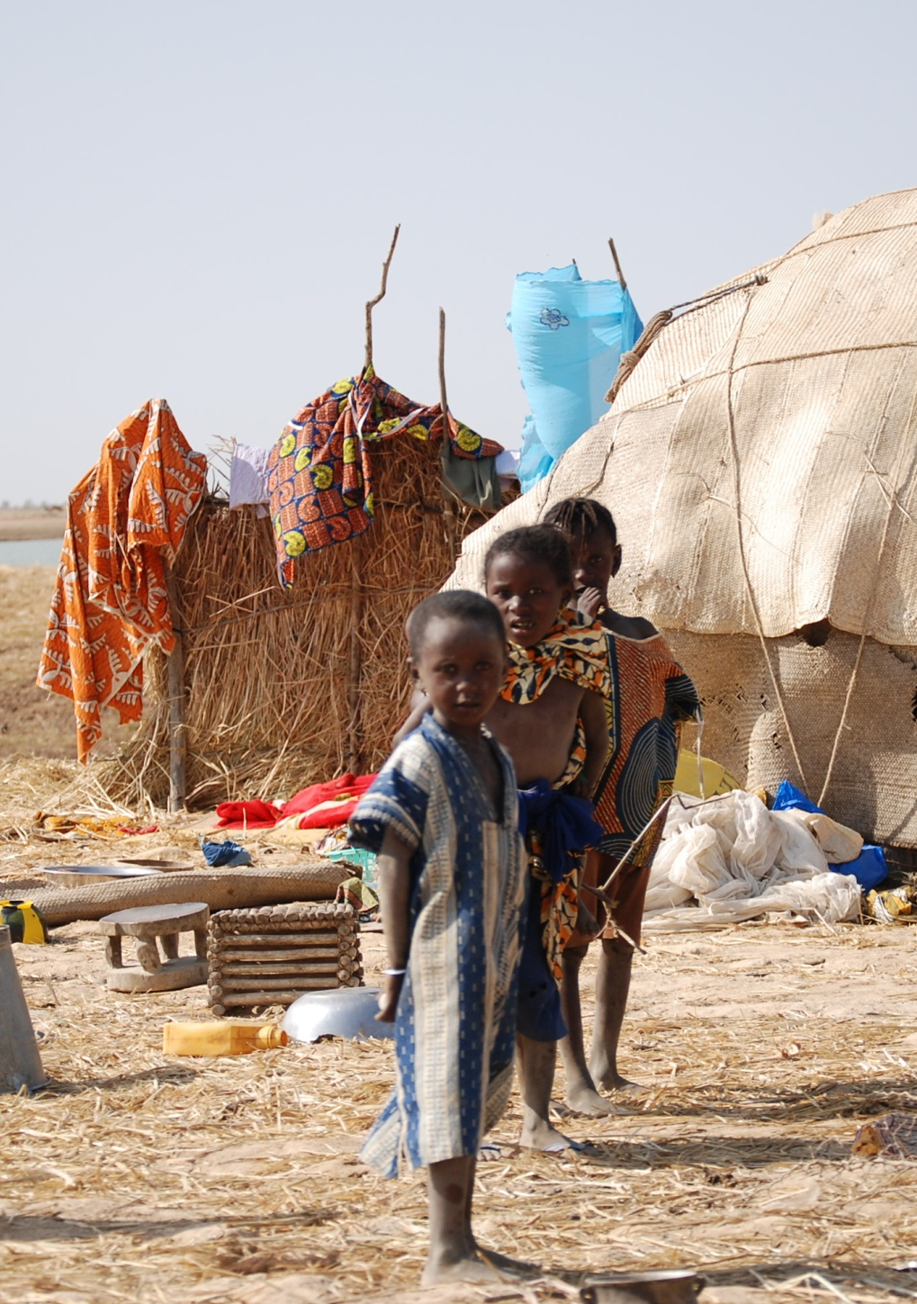


Learning to use resilience wisely
Chris Béné, Rachel Godfrey-Wood, Andy Newsham, Mark Davies
Adaptive Social Protection Programme
IDS, UK

Slide 2
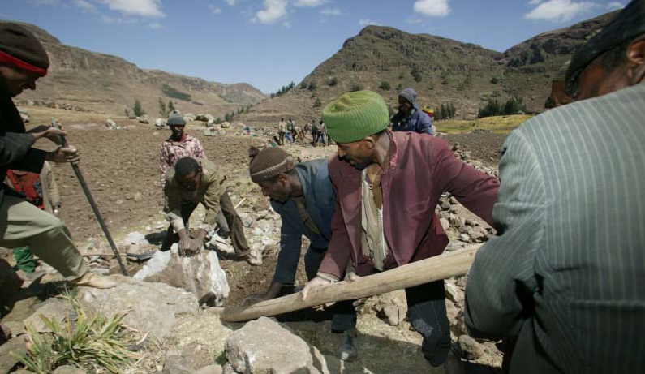
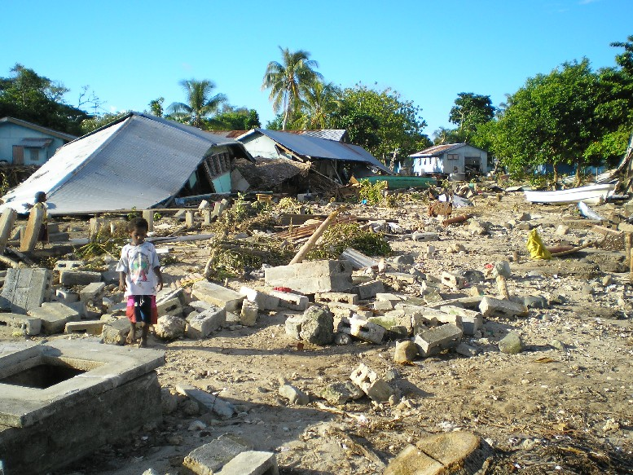
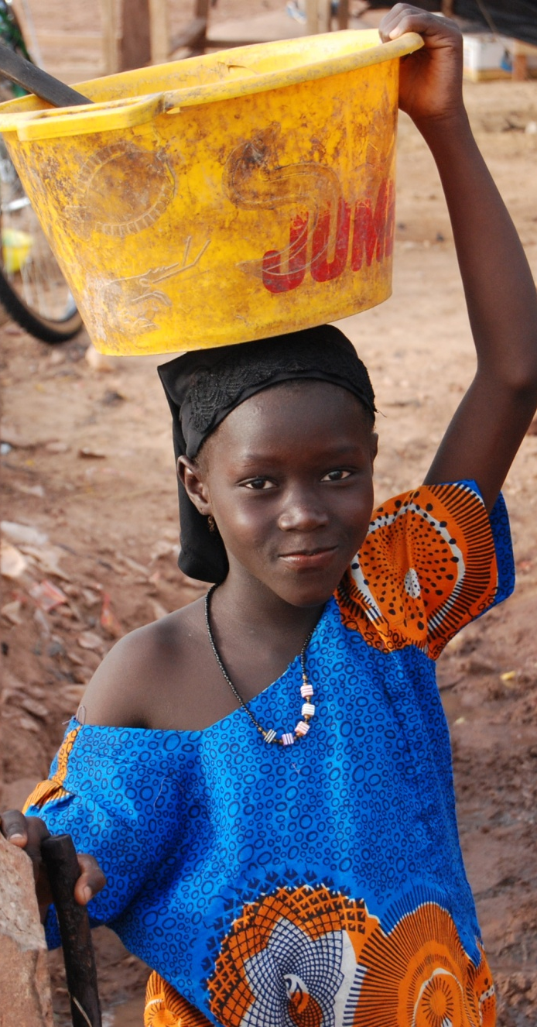
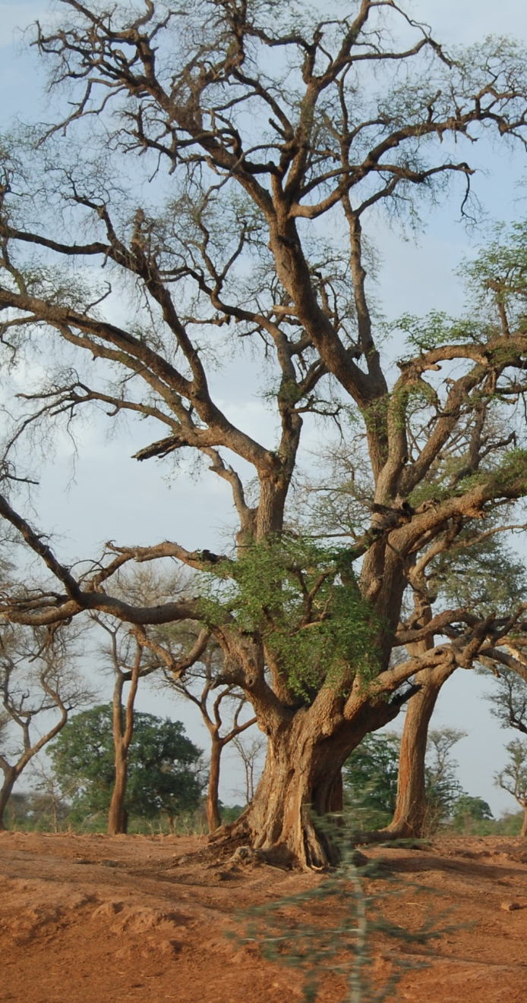
Background
Long term donor commitments?...
‘to help improve resilience, equity and opportunity in both low- and middle-income countries’
(Social Protection and Labour 2012-2022 Global
Strategy World Bank 2011)
‘commitments to embed resilience-building in all DFID country programmes by 2015, integrate resilience into [DFID] work on climate change and conflict prevention and improve the coherence of [DFID] development and humanitarian work’
(Humanitarian Emergency Response Review DFID 2011)
So:
how can we ensure we use it wisely?
Resilience in academia
  Resilience Alliance, Social-ecological system (Adger; Folke; Carpenter; Gallopin etc.)
  IDS bulletin on resilience (2008)
Resilience as a (new?) concept in relation to
vulnerability-reduction interventions
  Disaster Risk Reduction literature (IFRC 2004 WCDR 2005; Klein et al. 1998; Tobin 1999)
  Climate Change Adaptation literature (IPCC 2012; Moser et al. 2010; Allison and Hobbes 2004)
  Social Protection literature (World Bank 2012)
Resilience and Development
  Resilience building, resilience in practice (BOND process – 15 NGOs), CARE, etc.
“Appropriation” by donors and development agencies
  WFP, FAO, DFID, World Bank, etc.

Slide 3
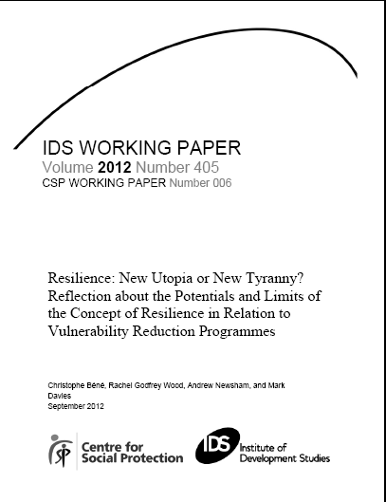
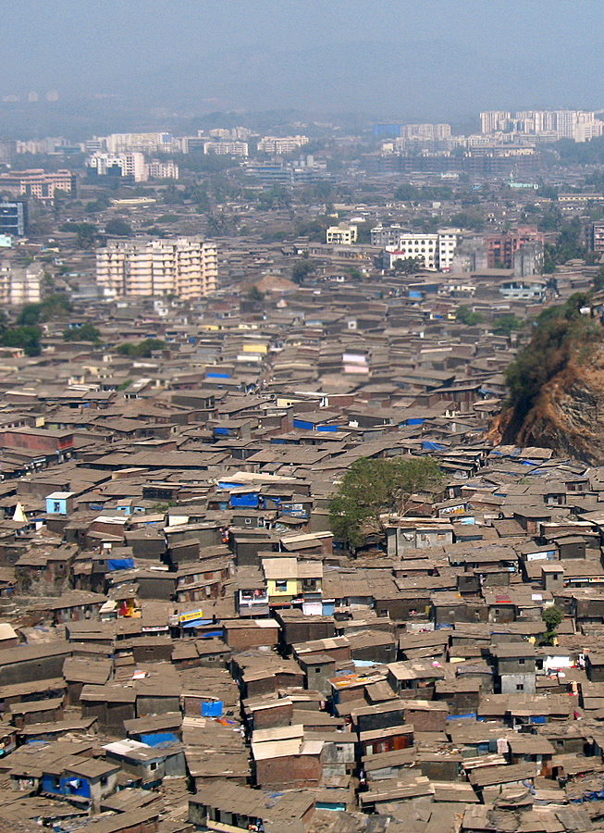
Objective - motivation
Objective:
Explore the promise and limits of the concept of resilience in relation to vulnerability reduction programmes
What is the link between resilience and poverty?
Is resilience always useful as an objective, as a framework?
  Method
What does a resilience-driven programme look like?
Analytical framework applied to current social protection initiatives in Ethiopia and Bangaldesh

Slide 4
Resilience: definition
  Definition of Resilience
  “ability of a system and its component parts to anticipate, absorb, accommodate, or recover from the effects of a hazardous event [shock] in a timely and efficient manner” (IPCC 2012, p.3)
  Shocks, capacity to recover, bounce back, to learn and adapt, prevention, etc.

Slide 5
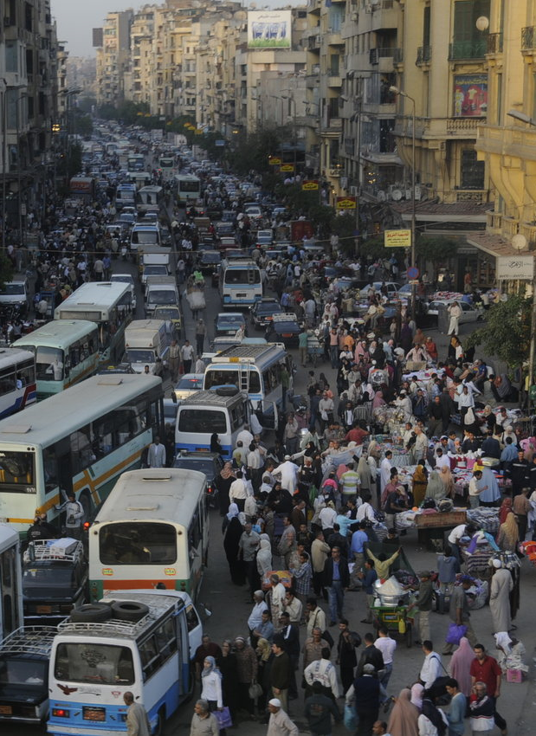
Some good things about resilience
Resilience as a way to think holistically
  Social-ecological linkages
    greater dependence of the poor on the environment/natural resources
    ‘natural disasters’ and the role of ES as buffer (Adger et al. 2005)
    widen the ‘nature/type’ of vulnerability
  Increasing occurrence of covariate shocks
  Recognition of cross-scale processes and cross-scale vulnerabilities
  Complexity and importance of -/+ feedback
  Emergence of new areas of research
  adaptation – adaptive capacity
  transformation

Slide 6
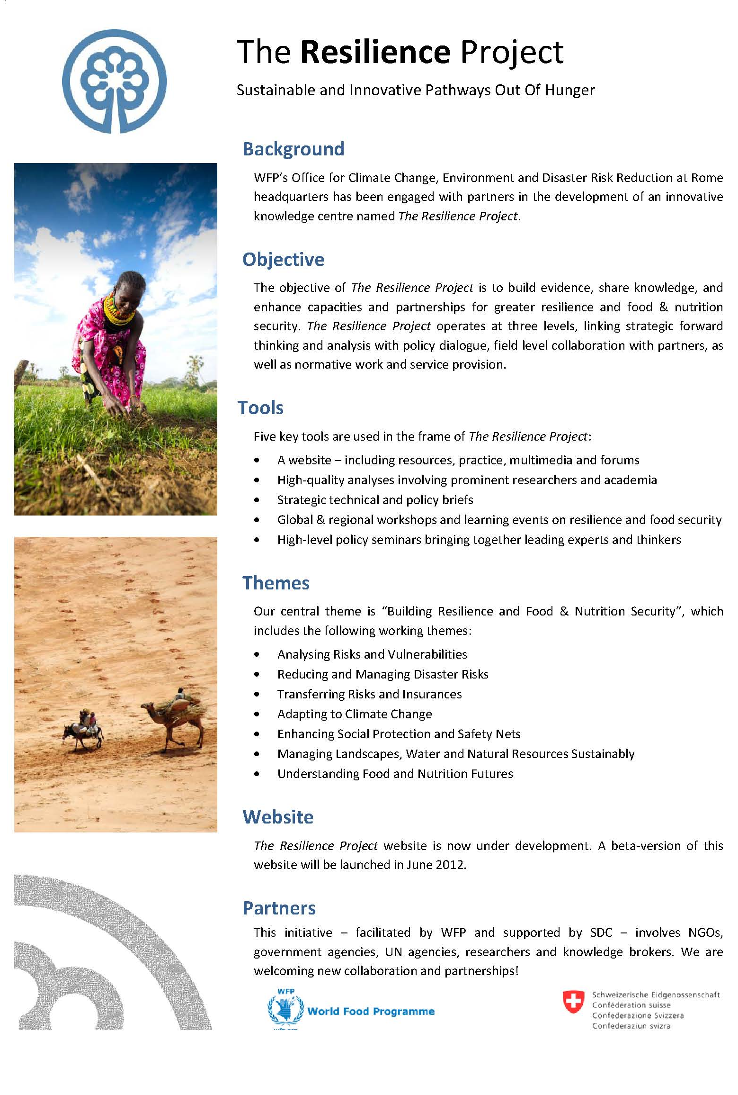
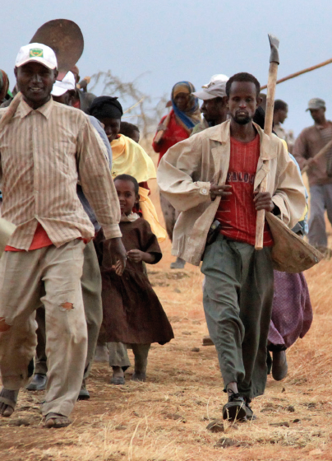
Some (more)good things about resilience
Resilience as a policy narrative
  ‘Intuitive’ concept - ‘policy broker’
  across discipline and background
  “decreases the rigidities of disciplinary and institutional structure”
  Martin-Breen and Anderies 2011
  potential for integration
  bridge between communities of practices
  (health, planning, food security, disaster risks management, etc.)
Resilience as integrating tool
‘resilience concept as a platform to ”share knowledge, foster policy dialogue, and field level collaboration”
(SDC and WFP 2011)

Slide 7
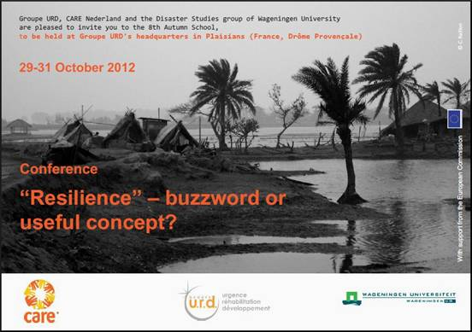
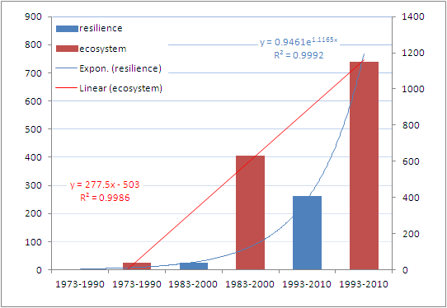

Some not-so-good things about resilience
Resilience as a fashionable research concept?
Increasing number of articles, PhD theses
Several hundred of definitions (moving target)
Not easily measurable (outcome, ability)
Not easily operationable
Risk to use the wrong concept
Risk to ‘complexify’ the problem instead of clarifying it
Number of articles published in PNAS
Notes:
In fact people have to be very resilient when they are poor

Slide 8
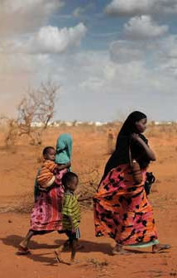
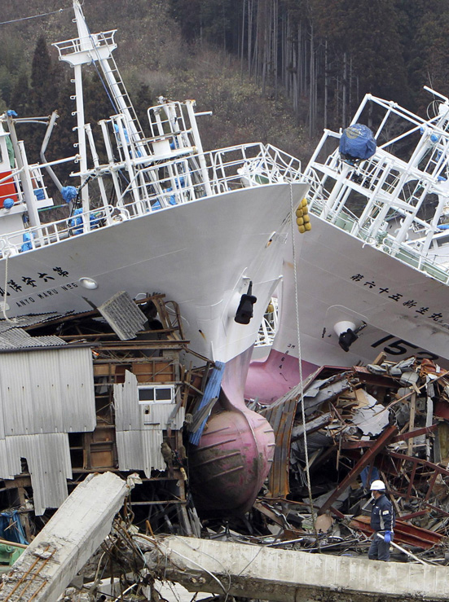
Some not-so-good things about resilience
Agency, power and resilience
  Definition of Resilience
  “ability of a system and its component parts to anticipate, absorb, accommodate, or recover from the effects of a hazardous event [shock] in a timely and efficient manner” (IPCC 2012, p.3)
  Shocks, capacity to recover, bounce back, to learn and adapt, prevention, etc.
(among the hundreds definitions that exist in the literature) how many of them do mention ‘power’, ‘inequity’, or ‘agency’ ?
no particular attention paid to agency, nor to power
resilience = technical, neutral, apolitical term
Notes:
In fact people have to be very resilient when they are poor

Slide 9
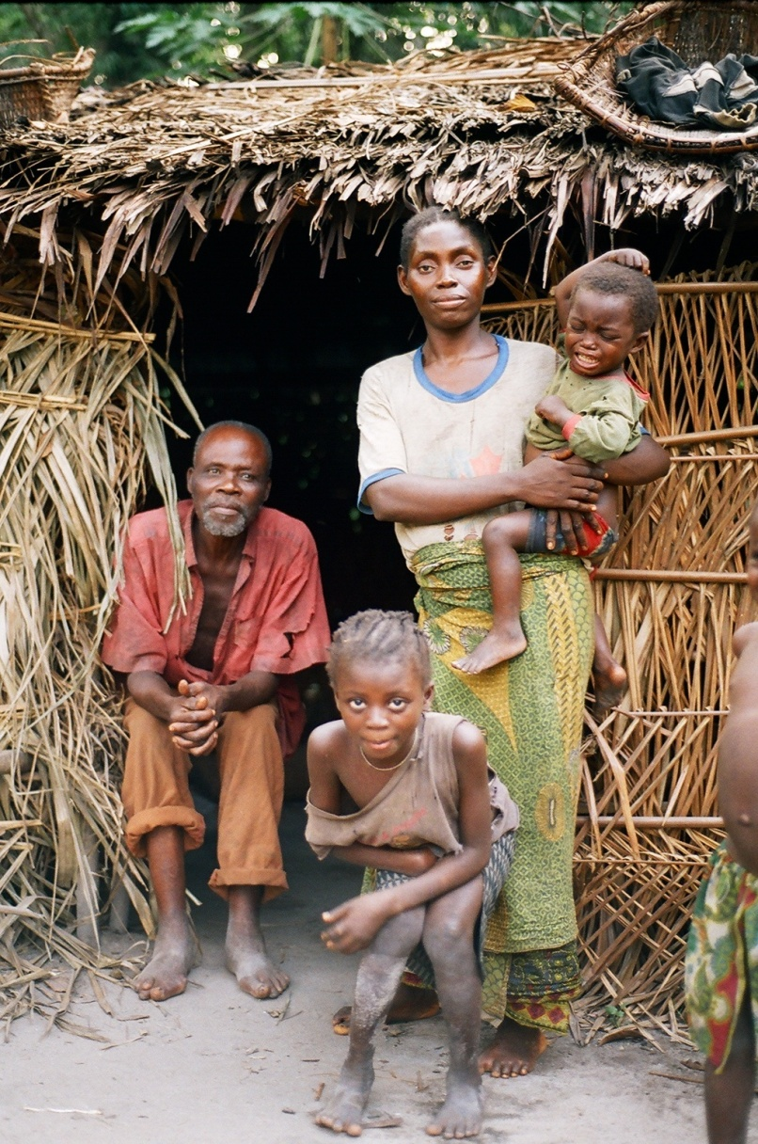
Some not-so-good things about resilience
  Resilience as a normative concept
  ‘strengthen community resilience ’
  as project objective
    Winners, losers....
    Building resilience is not zero-sum game, it is likely to have winners and losers
IDRC-DFID Global Adaptation Research Programme
GBP35million + CAD14 million over 7 years (2013-2019)
“The program will focus on increasing the resilience of the most vulnerable populations and their livelihoods in three ‘hot spots’ in Africa and South Asia, …”
    Adaptive preference: reduce one’s personal expectation in order to ‘pass by’
The deprived people tend to come to terms with their deprivation because of the sheer necessity of survival, and they may, as a result, … even adjust their desires and expectations to what they unambitiously see as feasible”
Sen 1999, p.62
Well-being and resilience are not necessarily positively correlated

Slide 10
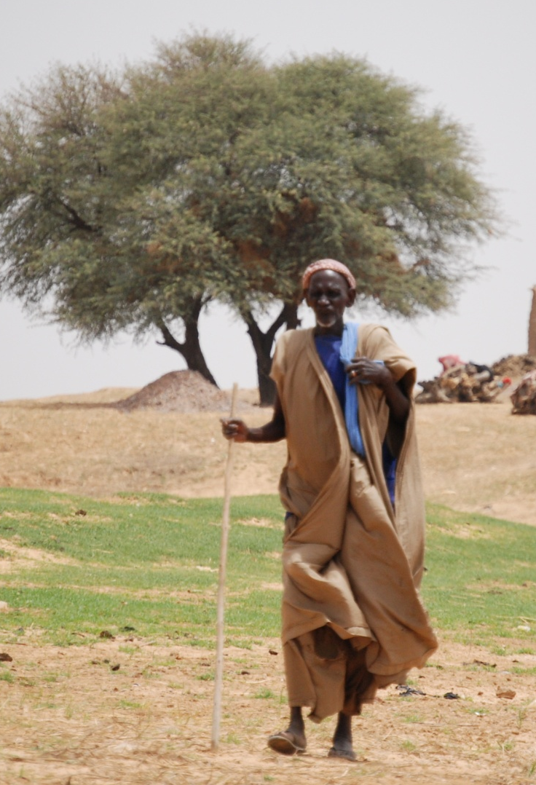
Some not-so-good things about resilience
Poverty and resilience
“people can be very poor and very resilient”
People HAVE to be very resilient when they are chronic poor (Sen 1999, Wood 2003)
Resilience is not automatically a pro-poor concept
No direct relation between building resilience and poverty alleviation!
Resilience as a dangerous idea
  Genuine (naive) ignorance of the real nature of resilience
  Abuse and mis-use of resilience
    repacketization of past, current projects
    instrumentalisation, cooptation
  Monsanto “let’s strengthen poor people resilience to bio-diversity loss”

Slide 11
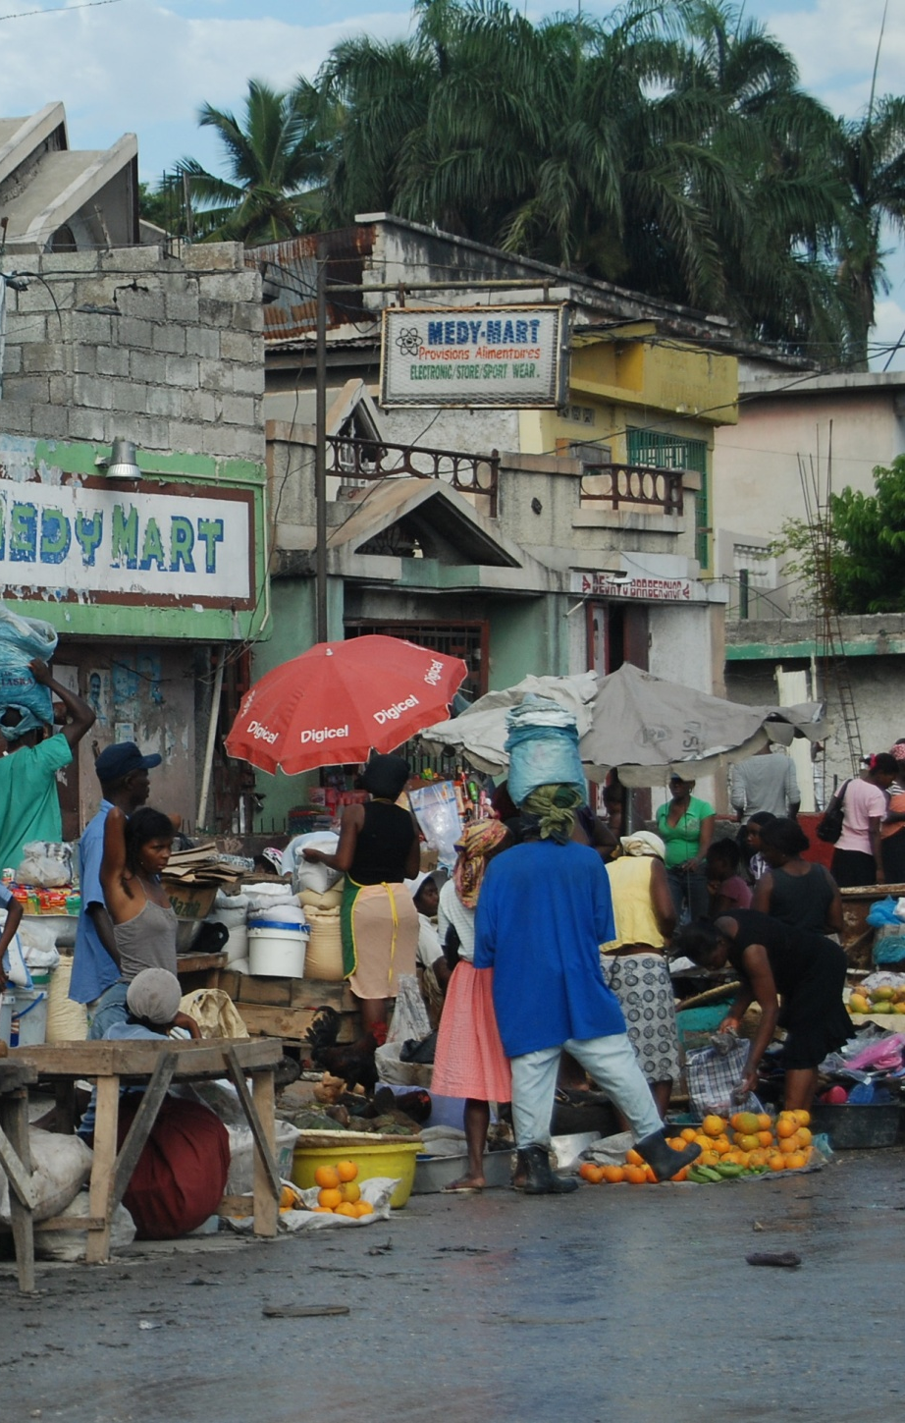
Resilience in the literature
‘Either–or’ approach...
  So far ... focus on adaptive capacity
  Resilience as “better conceptualized as adaptability than as stability” Norris et al. (2008)
  Predicted: shift to transformative capacity
  “From resilience to transformation” Pelling and Manuel-Navarrete (2010)
  “Transformation in a Changing Climate” conf, Oslo 19-21 June 2013 (‘deliberate’ transformation)
  ... often at the detriment of coping strategies
  “resilience as moving beyond coping strategies toward achieving longer-term development” Arcab (2012); Dowman (2009)

Slide 12
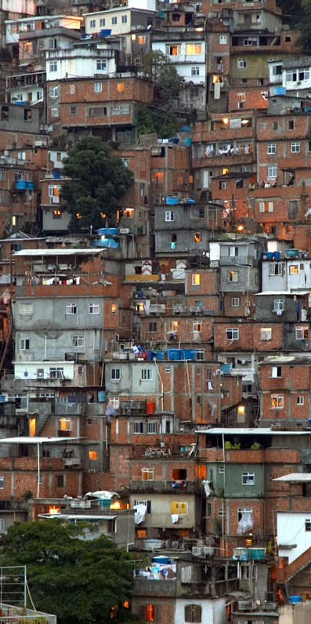
stability
Adapta-bility
Transfor-mation
Resilience in the literature
Trade-off or antagonism, perhaps....
  Conceptual confusion between resistance and risk-aversion (prevent changes)
  risk-aversion = result of lack of alternative
  resistance to change (status quo) to preserve current advantages
Resilience
  ... but more importantly, synergy and
  complementarities
    Stability is essential to create or to accumulate assets
      Poverty reduction
      Building adaptation
      Facilitating transformation
    Institutions (markets, insurance mechanisms) also created during stability
Notes:
Distinction between what is perceived as risk aversion and which results in fact simply from lack of alternative (so often poor are not adopting change, not because they don’t want but because they can’t)and o the other change resistance to change (often by the richers) as way to maintain their current advantage.
So in that context talking about trade-off is focusing on the wrong issue. The issue is not the trade-off the issue is what are the reason why people can’t or don’t want to change

Slide 13
Resilience and vulnerability
Often seen as separate camps but complementary even if have different strengths:
  Resilience for overall system perspective
  Vulnerability for power, agency, underlying causes etc
  ‘from vulnerability to resilience’ to describe the relationship between them
Notes:
Distinction between what is perceived as risk aversion and which results in fact simply from lack of alternative (so often poor are not adopting change, not because they don’t want but because they can’t)and o the other change resistance to change (often by the richers) as way to maintain their current advantage.
So in that context talking about trade-off is focusing on the wrong issue. The issue is not the trade-off the issue is what are the reason why people can’t or don’t want to change

Slide 14
‘Good resilience’ definition
the ability of a system to accommodate positively adverse changes and shocks, simultaneously at different scales and with consideration of all the different components and agents of the system, through the complementarities of its absorptive, adaptive and transformative capacities’.
Notes:
Distinction between what is perceived as risk aversion and which results in fact simply from lack of alternative (so often poor are not adopting change, not because they don’t want but because they can’t)and o the other change resistance to change (often by the richers) as way to maintain their current advantage.
So in that context talking about trade-off is focusing on the wrong issue. The issue is not the trade-off the issue is what are the reason why people can’t or don’t want to change

Slide 15
Resilience in the context of vulnerability reduction programmes
Conceptual framework - 3D resilience
3 components of Resilience
buffer capacity
adaptability
transformability

Slide 16
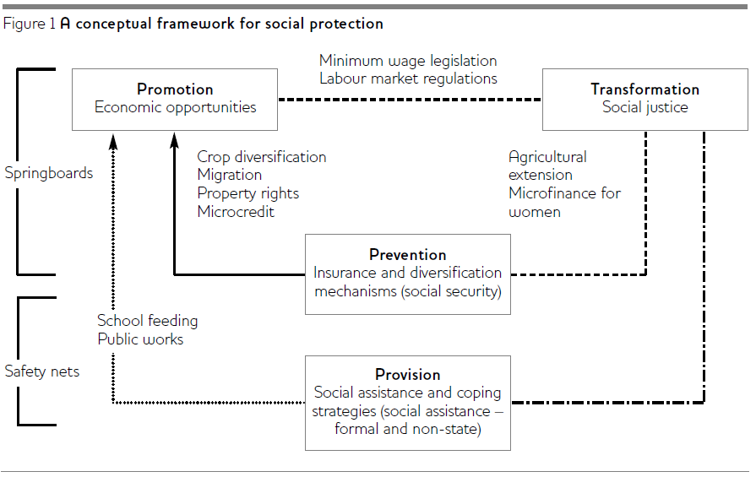
Using resilience for vulnerability reduction: the 3Ps & T framework
Notes:
Distinction between what is perceived as risk aversion and which results in fact simply from lack of alternative (so often poor are not adopting change, not because they don’t want but because they can’t)and o the other change resistance to change (often by the richers) as way to maintain their current advantage.
So in that context talking about trade-off is focusing on the wrong issue. The issue is not the trade-off the issue is what are the reason why people can’t or don’t want to change

Slide 17
The 3P&T-3D analytical framework
Notes:
Distinction between what is perceived as risk aversion and which results in fact simply from lack of alternative (so often poor are not adopting change, not because they don’t want but because they can’t)and o the other change resistance to change (often by the richers) as way to maintain their current advantage.
So in that context talking about trade-off is focusing on the wrong issue. The issue is not the trade-off the issue is what are the reason why people can’t or don’t want to change

Slide 18
Example: Ethiopia’s Productive Safety Nets programme (PSNP)
Attempt to break dependence on emergency food aid via cash/food transfers delivered through:
  employment in public works (construction, irrigation, reforestation
  Direct provision of cash/food to households without labour contribute (elderly, pregnant women etc)
Household Asset building Programme (HABP) for livelihood development and diversification
Notes:
Distinction between what is perceived as risk aversion and which results in fact simply from lack of alternative (so often poor are not adopting change, not because they don’t want but because they can’t)and o the other change resistance to change (often by the richers) as way to maintain their current advantage.
So in that context talking about trade-off is focusing on the wrong issue. The issue is not the trade-off the issue is what are the reason why people can’t or don’t want to change

Slide 19
Example: Ethiopia’s Productive Safety Nets programme (PSNP)
Protective & preventive – helps families avoid famine, protect food security and livelihoods (more so when combined with HABP) coping
Promotive – helped build and maintain assets, encourage investment in new productive activities, income used for new activities more than existing assets adaptive
Transformative – graduation when can withstand shocks transformation?
Notes:
Distinction between what is perceived as risk aversion and which results in fact simply from lack of alternative (so often poor are not adopting change, not because they don’t want but because they can’t)and o the other change resistance to change (often by the richers) as way to maintain their current advantage.
So in that context talking about trade-off is focusing on the wrong issue. The issue is not the trade-off the issue is what are the reason why people can’t or don’t want to change

Slide 20
Example: Ethiopia’s Productive Safety Nets programme (PSNP)
Implications
PSNP did not insulate against most severe shocks
Worked best in combination with other programme: 1 programme can’t do it all
What level of resilience? Enough to ‘get by’? How to define graduation?
Notes:
Distinction between what is perceived as risk aversion and which results in fact simply from lack of alternative (so often poor are not adopting change, not because they don’t want but because they can’t)and o the other change resistance to change (often by the richers) as way to maintain their current advantage.
So in that context talking about trade-off is focusing on the wrong issue. The issue is not the trade-off the issue is what are the reason why people can’t or don’t want to change

Slide 21
Example: Targeting the Ultra Poor in Bangladesh (BRAC)
BRAC realised its micro credit schemes did not reach the ‘ultra poor’ ‘Challenging the Frontiers of Poverty Reduction (CFPR)
Two types of intervention:
  Push down (get to the ultra poor)
  Push out (address underlying causes of chronic poverty)
Notes:
Distinction between what is perceived as risk aversion and which results in fact simply from lack of alternative (so often poor are not adopting change, not because they don’t want but because they can’t)and o the other change resistance to change (often by the richers) as way to maintain their current advantage.
So in that context talking about trade-off is focusing on the wrong issue. The issue is not the trade-off the issue is what are the reason why people can’t or don’t want to change

Slide 22
Example: Targeting the Ultra Poor in Bangladesh (BRAC)
Instruments and inputs
Cash transfers
Asset transfers
Skills training
obligatory savings
Micro credit
Awareness-raising
Notes:
Distinction between what is perceived as risk aversion and which results in fact simply from lack of alternative (so often poor are not adopting change, not because they don’t want but because they can’t)and o the other change resistance to change (often by the richers) as way to maintain their current advantage.
So in that context talking about trade-off is focusing on the wrong issue. The issue is not the trade-off the issue is what are the reason why people can’t or don’t want to change

Slide 23
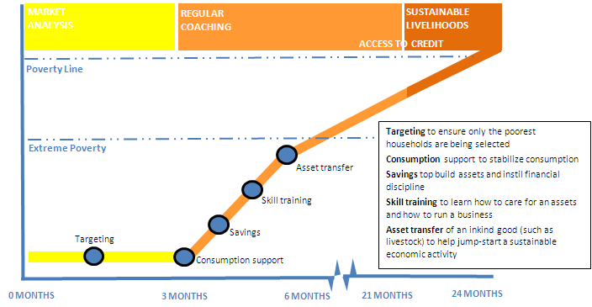
Resilience in practice
  BRAC Graduation model
  Source: Redrawn from Hashemi et al. (2011)

Slide 24
Example: Targeting the Ultra Poor in Bangladesh (BRAC)
Protective: cash transfers for covering basic food needs stability for coping
Preventive: free 2 year medical care
Coping and adaptation
Promotive: asset transfers, skills training, savings, credit adaptation
Transformative: Village assistance committees mobilise elite patronage networks for ultra (and rehabilitating) poor (especially women) transformation?
Notes:
Distinction between what is perceived as risk aversion and which results in fact simply from lack of alternative (so often poor are not adopting change, not because they don’t want but because they can’t)and o the other change resistance to change (often by the richers) as way to maintain their current advantage.
So in that context talking about trade-off is focusing on the wrong issue. The issue is not the trade-off the issue is what are the reason why people can’t or don’t want to change

Slide 25
Example: Targeting the Ultra Poor in Bangladesh (BRAC)
Implications
Pathway from ‘ultra-poverty’ to above the poverty line (if all goes to plan)
Difficulties from withdrawing health care
How far above poverty line does it get people and for how long?
Notes:
Distinction between what is perceived as risk aversion and which results in fact simply from lack of alternative (so often poor are not adopting change, not because they don’t want but because they can’t)and o the other change resistance to change (often by the richers) as way to maintain their current advantage.
So in that context talking about trade-off is focusing on the wrong issue. The issue is not the trade-off the issue is what are the reason why people can’t or don’t want to change

Slide 26
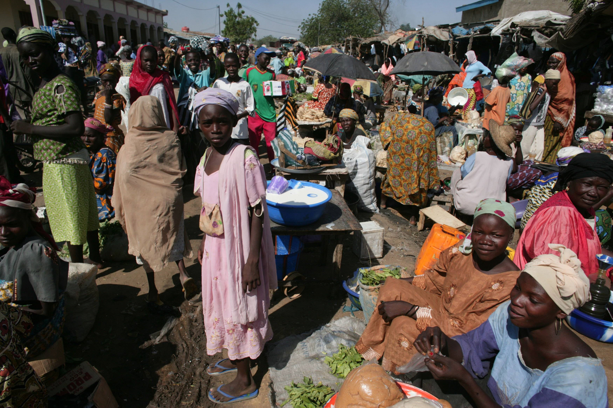
Conclusions
Resilience, Yes but...
Resilience : new utopia?
  Broker for integrated, multi/cross-disciplinary interventions & policies
  Promote system approach
  Emergence of new areas of research
  adaptation – transformation
New definition
  “Resilience is the ability of a system to accommodate positively adverse changes and shocks, simultaneously at different scales and with consideration of all the different components and agents of the system, through the complementarities of its absorptive, adaptive and transformative capacities.”
Resilience : new tyranny?
  Appropriated by policy-makers
  ‘romanticized’ – positive concept
Neutral, not pro-poor
Can be good or bad / winners losers
Not direct relation between resilience and wellbeing, or resilience and poverty
3D-Resilience in practice
  A resilience-centred programme
  recognize and build synergy between the 3 dimensions of resilience
  consider impacts of resilience building across groups and scales

