Slide 1
New Horizons in Outcome Monitoring
Richard Caldwell
Senior Program Officer – MLE
Global Development - Agriculture
June 12, 2012

Slide 2
Outcome Monitoring
The basic tracking of variables that have been adopted as measures or “indicators” of desired program outcomes¹
Outcomes include behavioral changes and systems changes
Positional outcomes can be tracked as well
Typically monitored through population-based surveys
Often tracked from ‘baseline’, ‘midterm’, and ‘endline’ events
No causality is normally assumed
As used, routine monitoring often does not contribute to real-time learning, and as such may not add much value to program-level MLE. We are planning to make outcome monitoring a standard M&E method for a set of our investments.
Notes:
MLE – Monitoring, Learning and Evaluation

Slide 3
Objectives for Today
Providing new insight into Outcome Monitoring …
Overview of BMGF Agriculture Approach to MLE
Gathering momentum for a major shift
MLE Grant Typology as a Means to an End
Solving for complexity
Measuring Success
Streamlined outcome measurement
OM Horizons Case Study - STRASA
Cost-effective sampling
Use of information technology
Notes:
2
© 2010 Bill & Melinda Gates Foundation

Slide 4
Bill and Melinda Gates Foundation
Three Major Programs
Global Health – Polio, Malaria, Emerging Diseases
Global Development – Agriculture, Family Planning, WatSan, Financial Services
US Education – College Ready, US Libraries, Post-2ndary Success
Agriculture is the largest strategy within Global Development
$520M/yr payout
214 active grants
70-80 new grants 2012
Bill Gates has become an agriculture fanatic!
Notes:
Global Redesign – polio to GD

Slide 5
Key Elements and Expected Results of the Agriculture Strategy
What AgDev
Does
Expected
Results
Implements Agricultural Strategy and TOC
Invests in Transformational Products and Technologies
Improved products and technologies on global/national scales
Products that respond to SHF productivity needs
Products that can be delivered at scale
SHFs are satisfied with availability, quality and performance
Influences the Way Systems Function
More effective global and national agriculture support systems
Improved HR capacities to respond to development challenges
Improved policies to support SHF productivity growth
Stronger partnerships and collaboration in the agr sector
Demonstrates Scalable Models
Models of successful solutions are documented and demonstrated
Evidence of scalability is provided
Successful models are adopted by others
Advocates/Markets Evidence of Success
Farm-level adoption of products and practices
Improved storage and marketing practices of SHFs
Increases in SHF productivity
Improved well-being of SHFs
Evidence on the sustainability of solutions
Notes:
C4 Rice, DTMA, digitized soil map of Africa,
CGIAR, China and Brazil, Rome UN, NARS
EADD, ATA
High risk

Slide 6
Grant MLE Typology
A Framework for Identifying the Expected Level of Effort for Grant-level MLE Systems
Is the grant Product Exclusive?*
Yes
B
A - Accountability and performance; Output-monitoring; descriptive; disaggregates; Output-specific learning; Min.
MLE Input; MLE 3-5%
Yes
Is the grant a Pilot or POC?
No
A
No
B - Assessing change over time; Pre-post outcomes; Change against benchmarks; Limited MLE input/TA;
MLE 4-7%
Types of Outcomes included**
Systems Only
Is the grant a Pilot or POC?
Yes
C
No
Is Scope < 3?
B
Systems and Behaviors
C – Responding to learning questions; Outcome-monitoring; systems change; Formal ME Plan review; periodic TA; MLE 6-10%
Is Scope > 3?
C
Is the grant a Pilot or POC?
D
* Only develops outputs
Yes
D - Contribution and attribution; System and behavioral change; Peer review for Plan; ongoing TA/QC; support 3rd party M&E; MLE 8-12%
Reach = 0
C
** Includes system or behavioral changes
No
Reach = 1
D
POC – Proof of Concept

Slide 7
GD Agriculture’s MLE Approach
Selling our successes
Depend on others to replicate or take to scale
Promoting cost-effective and right-sized MLE strategies
Testing success stories through deep insight from a set of strategically selected grants
Basing effort on a modest number of grants that likely tells 80% of the story
Realizing that good data is essential to robust MLE; but, we cannot get high quality data doing business as usual

Slide 8
Features of our Outcome Monitoring Efforts
Shift in burden from outputs to outcomes
Now 80/20, let’s change it to 20/80
Look for outcome investment opportunities
Focused on key behaviors
Based on ‘Light-touch’ Surveys
LQAS-based
3-page Questionnaire limit
Maximizing use of technology
E.g., Smart Phone or e-Pad Data Collection; AWhere
Rapid data turn-around
Pre-loaded analysis modules
Management driven and owned; dynamic

Slide 9
Measuring farm-level outcomes…
Outcomes we measure
How we measure farm-level outcome
Purpose and use of measured outcome
Who has responsibility to measure what
Key Outcomes Sustainable productivity growth Diffusion of new innovations and practices Farmer uptake and adoption of new technologies and practices (e.g., cropping, storage, marketing) Farmer use of new cropping and livestock practices (e.g., fertilizer, storage, AI) Farmer/herder access to and use of markets Changes in the way farmers receive information and learn | Outcome monitoring (at the grant level) to determine uptake and use of technology Evaluations to measure country/regional changes in crop yields or post-harvest losses for priority staples Evaluations that assess farmer behavior changes associated with grant-specific interventions (e.g., use of new crop/livestock management practices) Evaluations of extension modalities (e.g., Farmer Voice Radio) ATAI grant (using RCTs to assess barriers to adoption, impact of adoption) Grant-level M&E systems (quantitative and qualitative methods) | To determine if we are investing in the right things and at the right pace and scale to drive change To test assumptions & hypotheses about how change occurs in our TOC To provide estimates on key parameters (e.g., adoption) that drive impact | Grantees (grant evaluation reports) Third-party evaluators (evaluation reports) MLE Team & Data Team (cross-cutting evaluations; meta-evaluations; Initiative and Sub-Initiative scorecards)

Slide 10
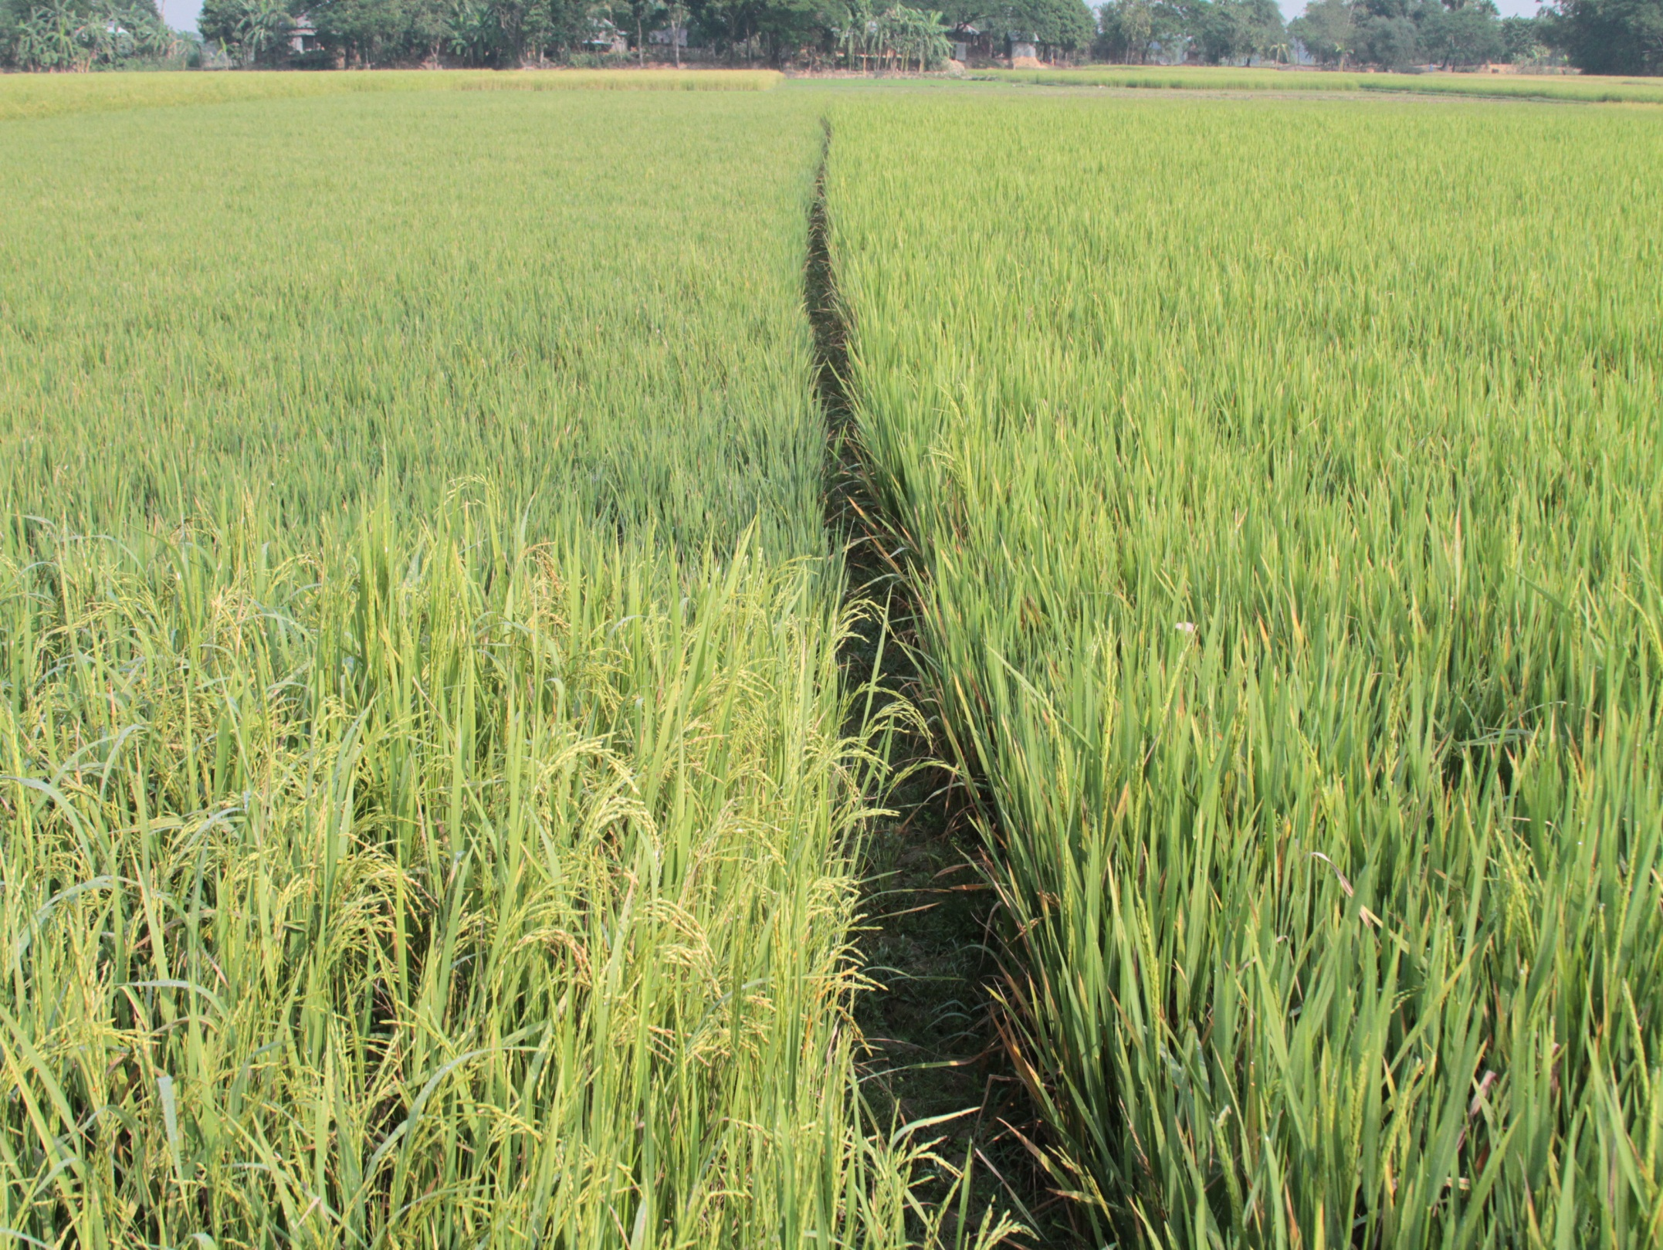
STRASA
Stress-tolerant Rice for Africa and South Asia

Slide 11
STRASA
New varieties of rice for abiotic stresses
Salinity tolerance
Submergence tolerance
Drought tolerance
Combined tolerance
Implemented by IRRI in India, Bangladesh, Africa
Outcomes of interest
Uptake
Adoption
Farmer-to-farmer dissemination (informal)
Seed sales (formal)
Notes:
Resilience

Slide 12
Inputs Activities Outputs
BMGF $
Resistance genes
Mega varieties
Breeding
Yield trials
Seed Multiplication
Resistant varieties
Breeder seed
BMGF $
Seed grants
Training NARS
Advocacy
Foundation seed
BMGF $
Land
Demo farms
Trainings
PVS
Demo fields
Variety selections
Trained farmers
1st Order Outcomes 2nd Order Outcomes Impact
Seed availability
Seed Multiplication
Seed availability
Seed sales
Scaling
Technology
spread
Dialogue/interaction
Knowledge
‘Built-In’ insurance
Adoption
Exchanges
Risk behaviors
Productivity gains
Income change
Improved food security

Slide 13
Elements of STRASA Outcome Monitoring
Objective: Determine in near real time key outcomes in order to maximize dissemination of new varieties
Provide evidence base for outcomes
Determine when to conduct deep-dive surveys
Adjust dissemination strategies by sub-area
Location of demonstration plots
Allocation of mini-kits
Testing 4 sampling strategies for estimating outcomes
LQAS (normal)
LQAS (modified)
Population-based survey
Expert opinion

Slide 14
Early Results
Adoption rates vary in areas of interest from negligible to over 25% (still early)
Farmer-to-farmer transmission as high as 72%
High proportion of those taking up are adopting
Female farmer uptake significantly lower

Slide 15
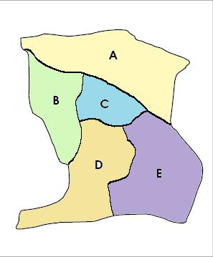
LQAS Study
Flood-prone Area
Objective: To test various methods of estimating adoption rates of improved varieties
1. LQAS (normal): Can LQAS be used in an iterative way to arrive at estimates of higher precision?
2. Can a modified LQAS reduce sample size while still providing useful estimates
6. Can we predict when and where expert opinions have high precision?

Slide 16
Challenges to Using Outcome Monitoring
Changing the mindset of staff (including M&E staff)
Identifying Supervision Areas or strata
Random selection of households
Data management and ownership
Outcome Investing
Grantees paid a premium for achieving specific outcomes
Water and Sanitation currently has several investments
STRASA would be candidate if granted today

Slide 17
Discussion Questions
What are some of the tradeoffs you would expect in Outcome Investment? How receptive would your organization be to OI?
What would be examples of critical outcomes to monitor in a program aimed at improving household and community resilience?

