Slide 1
The Goldilocks Approach: Using Agriculture Resources for Improved Nutritional Outcomes
Paul Sommers
Mercy Corps
TOPS FSN Meeting
Addis Ababa 2012
Notes:
FFP-MYAP: Strategic Objective: Food Insecurity among Vulnerable Populations Reduced
The FFP PMP indicators and the type of program for which they are applicable are:
Strategic Objective: Food Insecurity among Vulnerable Populations Reduced
Percentage of underweight children 0-5 years of age in Title II-assisted areas in FFP priority countries (MYAP)
Percentage of applicable programs reporting maintenance or improvement in nutritional status (SYAP/MYAP)
Average number of months of adequate food provisioning in Title II-assisted program areas (MYAP)
Percentage of applicable programs reporting maintenance or improvement in household food consumption (MYAP)
IR 2: Title II Impact in the Field Increased
Percentage of targeted direct beneficiaries reached (SYAP/MYAP)
Percentage of Title II program beneficiaries with improved health, nutrition or hygiene behaviors (MYAP)
Percentage of Title II-assisted producers using a project-defined minimum number of sustainable agricultural technologies (MYAP)
Percentage of Title II-assisted communities with disaster early warning and response systems in place (SYAP/MYAP)
Percentage of Title II-assisted communities with improved physical infrastructure to mitigate the impact of shocks (SYAP/MYAP)
Percentage of Title II-assisted communities with safety nets to address the needs of their most vulnerable members (MYAP)
Percentage of Title II-assisted communities with improved capacity (MYAP)
2012
FFP’s goal for multi-year development programming is to reduce risks and vulnerabilities to food insecurity and increase food availability, access and utilization/consumption. Title II programs must target the vulnerability of food insecure individuals, households and communities directly.

Slide 2
Session Outline
1. Overview of Topic 10 minute
2. Group work
Part 1 45 minutes 30 minutes small group discussion 15 minutes session group discussion
Break
Part 2 45 minutes 30 minutes small group discussion 15 minutes session group discussion
3. Way Forward 15 minutes

Slide 3
Key Messages for Group Work
View nutrition not as a problem but as part of your agricultural growth solution
Creating demand for nutrient dense locally grown foods can lead to increased economic crop value
Solving nutrition problems is not only a supply side issue-it is also a demand side issue.
Success is measured when both small farmer income and their children’s growth happens
Notes:
So it is not only about availability and access (increasing supply) but also utilization (increasing demand) ex. WALA > 200,000 HHs in the project.
The key is synchronize supply to meet demand creation for nutrient dense foods.

Slide 4
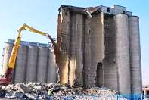
Imagine No Silos
Notes:
Image there are no silos-Drop the professional labels. This sets up barriers on Day 1.
Project staff should unify around achieving household food security- refer to your selves as food security practicioners.
After all isn’t that what we do?
Nuts go about creating demand with “their “ groups usually with little strategic thought about the supply side for nutrient dense foods, lean season gaps, or first food for baby.
Aggies go about working with “their” project groups with little strategic thought about linking their supply side work to meet the demand needs created by the nutrition colleagues.

Slide 5
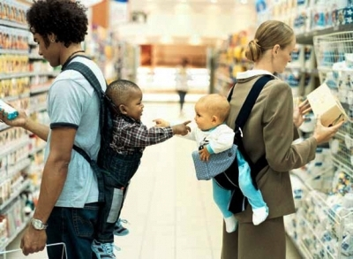
Making Friends
Notes:
Go about your group work seeking synergies- identify ways in which the project resources you have available to you can we used to improve outcomes for both nutrition and income growth. Identify program entry points where both supply and demand strategies achieve multiple outcomes.

Slide 6
Group Work Part 1
Each table will be provided with one crop to use as your case study
How would you propose using the value chain approach to improve both nutritional outcomes as well as income for poor farming Households?
Where , in the chain, do you see the most strategic interventions? Why?
Notes:
Each table will receive a crop that they will use as their example: pigeon pea, sesame seeds, orange flesh sweet potato, orange flesh pumpkin/squash
Interventions that increase economic value for the vulnerable value chain actors as well as associated with increased value for nutrition outcomes.
Look at each activity in a value chain and identify a practical indicator that will show a nutritional outcome while adding value to the product. Also identify needed financing to support change in the value of the chain. Tie in VSL’s value chains and nutritional outcomes for children.
Examples for VSL financing:
Inputs- seeds/ planting materials
Production- increase output and quality assurance use of on-farm resources (food safety)
Harvest- differentiating quality over quantity
Processing – low cost value added: farm level drying?
Storage improved conditions /extending time for optimal market timing
Availability- increasing the number of months HH are food security from their own land resources. Hungry season?
Access: optimizing the choice of crops and livestock (production, storage)so that they are of optimal economic value.
Utilization: nutrient dense foods/ dietary diversity. Health issues.

Slide 7
Step by Step
Step #1 Write down key components in a value chain for your case study crop.
Step #2 Identify interventions and tools in your nutrition and agricultural tool kits to achieve the outcome.
Step #3. Identify the most strategic intervention in the chain where agriculture and nutrition project resources can make the greatest impact.

Slide 8
Group Work-Part 2
With your understanding now of how you can contribute to the HFS 4 pillar framework, availability, access, utilization, resiliency, how do you propose to begin the conversation of a joint programming process with your nutrition colleague?
Where is the nexus in your work program?
(hint : start w/ outcome indicators)
Notes:
1)Identify one crop to use a focus. Ex- sweet potato
2) Aim: to increase the production and consumption of sweet potato.
3) ) Identify interventions that are within your tool box that can have a positive outcome.
Physical Availability – ag. tool box/ nut. Tool box
b) Access- ability to buy it or sell it.
C) Utilization Ag. higher quality (food safe) value add. Create demand
d) Resiliency- nut. Box –id chronic and acute food shortages. Ag tool box- 1&2

Slide 9
Ag. HFS Tool Box
Availability- intensify, diversity, productivity (production/post harvest)
Access- a) From farm resources (fresh /stored) b) off-farm- providing service within specific value chains (input supply, labor for crop production, harvest/post-harvest, storing, transport, sales)
Utilization- a)improved post-harvest chain b) demand creation for nutrient dense foods.
Vulnerability/resiliency - combination of 1-3 building on the HH’s resource base
10 min.
Notes:
Here are typical interventions in an aggie’s tool box to deal with HSF. Hardware: inputs / software training.
Use these 4 pillars as your programming guide to identify key interventions.

Slide 10
Nutrition HFS Tool Box
Demand side:
Availability- promote diversity in the HH food resource base. Promote increase the quantity of food produced.
Access- Promote quality improvement in current food crops grown.
Utilization- Create demand for nutrient dense foods. Promote food safety.
Resiliency- ID gaps in the lean season. Increase number of months HH’s are food secure. Loop back to #1 and 2.

Slide 12
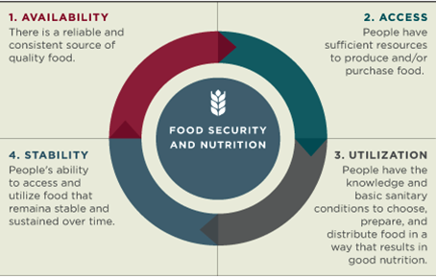

Slide 13
Framework for adding Nutrient Value for the End User
How to upgrade/create/add nutritional value to HH food supply chains?
Classical think: Jump from farm to fork-
Use ag. resources to produce a sufficient quantity of high quality foods year round. But in-between production and consumption several vital steps need to take place: ^seed quality, CA, harvest, post harvest. Your challenge is to id. Clear, simple, tweaks of existing activities w/in the existing HH food supply chains. Labor, capital using existing land no expansion =intensify/diversify

Slide 14
How does adding nutrional value also lead to increasing economic value?
4 step process
1) Start with a clear dietary gap/shortage in the community. Can also be viewed as potential market opportunity. Solution: both supply and demand driven .
To improve nutrition HH’s can grow their own
Availability b) Sell (access) or a combination of the two. What is stopping them from achieving availability? Improving access?
2) How can we use nutritional value to increase demand/acceptability? Ag. Is not only about supply side but also demand side.
3) Value chains provide a framework for income and nutritional value- Example orange flesh sweet potato. Supply side provide inputs to increase amount at the same time create demand promotional campaign on benefits of consuming OFSP
Notes:
Option #1 Availability -Guide them in growing more (production) b) Keeping more of what they grow (post harvest)
Option #2 Access -Sell some of what they grow. Improve quality/ marketability of what they grow –Upgrade value
Option #3 Utilization- Guide their bodies to better utilize more of what they eat- diversity, food safety, density, - non food –H 2o and sanitation.

Slide 15
Post harvest
Key Messages • Keep a focus on quality throughout the supply chain • Keep it healthy: at harvest and from there on • Keep it cool: check optimum temperature requirements • Keep it gentle: no rough handling/bumpy rides • Keep it clean: storage rooms, equipment, sanitation tanks, packaging materials and people • Keep it breathing: vegetables are alive, airflow and ventilation are vital in storage, transport and packaging

Slide 16
Feasible and Strategic Interventions for income and nutrition outcomes
GROUPS | Availability | Access | Utilization | Resilience
Mother Care | I.D. plants needed to fill in dietary gaps | Farm/off farm supply chain based income opportunities | Increase # of months of food security | Increase crop diversity/dietary diversity
Farm Production | Intensify/diversity | Quality, quantity, market timing | Post-harvest/food safety | Low input /climate protecting methods
Marketing | Increase quantity and quality | ID high “value “crops nutrient dense and income | Create demand for locally grown nutrient dense food | Adding value to crops/livestock creates a stable/productive land resource
VSLA | Loans for inputs | Loans for harvest labor/processing/storage/transport/ | Loans for Storage/processing | Loans for rehabilitation efforts- soil fertility /moisture conservation erosion control etc.

Slide 17
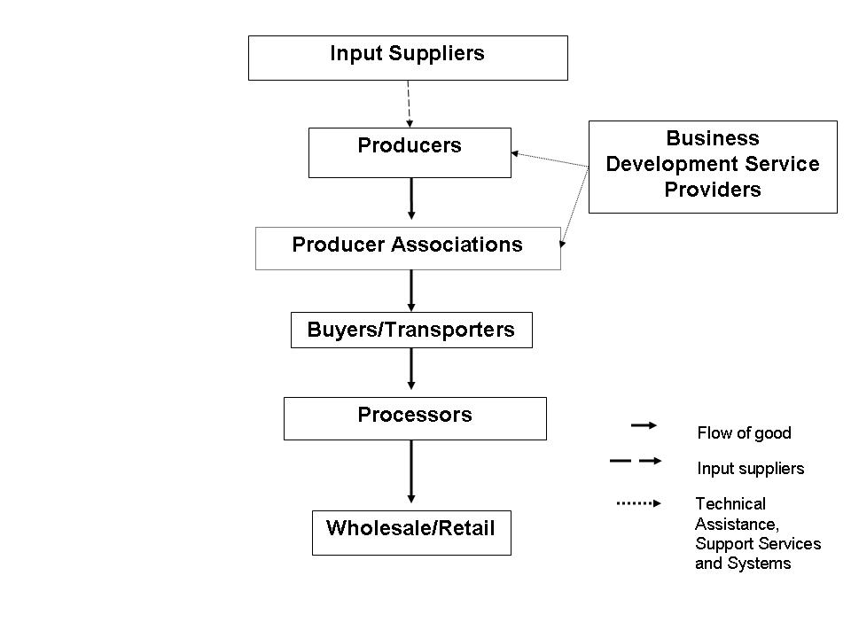
MAP OF A VALUE CHAIN
Notes:
A quick review of a typical value chain. Source: USAID

Slide 18
T-2 Goal
“FFP’s goal for multi-year development programming is to reduce risks and vulnerabilities to food insecurity and increase food availability, access and
utilization /consumption.
Title II programs must target the vulnerability of food insecure individuals, households and communities directly.”

Slide 19
Introduction
Name
Organization
Field experience with leveraging agriculture for improved nutritional outcomes
One question your table wants answered in the session.

Slide 20
Input Supplier
Farmer
Production
Farmer
Post Harvest
Buyer
Market Access
Notes:
Four main components of an agricultural supply chain.

Slide 21
Supply/Value Chain
What does the term mean to you?
How does it impact.. Positively or/negatively (land use labor, capital)
Food availability?
Food access?
Utilization?
Shocks?
How do you see VC’s interventions linked programmatically to nutritional outcomes/indicators
10 min.
Notes:
What is an agriculture value chain?
Theses are growth oriented transactions along a chain of specific crops and livestock ”. Think of it in terms of your own MYAP work. You are in the service delivery business right? MAYP’s deliver goods (food) and services in the form of knowledge and asset transfers to improve food security.
If one of the key functions malfunctions, what happens? If IT doesn’t work, drivers are ill, vehicles are out of service, food is delayed in a port, etc. The supply chain is broken.
Ag. is the same in MYAP (Go to slide)
. Will the proposed intervention contribute positively to:
Increasing food availability? Upgrading means improvement in quantity, quality and timing . This impacts availability by making more food available
Food access? Increase in the unit value of the crop being sold. More income.
Utilization? Improved quality should result in better storage quality, also larger quantity of food for family use.
Stability / Mitigate shock in the food system. Improving the overall productivity of the land resource reduces risks to climate/environmental shocks
Run a “do no harm” test. Will the proposed interventions contribute positively to :
Gender roles and equity?
The physical environment of the farm
Household economics (limited risk/ potential return +)
Market led
Positive nutritional outcomes
HOW DO YOU DECIDE ON AN AG. SUPPLY CHAIN THAT CAN BE UP-GRADED (VALUE ADDED?
Step #1- start with your project indicators. Indicators drive project decisions-which interventions will be used. Agriculture will be used to grow income, improve nutritional outcomes along with cross cuts environment, gender impact.
Increased dietary diversity and # of months HH are food secure? If can use the 4 pillar HFS as the cross check. Dietary diversity was increased by improving access to purchase food in the lean season and more diversified diet of foods not grown on the HH’s land

