Slide 1
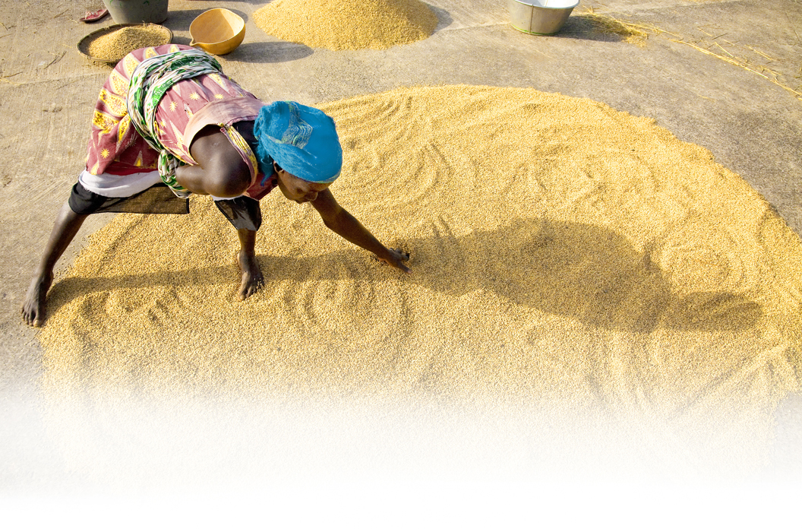
Food Security and
Nutrition Network:
Networking and Collaborating Mechanisms
Notes:
After this week of meeting with your colleagues, sharing technical information, brainstorming and problem solving I don’t think that I have to convince anyone of the benefits of collaboration
But we can’t all come together like this everyday. So we are going to talk about the tools that are available to you to do the kind of networking and collaboration that you have done over the past week everyday with people at a distance and the tools that are available to you to get the information and technical resources that you need.

Slide 2
Networking, Collaboration Mechanisms and Information Resources
Overcoming challenges and best practices for collaboration
Strategies for identifying information resources
Tools for collaboration
and finding information resources
Notes:
We will look at some of the challenges related to collaborating remotely and overcoming those challenges
Two tools we are going to talk about specifically are the FSN Network Portal and Ashleigh and Maciej are going to be talking about another very useful tool you can use-Agrilinks
We are also going to brainstorm about useful information tools and collaboration mechanisms

Slide 3
Why Connect?
Continuing a conversation
Working on a specific project
Finding answers/providing solutions
Notes:
In addition to attending meetings what are the reasons we want to connect with other people?
Can you think of another example of situation where you have wanted to network or collaborate at a distance?

Slide 4
Examples of Collaboration Mechanisms and Information Resources
Discussion groups
Listserves
Forums
Working groups
Online web portals
Resource libraries
Newsletters
Notes:
We will brainstorm specific examples of these later

Slide 5
Best Practices for Collaboration at a Distance and Online
Respect: Be mindful of different cultures. Remember that context can be lost when not meeting face-to-face.
Leadership: Picking a leader for any group or meeting can help keep you organized.
Set goals: Set small attainable goals, to help keep you focused. (Ex: to meet regularly, hold discussions on at least two new topics).
Notes:
Some best practices to keep in mind when we are collaborating with people at a distance

Slide 6
Best Practices for Collaborating at a Distance and Online
Make a schedule or timeline: Map out what you plan to do (meetings, creating deliverables) and when you plan to do it. Make sure that you share this with the group.
Record what you talk about: Take notes of conversations and share what you have learned.

Slide 7
Food Security & Nutrition Network Web Portal www.fsnnetwork.org
Discussion Groups
Resource library
Working groups and task forces
Notes:
A place for collaboration and to seek technical information http://www.fsnnetwork.org/
We have already talked about the portal during this meeting so I’m not going to go into great detail. I just want to highlight some of the collaborative features of the website as well as the information tools that may be useful to you.
Anyone with specific questions. I’m happy to go into greater detail and talk with you individually later.

Slide 8
Notes:
Left navigation bar there is a place to sign in. You can also see the resource library, discussion forum, place for task forces and interest groups
Network updates can be seen in the center panel

Slide 9
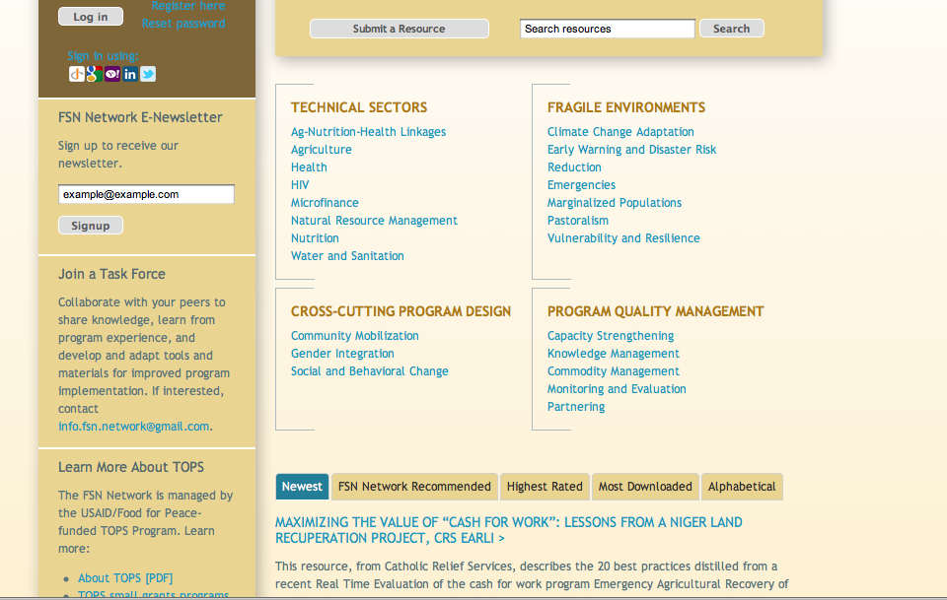
Notes:
Resource Library: Divided into Technical Sectors, Fragile Environments, Cross-Cutting Program Design, Program Quality Management
You can search for resources and also submit a resource- which we encourage you all to do!
Keep in mind that this is a new resource library and you will see the collection here growing over time. The more that you the community contribute and comment on this library the more valuable it will be.

Slide 10
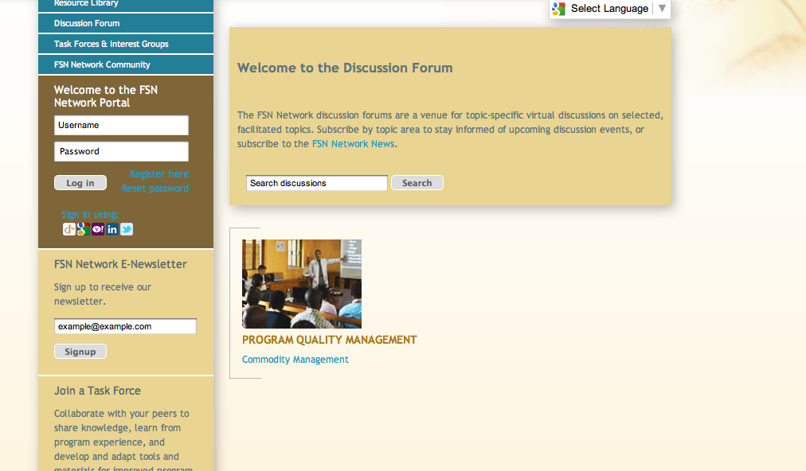
Notes:
Discussion Forum- Look through existing discussions and join one that is interesting to you.
These are topic specific virtual discussions on specific and facilitated topics

Slide 11
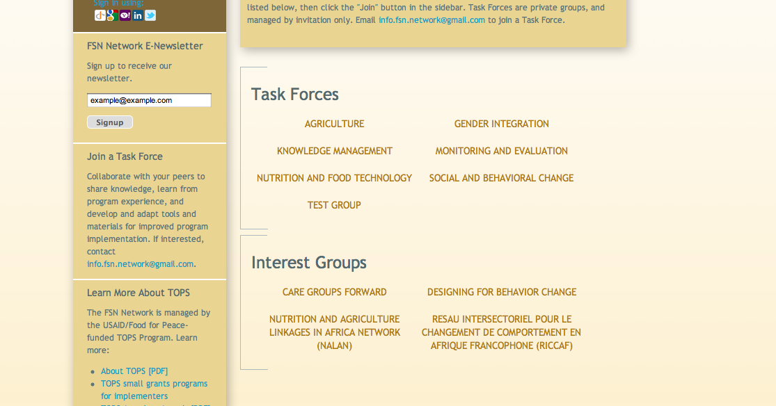
Notes:
Pages for the FSN Network’s Task Forces and Interest Groups
Task Forces: enable members from around the world to directly contribute their expertise in continuing discussions on development and adaptation of crucial information, tools, and methods that are responsive to stakeholder needs.
Interest Groups: Groups that have formed around common interests such as the ‘Care Groups forward’ where people can connect and share information about a common interest

Slide 12
Questions for Small Group Discussion
What are examples of the challenges you face in networking or collaboration with people at a distance.
Think about the best practices we discussed and positive experiences you have had working collaboratively and address at least one of those challenges.
Notes:
After question #2 share an example of how you overcame this challenge

Slide 13
Questions for Small Group Discussion
Thinking about what we discussed today look at the list of collaboration mechanisms and information resources.
Brainstorm anything that you would like to add to this list.
Select one resource that has been very helpful to you in your work and share why it has been so.
Notes:
Explain where the initial list came from and how it will be shared
REPORT OUT

Slide 14
Way Forward
What is on your wish list for the global community to help you address some of the challenges that you discussed in order to use these resources.
Notes:
Explain where the initial list came from and how it will be shared

Slide 15
This presentation was made possible by the generous support of the American people through the United States Agency for International Development (USAID). The contents are the responsibility of Save the Children and do not necessarily reflect the views of USAID or the United States Government.

