Slide 1
Food For Peace: Title II Programs and Gender
FSN Knowledge Sharing Meeting November 15, 2012
Presented by
Michelle Gamber, MA, DrPH
AAAS Fellow, FFP Gender Advisor

Slide 2
Session Overview
Overview of USAID’s Gender Equality and Female Empowerment Policy
Agency Expectations
FFP Expectations
Tips/Ways Forward
Notes:
-Before I go forward I think it’s important to acknowledge that my presentation today about what’s in the new RFA with regard to gender requirements
-This presentation will provide you with some expectation, ways to think about the program process, and strategies/approaches to go forward
-My intent is to provide some ways to think about approaching gender integration and gender analysis that can be applied in your work
-Lastly, I hope this serves as a way to create a platform for continued discussions about how best to approach gender in our work

Slide 3
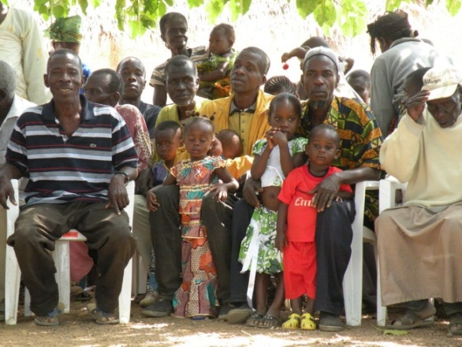
Goal of USAID’S Gender Equality and Female Empowerment Policy
Advancing equality between women and men
Empowering women and girls to participate fully in and benefit from the development of their societies

Slide 4
Policy Focuses on Three Outcomes
Reduce Gender Disparities
In access to, control over and benefit from resources, wealth, opportunities and services
Reduce Gender-Based Violence
Mitigate harmful effects
Individual and community approaches
Increase Capabilities of Women & Girls
Realize rights and determine life outcomes
Influence decision making at multiple levels
Notes:
-Take a moment to note that these outcomes move us beyond the often limited understanding of gender equality at/within USAID
-where it is equated with ensuring that women are half of the participants in a given project or program
-While this is necessary, it is not sufficient.
-Women must be empowered to be agents of change in any given effort-this must be part of the thought process
-Additionally, how do we address gender inequalities in a way that includes men, women, boys, and girls in appropriate ways?
*While these outcomes are deliberately set at a general level, in strategic planning and project design, these outcomes should be adapted to fit the local context and to translate into specific results that have associated targets and indicators for tracking progress.
Example: For instance, in a food security strategy, the first outcome could be operationalized as “Reduce the gap between female and male farmers’ access to productive inputs and services (credit, seeds, new technology, and agricultural extension) by 25 percent.”
-Indicators like: “percentage of men and women reporting access to credit,” “percentage of men and women reporting control over credit,” “percentage of men and women reporting access to seeds, technology, etc.”

Slide 5
What to expect from USAID
Solicitations
Increased attention to gender
Technical & institutional requirements
Technical Reviews
Clear understanding of issues within context
Logical approach to specified results
Monitoring & Evaluation
Request for sex disaggregation & gender-equality indicators
Required reporting on progress

Slide 6
New Paradigm…Continuation of past
Gender not additional, but integral to design
Should be a focus on identifying the gaps between men and women
Projects are designed to reduce those gaps

Slide 7
FFP Expectations/Changes
On-going and Evolving:
Aligning FFP activities with USAID Gender Equality and Female Empowerment Policy
Expanded attention/guidance on gender outlined in RFA process
Gender integration
Gender analysis
M & E-Gender Indicators

Slide 8
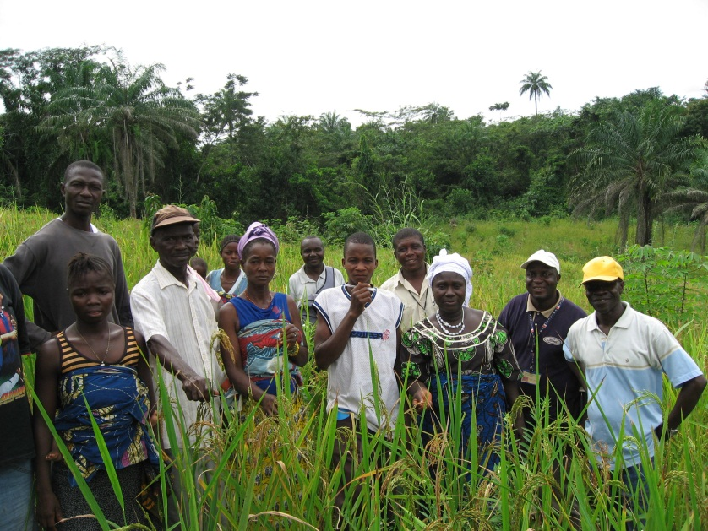
Challenges that Arise & Questions You May Have?
What is USAID/FFP looking for?
How to articulate/demonstrate gender integration?
What language needs to be there?
What activities should be proposed?

Slide 9
How to Approach Gender in Application and Program Implementation Phases
FY13 Title II Development Food Aid Programs Application:
Pre-Award/Application Phase:
Address identified gender issues in program description and design
Gender Annex if needed (optional)
Take into account gender in M & E components: sex-disaggregated data and gender indicators
Budget accordingly for gender expertise
Post-Award/Implementation phases:
Conduct a gender analysis-within first year of project activities
Monitor and evaluate gender issues
Report on progress in closing gaps, creating opportunities, negative impacts avoided and emerging issues
Notes:
-While gender integration should be thought of and taken into consideration in all aspects of the project (from the design and application phases throughout the life-cycle of a project)
-I also think it can be meaningful and appear more manageable to think about gender integration in smaller digestible parts
-This is why I have separated, for the purposes of this presentation, the different components of gender analysis within the different components of the project life cycle

Slide 10
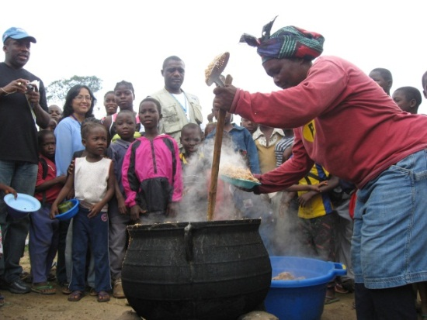
What is Gender Integration?
Involves identifying and then addressing gender inequalities during:
Program description and project design
Implementation
Monitoring and evaluation
Identifying the roles and power relations between men and women and how this affects how an activity is implemented
Essential that addressed on an on-going basis.

Slide 11
Addressing Gender Integration: Questions to Guide You
What gender issues exist within a country/program context?
How will this affect food security programming?
How will this be addressed in project activities?
How can program activities contribute gender equality and female empowerment?
Notes:
-This is not meant to serve as an exhaustive list, but rather this can be used as a template to guide you through ensuring that gender is integrated appropriately in program description and project design
-These questions also serve to address areas that are often either missing or not fully expanded upon at the application level
-By answering these questions with breadth and depth-you are contextualizing the gender issues in a given context and therefore allowing for the potential project activities to be transformative
-Also, by answering these questions you are demonstrating a through understanding of the local context and the ability to successfully carry out project activities

Slide 12
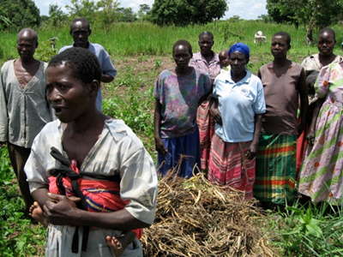
Purpose of a Gender Analysis
Tool for examining the differences between the roles that women and men play in communities and societies
Should dig deeper and identify relevant differences in the roles and status of women and men in the context of the proposed project
The gender analysis should influence the project design
Changes to program activities should result if gender analysis reveals data that supports this
Notes:
-A gender analysis is a tool for examining the differences between the roles that women and men play in communities and societies.
-At the project level, the gender analysis should dig deeper and identify the relevant differences in the roles and status of women and men in the context of the proposed project, any inequalities that could hinder the achievement of project goals, and any possible differential effects the project might have on men and women.
-At this level, the gender analysis should influence the project design to ensure that it addresses any differences or inequalities that are revealed, and that it results in equal outcomes and benefits for males and females.

Slide 13
Gender Analysis: What Should it Do?
At the project level, the gender analysis should:
Examine different roles and rights as well as relations between men and women
Identify inequalities and their root causes
Examine differing needs, constraints, and opportunities for women and men
Identify potential adverse impacts or gender-based exclusion in planned projects
Guided by project objectives and activities
Result in necessary changes
Determine how to address/incorporate results into program activities
Take action

Slide 14
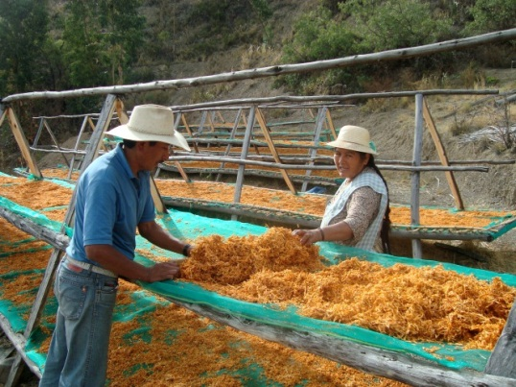
Gender Analysis: Domains to Consider
Several domains to consider when conducting the gender analysis (applicable to M & E):
Laws, Legal Rights, Policies, Institutions
Gender Roles, Responsibilities and Time Use
Access to/Control over Resources and economic empowerment
Knowledge, Beliefs, Perceptions
Participation and leadership
Male Involvement and shared responsibility
Mobility

Slide 15
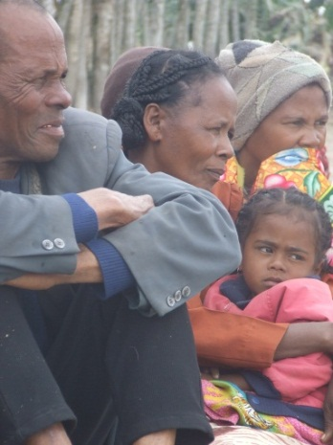
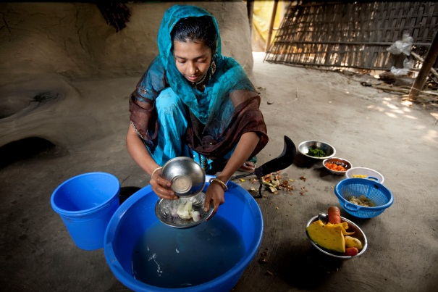
Monitoring & Evaluation
Expected to identify a set of gender indicators-output and outcome levels
Collected at baseline, annually through the life of the program, and at final evaluation
Measure the gender objective(s) identified in the RF
FFP is in process of creating a new indicator list
FFP Standard indicators
“F” indicators
FTF indicators
Gender indicators

Slide 16
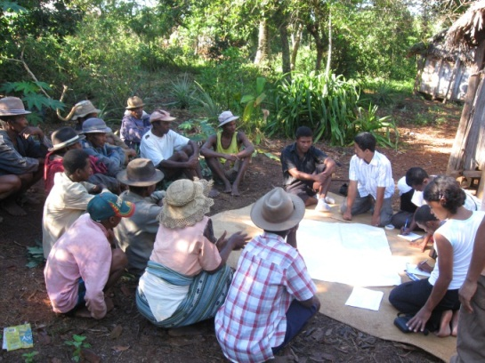
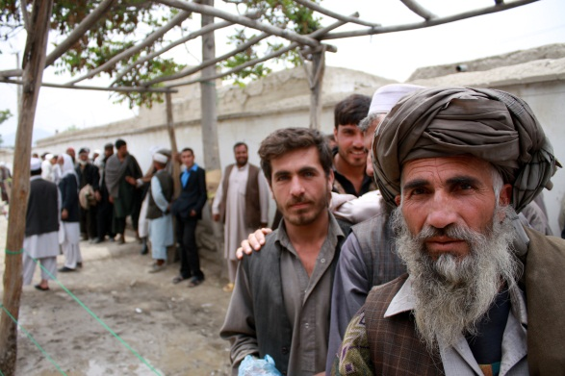
Monitoring & Evaluation Cont.
FANTA and gender indicator guidance
Examples of gender measurement areas for Title II development food aid programs
Examples of activities awardees could consider implementing to achieve relevant gender outcomes
Menu of standard outcome-level gender indicators within each gender measurement area (domain)
Choose from to include in Indicator Performance Tracking Tables (IPTTs)

Slide 17
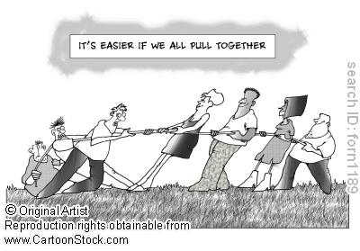
Key Take Away Messages:
USAID’s new gender equality and female empowerment policy and what is expected
List of questions to think about with regard to gender integration and domains to examine for gender analysis
Welcome you to provide your feedback and your experiences/lessons learned as programs continue
Important to go forward as a group and continue making progress
Next steps: look at collected data, compile lessons learned, and application of results
Notes:
-I welcome you to provide your feedback and any experiences and lessons learned as you all continue to implement your programs and as we continue to go forward and advance USAID’s gender equality and female empowerment policy
-I also hope that we can see the importance of some of the changes to the RFA and think about how we go forward as a group and think about and learn how to better integrate, measure, and improve gender issues in the work that we do
-I think this is an exciting time for moving gender into a realm where it gets the attention it deserves
-While some of these changes may challenge us in think about designing and implementing Title II projects, I really encourage us not to think about gender as a burden to our work
-Instead, lets recognize the momentum and the foundation that has been set with the new policy and capitalize on this opportunity

Slide 18
Questions/Comments?
Michelle Gamber
mgamber@usaid.gov
(202) 712-5368

Slide 19
Resources to Consult
FY13 FY13 Title II Development Food Aid Programs application can be found at: http://transition.usaid.gov/our_work/humanitarian_assistance/ffp/development.html
USAID’s new policy on Gender Equality and Female Empowerment can be found at: (http://transition.usaid.gov/our_work/policy_planning_and_learning/documents/GenderEqualityPolicy.pdf)
More information on gender integration in program design can be found at: http://transition.usaid.gov/our_work/cross-cutting_programs/wid/gender/
Gender Analysis Overview: http://transition.usaid.gov/our_work/cross-cutting_programs/wid/gender/gender_analysis.html
Tips for conducting a gender analysis at the activity or project level: http://transition.usaid.gov/policy/ads/200/201sae.pdf
MORE GUIDANCE TO COME!

