Slide 1
Designing programming to improve feeding practices for infants, young children and women

Slide 2
Nutrition: Session 1
Looking at data using the
Nutrition Program Design Assistant (NPDA)*:
STEP 1 Indicators
IYCF
Micronutrients
NPDA Reference Guide:
http://www.coregroup.org/storage/documents/
Workingpapers/NPDA_RefGuide)web.pdf
NPDA Workbook:
http://www.coregroup.org/storage/documents/Workingpapers/NPDA_workbook_web.pdf

Slide 3
HANDOUT: DATASET DHS AND KPC SURVEYS* | GROUP A | GROUP B
INFANT AND YOUNG CHILD FEEDING | % National Level (rural) | % National Level (rural)
BREASTFEEDING PRACTICES
% of children born in the last 24 months who were put to the breast within one hour of birth | 67.1% | 47.5%
% of infants 0-5 months of age who are fed exclusively with breast milk | 26.9% | 35.0%
% of children 12-15 months of age who are fed breast milk | 95.3% | 93.2%
COMPLEMENTARY FEEDING PRACTICES
% of infants 6-8 months of age who receive solid, semi-solid or soft foods | 77.5% | 72.4%
% of breastfed and non-breastfed children 6-23 months of age who receive solid or soft foods the minimum number of times or more | 31.3% | 36.3%
% of children 6-23 months of age who receive foods from four or more food groups | 65.4% | 53.8%
% of children 6-23 months of age who receive a minimum acceptable diet | 23.1% | 22.7%
FEEDING DURING ILLNESS
% of children 0-23 months of age with diarrhea in the last 2 weeks who were offered more fluids during the illness (note: fluid is breast milk only in children under 6 months of age) | 36.0% | 34.3%
% of children 6-23 months of age with diarrhea in the last 2 weeks who were offered the same amount or more food during the illness | 53.8% | 49.1%
MICRONUTRIENTS
% of children 6-23 months of age who ate vitamin A-rich foods in the past 24 hours | 63.3% | 50.6%
% of children 6-59 months of age who have received vitamin A supplement in previous 6 months | 64.9% | 43.4%
% of children 6-59 months of age with anemia | 74.1% | 62.0%
% of children 6-23 months of age who ate iron-rich foods in the past 24 hours | 40.1% | n/a
* Note that the data is taken from several different surveys done in a combination of countries in Southern Africa

Slide 4
SESSION 1: LOOKING AT DATA TO DESIGN PROGRAMS
Prioritizing IYCF Practices by looking at IYCF Indicators
Small group work instructions:
Look at the data for Group A or Group B on the handout. Which practices does your group feel are very low? Why did you choose these? (Note: choose just a few.)
Examples from small group presentations:
% of infants 0-5 months of age who are exclusively breastfed
% of children 6-23 months of age who receive the minimum acceptable diet. Note this is a composite indicator which is a combination of:
Diversity of diet (low)
Frequency of feeding (lower)

Slide 5
% of children 6-23 months of age that are sick (with diarrhea) who were offered MORE fluids (including breast milk) during the illness
% of children 6-23 months of age that are sick (with diarrhea) who were offered the SAME or MORE food during the illness
% of children born who were put to the breast within 1 hour of birth
% of children 6-23 months of age who ate iron-rich foods in the previous 24 hours
% of children 6-23 months of age who received Vitamin A supplement in previous 6 months
% of children 6-59 months of age with anemia

Slide 6
Small group work continued:
Among the recommend infant and young child feeding practices, which does your group feel are being done by a good percentage of women? (Note: choose just a few.)
% of children 12-15 months who continue to be breast fed
% of infants 6-8 months receiving solids or semi-solids or soft food
% of children 6-23 months of age sick (with diarrhea) who were offered the SAME or more amount of food during the illness

Slide 7
Small group work: Which two practices (for any reason) would you suggest be prioritized for additional emphasis by a project? Why?
Exclusive breastfeeding 0-5 months: it’s cheap (and easy to promote among poor families), no need for preparation, has a big statistically significant impact on child health and growth, has all the required nutrients, easy to digest, and can be expressed and used when mother is away.
Children 6 to 23 months who receive a minimum acceptable diet (frequency, diversity, don’t forget about QUANTITY): improving these practices should have a strong positive impact on child growth including reduction of stunting and improving weight gain, prevention of illness/disease, and overall normal growth and development.

Slide 8
Small group work continued: Which two practices (for any reason) would you suggest be prioritized for additional emphasis by a project? Why?
Early initiation of breastfeeding within 1 hour of birth: Because colostrum provides natural immunity for the child, which is important and has a long term positive impact on the health of the child and reduction of child mortality.
Feeding during illness: improvements in this practice may have a positive impact in reducing high infant mortality rates.

Slide 9
Optimal Complementary Feeding
of Infants and Young Children
NOTE this is one way to remember key practices:
CONSISTENCY (e.g. of porridge)
FREQUENCY
QUANTITY !!!!!!!!!!!!!!
QUALITY (DIVERSITY)

Slide 10
FATVAH: Another memory tool for promoting key complementary feeding practices
F = Frequency
A = Amount
T = Thickness
V = Variety
A = Active feeding
H = Hygiene

Slide 11
Importance of QUANTITY*
Age | Quantity of semi-solid food recommended | % of children consuming at least HALF the recommended quantity
6–8 months | 100+ grams | 43.2%
9-11 months | 150+ grams | 36.6%
12-23 months | 200+ grams | 44.8%
*Evaluation research of the Nutrition interventions in the integrated Nutrition and health Program II Areas of CARE India, Final Report January 28, 2008; Johns Hopkins Bloomberg School of Public Health for USAID.

Slide 12
Nutrition: Session 2
Looking at new IYCF materials with SBC messages:
UNICEF
http://www.unicef.org/nutrition/index_58362.html
Essential Nutrition Actions
http://www.coregroup.org/resources/core-tools
CARE, URC, CHS
http://thewindowofopportunity.info/resources

Slide 13
Session 2: Review new IYCF SBC materials
INSTRUCTIONS, WORK IN PAIRS OR 3 PEOPLE
Step 1. Look at the Cover Page of each of the 3 materials (from UNICEF, from ENA Consortium, from CARE). Each person should take one set of materials to find information and/or read to the other 2 people.
Step 2. Look at the guidance for (INSERT YOUR GROUP’S TOPIC) among pages (appropriate pages noted on handout) of each of the UNICEF, ENA, CARE IYCF materials :
Are there any POSITIVE differences between the 3 sets of materials? (Look for inclusion of persons of influence; additional useful topics; practical information; etc.)
Why do you think it is a POSITIVE addition to the materials?
NOTE a few of your comments on a flipchart

Slide 14
(Session 2 continued) TOPICS FOR SMALL GROUP WORK
Group A:
Food intake and nutrition during pregnancy
Early initiation of breastfeeding
Group B:
Exclusive breastfeeding for the first 6 months
Other recommendations for optimal breastfeeding
Group C:
Complementary feeding 6 to 8 months
Group D:
Complementary feeding 12 to 23 months
Group E:
Feeding the sick child

Slide 15
Group A: Pregnancy and nutrition
All three materials emphasize increasing food intake during pregnancy which isn’t always included in standard ante-natal health care messages and which is useful for improving nutritional status.
The UNICEF materials also emphasize the importance of meeting the special needs of the adolescent mother.
The ENA materials direct messages at the husband, as a person of influence, and show the husband and wife “together”.

Slide 16
Group A cont’d: Early initiation of breastfeeding
All 3 materials mention that immediate early initiation of breastfeeding will help reduce bleeding from the womb; ENA and CARE materials also note that this helps to expel the placenta
The CARE and UNICEF material include emphasis on immediate skin to skin contact between mother and newborn
ENA and CARE materials include traditional midwife (or grandmother?) in the visual graphic

Slide 17
Group B: Exclusive breastfeeding for the first 6 months
All 3 materials note that a breastfeeding woman needs additional food. The graphic in the CARE material includes the grandmother in the picture and emphasizes the importance of her role in offering a daughter or daughter-in-law extra food. The ENA materials include a message and visual graphic emphasizing that a husband should ensure that a breastfeeding wife has 2 extra meals each day, including foods like papaya.
UNICEF and CARE materials describe how to “recognize” demand at early stages (i.e. before the “late” stage when baby is crying).
UNICEF material emphasizes that mixed feeding (semi-solids AND breast milk) can damage the baby’s stomach.
The CARE and UNICEF materials give detailed information about how to express milk and feed from a cup.
All 3 materials have good graphics and information on positioning and attachment.

Slide 18
Group C: Complementary feeding 6 to 8 months
ENA and CARE materials mention cooking porridge with breast milk or other milk rather than water; this helps avoid contamination from water and increases protein content of porridge.
UNICEF and CARE promote using the FATVAH acronym to remember key complementary feeding practices (frequency, amount, thickness, variety, active feeding and hygiene).
ENA material has only one to two messages per counseling card. UNICEF and CARE materials have one card with all of the key complementary feeding messages. There are positives to each approach, with mothers perhaps better understanding fewer messages on any visual card or, on the other hand, community educators better able to manage one card and choose the message to be shared at any counseling session.
(Note that different ways of expressing the appropriate age range was potentially confusing for field staff.)

Slide 19
Group D: Complementary feeding 12 to 23 months
(Note that these messages build on the messages previously covered for optimal complementary feeding 6 to 8 months)
ENA material shows the involvement of men in the visual graphics.
ENA has short clear messages.

Slide 20
Group E: Feeding the sick child
The ENA material includes the husband supporting the wife and sick child and shows his support for additional food for both a child when sick and/or the wife when sick.
ENA notes that sick mothers can continue to breast feed a child.
UNICEF and CARE materials have two separate cards for <6 month age and >6 month; this helps avoid confusion in messaging.

Slide 21
1,000 Days Initiative
US Secretary of State and Irish Foreign Minister
“a global effort to jumpstart the implementation of the”
Scaling Up Nutrition Framework and Roadmap

Slide 22
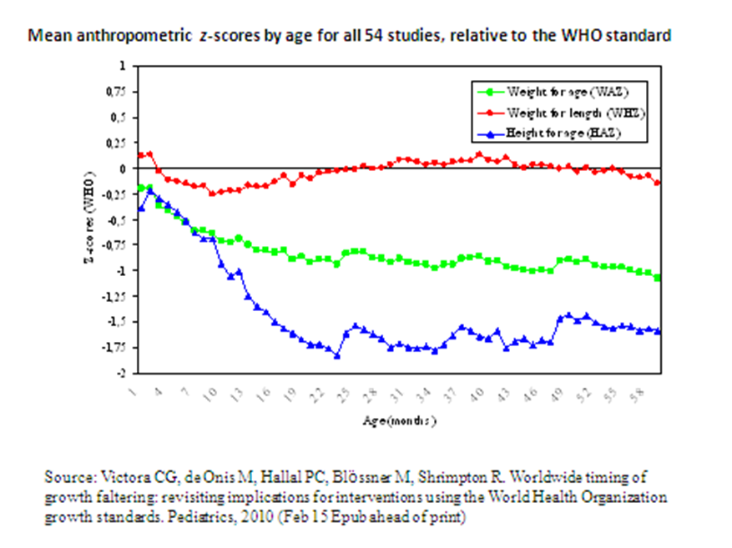
Poor growth and development during pregnancy and up to age 2:

Slide 23
1,000 Days Initiative:
“Adequate nutrition, from the start of a mother’s pregnancy until a child is two years old, is crucial to a child’s development.
Undernutrition leads to physical stunting, mental impairment, higher susceptibility to disease, increased risk of mortality, poorer performance in school and lower future incomes.”

Slide 24
This presentation was made possible by the generous support of the American people through the United States Agency for International Development (USAID). The contents are the responsibility of Save the Children and do not necessarily reflect the views of USAID or the United States Government.

