Slide 1
“"A Huge Case of and for Learner-centric Design" How a combination of 10 learning formats, all designed with the learner in mind, turned a large-scale, multi-stakeholder event into a success based on knowledge shared and absorbed. arno boersma for the KM task force Sept 10, 2015
!

Slide 2
WARNING! THIS PRESENTATION MAY CONTAIN powerpoint slides. LEARN AT YOUR OWN RISK.
;)
by Arno Boersma for the KMTF – 9/10/15

Slide 3
by Arno Boersma for the KMTF – 9/10/15

Slide 4
A funny thing happened on the way to “the Forum”…
A learning & knowledge-sharing event for WBG staff working on agriculture, energy and extractives, environment, ICT, transport, urban, social, rural and DRM, and water.
Feb.24-28, 2014 Washington, DC
by Arno Boersma for the KMTF – 9/10/15

Slide 5
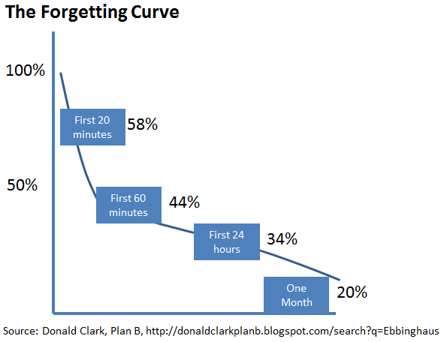
WE AIMED TO ADDRESS “THE FORGETTING CURVE’
Our memory is limited
by Arno Boersma for the KMTF – 9/10/15

Slide 6
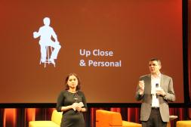
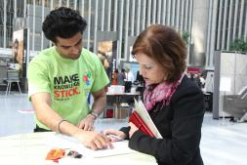
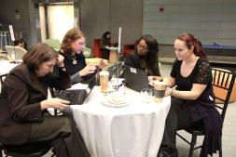
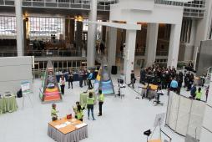
FORMATS TO “MAKE KNOWLEDGE STICK” HAD A FEW THINGS IN COMMON
The Forum was…
Collaborative, Bite-Sized, Practical, Staff2Staff, Small Groups, Bottom-up, Long-term
One-way lectures, Death by PowerPoint, Managers unloading, Large Plenaries, Panel Talks, One-off moment
≠
The Forum was NOT:
by Arno Boersma for the KMTF – 9/10/15

Slide 7
THE FORUM IN NUMBERS
5
10
10
100+
150+
250+
400+
1500+
2850
Days
Topical ‘Streams’
Learning Formats
Facilitators
Volunteers
Events
Speakers
Participants (40% Field staff)
Evaluations
by Arno Boersma for the KMTF – 9/10/15

Slide 8
TOP 10 YOU KNOW A FORUM IS ‘STICKY’ WHEN…
!
by Arno Boersma for the KMTF – 9/10/15

Slide 9
DESIGN IS LEARNER-CENTERED
10.
Wikithon
Up Close & Personal
Meet the Managers
10 formats
Project Expo
Master Classes
Relational knowledge
TTL Trade Secrets
Project Clinics
Hard Talks
Experts on Call
Genius Bar
Contextual Knowledge
by Arno Boersma for the KMTF – 9/10/15

Slide 10
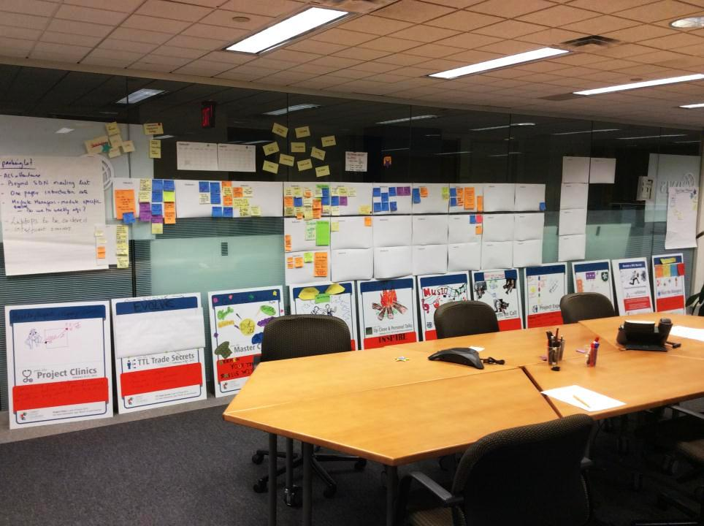
ORG. SILOS ARE BROKEN
9.
SDN
KLI
WBI
ITS
HR
OTHER NET-WORKS
IFC
by Arno Boersma for the KMTF – 9/10/15

Slide 11
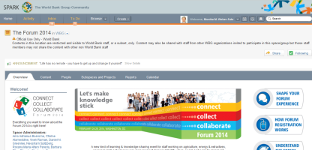
COMMUNICATION: APPEALING, RELEVANT, CONSISTENT
8.
by Arno Boersma for the KMTF – 9/10/15

Slide 12
TOPICS ARE SOURCED BOTTOM-UP
7.
by Arno Boersma for the KMTF – 9/10/15

Slide 13
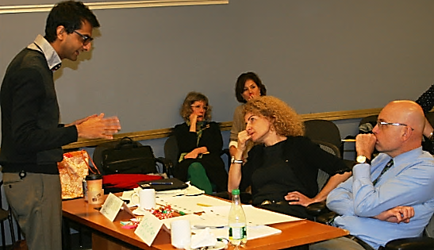
‘PERFORMERS’ ARE TRAINED
6.
by Arno Boersma for the KMTF – 9/10/15

Slide 14
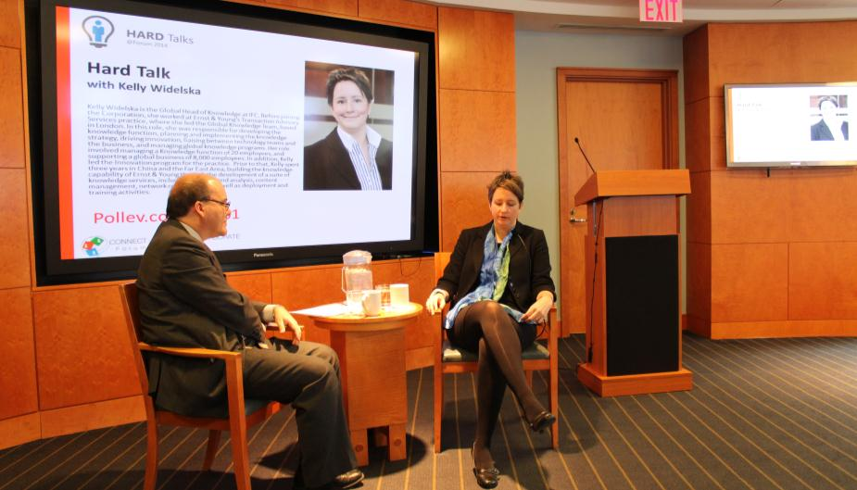
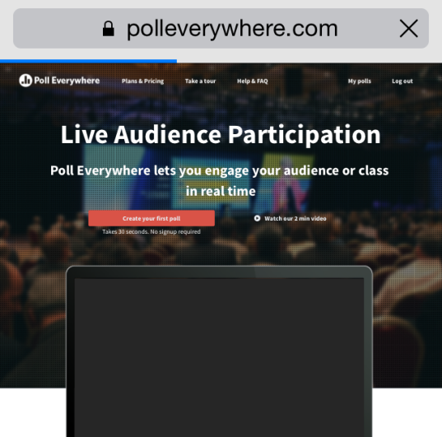
INTERACTION IS THE DEFAULT
5.
by Arno Boersma for the KMTF – 9/10/15

Slide 15
PARTICIPANTS ARE PRE-SELECTED BASED ON PROFILE
4.
☑ Field-based staff
☑ Sector Expertise
☑ Years at the Org
☑ Diversity
by Arno Boersma for the KMTF – 9/10/15

Slide 16
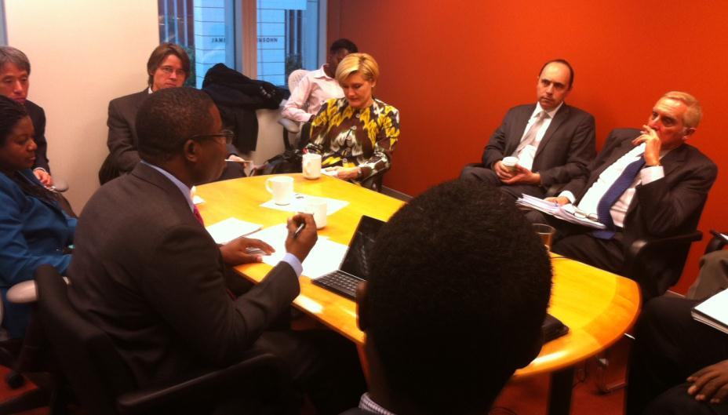
GROUPS ARE SMALL
3.
by Arno Boersma for the KMTF – 9/10/15

Slide 17
KNOWLEDGE IS ‘BITE SIZED’
2.
by Arno Boersma for the KMTF – 9/10/15

Slide 18
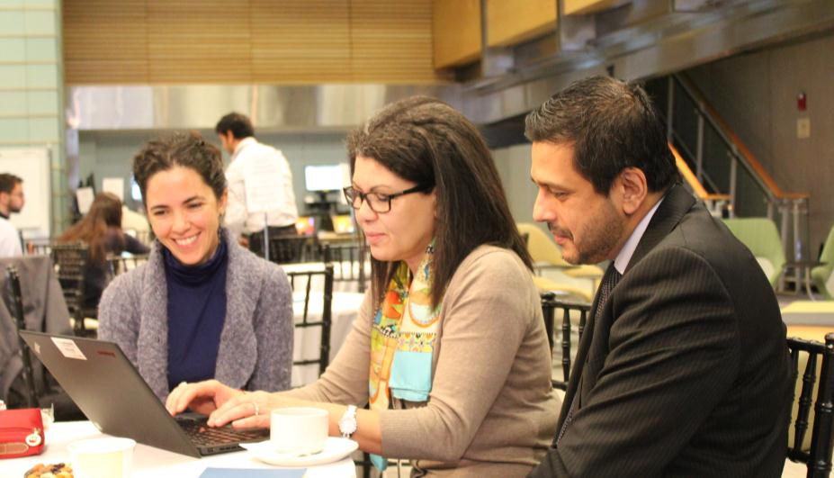
The experience is fun
1.
by Arno Boersma for the KMTF – 9/10/15

Slide 19
DID IT WORK?
by Arno Boersma for the KMTF – 9/10/15

Slide 20
by Arno Boersma for the KMTF – 9/10/15

Slide 21
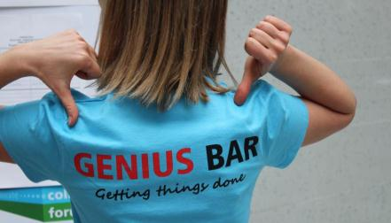
EVIDENCE: [SOME] FORMATS HAVE SPREAD
&
by Arno Boersma for the KMTF – 9/10/15

Slide 22
EVIDENCE: FEEDBACK IS POSITIVE
…I like the various formats used…
…so much "sticky" knowledge shared…
…opportunity to "cross" our little boundaries…
…a very upbeat atmosphere…
X
X
☹ 😐 ☺
…variety and relevance of
topics made
it very exciting…
…scaled up as a more permanent thing?…
…they have never had such good interaction…
…so many memorable events…
…team came back super charged up…
…enjoyed the overall Forum experience…
by Arno Boersma for the KMTF – 9/10/15

Slide 23
EVALUATIONS: WHAT DID PARTICIPANTS SAY?
2850 RESPONSES TO SESSION EVALUATIONS
652 RESPONSES TO THE POST-FORUM EVALUATIONS
As a result of Forum, participants said they:
71 %: learned knowledge/skills directly applicable to job
85 %: job effectiveness will be improve as a direct result
63 %: want to create knowledge more now
69 %: to share knowledge more now
69 %: want to collaborate more with others
95 %: will apply some of knowledge/skills directly in work
by Arno Boersma for the KMTF – 9/10/15

Slide 24
Did we beat the “forgetting curve”!
Although our memory is limited… (% of what we remember)
Survey results:
How “sticky” was the knowledge in the end …
100%
First 20 minutes
58%
50%
First 60 minutes
44%
First 24 hours
34%
One Month
20%
Source: Donald Clark, Plan B, http://donaldclarkplanb.blogspot.com/search?q=Ebbinghaus
by Arno Boersma for the KMTF – 9/10/15

Slide 25
After-event ratings (n=259): 4 months later: Knowledge has “stuck”
What % of new knowledge/skills gained
do you estimate you will directly apply in your work?
Have you used or
applied what you learned
at Forum?
by Arno Boersma for the KMTF – 9/10/15

Slide 26
THANK YOU! questions? MORE INFO? ABOERSMA@WORLDBANK.ORG
?
by Arno Boersma for the KMTF – 9/10/15

